Slide 1
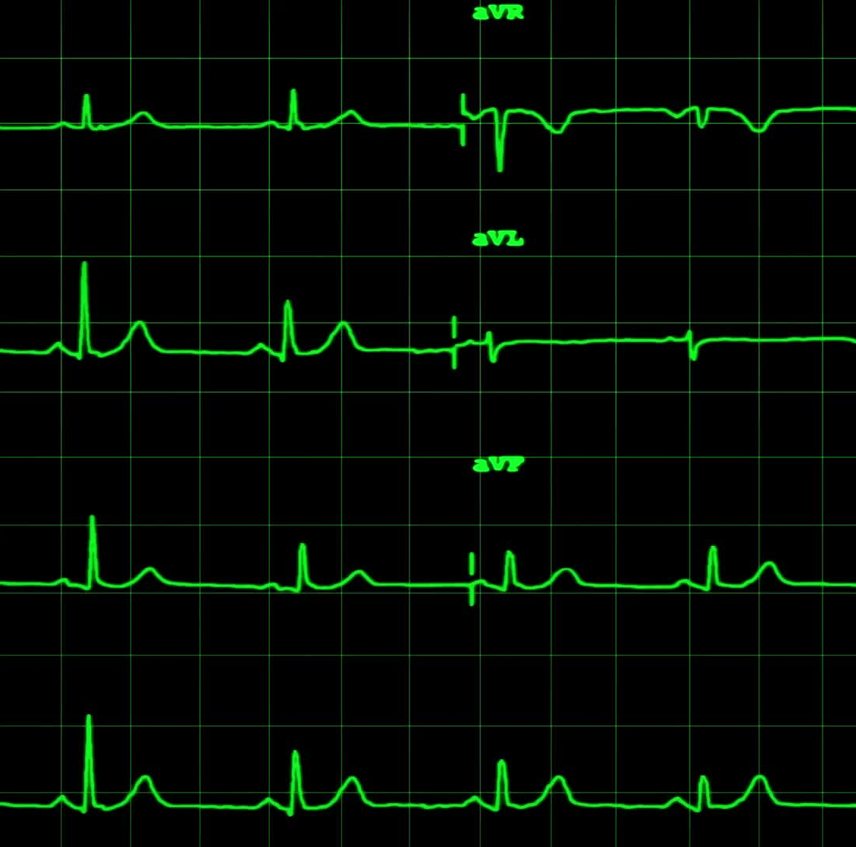
Heart Failure Prediction
Christina
David Adeline rock
Fatema G
Frank

