Slide 1


Kompics Introduction
Iman saberi

Slide 2
What is Kompics
Kompics proposes a message-passing, concurrent, and hierarchical component model with support for dynamic reconfiguration.
The Kompics component model and programming framework was designed to simplify the development of complex distributed systems.
Kompics aims to raise the level of abstraction in programming distributed systems.

Slide 3
Brief history
First release on 2009
It under the terms of the GNU General Public License as published by the Free Software Foundation.
From an academic PHD thesis(Cosmin Arad) in royal institute of technology.

Slide 4
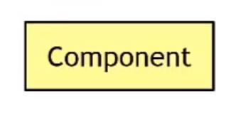



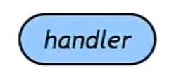

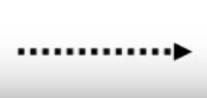
Concepts in Kompics
Components
Events
Ports
Channels
Handlers
Subscription
Publication/Trigger

Slide 5
Components
event-driven state machines
execute concurrently and communicate asynchronously by message-passing
Each Kompics program has a Main Component, created when the runtime system starts. Main will create other functional sub-components
Components can encapsulate subcomponents to hide details and manage system complexity

Slide 6
Events
Events are passive and immutable typed objects
having any number of typed attributes
The type of an attribute can be any valid type in the host programming language.
class Message implements KompicsEvent { String Source; String Dest; } class DataMessage extends Message{ Data data; }

Slide 7
Ports
Ports are bidirectional event-based component interfaces.
A port is a gate through which a component communicates with other components in its environment by sending and receiving events.
It allows a specific set of event types to pass and disallows all other event types.
Port type definition consists of two sets of event types
Positive
Negative

Slide 8
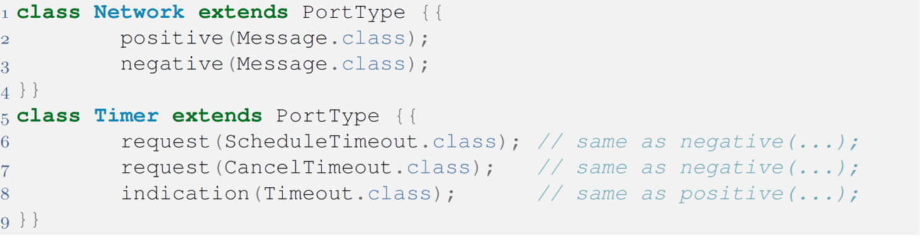
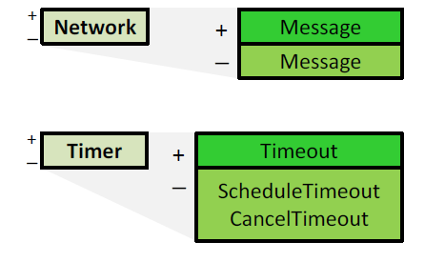
Ports

Slide 9
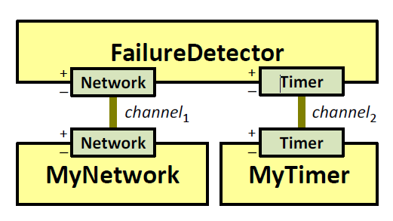
Channels
Channels are bindings between component ports.
A channel connects two complementary ports of the same type.
Channels forward events in both directions in FIFO order.

Slide 10
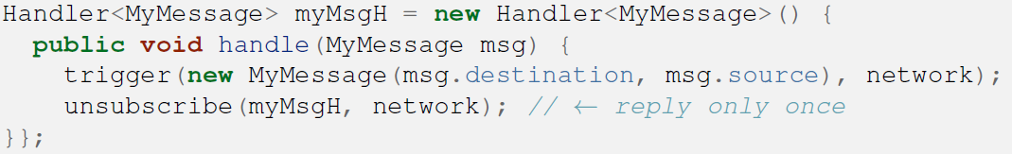
Handlers
An event handler is a first-class procedure of a component.
A handler accepts events of a particular type and it executes reactively when the component receives such events.
During its execution, a handler may trigger new events, mutate the component's local state, etc.

Slide 11
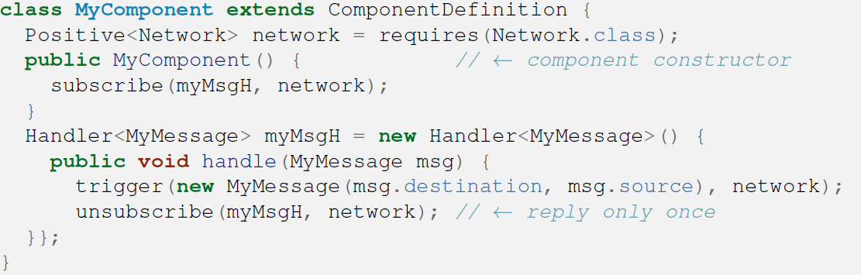
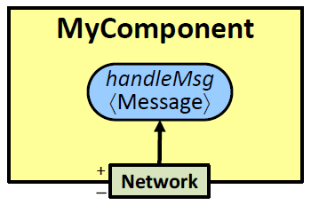
Subscriptions
A subscriptions binds an event handler to one component port
A subscription is legal if and only if the handler's accepted event type is allowed to pass by the port's type denition.
During its execution, a handler may trigger new events, mutate the component's local state, etc.

Slide 12
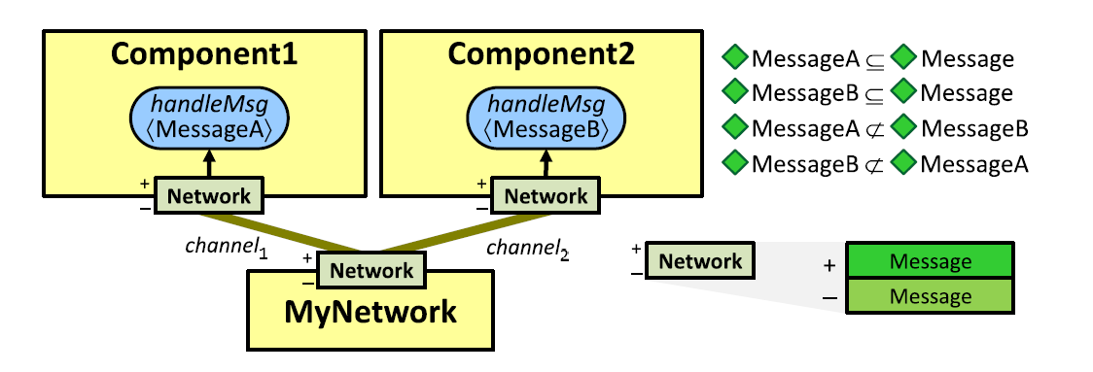
Practice

Slide 13
Components
In Java terms, a component is a class that extends ComponentDefinition.
Consisting of any number of local state variables, event handlers, provided and required ports.
Each component has a constructor that is executed when the component is created.

Slide 14
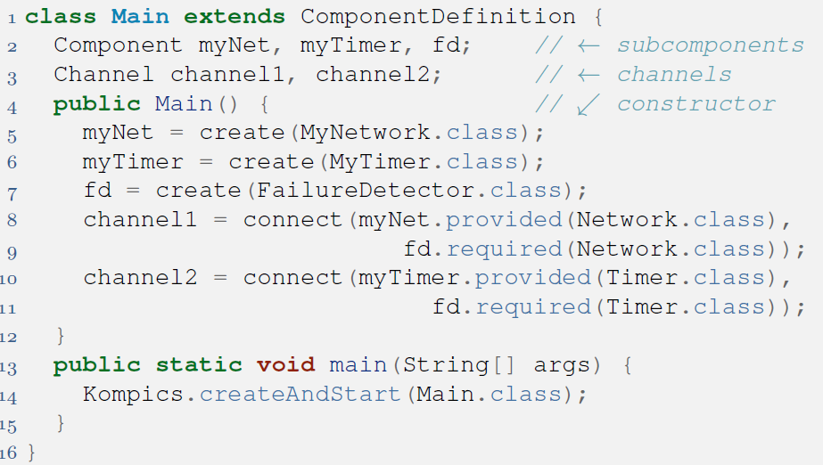
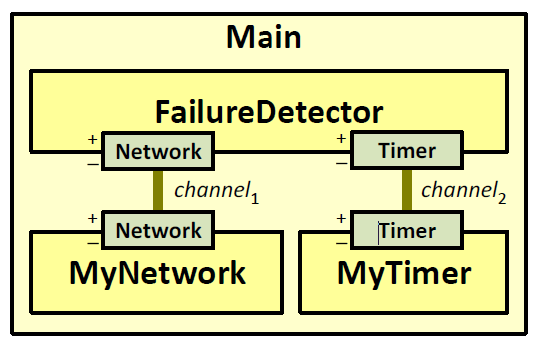
Main Component

Slide 15
Component initialization
Component constructors take no arguments.
1
public class InitMessage extends Init<Node> { public String nodeName; public HashMap<String,Integer> neighbours = new HashMap<>(); public InitMessage(String nodeName,HashMap<String,Integer> neighbours) { this.nodeName = nodeName; this.neighbours = neighbours; } }

Slide 16
Component initialization
2
public class Node extends ComponentDefinition {
…
public Node(InitMessage initMessage) { nodeName = initMessage.nodeName; this.neighbours = initMessage.neighbours; subscribe(startHandler, control); }
3
Component c = create(Node.class,new InitMessage(edge.src, findNeighbours(edge.src)));

Slide 17
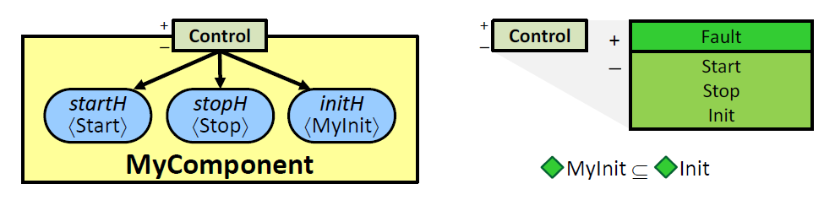
Control Port
Init event triggers on the component's Control port
An Init event is guaranteed to be the first event handled.

Slide 18


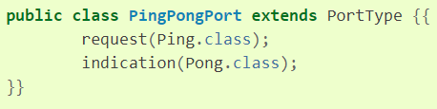
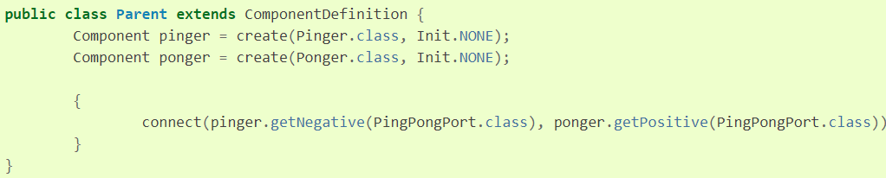
All together
Pinger
+
PingPongPort
_
+
_
PingPongPort
Ponger

Slide 19
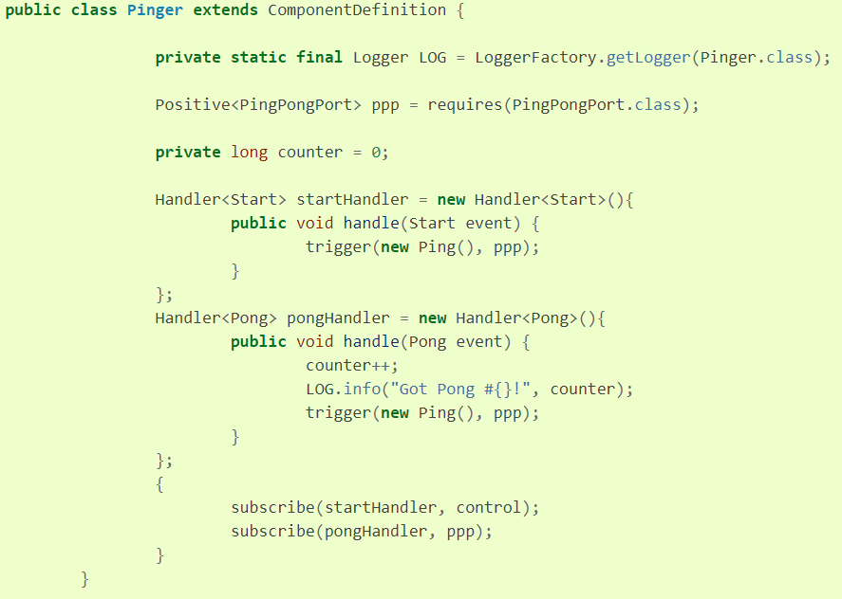
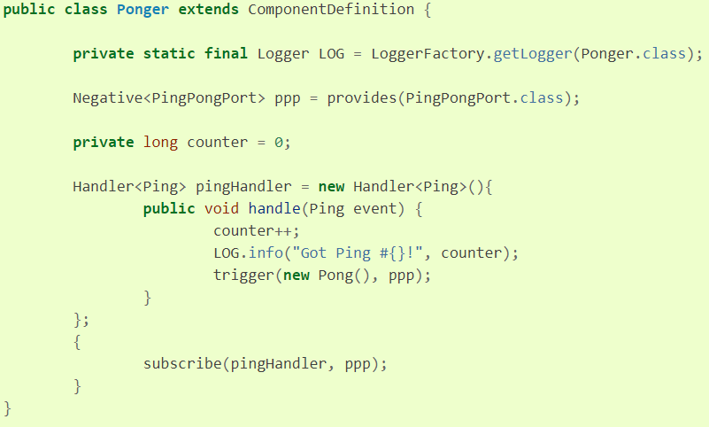
All together

Slide 20
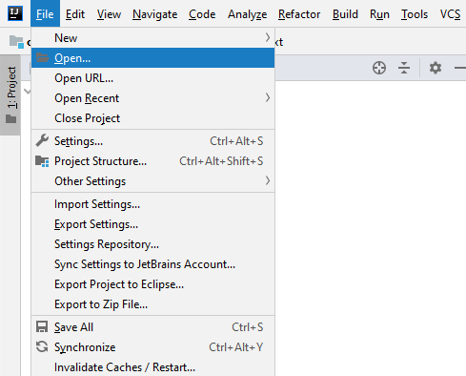
Get project

Slide 21
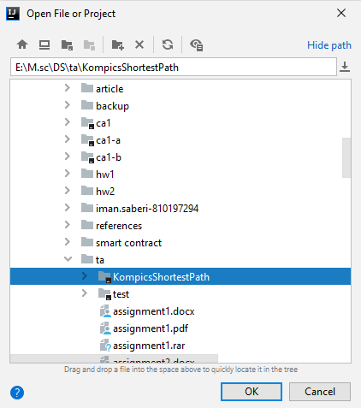
Get project

Slide 22
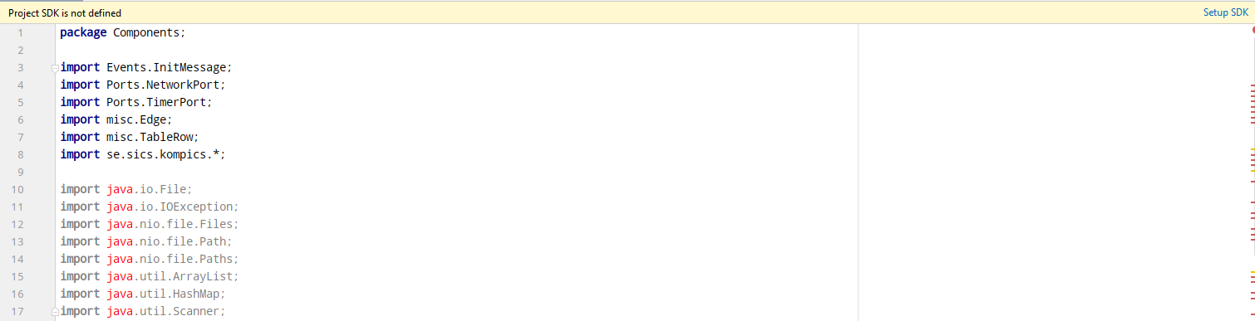
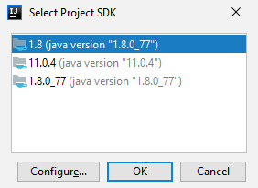
Get project

Slide 23
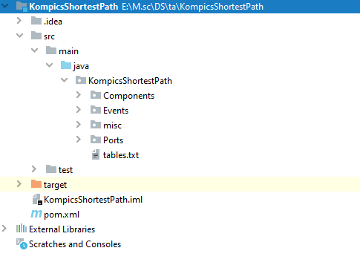
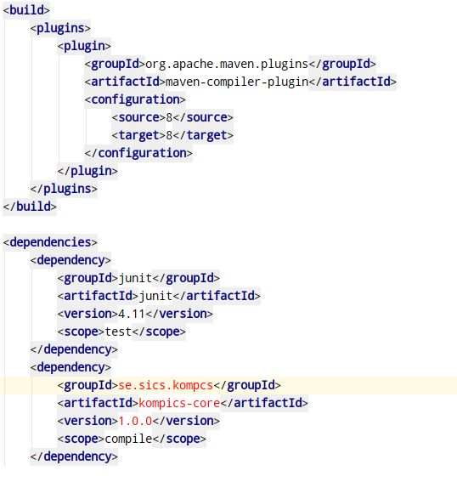
Get project

Slide 24
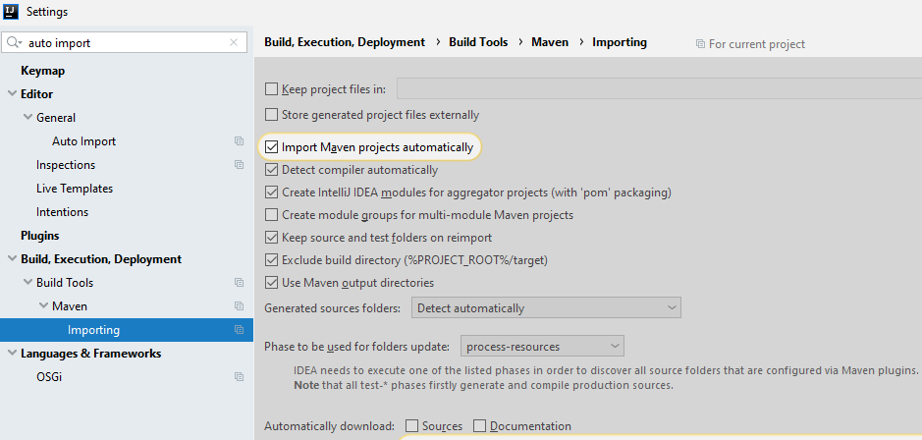
Get project
Ctrl + alt + s

Slide 25

Get project

Slide 26
Thank you ☺

