Slide 1
Introduction To Machine Learning
Mohammad Ghoddosi

Slide 2
بارم بندی
تمرین‌های کلاسی (۸ عدد) ۸ نمره
برنامه نویسی
حل کردنی
مینی پروژه (۱ عدد) ۵ نمره
پروژه پایانی ۷ نمره
Email : mohamadqodosi1996@gmail.com

Slide 3
Libraries
numpy
matplotlib
pandas
scikit-learn
…

Slide 4
Related topics
Linear Algebra
Probability Theory and Statics
Multivariate Calculus
Other…

Slide 5
What is MACHINE LEARNING?
Field of study that gives “computers the ability to learn without being explicitly programmed” (Arthur Samuel, 1959)
A computer program is said to learn from experience E with respect to some class of task T and performance measure P, if its performance at task T, as measured by P, improves with experience E. (Tom Mitchell 1997)

Slide 6
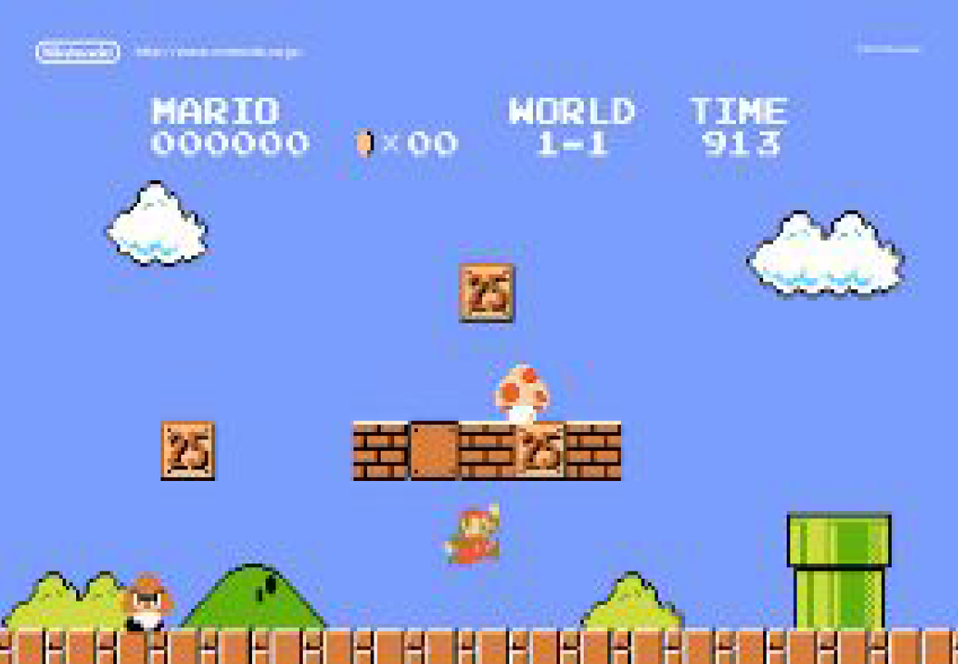
What is MACHINE LEARNING?

Slide 7
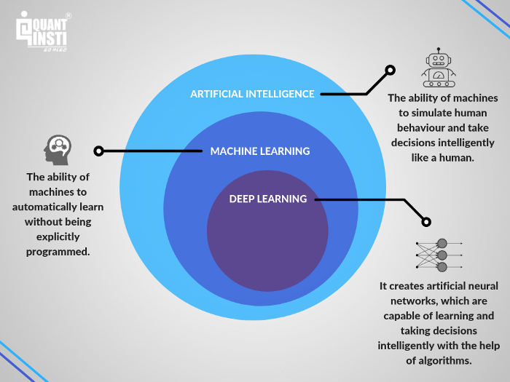
What is machine learning

Slide 8
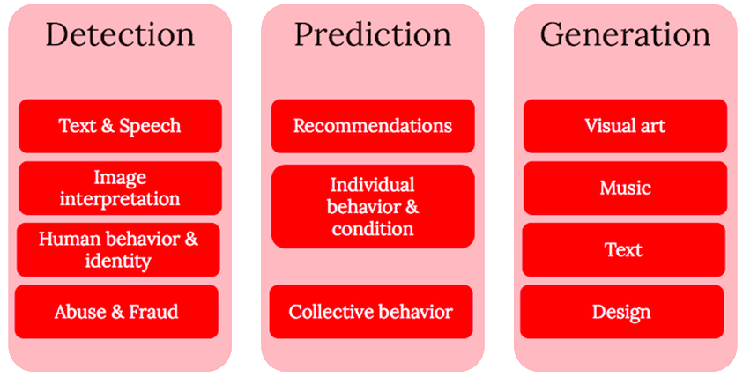
Usages

Slide 9
Types of machine learning
Supervised Learning
Unsupervised Learning
Semi-Supervised Learning
Reinforcement Learning

Slide 10
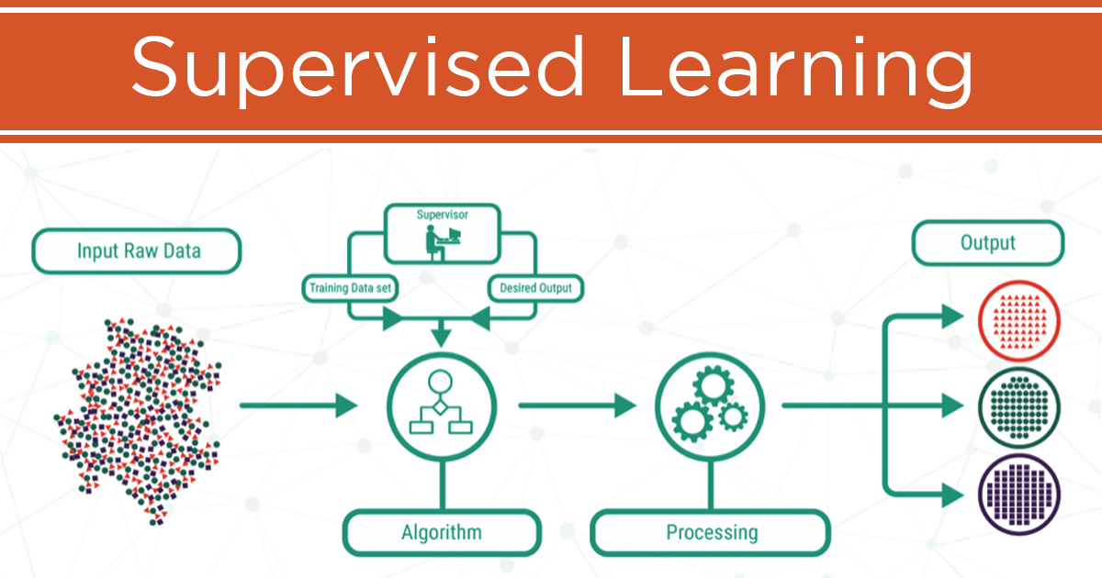
Supervised Learning

Slide 11
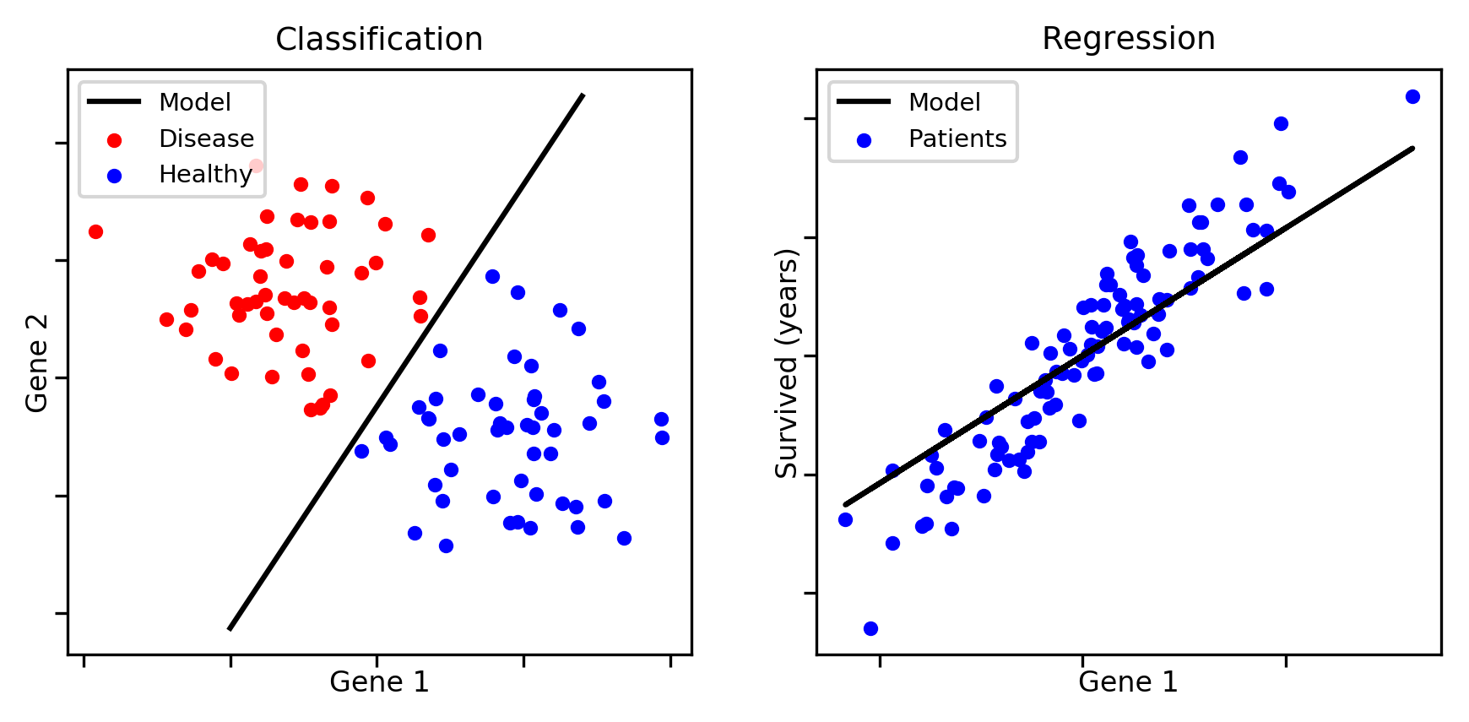
Supervised Learning
Regression
Classification

Slide 12
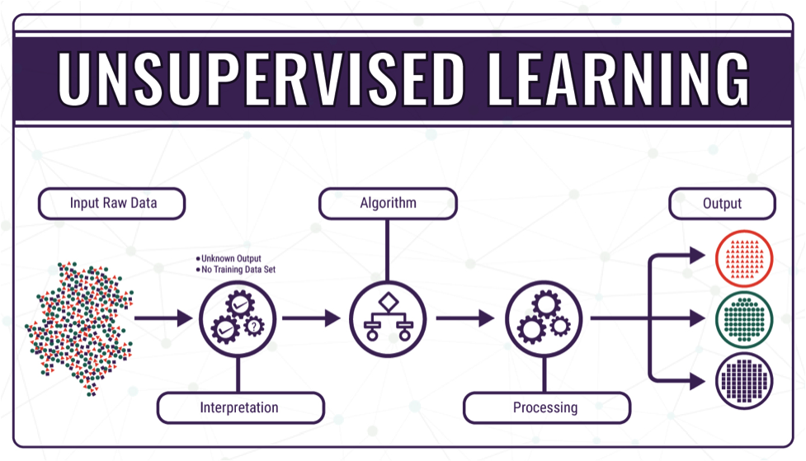
Unsupervised Learning

Slide 13
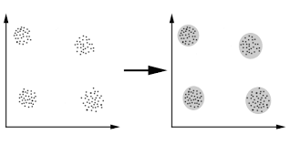
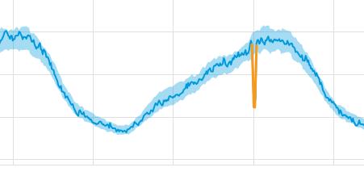
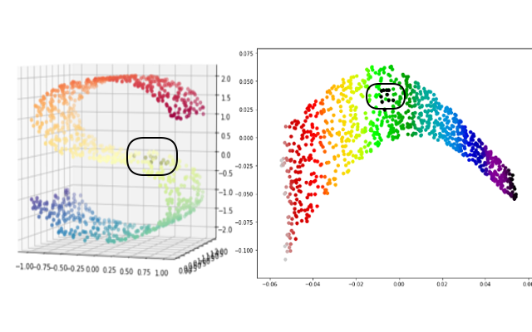
Unsupervised Learning
a
Clustering
Dimensionality Reduction
Anomaly Detection
c
b

Slide 14
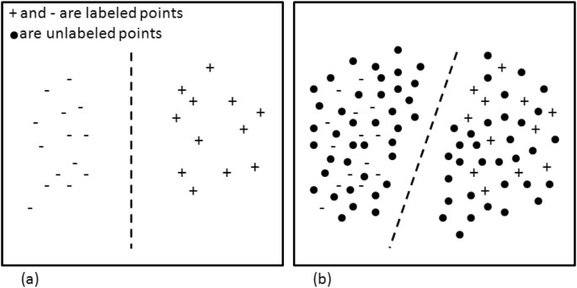
Semi-Supervised Learning

Slide 15
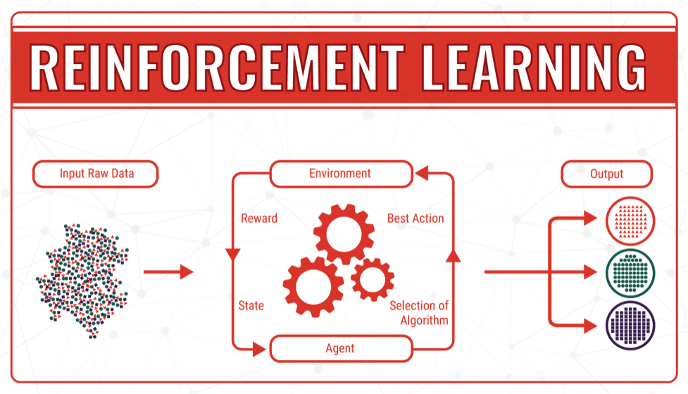
Reinforcement Learning

Slide 16
Why ML? Where?
You don’t know what you are looking for
You can’t write program explicitly
You can write program explicitly but performance is not satisfactory
Data is dynamic and it changes over time
There is more than one solution

