Slide 1
Linear Regression
Mohammad GHoddosi

Slide 2
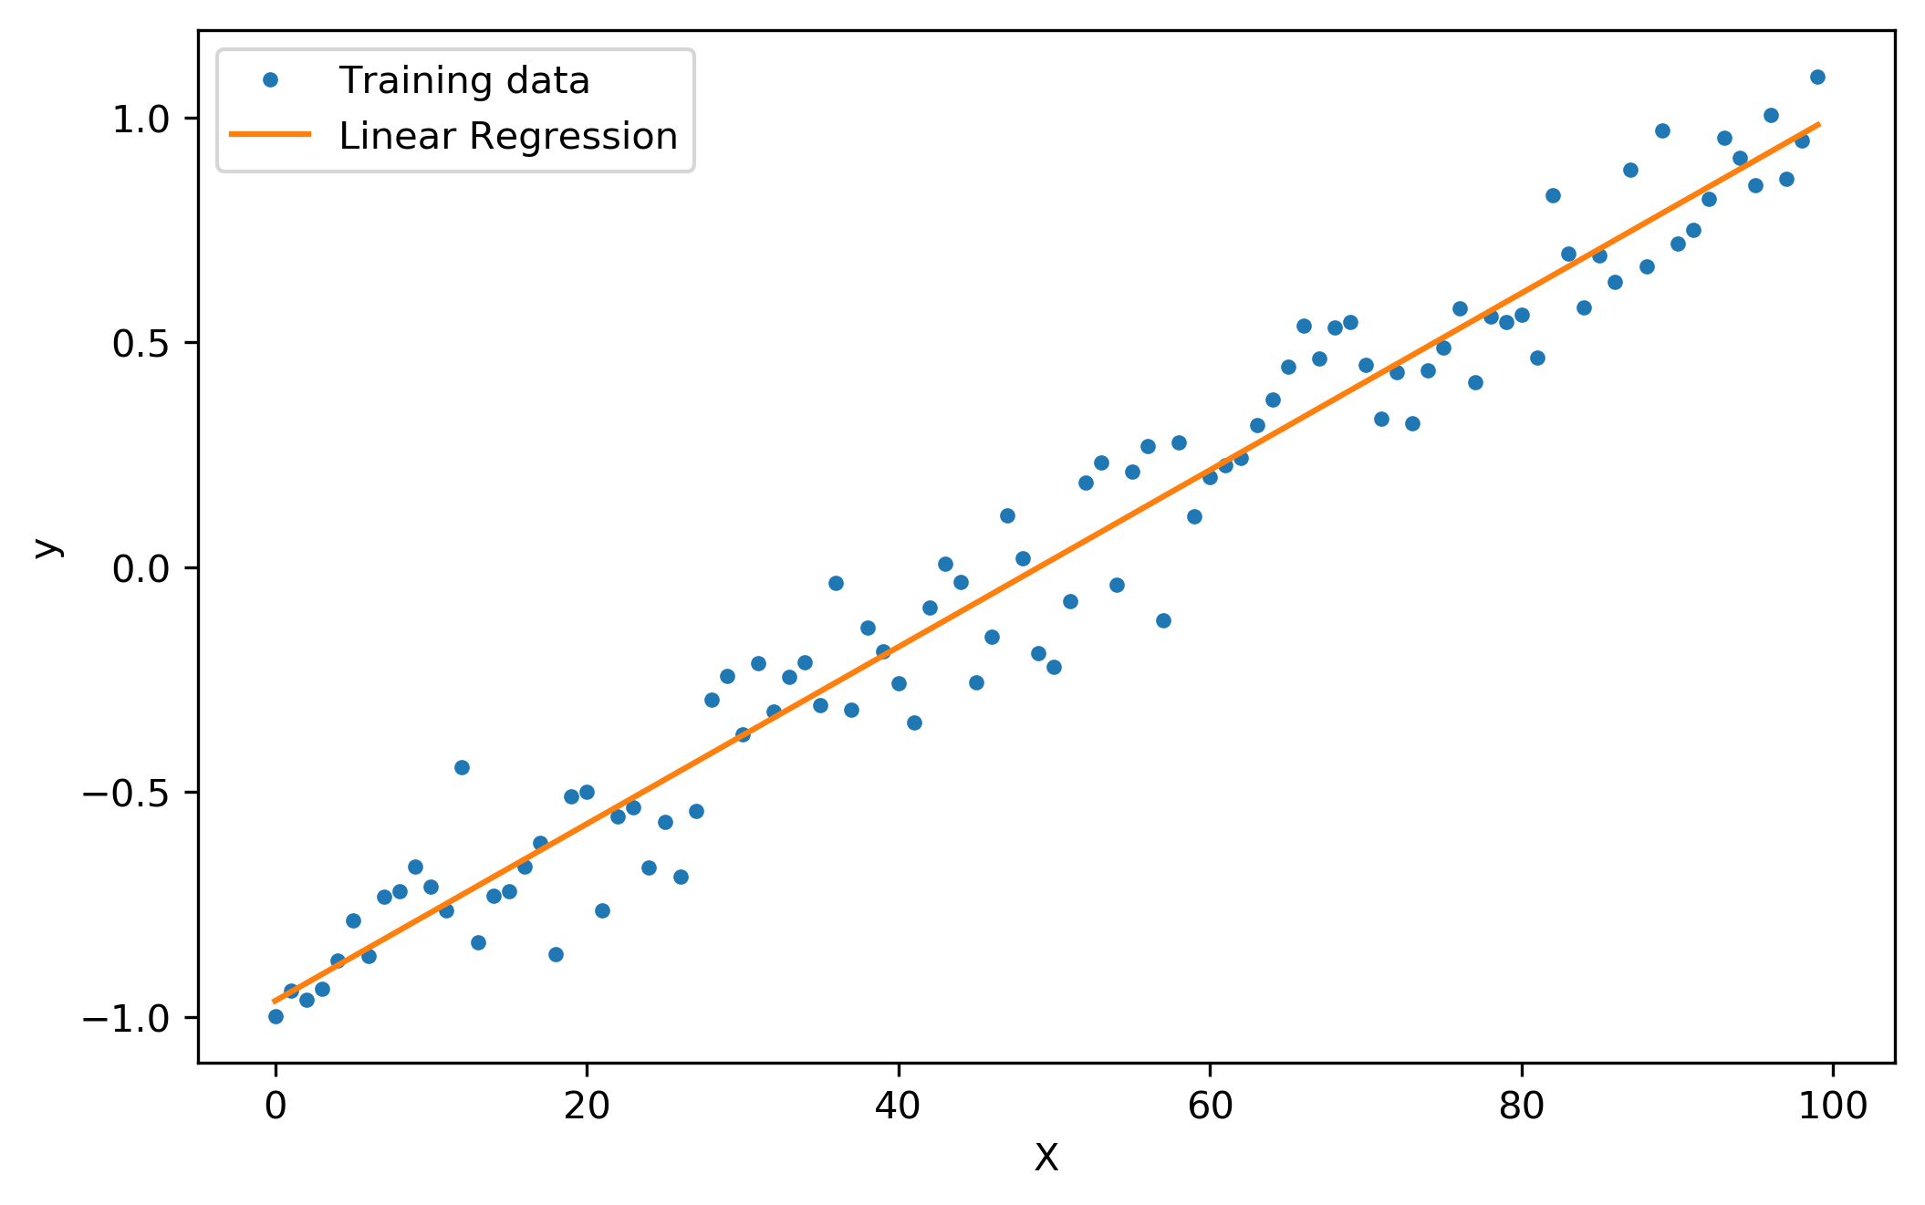
Regression

Slide 3

Line Equation
Standard form
$$ax+by=c$$
Point-Slope Form
$$y −y1=m(x −x1)$$
Intercept Form
$$\frac{x}{a}+ \frac{y}{b}=1$$
Slope-Intercept Form
$$y=mx+b$$

Slide 4

Line Equation
Standard form (3 variables)
$$ax+by=c$$
Point-Slope Form (3 variables)
$$y −y1=m(x −x1)$$
Intercept Form (2 variables)
$$\frac{x}{a}+ \frac{y}{b}=1$$
Slope-Intercept Form (2 variables)
$$y=mx+b$$

Slide 5

Line Equation
If we have more than one feature, use all:
We want to predict y using x1, x2, x3, x4
$y=w_{1}x_{1}+w_{2}x_{2}+w_{3}x_{3}+w_{4}x_{4}+b$
If we have n features:
$y=\sum_{i=1}^{n}{w_{i}x_{i}}+b$

Slide 6


Slide 7
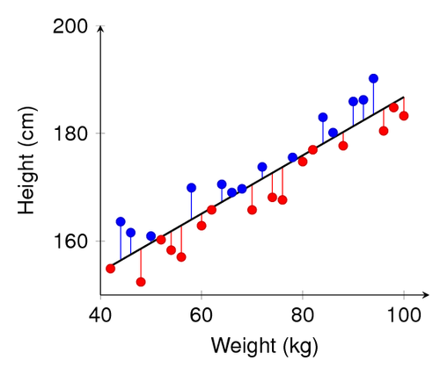
MSE Cost Function

Slide 8

MSE Cost Function
We need a performance measure (Tom Mitchell)
We can use idea of euclidean distance
2d : $d\left(P, Q\right)=\sqrt{{\left(P_{x}−Q_{x}\right)}^{2}+{\left(P_{y}−Q_{y}\right)}^{2}}$
Md: $d\left(P, Q\right)=\sqrt{{\left(P_{1}−Q_{1}\right)}^{2}+{\left(P_{2}−Q_{2}\right)}^{2}+ …{\left(P_{M}−Q_{M}\right)}^{2}}$

Slide 10



MSE Cost Function
$$MSE=\frac{1}{n} \sum_{i=1}^{n}{{\left(Y_{i}−{\hat{Y}}_{i}\right)}^{2}}$$
$$MSE=\frac{1}{2n} \sum_{i=1}^{n}{{\left(Y_{i}−{\hat{Y}}_{i}\right)}^{2}}$$
$$J\left(θ\right)=\frac{1}{n} \sum_{i=1}^{n}{{\left(h_{θ}\left(x^{\left(i\right)}\right)−y^{(i)} \right)}^{2}}$$

Slide 11
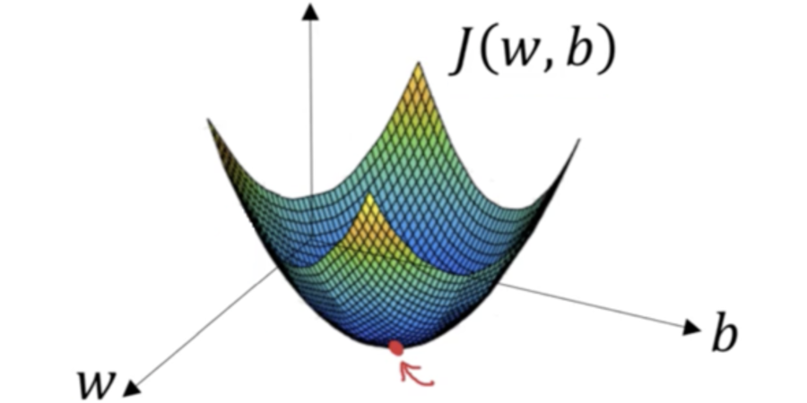
Optimization

Slide 12
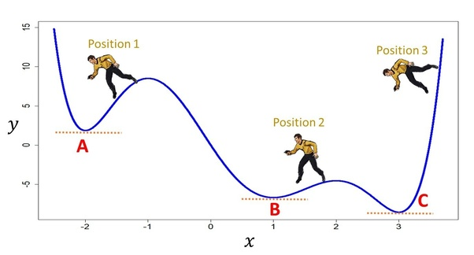
Optimization and derivatives (2d)

Slide 13

Optimization and derivatives (2D)
$$f^{′}\left(x\right)= \lim_{Δx →0}{\frac{f\left(x+Δx\right)−f(x)}{Δx}}$$
$$\lim_{Δx →0}Δx ∗f^{′}\left(x\right)= \lim_{Δx →0}{f\left(x+Δx\right)−f\left(x\right)}$$
$$Δx ∗f^{′}\left(x_{0}\right)≈f\left(x_{0}+Δx\right)−f\left(x_{0}\right)$$
$$\left\{\begin{aligned}Δf_{x_{0}}<0 Δx ∗f^{′}\left(x_{0}\right)<0 \\ Δf_{x_{0}}>0 Δx ∗f^{′}\left(x_{0}\right)>0\end{aligned}\right.$$

Slide 14
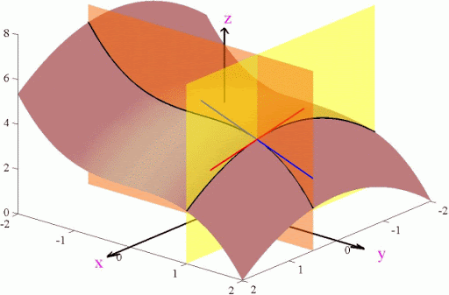
Optimization and derivatives (nD)

Slide 15

Optimization and derivatives (nD)
$$∇f=\begin{matrix}\frac{∂f}{∂x_{1}} & \frac{∂f}{∂x_{2}} … & \frac{∂f}{∂x_{3}}\end{matrix}$$
$$f\left({\vec{X}}_{0}+ \vec{u}\right)≈f\left({\vec{X}}_{0}\right)+∇f\left({\vec{X}}_{0}\right). \vec{u}$$
$$\left\|f\left({\vec{X}}_{0}+ \vec{u}\right)−f\left({\vec{X}}_{0}\right)\right\|≈\left\|∇f\left({\vec{X}}_{0}\right) . \vec{u} \right\|$$
$$\left\|f\left({\vec{X}}_{0}+ \vec{u}\right)−f\left({\vec{X}}_{0}\right)\right\|≈\left\|∇f\left({\vec{X}}_{0}\right)\right\|∗ \left\|\vec{u}\right\| ∗cos⁡(θ_{X_{0},u})$$

Slide 17

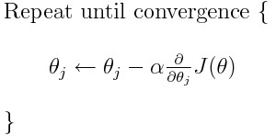
Why MSE + GD works?

Slide 18
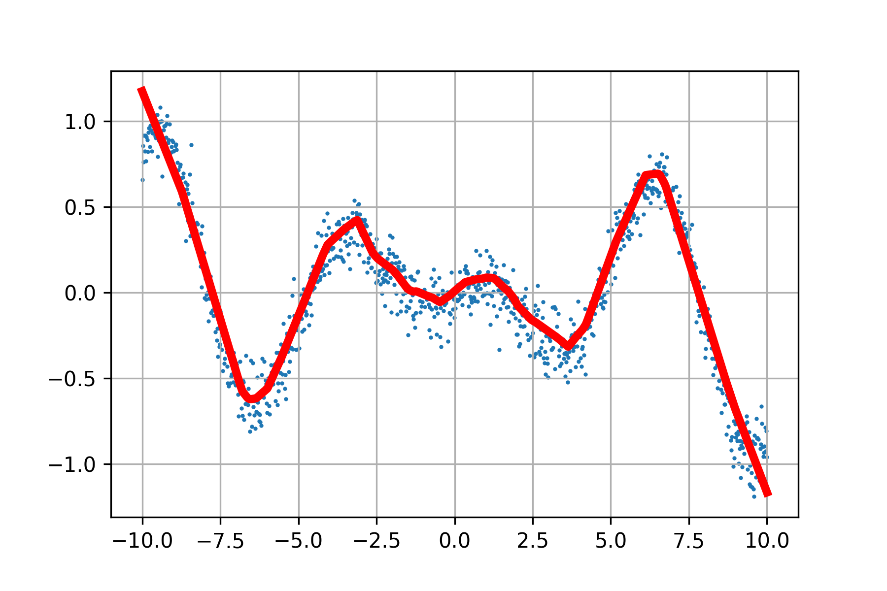
Non-linear Regression

Slide 19

Non-linear Regression
Use different degree of polynomial
$y= w_{0}+w_{1}x+w_{2}x^{2}$
$y= w_{0}+w_{1}x+w_{2}x^{2}+w_{3}x^{3}$
$y= w_{0}+w_{1}x+w_{2}x^{2}+w_{3}x^{3}+w_{4}x^{4}$
…
If we have more than one feature, use all possible terms:
$y= w_{0}+w_{1}x+w_{2}y+w_{3}x^{2}+w_{4}y^{2}+w_{5}xy$
$y= w_{0}+w_{1}x+w_{2}y+w_{3}x^{2}+w_{4}y^{2}+w_{5}xy+w_{6}y^{3}+w_{7}x^{3}+w_{8}y^{2}x$ $+w_{9}x^{2}y$

Slide 20


Vector Dot product
$$\vec{a}. \vec{b}= \left[\begin{matrix}a_{1} & a_{2} & … & a_{n}\end{matrix}\right].\left[\begin{matrix}b_{1} & b_{2} & … & b_{n}\end{matrix}\right]$$
$$=a_{1}b_{1}+a_{2}b_{2}+ …+a_{n}b_{n}$$
$$=\sum_{i=1}^{n}{a_{i}b_{i}}$$

Slide 21

Matrix dot product
$$X. Y=\left[\begin{matrix}X_{11} & X_{12} & ⋯ & X_{1k} \\ X_{21} & X_{22} & … & X_{2k} \\ ⋮ & ⋮ & ⋱ & ⋮ \\ X_{n1} & X_{n2} & ⋯ & X_{nk}\end{matrix}\right].\left[\begin{matrix}Y_{11} & Y_{12} & ⋯ & Y_{1m} \\ Y_{21} & Y_{22} & … & Y_{2m} \\ ⋮ & ⋮ & ⋱ & ⋮ \\ Y_{k1} & Y_{k2} & ⋯ & Y_{km}\end{matrix}\right]$$

Slide 22









Matrix dot product
$$\vec{y_{1}}$$
$$\vec{y_{2}}$$
$$\vec{y_{m}}$$
$$⋯$$
$$\vec{x_{1}}$$
$$\left[\begin{matrix}X_{11} & X_{12} & ⋯ & X_{1k} \\ X_{21} & X_{22} & … & X_{2k} \\ ⋮ & ⋮ & ⋱ & ⋮ \\ X_{n1} & X_{n2} & ⋯ & X_{nk}\end{matrix}\right].\left[\begin{matrix}Y_{11} & Y_{12} & ⋯ & Y_{1m} \\ Y_{21} & Y_{22} & … & Y_{2m} \\ ⋮ & ⋮ & ⋱ & ⋮ \\ Y_{k1} & Y_{k2} & ⋯ & Y_{km}\end{matrix}\right]$$
$$\vec{x_{2}}$$
$$⋮$$
$$\vec{x_{n}}$$

Slide 23

Matrix dot product
$$\left[\begin{matrix}\vec{x_{1}}.\vec{y_{1}} & \vec{x_{1}}.\vec{y_{2}} & ⋯ & \vec{x_{1}}.\vec{y_{m}} \\ \vec{x_{2}}.\vec{y_{1}} & \vec{x_{2}}.\vec{y_{2}} & … & \vec{x_{2}}.\vec{y_{m}} \\ ⋮ & ⋮ & ⋱ & ⋮ \\ \vec{x_{n}}.\vec{y_{1}} & \vec{x_{n}}.\vec{y_{2}} & ⋯ & \vec{x_{n}}.\vec{y_{m}}\end{matrix}\right]$$

Slide 24

Linear Regression as Vector Multiplication
$$y=w_{1}x_{1}+w_{2}x_{2}+w_{3}x_{3}+w_{4}x_{4}+b$$
$$y=w_{1}x_{1}+w_{2}x_{2}+w_{3}x_{3}+w_{4}x_{4}+w_{5}$$
$y= \left\langle w_{1} w_{2} w_{3} w_{4} w_{5}\right\rangle$ . $\left\langle x_{1} x_{2} x_{3} x_{4} 1\right\rangle$
$$\left[\begin{matrix}y_{1} \\ y_{2} \\ ⋮ \\ y_{N}\end{matrix}\right]= \left[\begin{matrix}x_{1,1 } & ⋯ & x_{M,1} & 1 \\ x_{1,2} & … & x_{M,2} & 1 \\ ⋮ & ⋱ & ⋮ & ⋮ \\ x_{1, N} & ⋯ & x_{M, N} & 1\end{matrix}\right] \left[\begin{matrix}w_{1} \\ w_{2} \\ ⋮ \\ w_{M}\end{matrix}\right]$$

Slide 25



Linear Regression as Vector Multiplication
$$H=X.W^{T}$$
$$J=\frac{1}{2N}{\left(Y−H\right)}^{T}.\left(Y−H\right)$$
$$∇J=\frac{1}{N}{\left(Y −H\right)}^{T} .X$$

