Slide 1
Logistic Regression
Mohammad ghoddosi

Slide 2
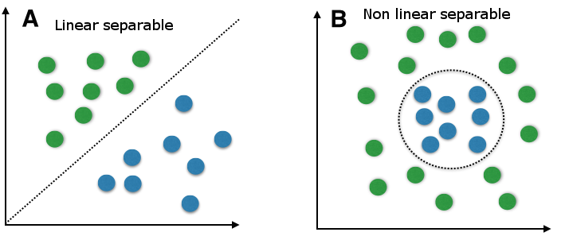
classification

Slide 3
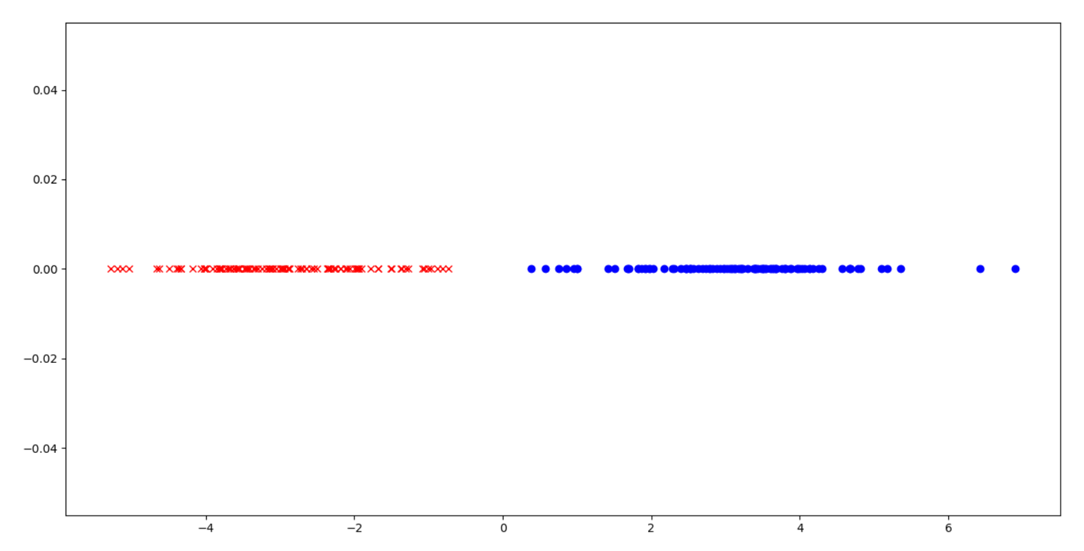
1D - classification

Slide 4
1D - classification

Slide 5
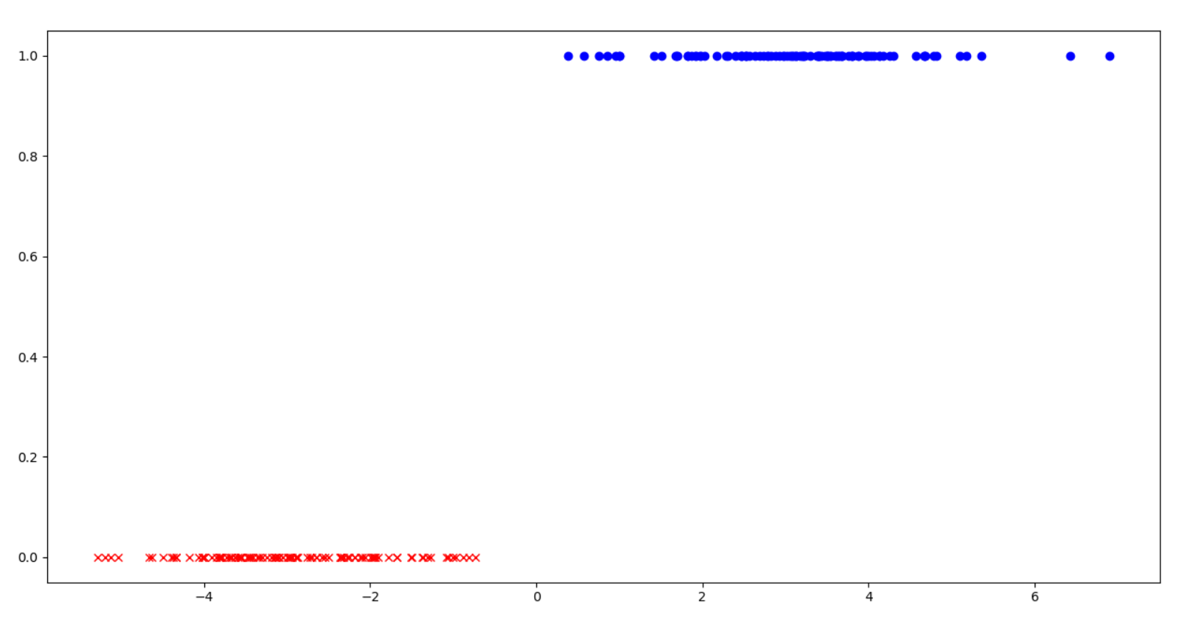
1D – Classification as 2D regression

Slide 6
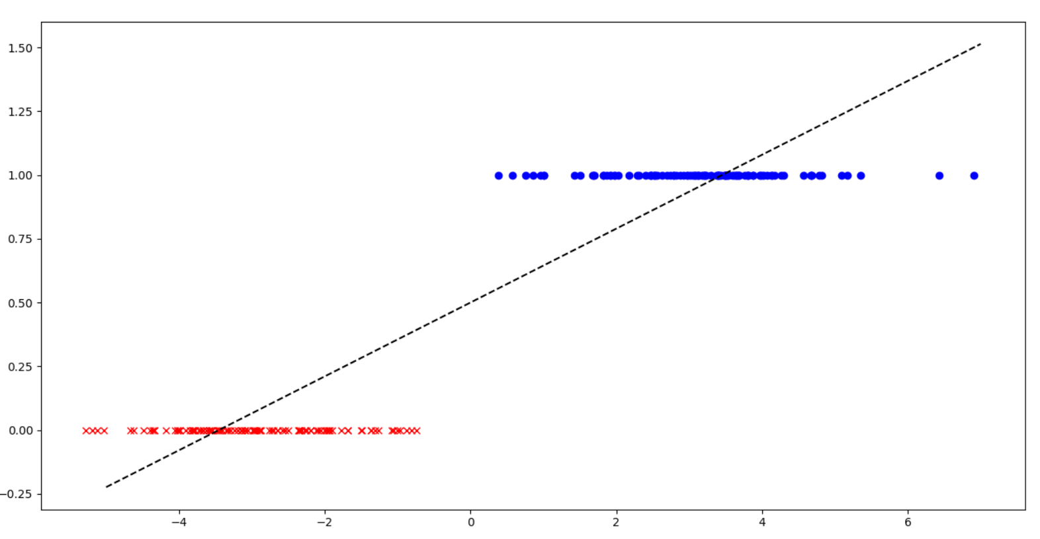
1D – Classification as 2D regression

Slide 7
1D – Classification as 2D regression

Slide 8
Problems
It doesn't wok fine every where
One noisy point far away from data
Error is not categorical
What if we need probability

Slide 9
Classification AS Regression
Training
Inference
LR
LR
X
X
y

Slide 10
Classification
Training
Inference
LR
LR
X
X
y

Slide 11
Classification
Training
Inference
LR
LR
X
X
y

Slide 12
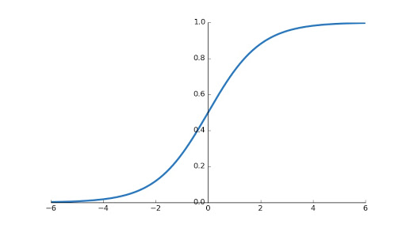


Sigmoid function
Output is a probability
Output is between 0 and 1
It has nice and smooth derivatives
$$σ\left(z\right)=\frac{1}{1+e^{−z}}$$
$σ^{′\left(z\right)}=σ\left(z\right)∗(1−σ\left(z\right)$)

Slide 13


Logistic regression (output)
$$z=\sum_{i=1}^{M}{w_{i}x_{i}}$$
$$h=\frac{1}{1+e^{−z}}$$

Slide 14


Logistic regression (cost)
$$J=\frac{1}{N}\sum_{i=1}^{N}{−y^{(i)} ∗\log\left(h^{(i)}\right) −\left(1−y^{(i)}\right)∗log⁡(1−h^{(i)}) }$$
$$loss= −y ∗\log\left(h\right) −\left(1−y\right)∗log⁡(1−h)$$
$$loss= \left\{\begin{aligned}−\log\left(h\right) y=1 \\ −log\left(1−h\right) y=0\end{aligned}\right.$$

Slide 15
Logistic regression (LOSS)

Slide 16



Linear regression vs logistic regression
$$h=\sum_{i=1}^{N}{w_{i}x_{i}}$$
$$z=\sum_{i=1}^{N}{w_{i}x_{i}}$$
$$h=\frac{1}{1+e^{−z}}$$

Slide 17




Linear regression vs logistic regression
$$h=\sum_{i=1}^{M}{w_{i}x_{i}}$$
$$z=\sum_{i=1}^{M}{w_{i}x_{i}}$$
$$h=\frac{1}{1+e^{−z}}$$
$$J=\frac{1}{2N}\sum_{i=1}^{N}{{\left(y^{(i)} −h^{(i)}\right)}^{2}}$$
$$J=\frac{1}{N}\sum_{i=1}^{N}{−y^{(i)} ∗\log\left(h^{(i)}\right) −\left(1−y^{(i)}\right)∗log⁡(1−h^{(i)}) }$$

Slide 18


Linear regression vs logistic regression
$$h=\sum_{i=1}^{N}{w_{i}x_{i}}$$
$$z=\sum_{i=1}^{N}{w_{i}x_{i}}$$
$$h=\frac{1}{1+e^{−z}}$$
$$J=\frac{1}{2N}\sum_{i=1}^{N}{{\left(y^{(i)} −h^{(i)}\right)}^{2}}$$
$$J=\frac{1}{N}\sum_{i=1}^{N}{−y^{(i)} ∗\log\left(h^{(i)}\right) −\left(1−y^{(i)}\right)∗log⁡(1−h^{(i)}) }$$
$$\frac{∂J}{∂w_{j}}=\frac{1}{N}\sum_{i=1}^{N}{\left(h^{(i)}−y^{(i)}\right)x_{j}^{(i)}}$$
$$\frac{∂J}{∂w_{j}}=\frac{1}{N}\sum_{i=1}^{N}{\left(h^{(i)}−y^{(i)}\right)x_{j}^{(i)}}$$

Slide 19






derivatives
$$\frac{∂z^{\left(i\right)}}{∂w_{j}}=x_{j}^{(i)}$$
$$\frac{∂J}{∂w_{j}}=\frac{1}{N}\sum_{i=1}^{N}{\frac{∂J}{∂h^{\left(i\right)}}∗\frac{∂h^{\left(i\right)}}{∂z^{\left(i\right)}}∗\frac{∂z^{\left(i\right)}}{∂w_{j}}}$$
$$\frac{∂h^{\left(i\right)}}{∂z^{\left(i\right)}}=h^{\left(i\right)} ∗\left({1 − h}^{\left(i\right)}\right)$$
$$\frac{∂J}{∂w_{j}}=\frac{1}{N}\sum_{i=1}^{N}{\left(h^{\left(i\right)}−y^{\left(i\right)}\right)∗x_{j}^{(i)}}$$
$$\frac{∂J}{∂h^{\left(i\right)}}=\frac{−y^{(i)}}{h^{(i)}}+\frac{1−y^{(i)}}{{1−h}^{(i)}}$$
$$=\frac{h^{(i)}−y^{(i)}}{h^{(i)} ∗\left({1−h}^{\left(i\right)}\right)}$$

Slide 20


Slide 21
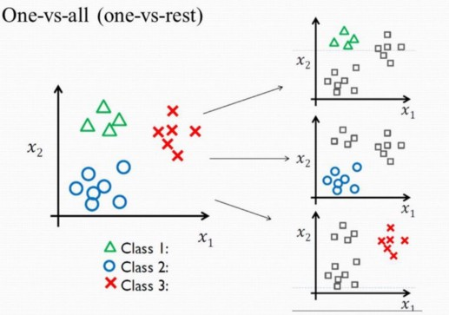
Multiclass classification(ovr)

Slide 22
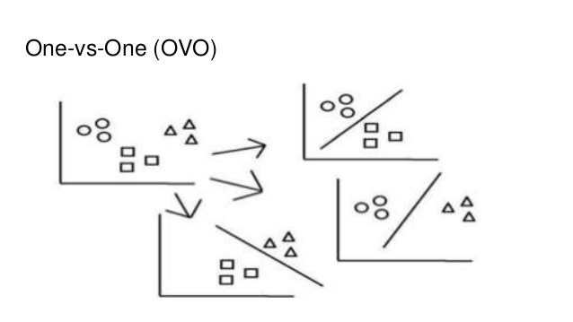
Multiclass classification(ovo)

Slide 23


binary Logistic Regression as Matrix multiplication
$$\left[\begin{matrix}y^{(1)} \\ y^{(2)} \\ ⋮ \\ y^{(N)}\end{matrix}\right]=σ\left(\left[\begin{matrix}x_{1}^{(1)} & x_{2}^{(1)} & … & x_{f}^{(1)} \\ x_{1}^{(2)} & x_{2}^{(2)} & … & x_{f}^{(2)} \\ ⋮ & ⋮ & ⋱ & ⋮ \\ x_{1}^{(N)} & x_{2}^{(N)} & … & x_{f}^{(N)}\end{matrix}\right]. {\left[\begin{matrix}w_{1} & w_{2} & … & w_{M} & w_{f}\end{matrix}\right]}^{T}\right)$$
$$Y=σ\left(X.W^{T}\right)$$

Slide 24

multiclass Logistic Regression as Matrix multiplication
$$\left[\begin{matrix}y_{1}^{(1)} & y_{2}^{(1)} & … & y_{c}^{(1)} \\ y_{1}^{(2)} & y_{2}^{(2)} & … & y_{c}^{(2)} \\ ⋮ & ⋮ & ⋱ & ⋮ \\ y_{1}^{(N)} & y_{2}^{(N)} & … & y_{c}^{(N)}\end{matrix}\right]=σ\left(\left[\begin{matrix}x_{1}^{(1)} & x_{2}^{(1)} & … & x_{f}^{(1)} \\ x_{1}^{(2)} & x_{2}^{(2)} & … & x_{f}^{(2)} \\ ⋮ & ⋮ & ⋱ & ⋮ \\ x_{1}^{(N)} & x_{2}^{(N)} & … & x_{f}^{(N)}\end{matrix}\right]. {\left[\begin{matrix}w_{1,1} & w_{1,2} & … & w_{1, f} \\ w_{2,1} & w_{2,2} & … & w_{2,f} \\ ⋮ & ⋮ & ⋱ & ⋮ \\ w_{c,1} & w_{c,2} & … & w_{c,f}\end{matrix}\right]}^{T}\right)$$
$$Y=σ\left(X.W^{T}\right)$$

