Slide 1
KNN
Mohammad Ghoddosi

Slide 2
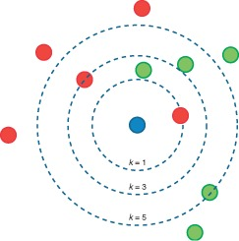
K-Nearest neighbors Classifier

Slide 3
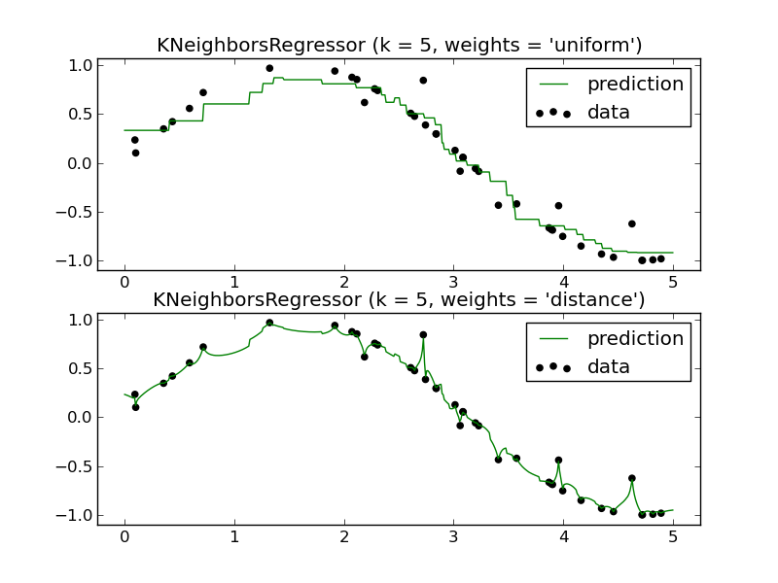
K-Nearest neighbors Regression

Slide 4
Pros and cons
Pros:
No assumptions about data
Simple algorithm
useful for classification or regression
Cons:
Computationally expensive
High memory requirement
Stores all of the training data
Prediction stage might be slow
Sensitive to irrelevant features and the scale of the data

Slide 5
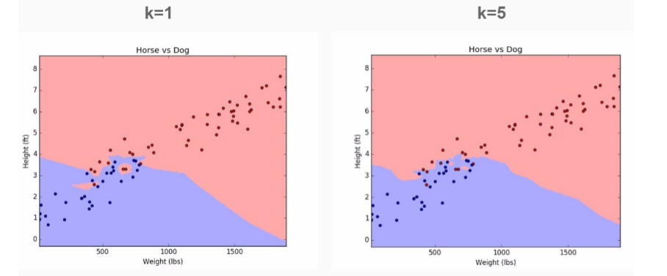
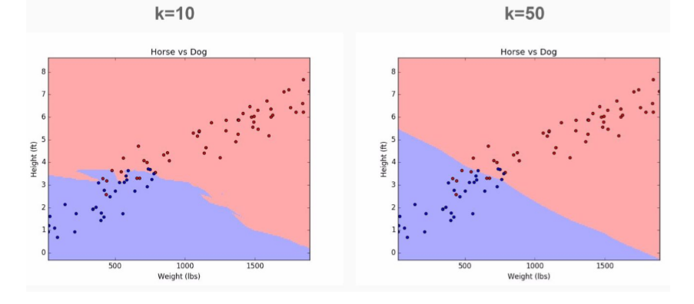
K

Slide 6


Slide 7
SVM
Mohammad Ghoddosi

Slide 8
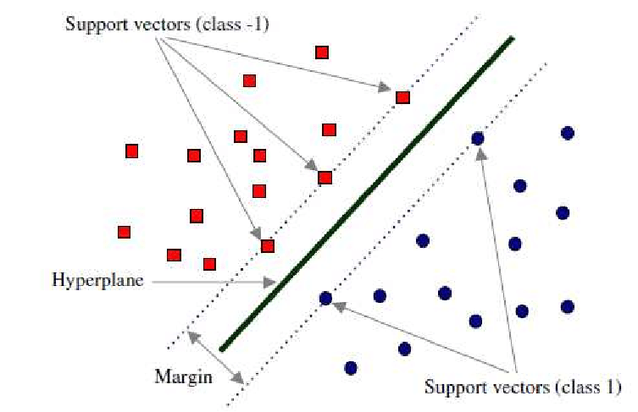
Support vector machine (SVM)

Slide 9
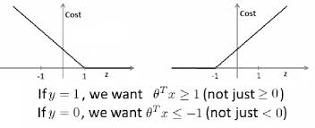


SVM (math)
$$\min_{W}{\frac{1}{2}\sum_{j=1}^{M}{w_{j}^{2}}}$$
$$s.t.$$
$$\left\{\begin{aligned}x^{\left(i\right)}.W^{T}>1 if y^{(i)}=1 \\ x^{\left(i\right)}.W^{T}<1 if y^{(i)}=−1\end{aligned}\right.$$
$$\min_{W}{C \sum_{i=1}^{N}{[y^{\left(i\right)}cost_{1}\left(h\right)+(1−y^{\left(i\right)})cost_{2}\left(h\right)]}+\frac{1}{2}\sum_{j=1}^{M}{w_{j}^{2}}}$$

Slide 10
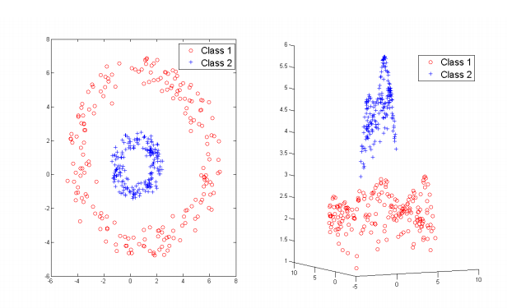
sVM with RBF kernel

