Slide 1
Decision Tree
Mohammad ghoddosi

Slide 2
What is Decision Tree
Flowchart-like structure
Each internal node represents a test on an attribute
Each branch represents the outcome of the test
Each leaf node represents a class label

Slide 3
Leaf nodes
Max depth
Min Samples
Output is most frequent class in leaf
Output probability is proportion of most frequent class in leaf to others

Slide 4
Example - binary
Has feathers?
True
False
Can Fly?
Has finns?
True
False
True
False
Hawk
Penguin
Dolphin
Bear

Slide 5
Example - categorical
Income
High
Low
Medium
…
…
…

Slide 6
Example - continuous
Age > 30
Age
True
False
<15
>45
15-45
…
…
…
…
…

Slide 7
Decision tree – pros and cons
Pros:
Understandable rules
Low computation
Both continuous and categorical variables
Shows more important features
Cons:
Not powerful in regression
computationally expensive to train

Slide 8
Decision Tree in 2d space
Age > 30
Age
True
False
Income > 2000
Income > 1000
True
False
True
False
Income
Yes
No
Yes
No

Slide 9
Decision Tree in 2d space
Age > 30
Age
True
False
30
Income > 2000
Income > 1000
True
False
True
False
Income
Yes
No
Yes
No

Slide 10
Decision Tree in 2d space
Age > 30
Age
True
False
30
Income > 2000
Income > 1000
True
False
True
False
Income
1000
2000
Yes
No
Yes
No

Slide 11
Decision Tree in 2d space
Age > 30
Age
Decision Tree
True
False
30
Income > 2000
Income > 1000
Logistic Regression
SVM
True
False
True
False
Income
1000
2000
Yes
No
Yes
No

Slide 12
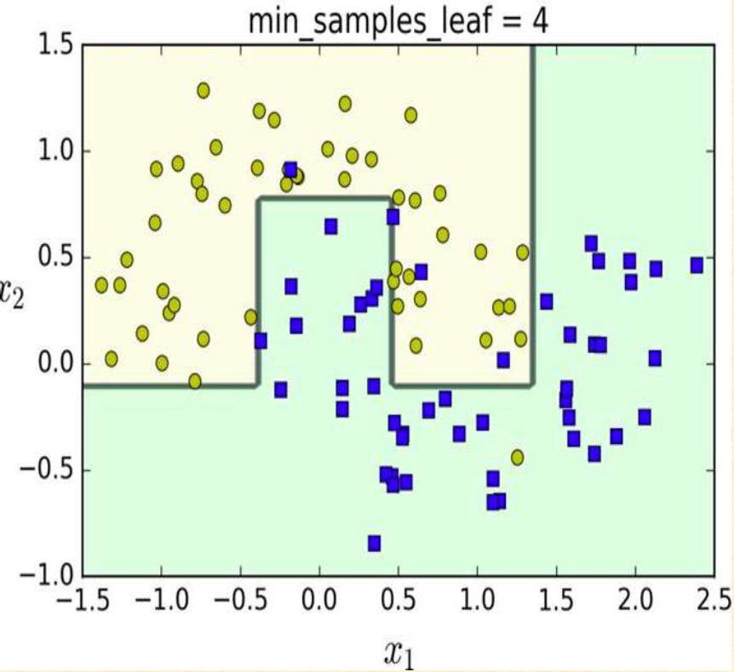
Decision Tree for classification

Slide 13
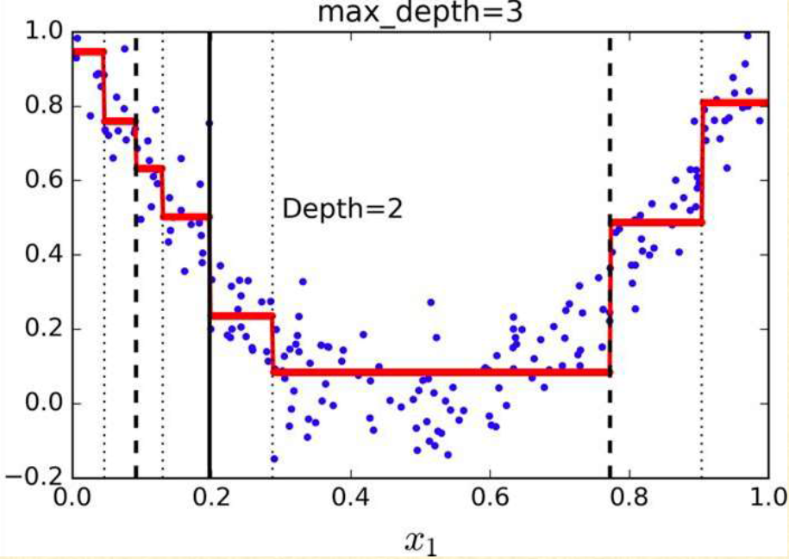
Decision Tree For Regression

Slide 14

Cart algorithm
Split dataset into 2 subsets using a single feature $k$ and threshold $t_{k}$
Search for best $\left(k, t_{k}\right)$ that produces the purest subsets.
Do same algorithm recursively for subsets …

Slide 15
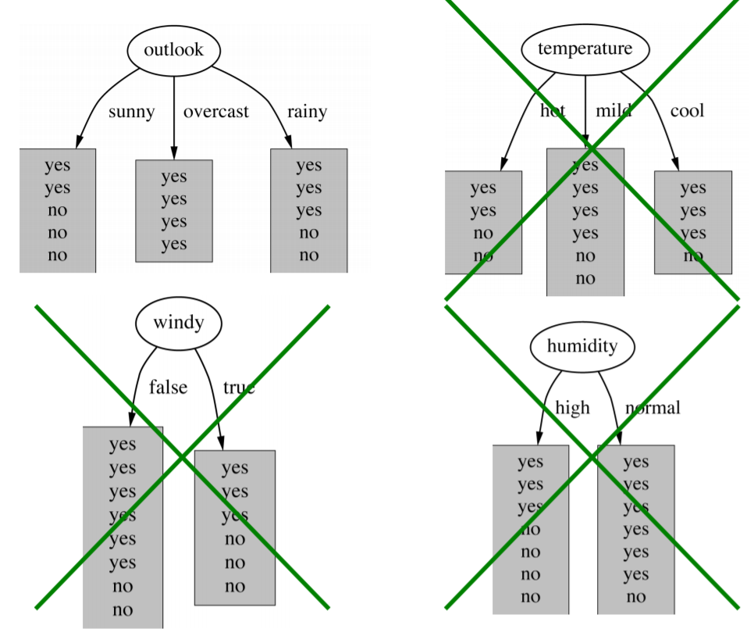
purity

Slide 16




Purity
$$Entropy:E\left(S\right)=−\sum_{i=0}^{C}{p_{i}\log{p_{i}}}$$
Entropy
Average Entropy / Information
Information Gain
Gain ratio
Gini Index
$$Information=I\left(S, A\right)= \sum_{i}{\frac{\left|S_{i}\right|}{S}.E(S_{i})}$$
$$Gini:G\left(S \right)=1 − \sum_{i=0}^{C}{p_{i}^{2}}$$
$$Gini:G\left(S, A\right)= \sum_{i}{\frac{\left|S_{i}\right|}{S}.G(S_{i})}$$

Slide 17
Overfitting and pruning
Pre-pruning
Stop growing a branch when information becomes unreliable
Post-pruning
simplify tree after training by replacing some nodes with leafs
Post-pruning preferred in practice

Slide 18


