Slide 1
Ensemble learning
Mohammad Ghoddosi

Slide 2
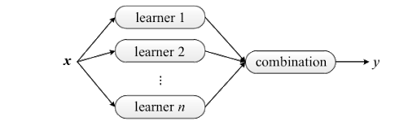
What is ensemble learning
Grouping multiple predictors is called ensemble learning
The winning solutions in Machine Learning competitions often involve several Ensemble methods
Wisdom of crowd

Slide 3
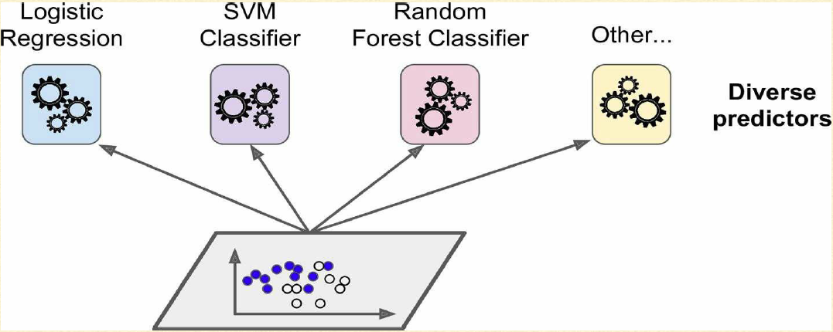
Ensemble learning

Slide 4
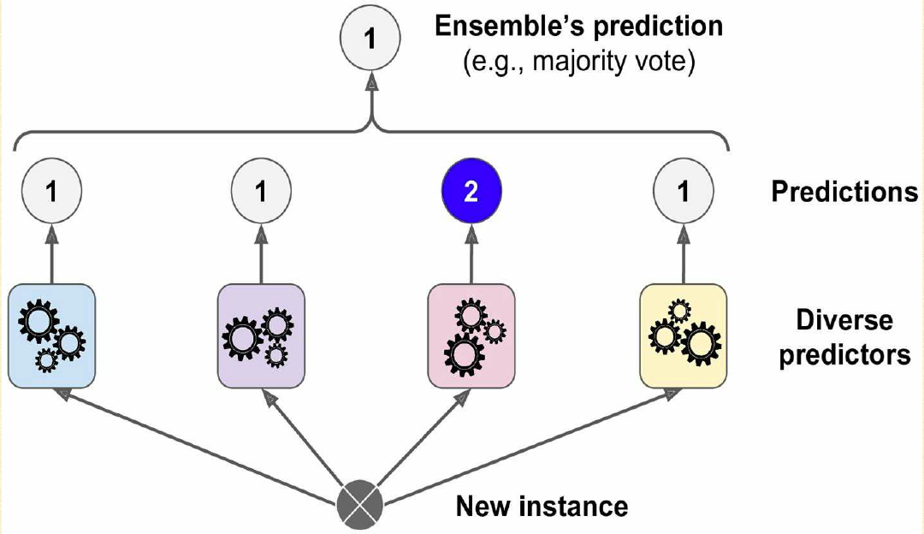
Voting classifier

Slide 5
Why dose ensemble help (1)
We have a biased coin
51% chance of head
49% chance of tail
If we toss it 10,000 times, we will get more or less
510 heads
490 tails
So majority of heads.

Slide 6
Why dose ensemble help (2)
If we flip this coin 3 times:
3 heads and 0 tails => 0.51 * 0.51 * 0.51 * 1 = 0.132651
2 heads and 1 tails => 0.51 * 0.51 * 0.49 * 3 = 0.382347
1 heads and 2 tails => 0.51 * 0.49 * 0.49 * 3 = 0.367353
0 heads and 3 tails => 0.49 * 0.49 * 0.49 * 1 = 0.117649
P(majority of heads) = 0.514998

Slide 7

Why dose ensemble help (3)
If we toss a coin n times we have:
a is probability of heads
b is probability of tails
For n = 1000, probability of majority of heads is : 72.6%
$$P(r number of heads)\left({n \atop r}\right)∗a^{r}∗b^{n−r}$$

Slide 8
voting
Hard voting
Just final output of each classifier
Soft voting
Use probabilities to compute final output

Slide 9


Slide 10
problems
We need a diverse set of classifiers
Use different training algorithm
Use different random subsets of training data

Slide 11
Bagging and pasting
Bagging
Sampling with replacement
Also called bootstrapping
Pasting
Sampling without replacement

Slide 12
Random patches and random subspaces
Like pasting but for features
Each predictor is trained on a subset of features
Useful for high-dimensional inputs
Random patches:
Sampling both training instances and features
Random subspaces:
Just sampling features

Slide 14
Random Forests
Mohammad Ghoddosi

Slide 15
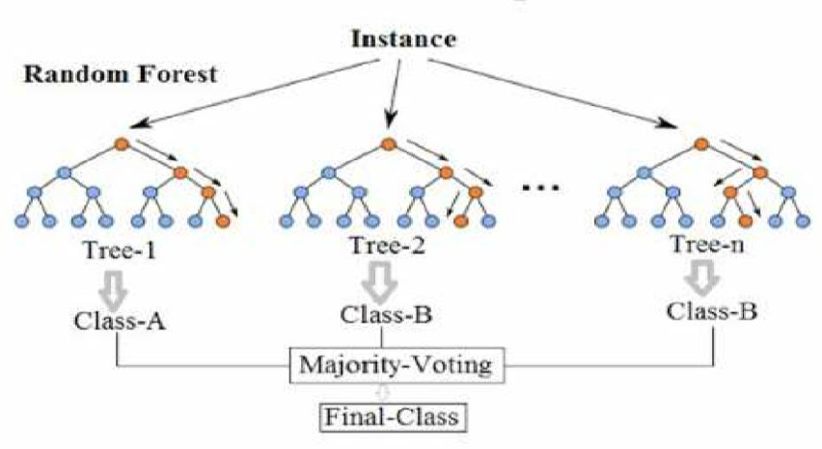
Random forests
An ensemble of Decision Trees
Generally trained with the bagging method

Slide 16
Extra randomness
Searching in a small random subset of features for splitting
Greater tree diversity
Higher bias
Lower variance
Using a random threshold for each feature
Extra-Tree

Slide 18
boosting
Training sequentially
Each predictor trying to correct its predecessor
AdaBoost (Adaptive Boosting)
Gradient Boosting

Slide 19
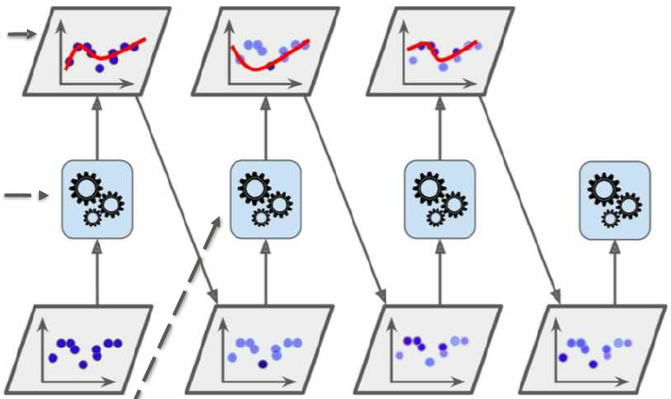
Adaboosting
Each predictor pay a bit more attention to the training instances that the predecessor underfitted
Focusing more and more on the hard cases

Slide 20

Gradient boosting
Sequentially adding predictors to an ensemble, each one correcting its predecessor
Fit new predictor to the residual error
$h\left(x\right)=h_{1}\left(x\right)+h_{2}\left(x\right)+h_{3}\left(x\right)+ …+h_{k}(x)$

