Slide 1
Neural Networks
Mohammad Ghoddosi

Slide 2
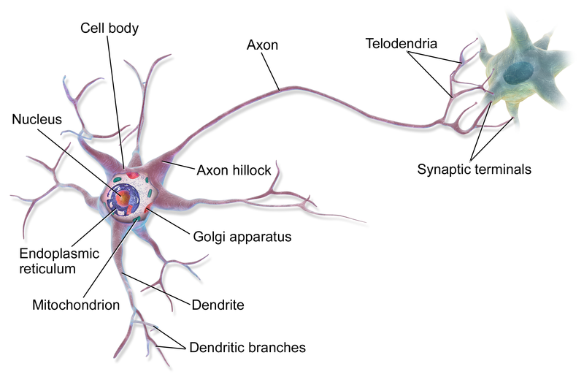
Biological neuron

Slide 3
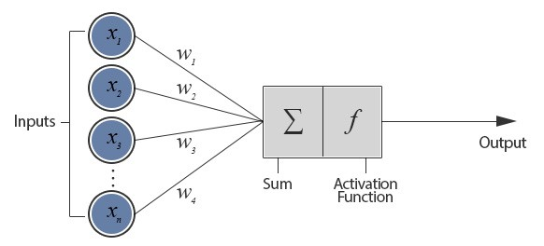
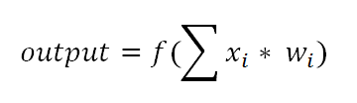
Computational neuron

Slide 4
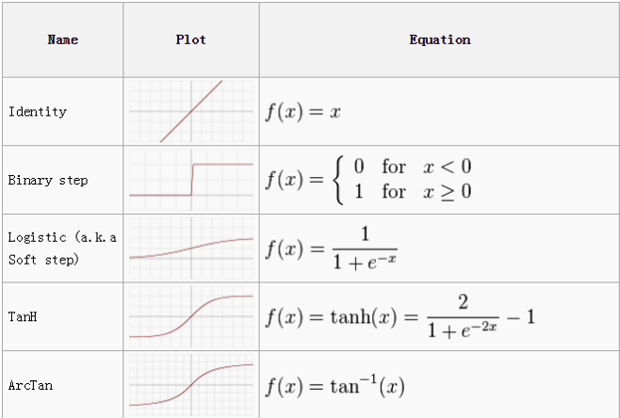
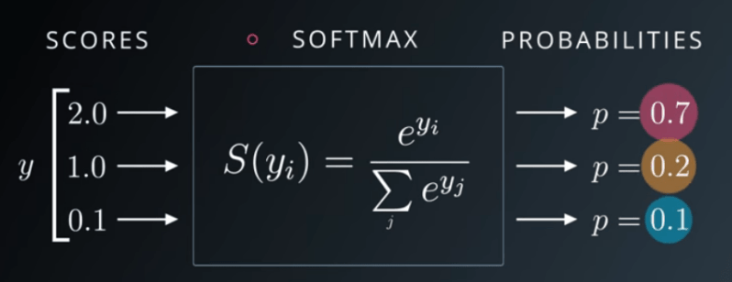
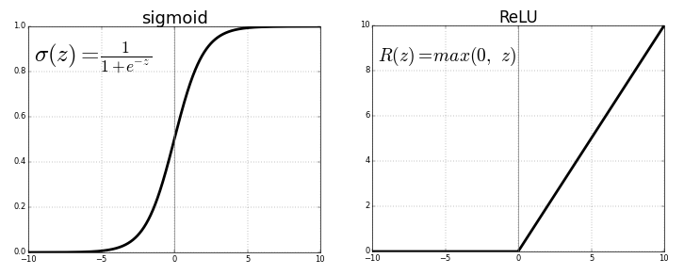
Activation functions

Slide 5
perceptron
Old algorithm (1958)
Perceptron is a basic algorithm for neural networks
Much like logistic regression
linear problems
Hebbian learning rule

Slide 6

Perceptron output
Activation function = step function
$f\left(z\right)= \left\{\begin{aligned}1 z>0 \\ 0 z≤0\end{aligned}\right.$

Slide 7

Perceptron learning rule
Learning rate: $r$
Perceptron input: $x^{(i)}$ and label: $y^{(i)}$
Perceptron output: $h^{\left(i\right)}=f(z^{\left(i\right)})$
If $y^{(i)}=h^{\left(i\right)}$ then do nothing
Else
If $y^{(i)}=0 and h^{\left(i\right)}=1$ then $w\left(t+1\right)=w\left(t\right)+r∗x^{\left(i\right)}$
If $y^{(i)}=1 and h^{\left(i\right)}=0$ then $w\left(t+1\right)=w\left(t\right)−r∗x^{\left(i\right)}$

Slide 8

Perceptron learning rule
Learning rate: $r$
Perceptron input: $x^{(i)}$ and label: $y^{(i)}$
Perceptron output: $h^{\left(i\right)}=f(z^{\left(i\right)})$
If $y^{(i)}=h^{\left(i\right)}$ then do nothing
Else
If $y^{(i)}=0 and h^{\left(i\right)}=1$ then $w\left(t+1\right)=w\left(t\right)+r∗x^{\left(i\right)}$
If $y^{(i)}=1 and h^{\left(i\right)}=0$ then $w\left(t+1\right)=w\left(t\right)−r∗x^{\left(i\right)}$
$$w\left(t+1\right)=w\left(t\right)+r ∗ \left(h^{\left(i\right)}−y^{\left(i\right)}\right)x^{(i)}$$

Slide 9
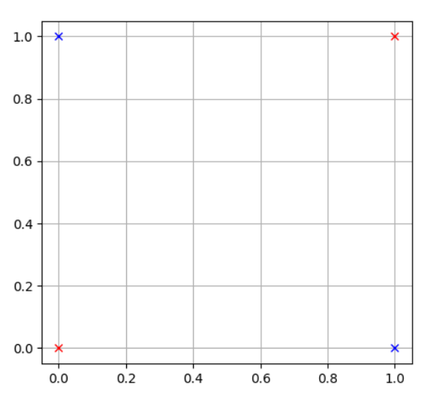
Problems with Perceptron

Slide 10
Problems with Perceptron
0
1
0
1

Slide 11
Problems with Perceptron
0
1
0
1

Slide 12
Problems with Perceptron
x
h
x
h

Slide 13
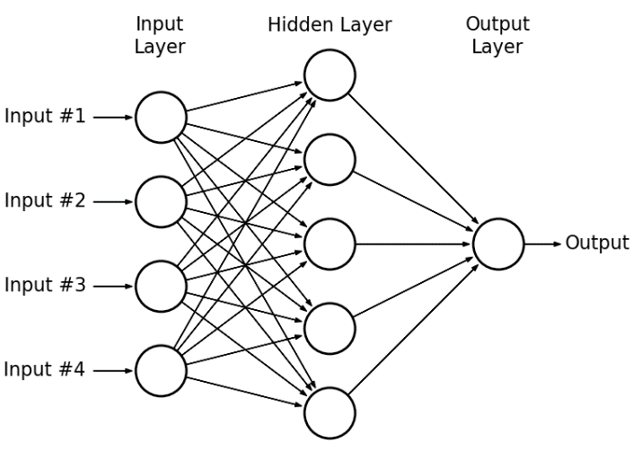
MLP

Slide 14
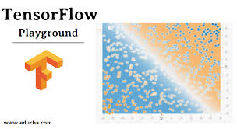

Slide 15
MLP pros and cons
Pros
Flexible
Both regression and classification
Good for nonlinear data with large number of inputs
Cons
black box
computationally very expensive and time consuming to train
depend a lot on training data
overfitting

Slide 16
MLP architecture
Single hidden layer is enough.
If we have enough hidden units, we can solve every problem.
Hidden units cant use linear (identity) activation function.

Slide 17
Shallow vs deep neural networks
Shallow
Only one hidden layer
Simple neurons
Deep
More than one hidden layer
Various types of neurons
Convolutional
Recurrent
…

Slide 18
Shallow vs deep neural networks
deep NN with the right architectures achieve better results than shallow ones
the deep models are able to extract/build better features than shallow models

Slide 19
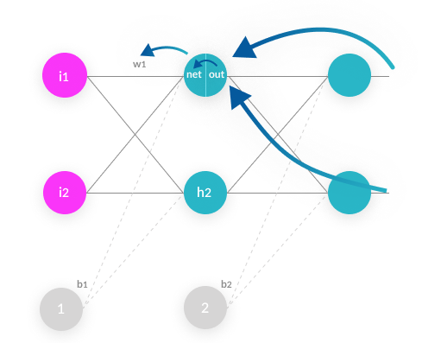
backpropagation

Slide 20
optimizers
Gradient descent
SGD
mini-batch GD
Momentum
AdaGrad
AdaDelta
RMSprop
Adam

Slide 21


