Slide 1
Clustering
Mohammad Ghoddosi

Slide 2
What is clustering
grouping a set of objects
objects in the same group are more similar to each other than to those in other groups.

Slide 3
Clustering VS classification
Clustering is unsupervised
We just have input
We don’t know possible outputs
Classification is supervised
We have input and label
We know possible outputs

Slide 4
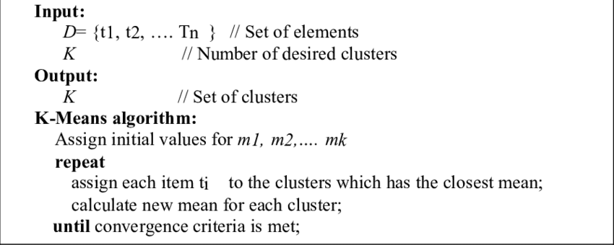
K-means

Slide 5
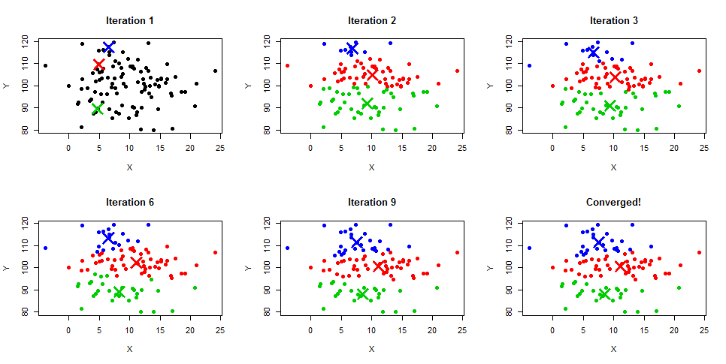
K-means

Slide 6
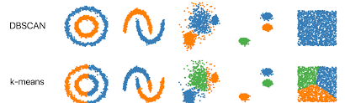
DB-scan

Slide 7
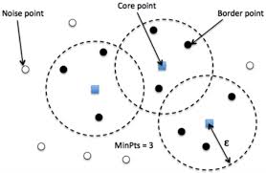
Core, border and noise points

Slide 8
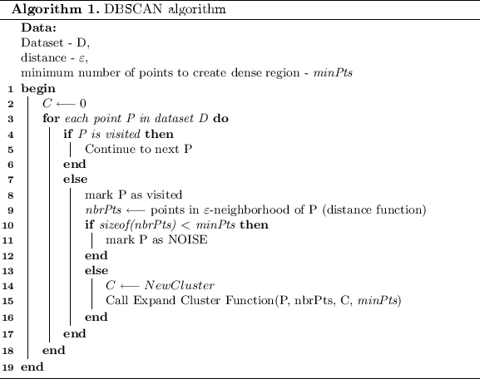
DB-scan

Slide 9
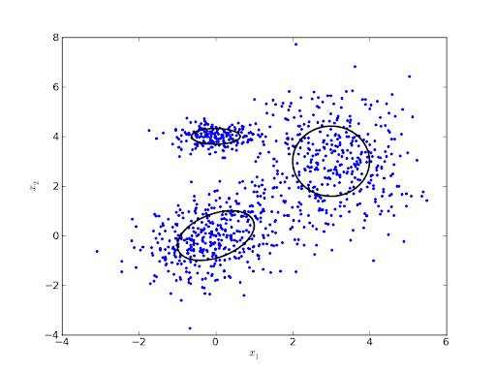
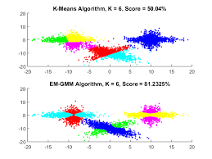
Gaussian mixture model

Slide 10
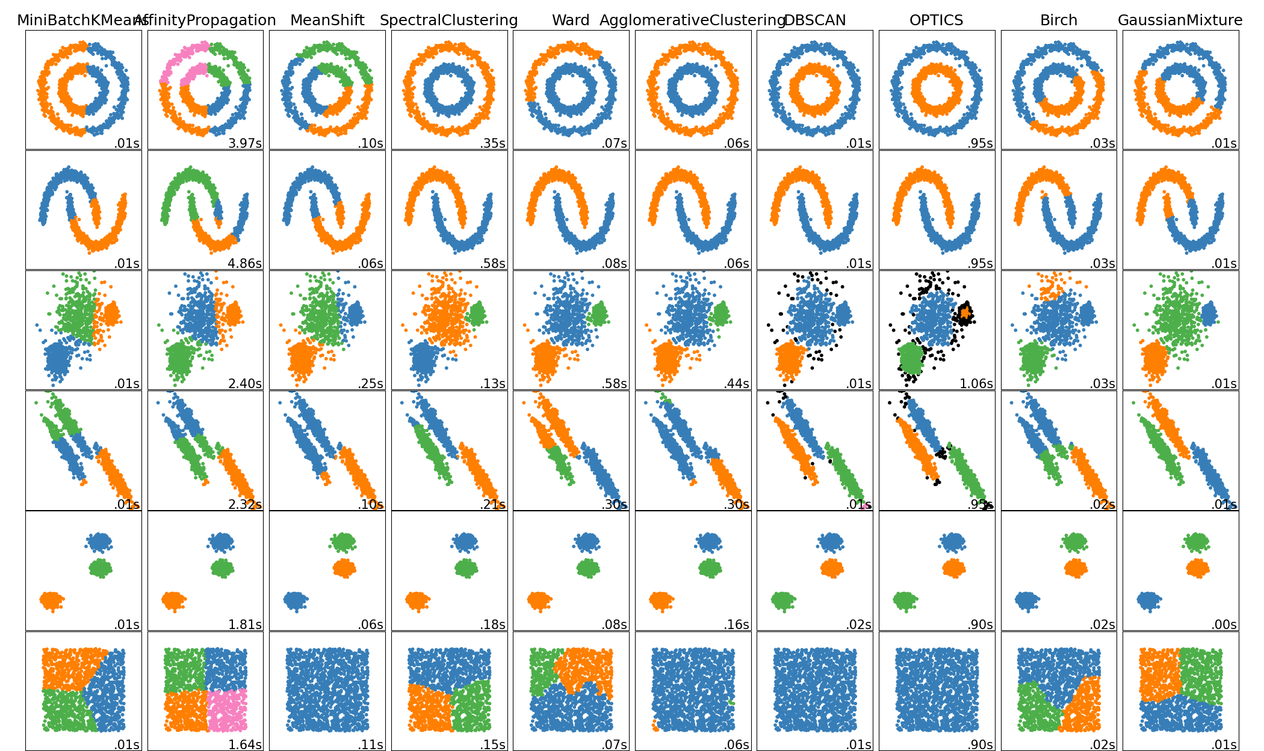
Clustering in different data

Slide 11


Slide 12
Dimensionality Reduction
Mohammad Ghoddosi

Slide 13
Dimensionality reduction
transformation of data from a high-dimensional space into a low-dimensional space
low-dimensional representation retains some meaningful properties of the original data

Slide 14
Dimensionality reduction use cases
Prevent overfitting
Visualization
Faster and more efficient models
Storing datasets
Decorrelation

Slide 15
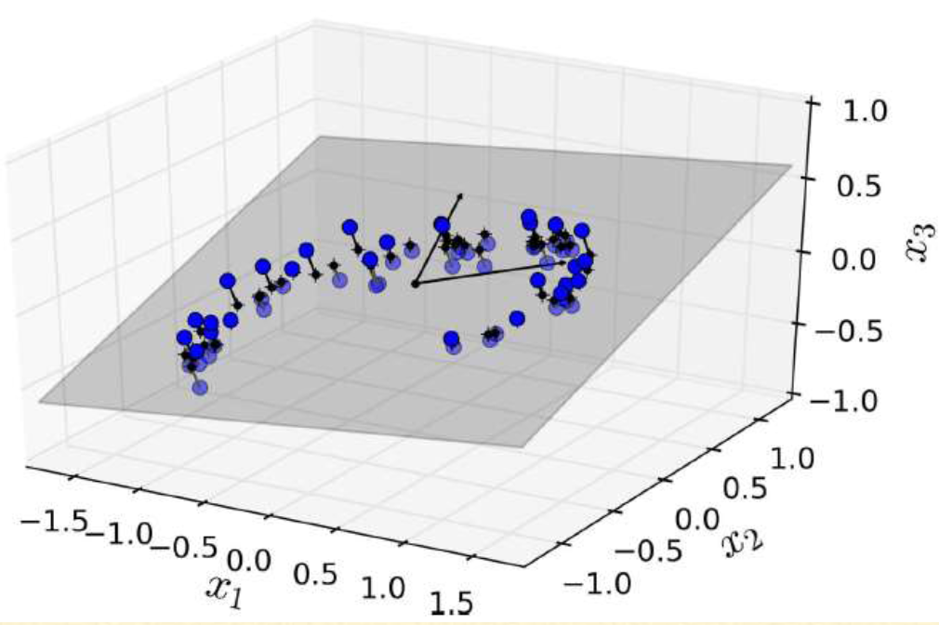
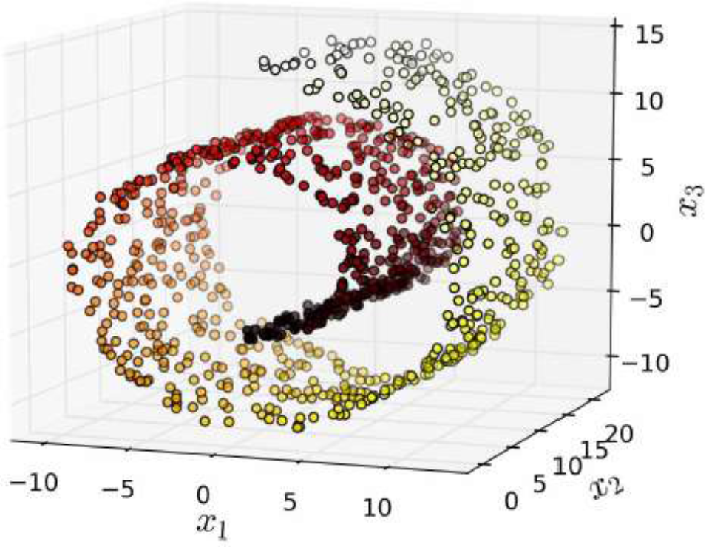
Dimensionality reduction techniques
Feature selection
Feature projection
PCA
Manifold learning
LLE

Slide 16
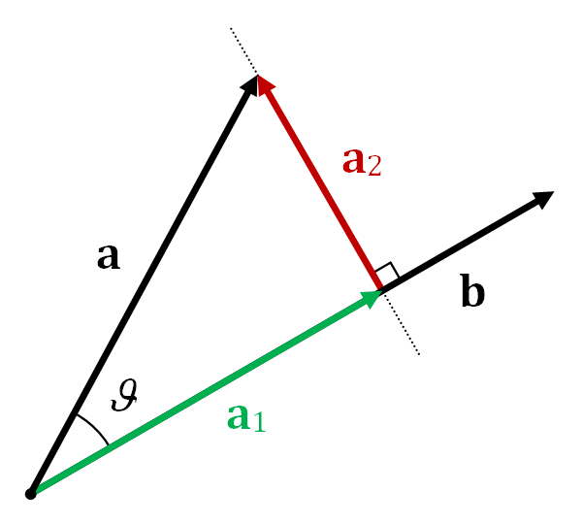
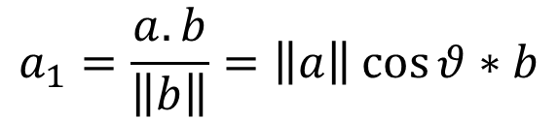
projection
$$a_{1}=\frac{a.b}{\left\|b\right\|}=\left\|a\right\|\cos{θ}∗b$$

Slide 17
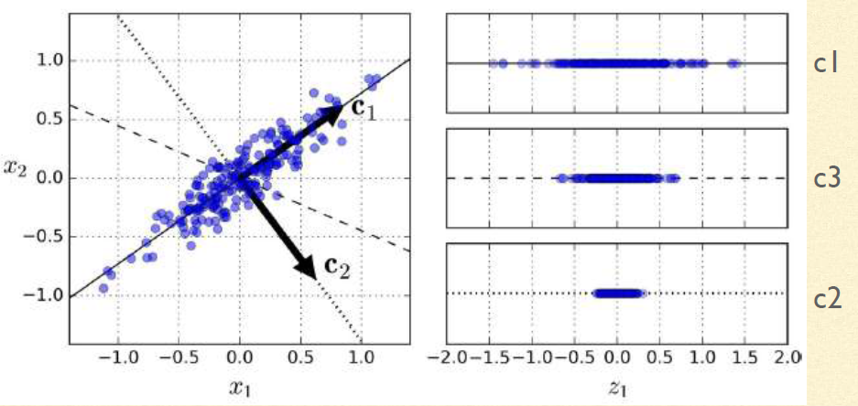




Principle Component Analysis (PCA)
$$c_{1}$$
$$c_{3}$$
$$c_{2}$$
$$c_{2}$$

Slide 18




PCA in vectors
$$M=U.Σ.V^{T} (SVD decomposition)$$
$$U^{∗}U=UU^{∗}=I$$
$$Σ is diagnal$$
$$Vis components$$
$$if M is real, U and V are real and ortogonal$$

Slide 19
Local Linear Embedding (LLE)
Measuring how each training instance linearly relates to its closest neighbors
Then looking for low-dimensional representation where these local relationships are best preserved

Slide 20
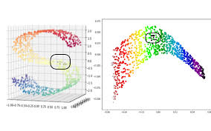
LLE

Slide 21

LLE algorithm
Step I: find k-nearest neighbors
Step II: find W such that:
$$W=\underset{W}{argmin}{{\sum_{i=1}^{m}{\left\|X^{\left(i\right)} − \sum_{j=1}^{m}{w_{i, j} X^{\left(j\right)} } \right\|}}^{2}}$$
$$W=\left\{\begin{aligned}w_{i,j} if X^{\left(j\right)} is not in KNN X^{(i)} \\ \sum_{j=1}^{m}{w_{i, J}=1 for each i}\end{aligned}\right.$$

Slide 22

LLE algorithm
Step III: find Z matrix in lower dimension such that:
$$Z=\underset{Z}{argmin}{{\sum_{i=1}^{m}{\left\|Z^{\left(i\right)} − \sum_{j=1}^{m}{w_{i, j} Z^{\left(j\right)} } \right\|}}^{2}}$$

Slide 23
Other techniques
Multidimensional scaling (MDS)
Preserve the distances between the instances
Isomap
Forms nearest neighbor graph and try to preserve geodesic distances
T-SNE
Keep similar instances close and dissimilar apart (cluster visualization)
LDA
Classification algorithm, keep classes as far apart as possible.

Slide 25
autoencoders
Artificial Neural Network
learns efficient data representation in an unsupervised manner
Used in dimensional reduction

Slide 26
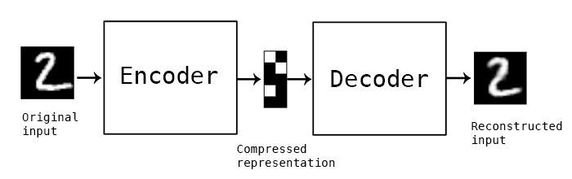
Autoencoders, idea

Slide 27
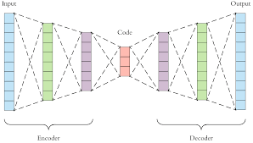
undercomplete Autoencoders

Slide 28
Autoencoders Variations
undercomplete Autoencoders
bottleneck
Sparse Autoencoders
L1 regularization
Better for classification
Denoising Autoencoders
Input is corrupted

Slide 29
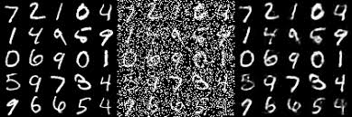
Denoising Autoencoders

