Slide 1

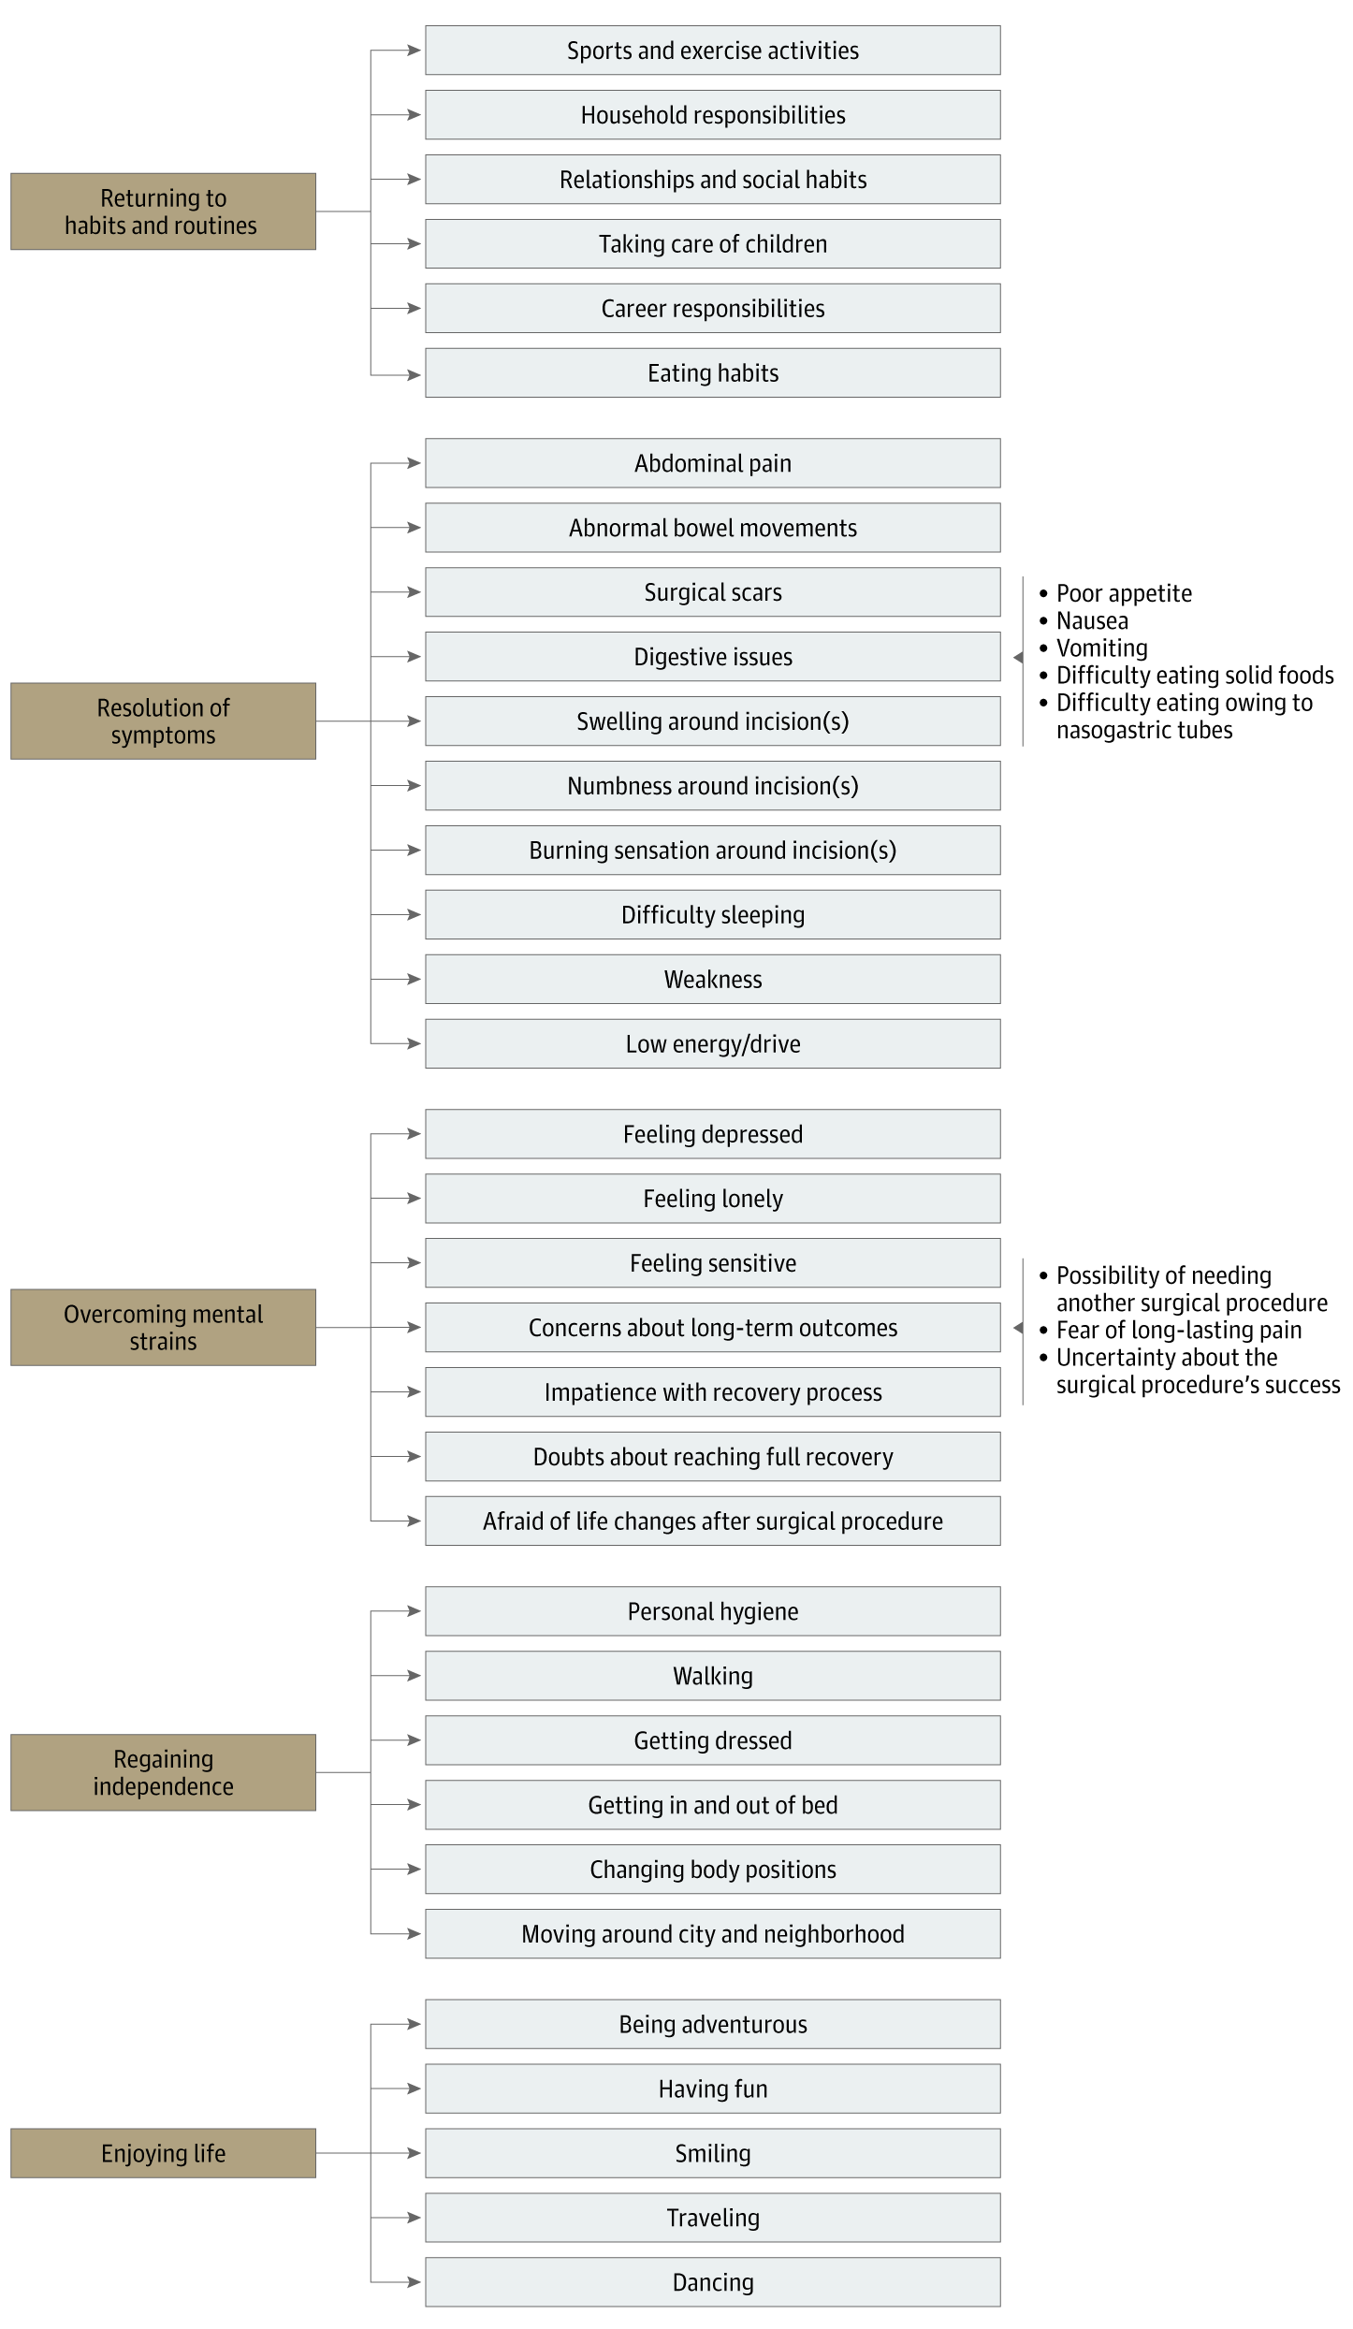
From: Understanding the Meaning of Recovery to Patients Undergoing Abdominal Surgery
JAMA Surg. 2021;156(8):758-765. doi:10.1001/jamasurg.2021.1557
^{Figure Legend:}
Themes and Subthemes Concerning the Meaning of Recovery After Abdominal Surgery
^{Date of download: 9/1/2024}
Copyright 2021 American Medical Association. All Rights Reserved.

