Slide 1
Qualitative Studies and Analysis
Fateme Rajabiyazdi - Tutorial July 25th
frajabiy@ucalgary.ca

Slide 2
Qualitative & Quantitative Study
Is primarily exploratory research. It is used to gain an understanding of underlying reasons, opinions, and motivations behind the research topic!

Slide 3
Class Participation!

Slide 4
Differences
Quantitative
Harder to design the study
Answer a specific/predefined research Q
Data is in numerical format
Collect data via screen record, time capture, ..
Easier to analyse the results
Qualitative
Easier to design the study - questions
Gain deeper understanding of the research Q
Data is in descriptive format
Collect data via asking questions, observation, ...
Harder to analyse the results

Slide 5
Qualitative Studies
Interview
Observation
Field study
Cultural probe
Focus group
Diary
...

Slide 6
Qualitative Studies
Interview
Observation
Field study
Cultural probe
Focus group
Diary
...

Slide 7
Interview
Structured
Semi-structured
Narrative
Notes:
http://www.joshd.net/article.asp?issn=2321-0656;year=2013;volume=1;issue=2;spage=56;epage=59;aulast=Stuckey

Slide 8
Recording Interview
Video Recording
Audio Recording

Slide 9
Ethics
Write your proposal to get approval from U of C Research Ethics Board.
Describe the study to your participants.
Ask them to fill out consent form.
Inform them that they can quit the study at any point without penalty.

Slide 10
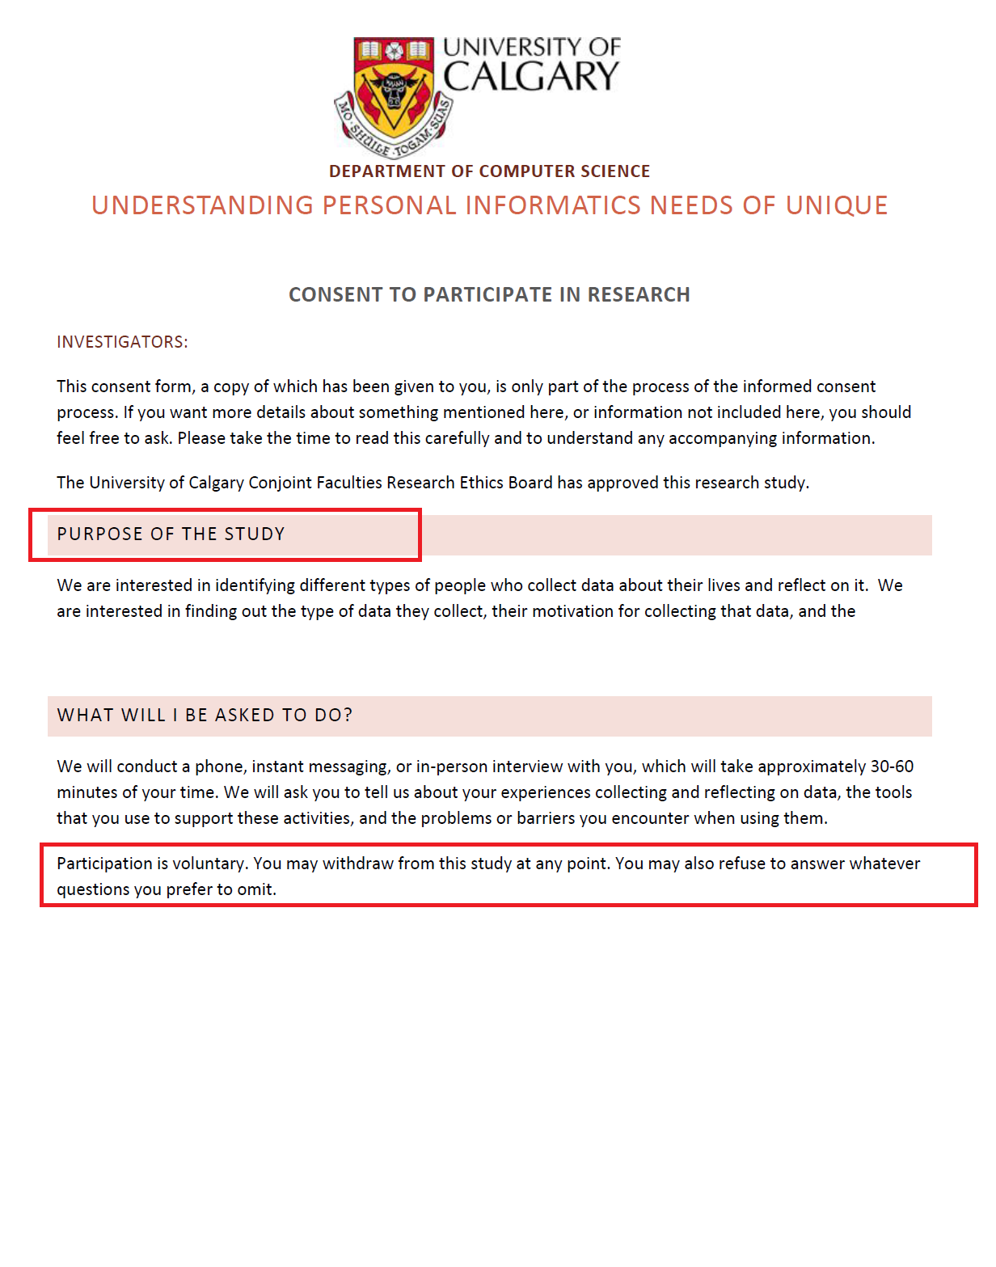
Sample Ethics Consent Form

Slide 11
Sample of interview topics!

Slide 12

Time to interview other teams!!!

Slide 13
Exercise
Pick a topic! A meaningful one!
Form FIVE questions that will help you understand the interviewee’s opinion on that topic!
It is a semi-structured interview style, so ask clarifying questions!

Slide 14
Exercise
Ask one of the other teams’ member if they are willing to interview!
Get their verbal consent!
Start recording his/her voice with your phone/laptop!
Note: The interviewee can quit the session at any time. You are obligated to delete their data.

Slide 15
Transcribe your interview recording and bring it for Thursday tutorial/assignment!

Slide 16
How to transcribe?

Slide 17
What will happen on THURSDAY tutorial??
We will analyze the interview scripts.
Bring your transcripts and sticky notes!
We will make an affinity diagram like this …

Slide 18
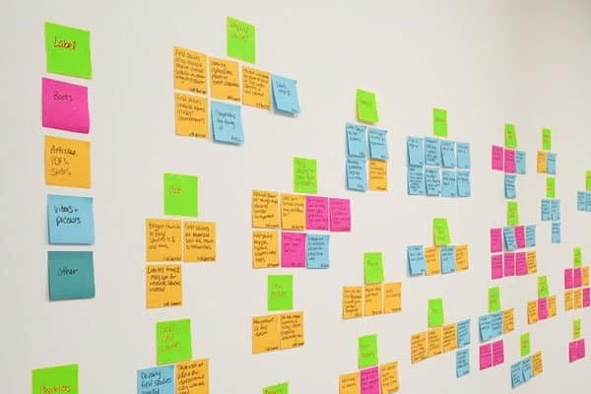

Slide 19
