Slide 1
Visualization
(Excel & Tableau)
Fateme Rajabiyazdi - Tutorial Aug 1st
frajabiy@ucalgary.ca

Slide 2


Software needed for today
→ Download Tableau - use the key provided on D2L
https://www.tableau.com/products/desktop
→ Download Excel (any version)

Slide 3
Three level of reading:
Elementary: An elementary question focuses on specific element of graphic.
Intermediate: An intermediate question focuses on a group of elements or trends in the graph.
Overall: The overall question seeks an answer to the general message.

Slide 4
Elementary: An elementary question focuses on specific element of graphic.
Example: Norway has highest household income and Russia has the lowest.

Slide 5
Intermediate: An intermediate question focuses on a group of elements or trends in the graph.
Example: Northern European countries have the highest income and believe in free education for everyone.

Slide 6
Overall: The overall question seeks an answer to the general message.
Example: There is a tradeoff between household income and spending time with family.

Slide 7
Download BetterLifeIndex.xls dataset from D2L!

Slide 8
Open the dataset in Excel and answer the following questions using Excel graph!

Slide 9
Exercise #1 (elementary)
Which country has the highest long term unemployment rate?
Which country has the lowest long term unemployment rate?

Slide 10
Demo!

Slide 11
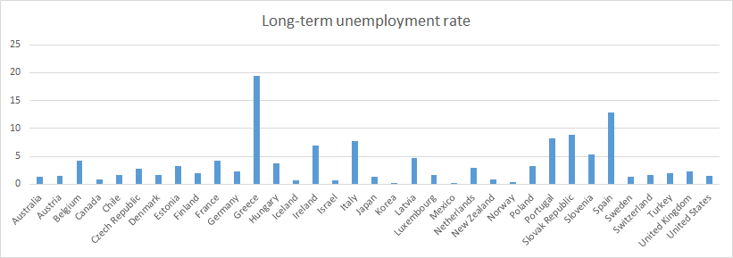
Insert → Charts → Choose a chart type

Slide 12
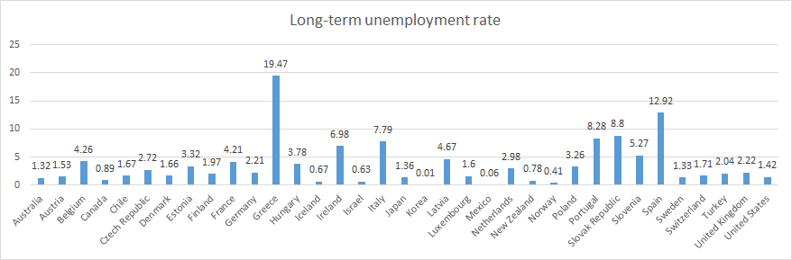
Right click → Add data labels

Slide 13
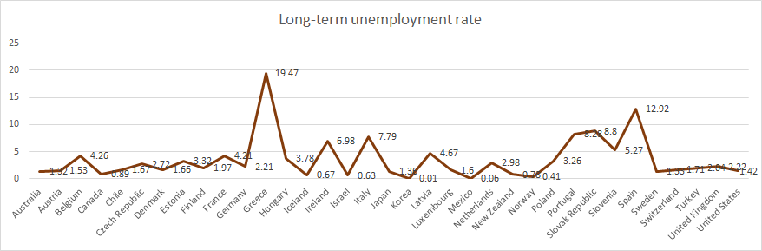
Right click → Change chart type

Slide 14
Exercise #2 (elementary)
Use a bar graph to answer this question!
Which country has the highest years in education?
Which country has the lowest years in education?

Slide 15
Demo!

Slide 16
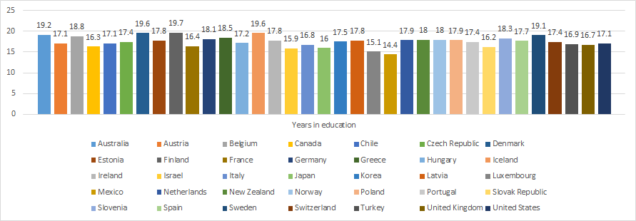
Design → Add chart elements

Slide 17
Exercise #3 (intermediate)
Use a line graph to answer this question!
Is there any relationship between life expectancy and life satisfaction?
If yes, show the relation. If not, explain why.

Slide 18
Demo!

Slide 19
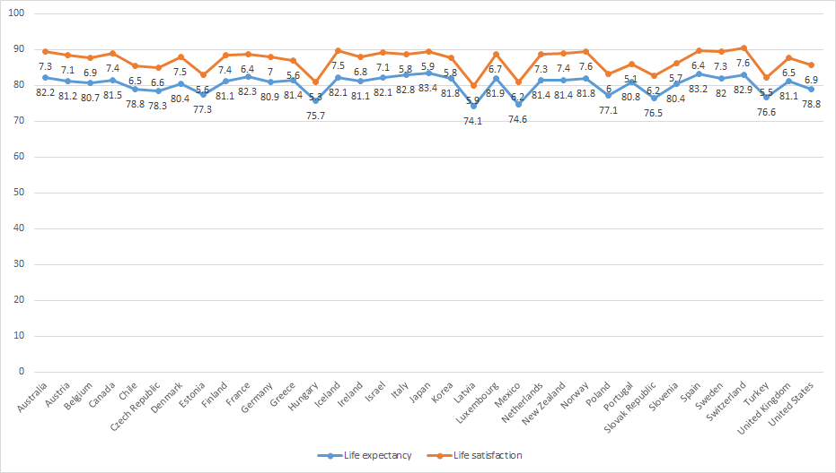
Select both columns as wells as country column

Slide 20
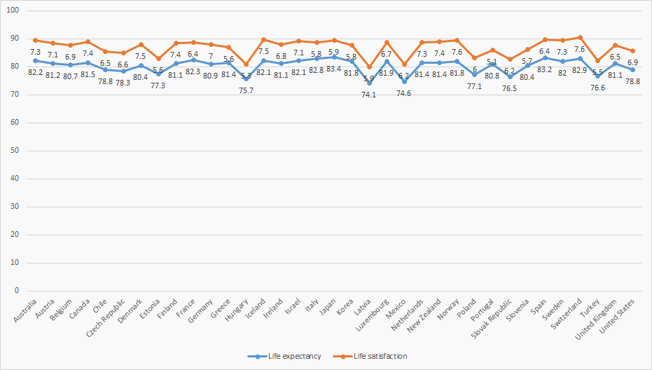
Hard to see the trend.
How to make the chart more clear to see the trend better?

Slide 21
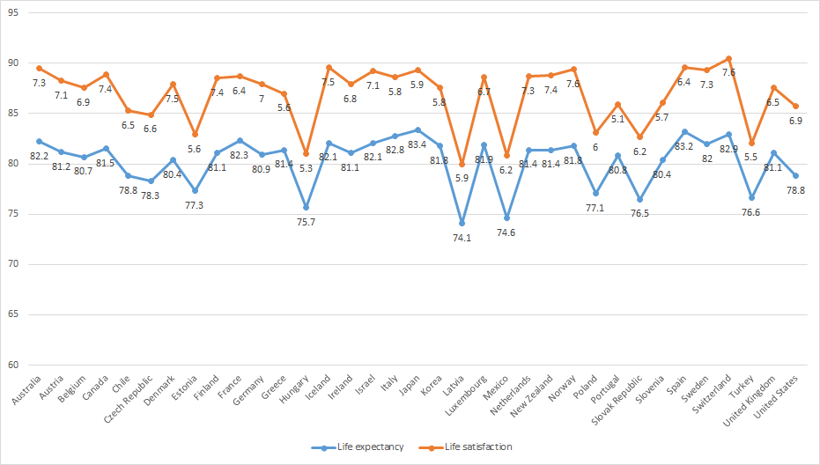
Right click on x-axis → Format axis → Set min to 60

Slide 22
Exercise #4 (Overall)
I want to see if there is countries with higher years in education are safer or not?

Slide 23
Define your own formula!
What makes sense to you?
Explain your assumption!

Slide 24
Number of ppl who may be in danger = Feeling safe * Homicide ratio/100
Change the type of data to number → then into one decimal
Sort years in education column

Slide 25
Demo!

Slide 26
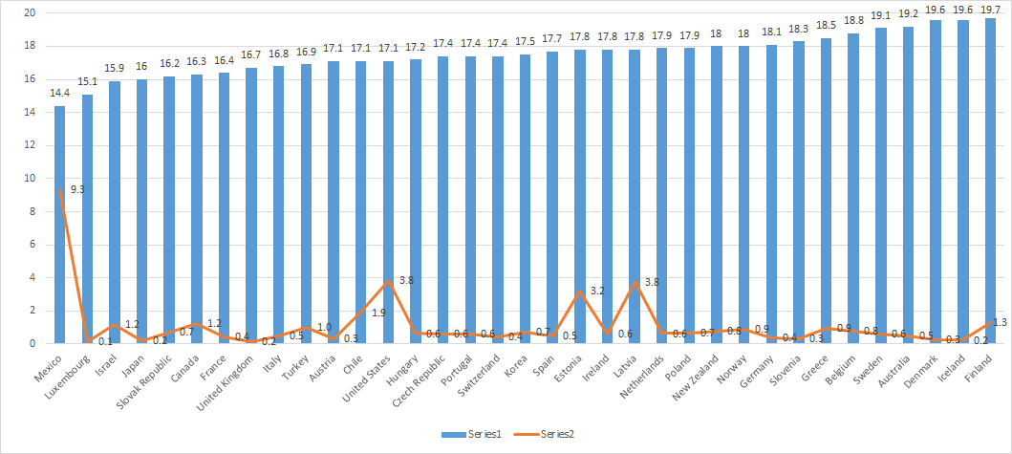

Slide 27
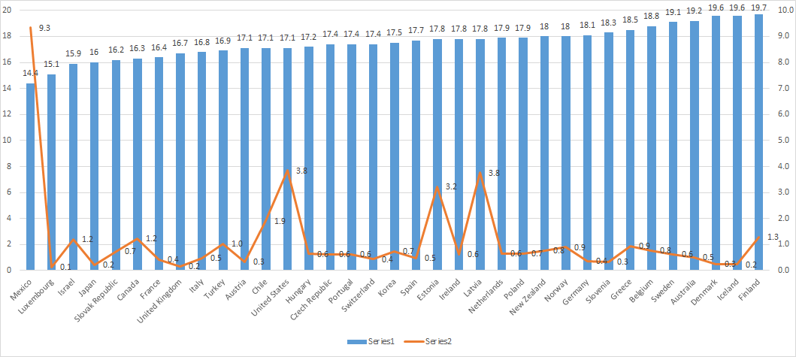
Format data series → secondary axis

Slide 28
Exercise #5
As a team discuss and visualize one interesting fact (either intermediate or overall reading level) using Excel graphs.

Slide 29
Tableau Time!

Slide 30
https://www.tableau.com/learn/training
Notes:
If you want to learn more about how to work with Tableau!

Slide 31
Show video!
Notes:
Start from minute 4:00 till 6:57
In this video, we are working with an excel sheet containing product list and their sale in Superstore

Slide 32
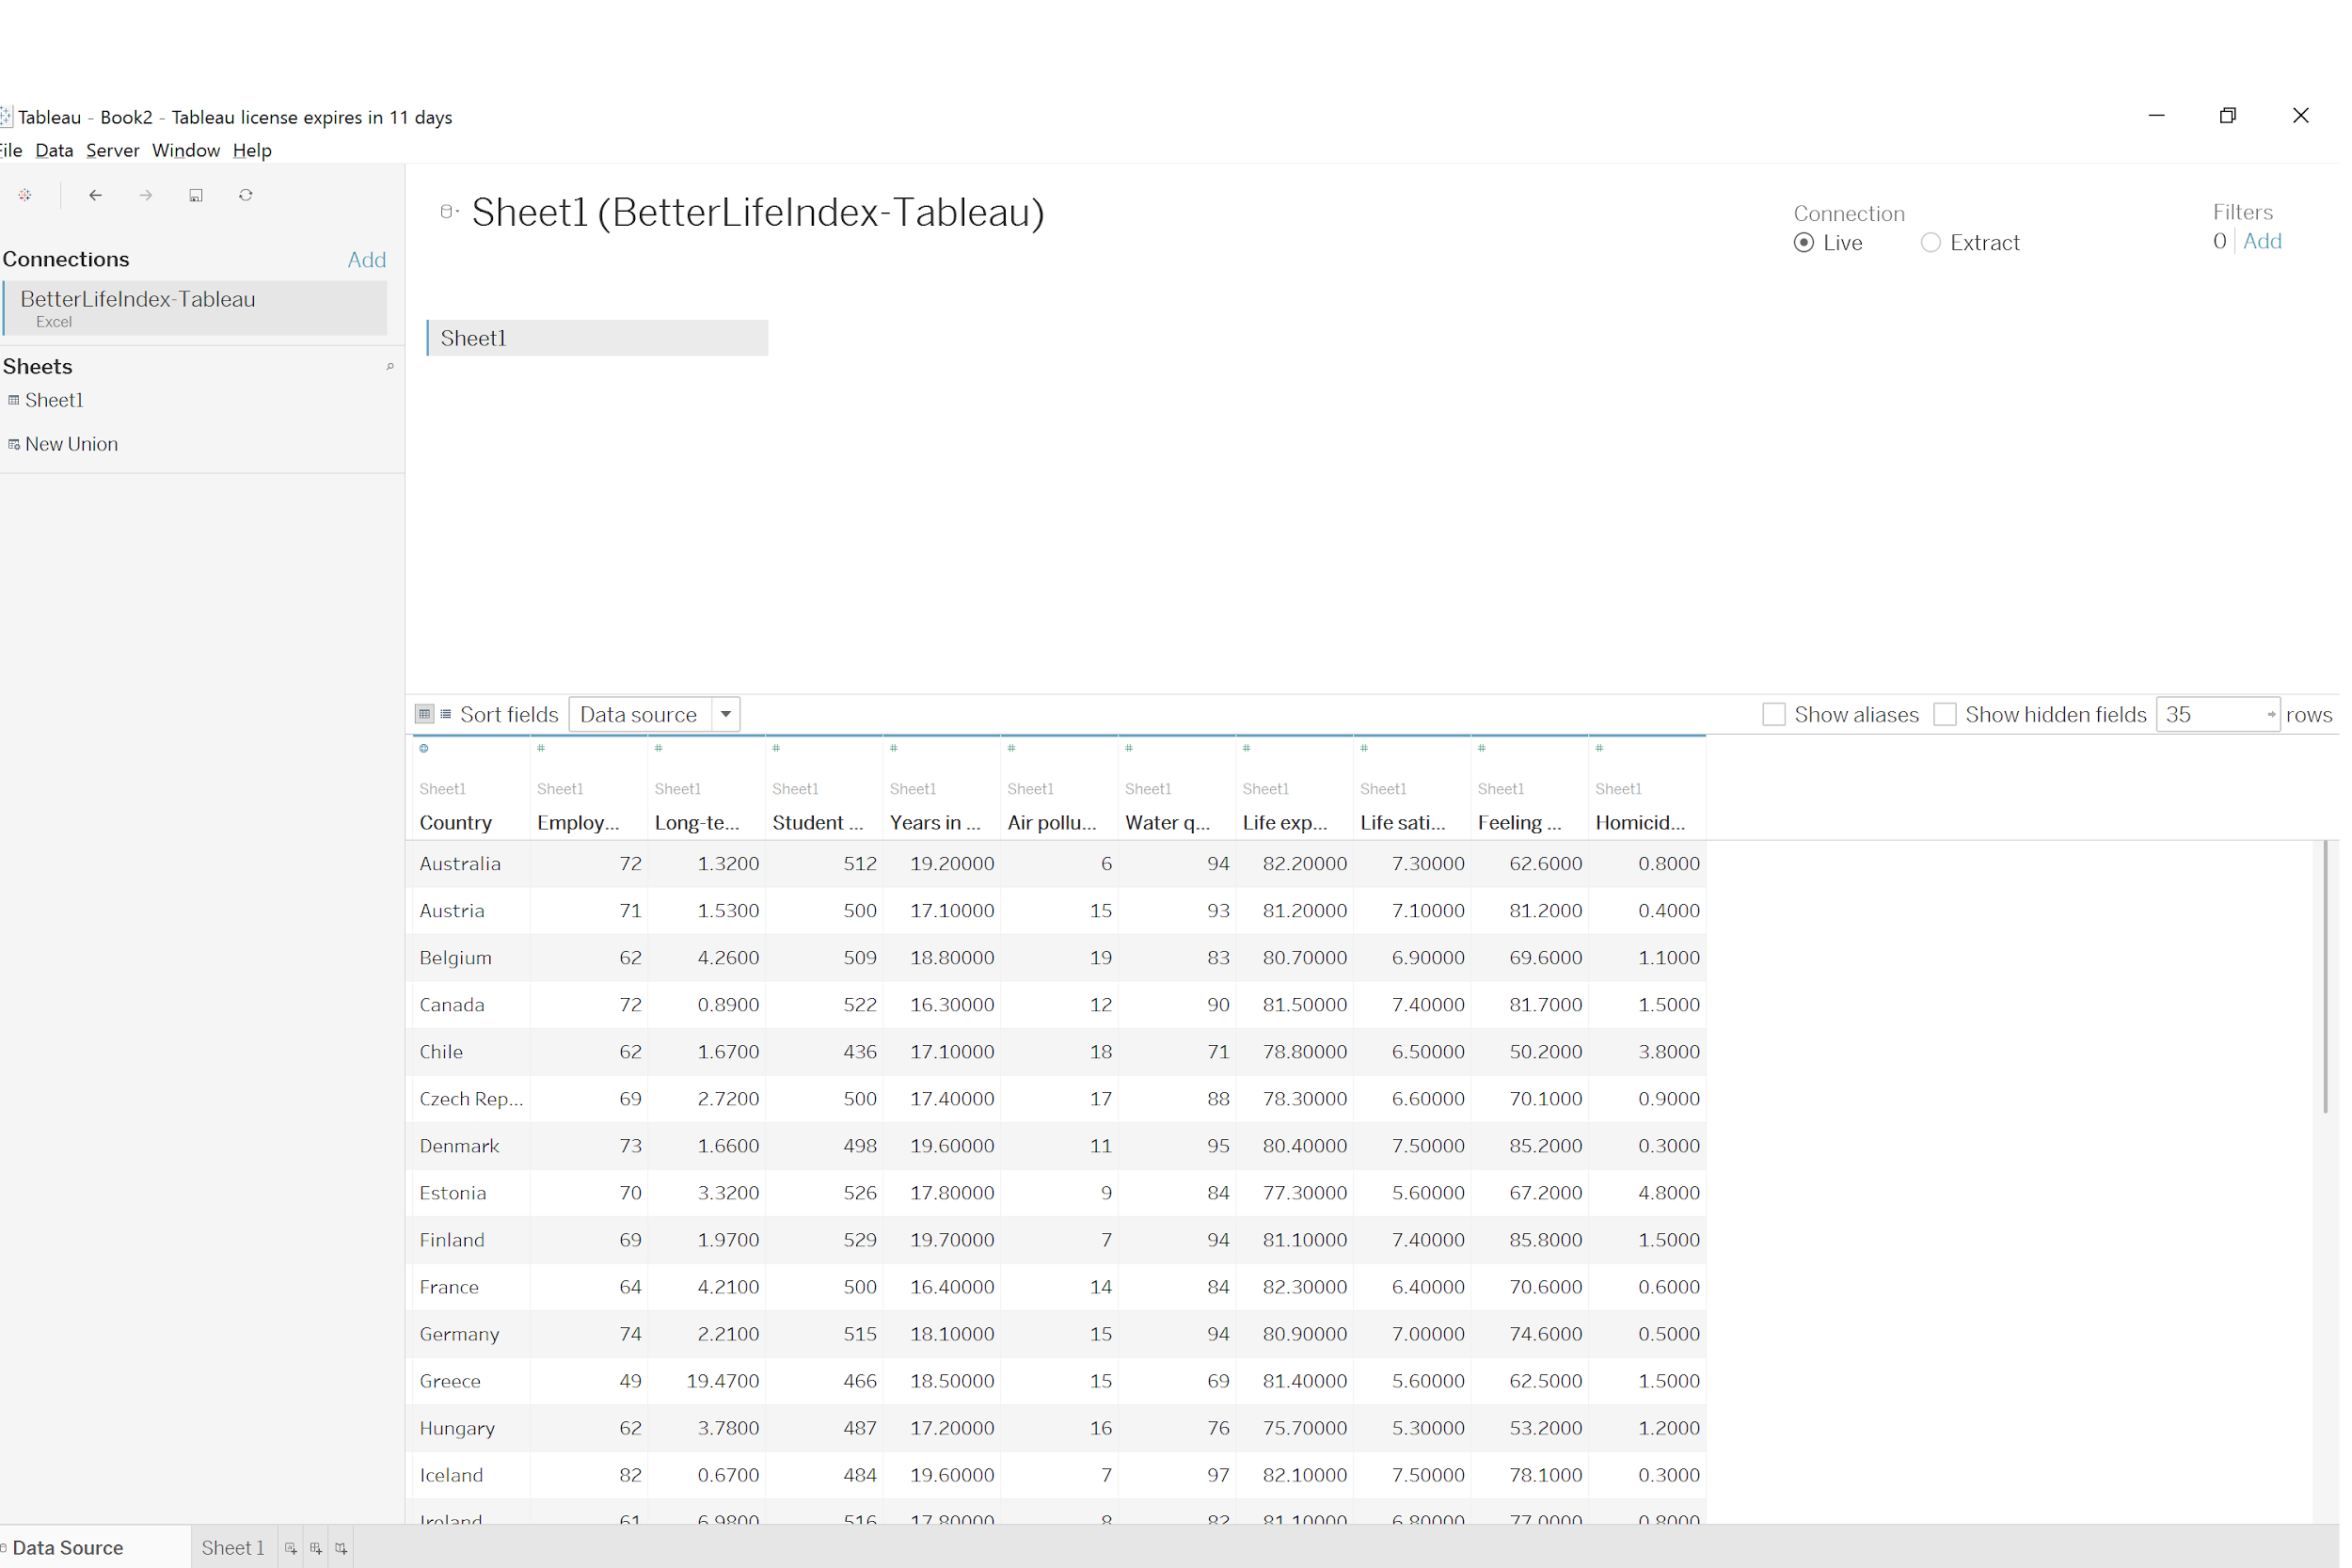
Open Tableau → Import your dataset

Slide 33
Exercise #1 (elementary)
Which country has the highest long term unemployment rate?
Which country has the lowest long term unemployment rate?

Slide 34
Demo!

Slide 35
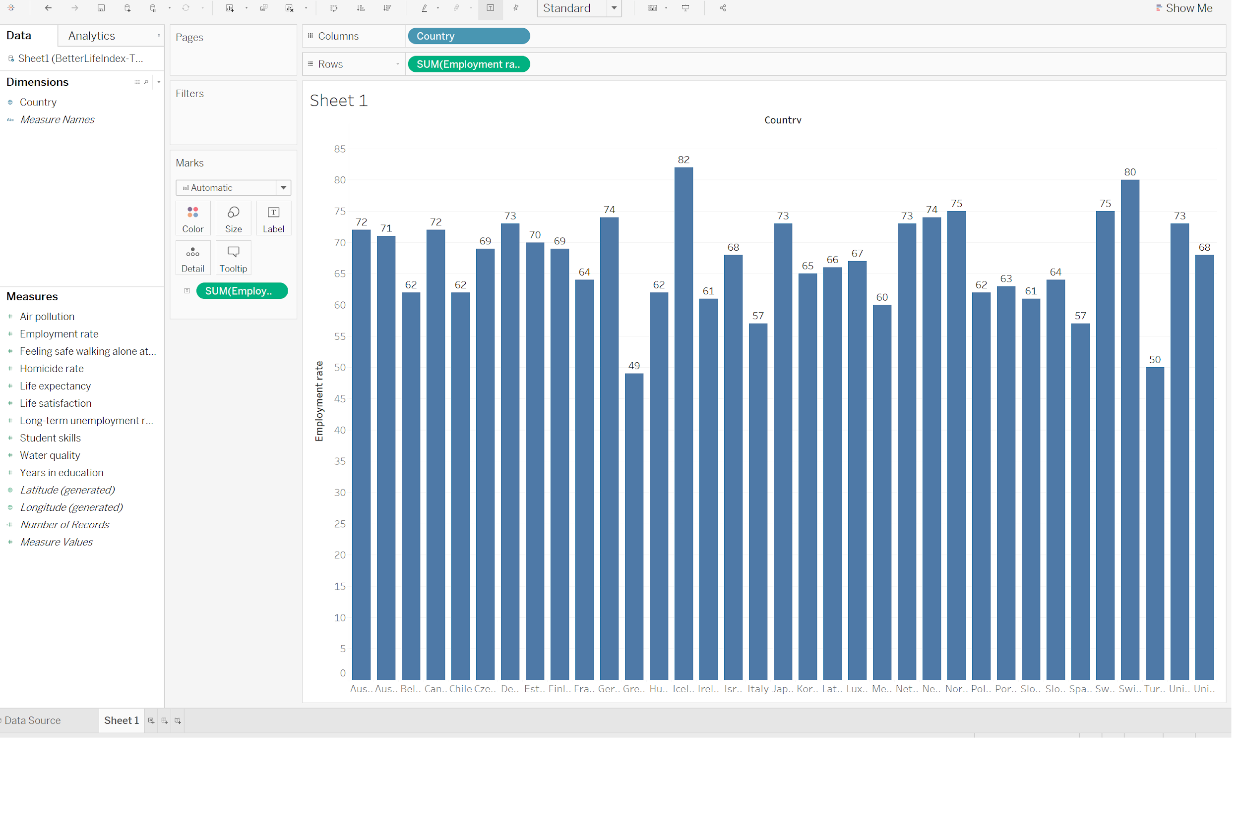
Drag and drop “country” and “unemployment rate”

Slide 36
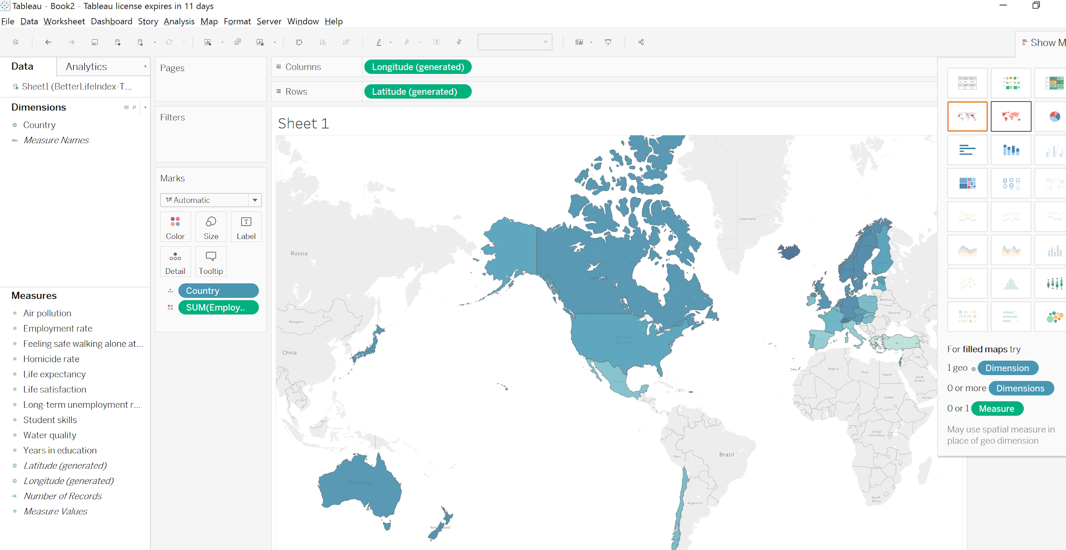
On the top right, choose “show me” button.

Slide 37
Exercise #2 (elementary)
Which country has the highest years in education?
Which country has the lowest years in education?

Slide 38
Exercise #3 (intermediate)
Is there any relationship between life expectancy and life satisfaction?
If yes, show the relation. If not, explain why.

Slide 39
Exercise #4 (Overall)
I want to see if there is countries with higher years in education are safer or not?

Slide 40
https://www.tableau.com/learn/training
Notes:
If you want to learn more about how to work with Tableau!

