Slide 1
Visualization
(Excel & Tableau - cont.)
Fateme Rajabiyazdi - Tutorial Aug 3rd
frajabiy@ucalgary.ca

Slide 2
Project!
Analysis Questions
Based on your initial exploration and curiosity, pose 6 analysis questions that you will address in Part 3. The TA will provide more details about the nature of the questions.

Slide 3
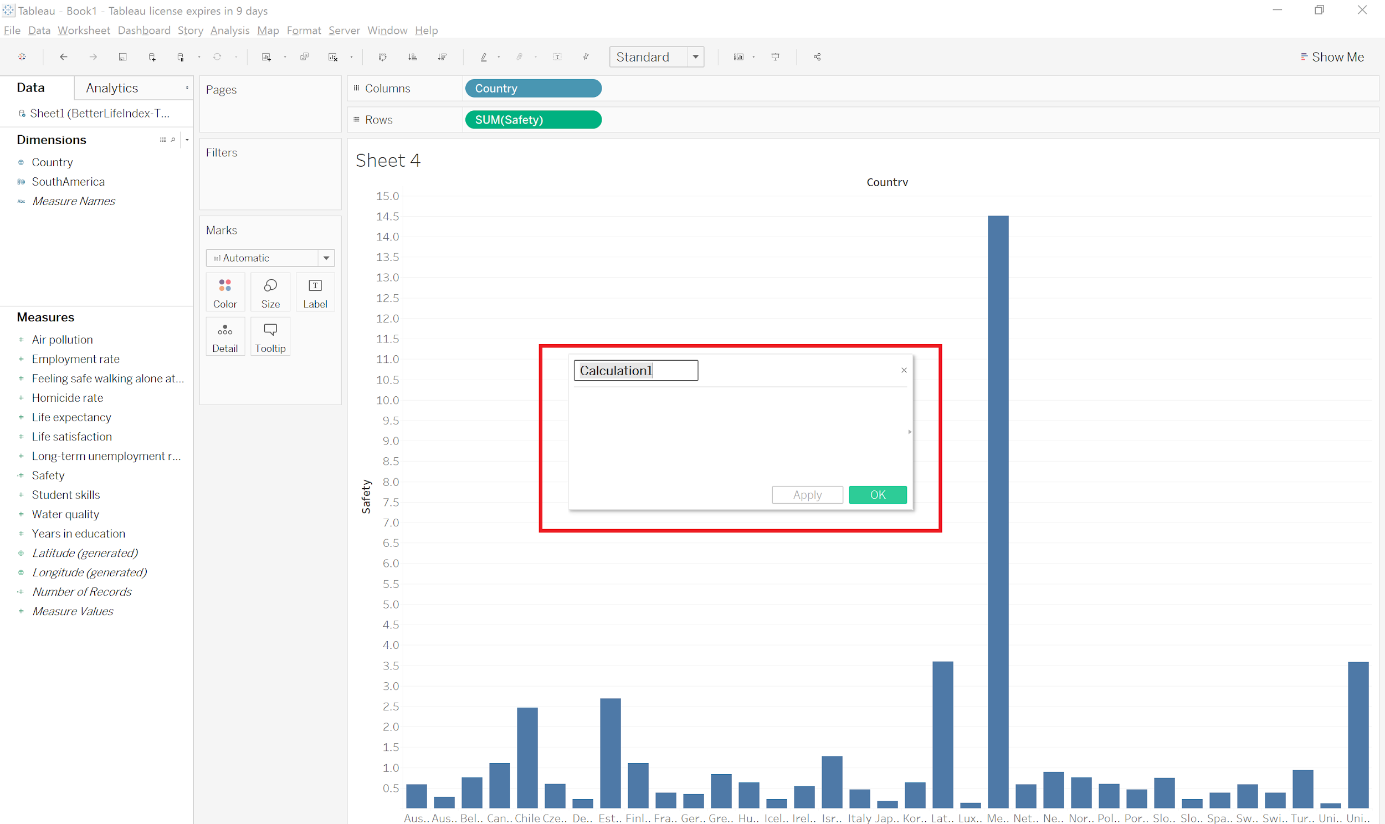
Right click in measures sections → Create calculated field

Slide 4
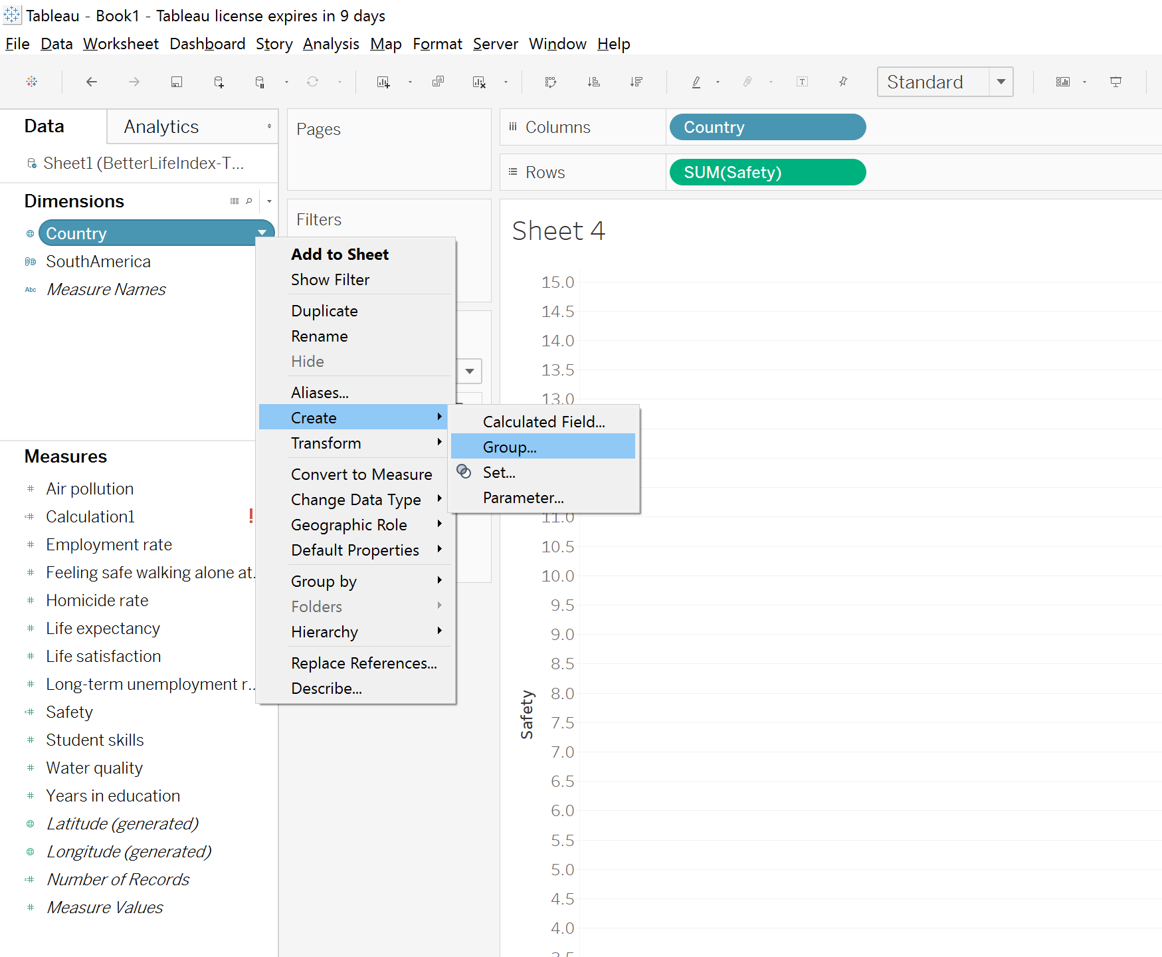
Group items in the dimension

Slide 5
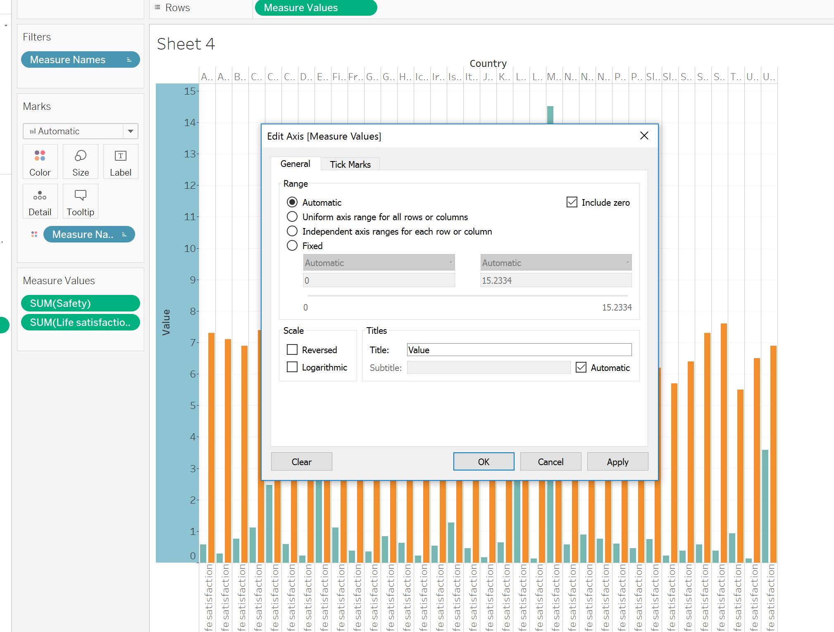
Right click on Axis → Edit axis

Slide 6
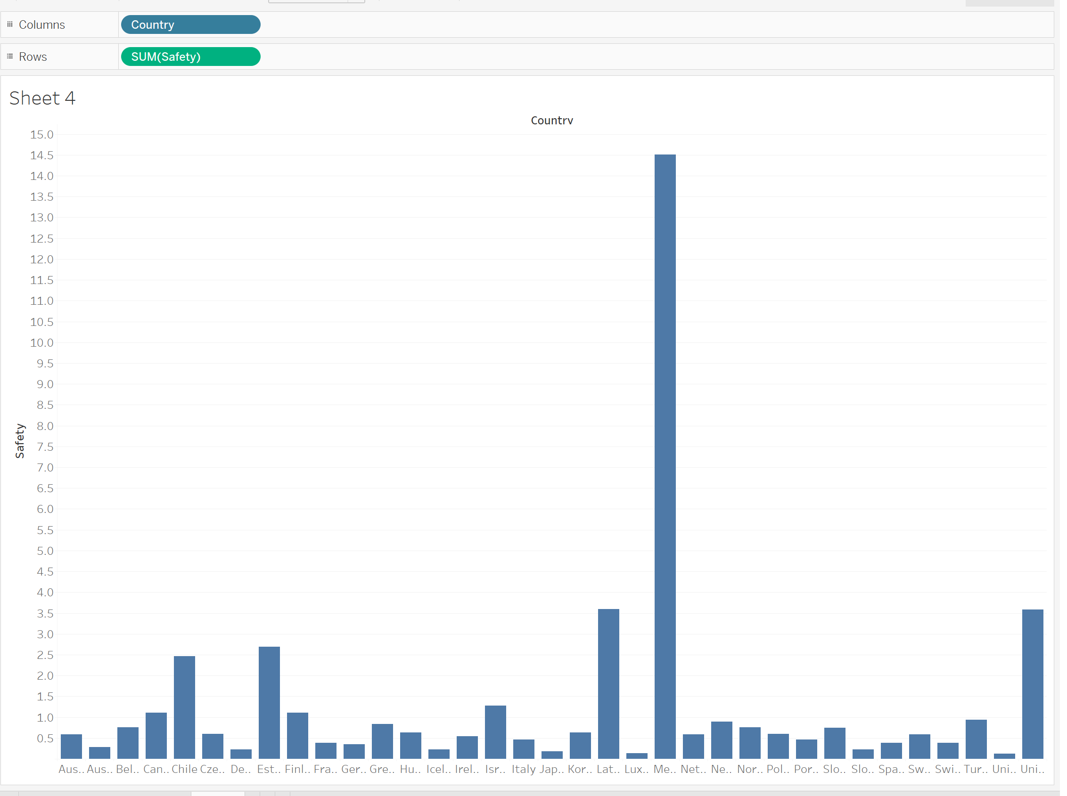
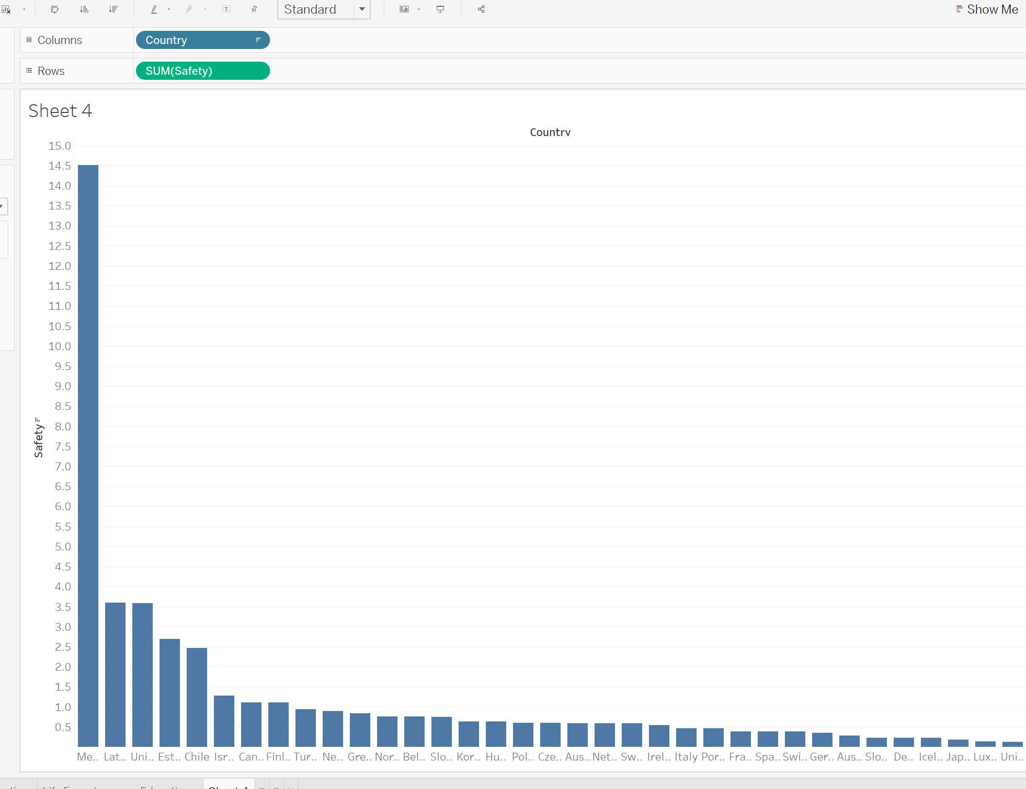
How to sort our chart?

Slide 7
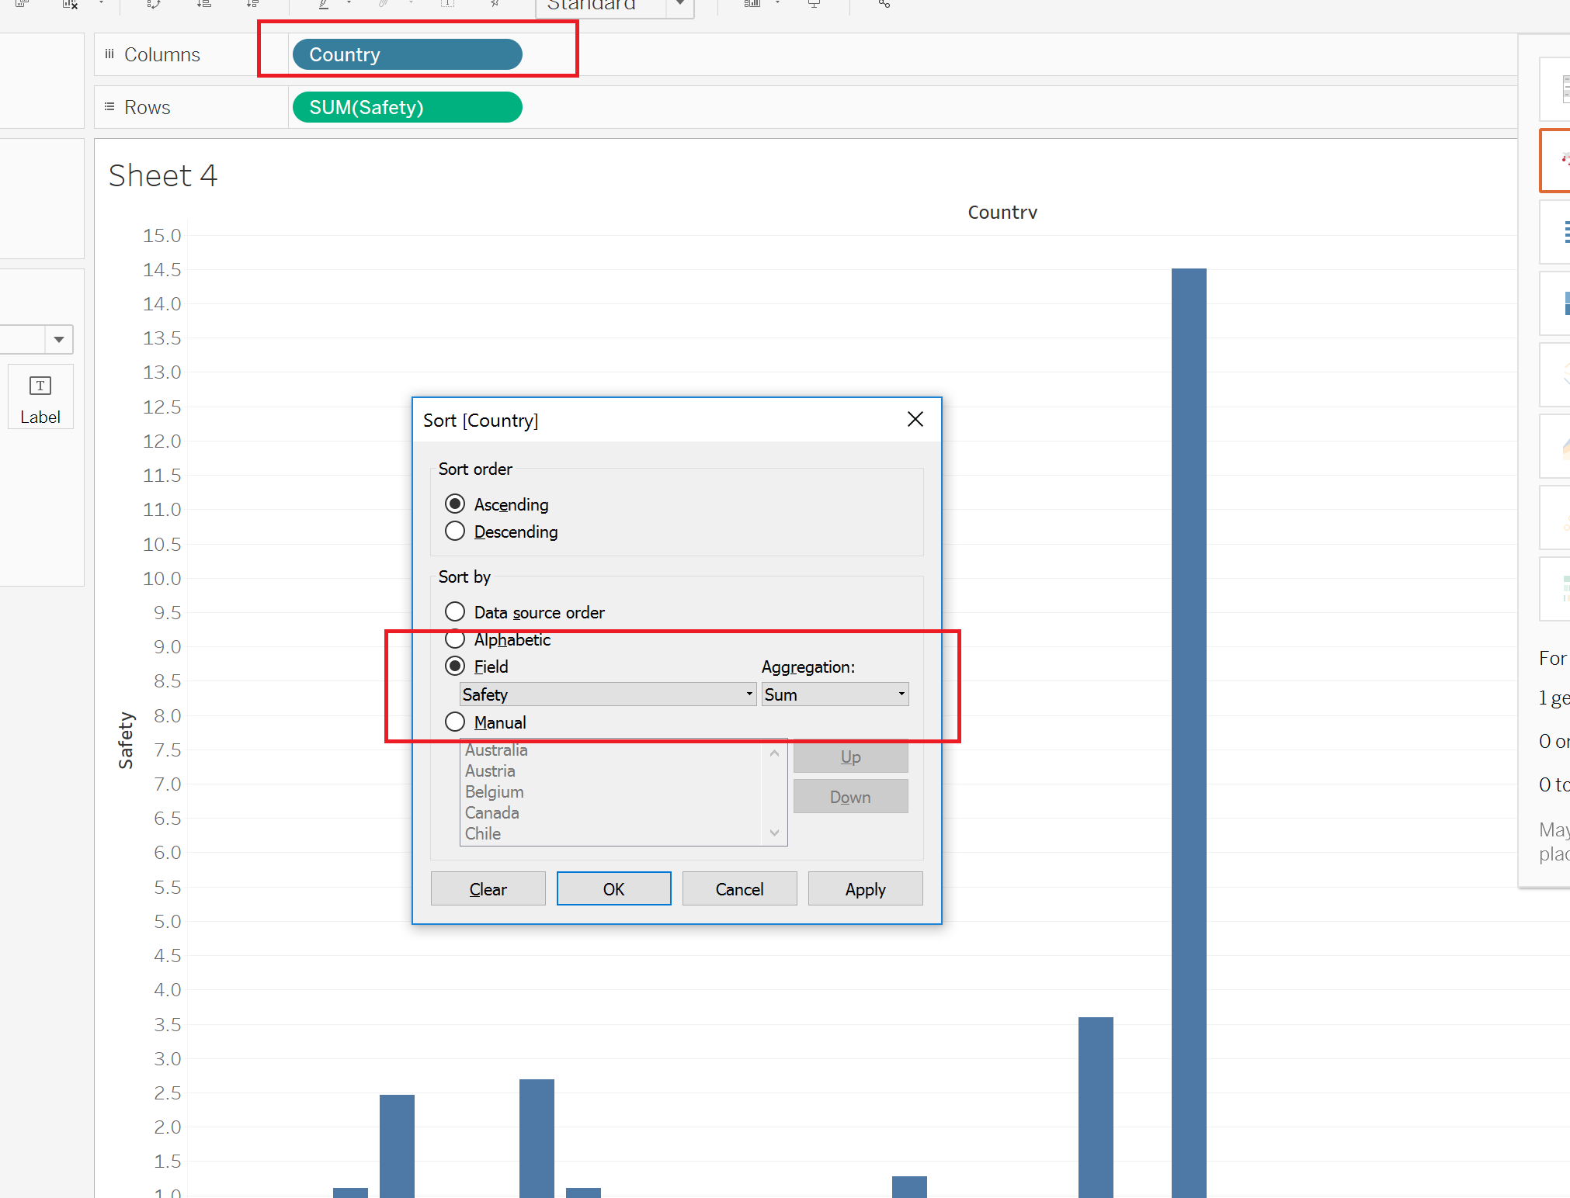
Click on dimension → Sort → Sort by field

Slide 8
Time for assignment #5!
First, discuss your 5 questions with your group!
Use both Excel and Tableau to answer the questions!
Don’t forget to add legends, titles, data labels etc. to your charts!

