Slide 1
Tutorial 7
Introduction to Tableau
Fateme Rajabiyazdi
twwun@ucalgary.ca || frajabiy@ucalgary.ca
Notes:
Tableau is a datavis and analysis tool tool used in industry
You may find it a useful tool for your assignments as you can visualize datasets or subsets of data to see how it would initially look
Lab computers here have tableau, or you could download it for free for academics for a year
We also have licensing keys that last for a year, if you have trouble validating send us an email

Slide 2
Download BetterLifeIndex.xls dataset from D2L.
Notes:
Give them a minute to do this

Slide 3
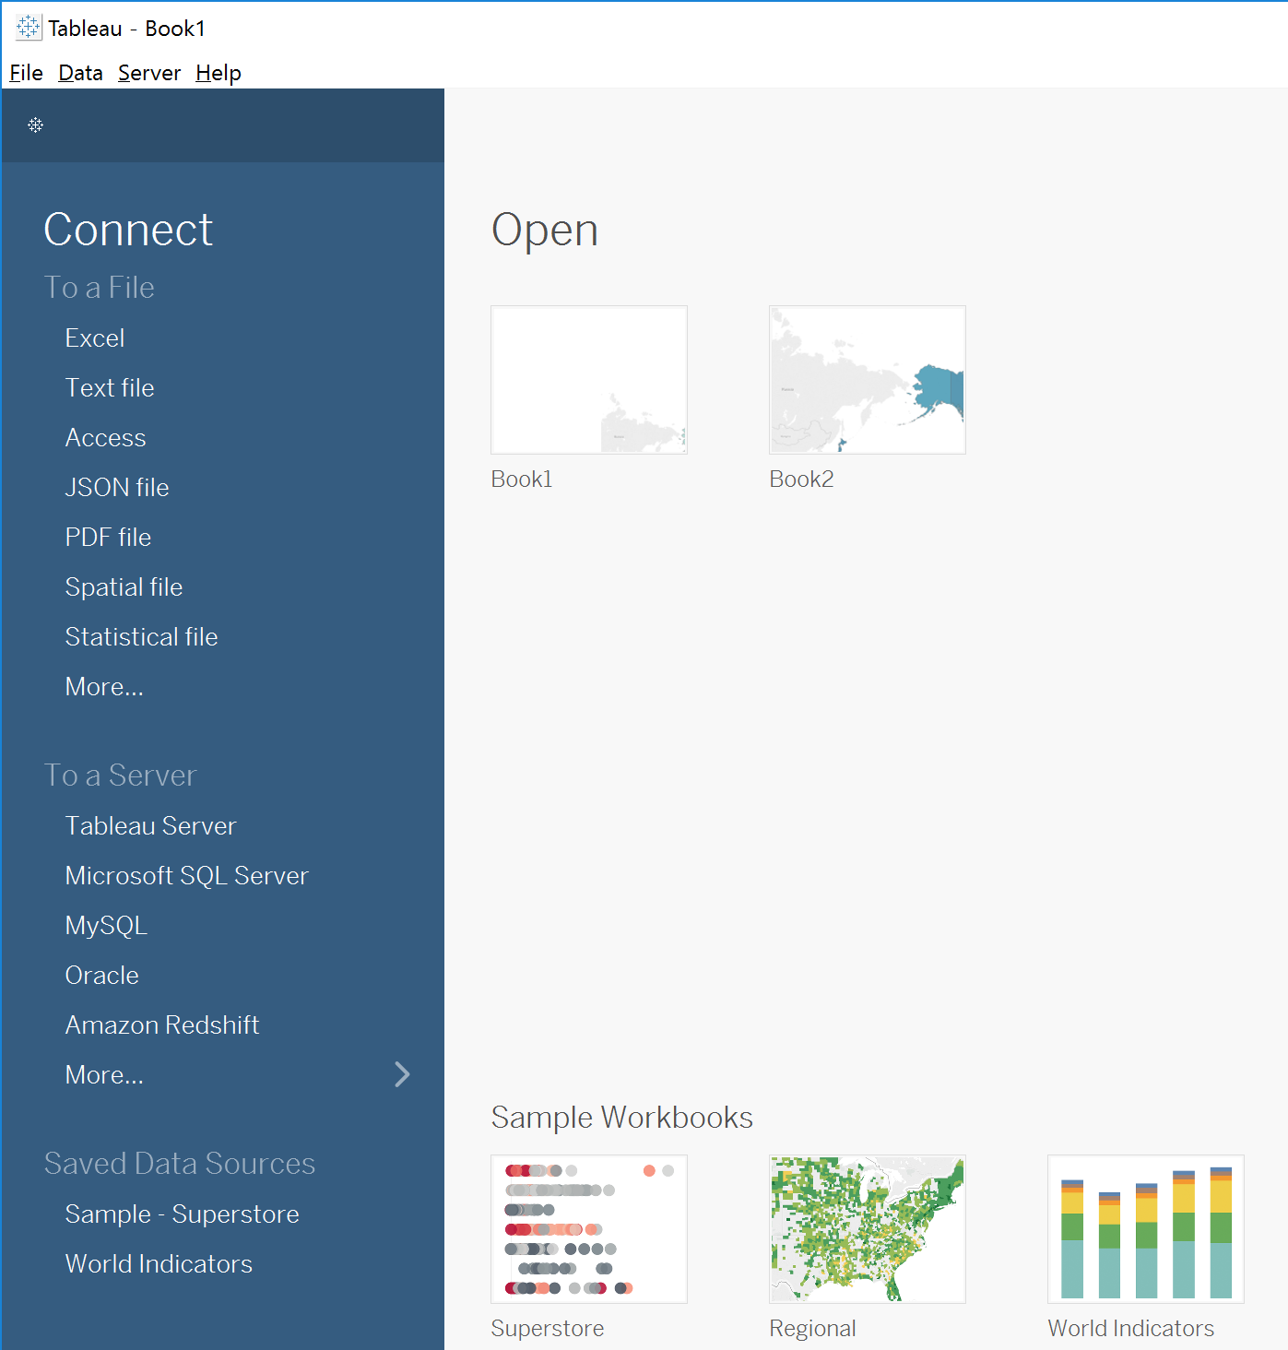
Connecting to Data
Notes:
In the Connect pane, we can see the wide variety of data sources Tableau connects to natively.

Slide 4
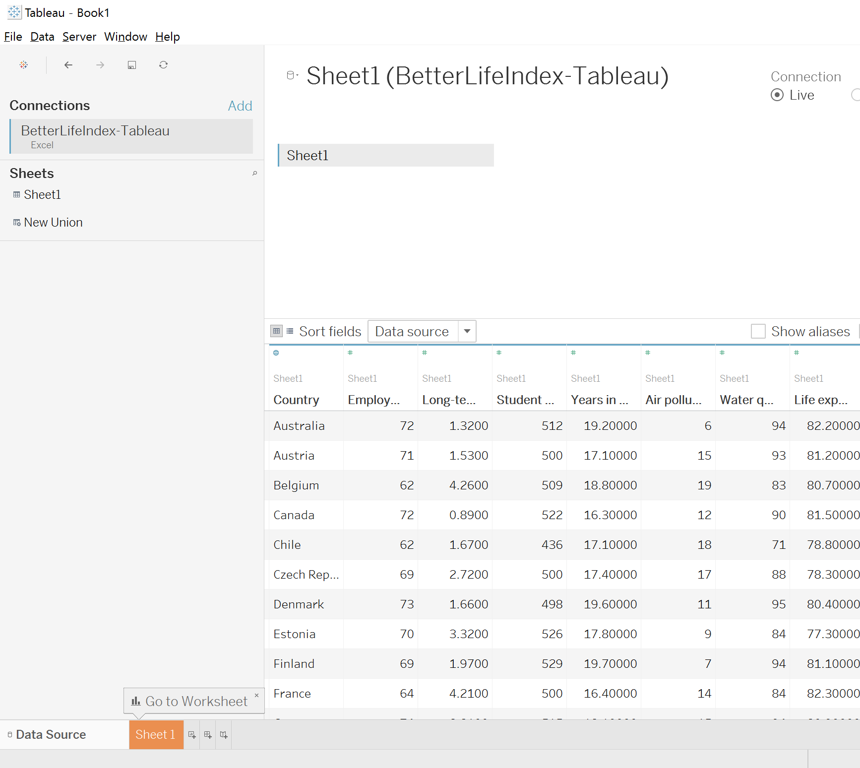
Adding File
Notes:
Alternatively, if we have related data in another data source, we can create an integrated data source by adding a connection, by clicking Add

Slide 5
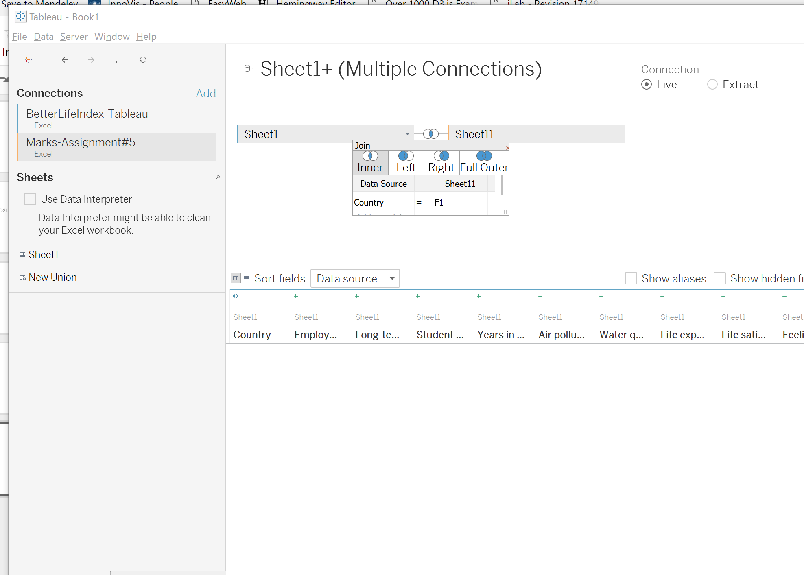
Joins & Data Preparation
Notes:
Tableau Desktop automatically creates a default join as we can see in the icon here. Clicking on the icon brings up the details of the join, and we can edit it directly.
For now, we are just going to work with one file so no need to join datasets yet!

Slide 6
Connecting Live versus Extracting
Notes:
Next, we can decide if we’d like to connect live to the data or extract it. Connecting live is great when we have constantly changing data or when we want to leverage the high performance database we’re connected to. Alternatively, we may choose to import data into Tableau’s fast data engine with an extract. This takes the data offline, and allows us to minimize performance impact critical systems, while still allowing for regular, scheduled refreshes to keep the data up to date.

Slide 7
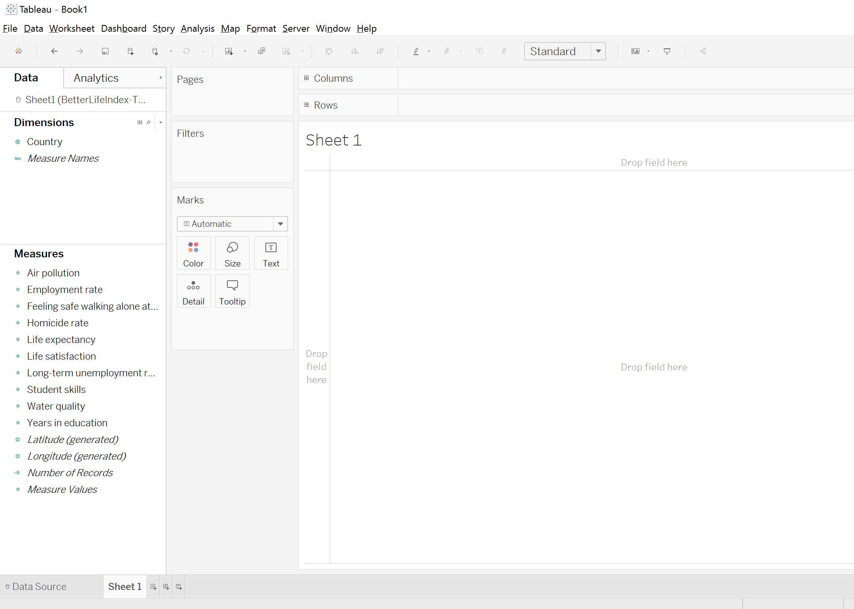
Dimensions and Measures
Notes:
We’re now connected to that data set. Let’s see how easy it is to dive into our data. We simply drag the fields out, You’ll notice that the data pane here on the left is broken up into dimensions and measures that represent the column headers in the excel sheet.

Slide 8
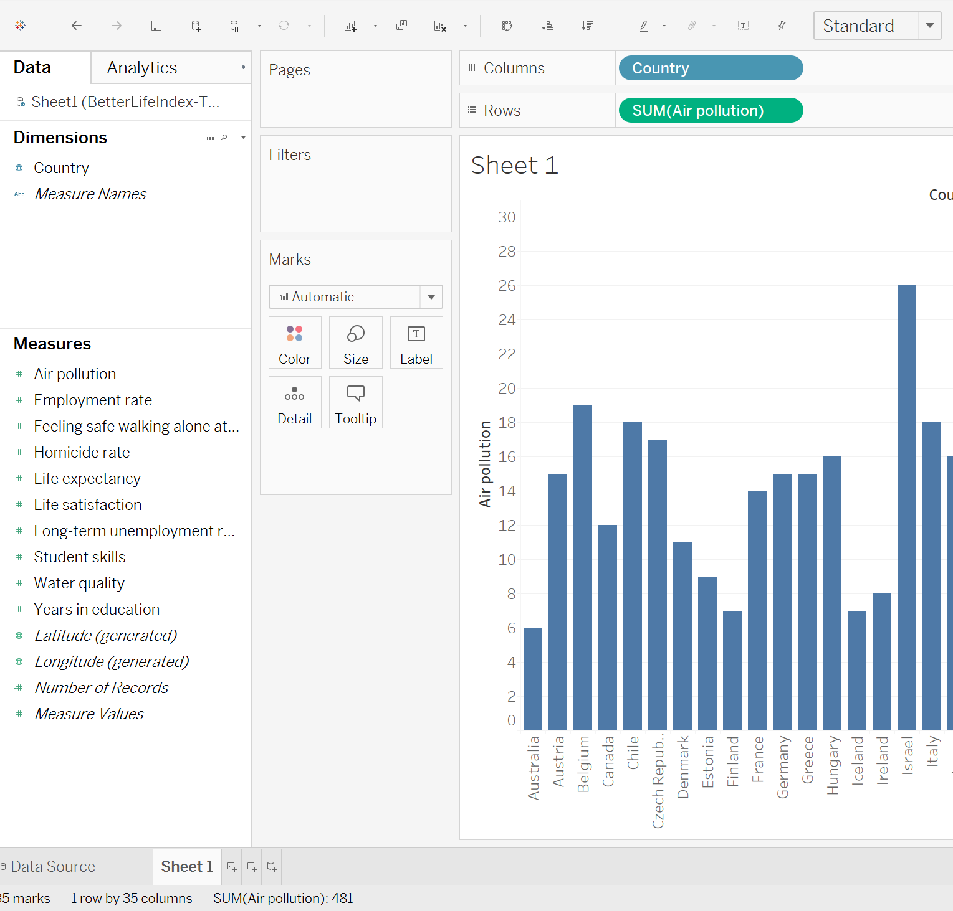
Dimensions and Measures
Notes:
USE WATER QUALITY INSTEAD
Dimensions = categories (fields to slice numbers by), measures are metrics (numbers to analyze)
What are dimensions and measures? Dimensions are categorical fields, in this case, fields such as country. These are fields that we want to slice and dice our numerical data by. Dimensions are often discrete (qualitative). Discrete fields create labels in the chart and are color coded blue in the data pane and in the view. Measures, on the other hand, are our metrics (quantitative). They are the numbers we want to analyze. Measures are often continuous. Continuous fields create axes in the chart and their pills are color coded green.
Blue = columns, green = rows
Sum is aggregated data

Slide 9
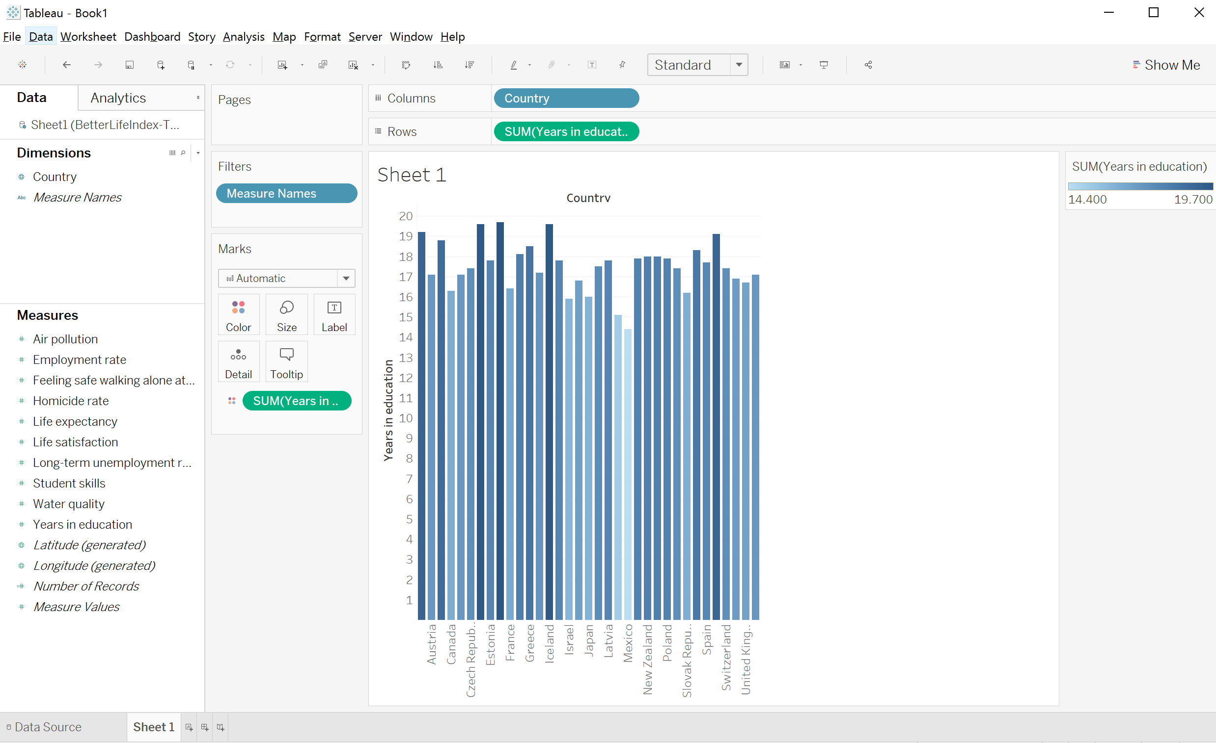
Building Views
Notes:
Now, let’s say we’re interested in number of education years per country. Then you can drag and drop years in education in Marks section into colour and you will see the bars are colour coded.
Don’t worry about measure names atm in filters

Slide 10
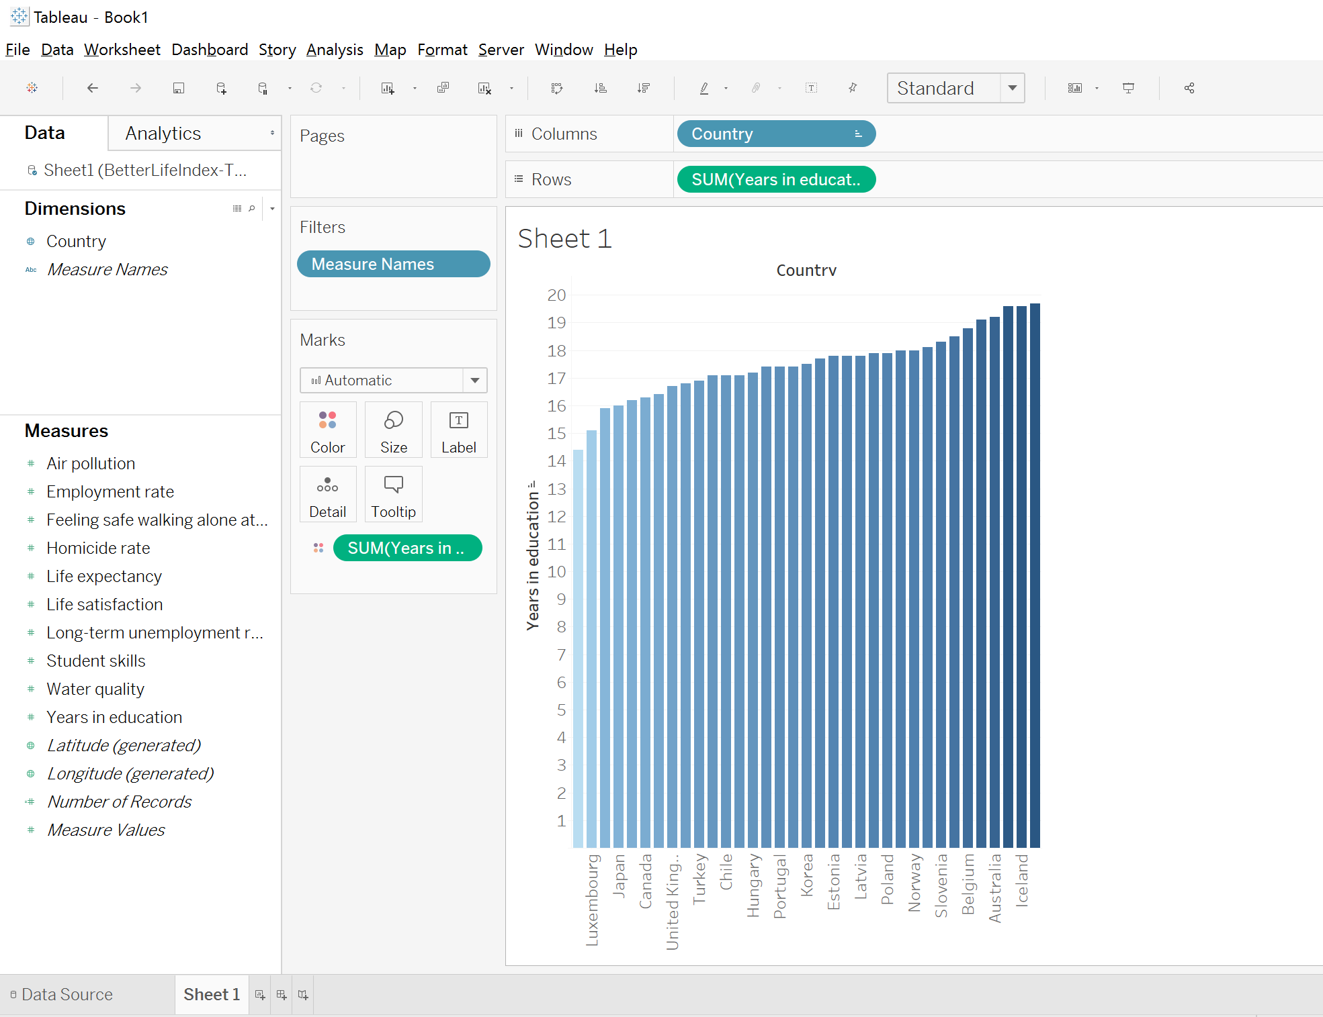
Sorting
Notes:
To see your barchart a bit more clear, lets sort the bars. Right click on the axis name (here country) then select sort ascending or descending. This way it is a bit easier to see countries with the most and the least years of education.
Sort order: asc, sort by field > water quality

Slide 11
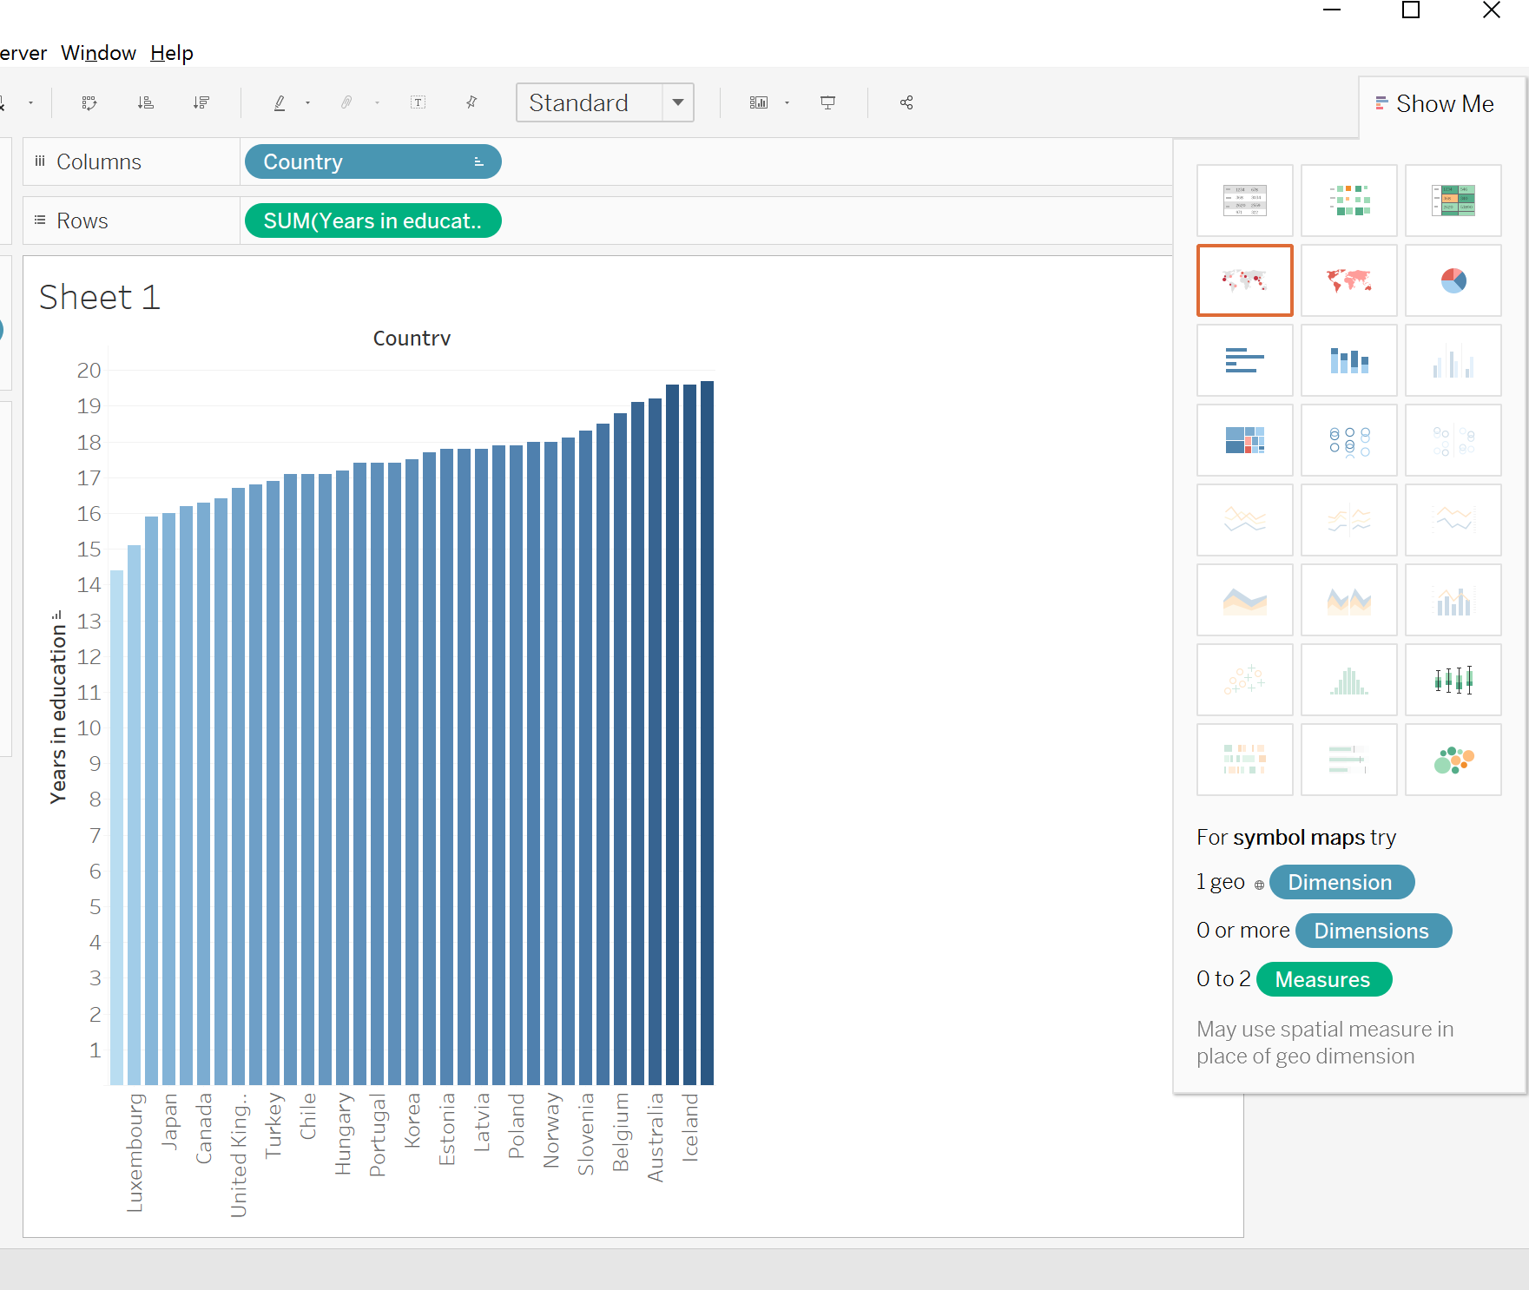
Show Me
Notes:
Tableau Desktop provides a simple tool called “Show Me” to help in cases where we know the data we want to look at, but don’t know how to create an effective view. “Show Me” contains a list of common chart types that can help you start your analysis. Let’s try and see how the map visualization will look like with our data here!

Slide 12
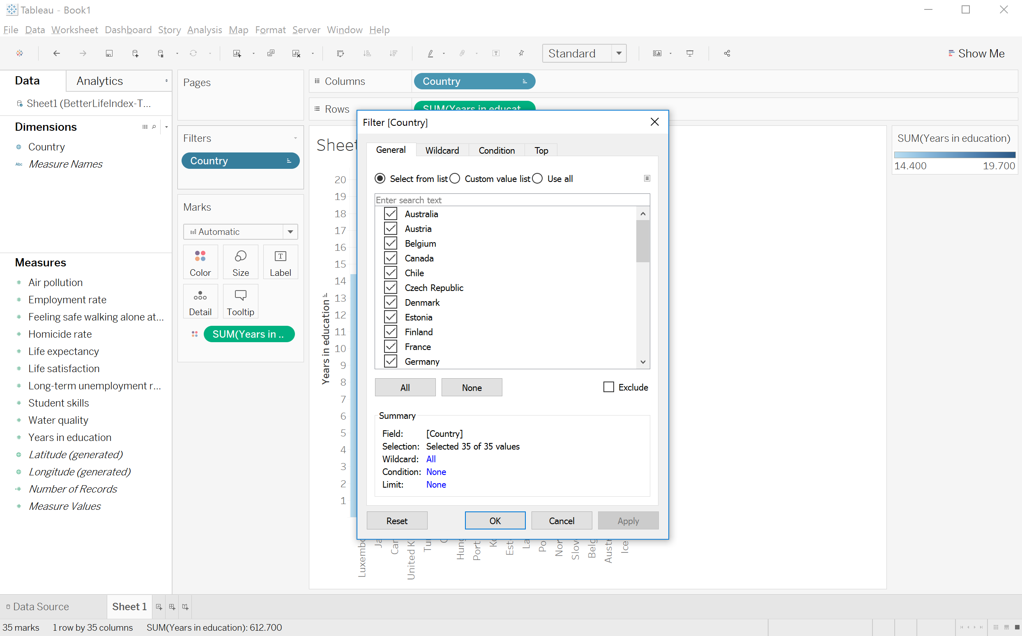
Filters
Notes:
To make this an interactive filter, we’ll right click the pill country and select “Show Filter”. We can also modify filters by selecting their drop-down menu and choosing from a variety of options.
You can also see that filters is a card in the window

Slide 13
Working with Marks
Notes:
We can assign fields on the Marks card to different roles. For instance, we can click on the color icon in front of for air pollution and change it to Label. We can bring fields directly to the label shelf.

Slide 14
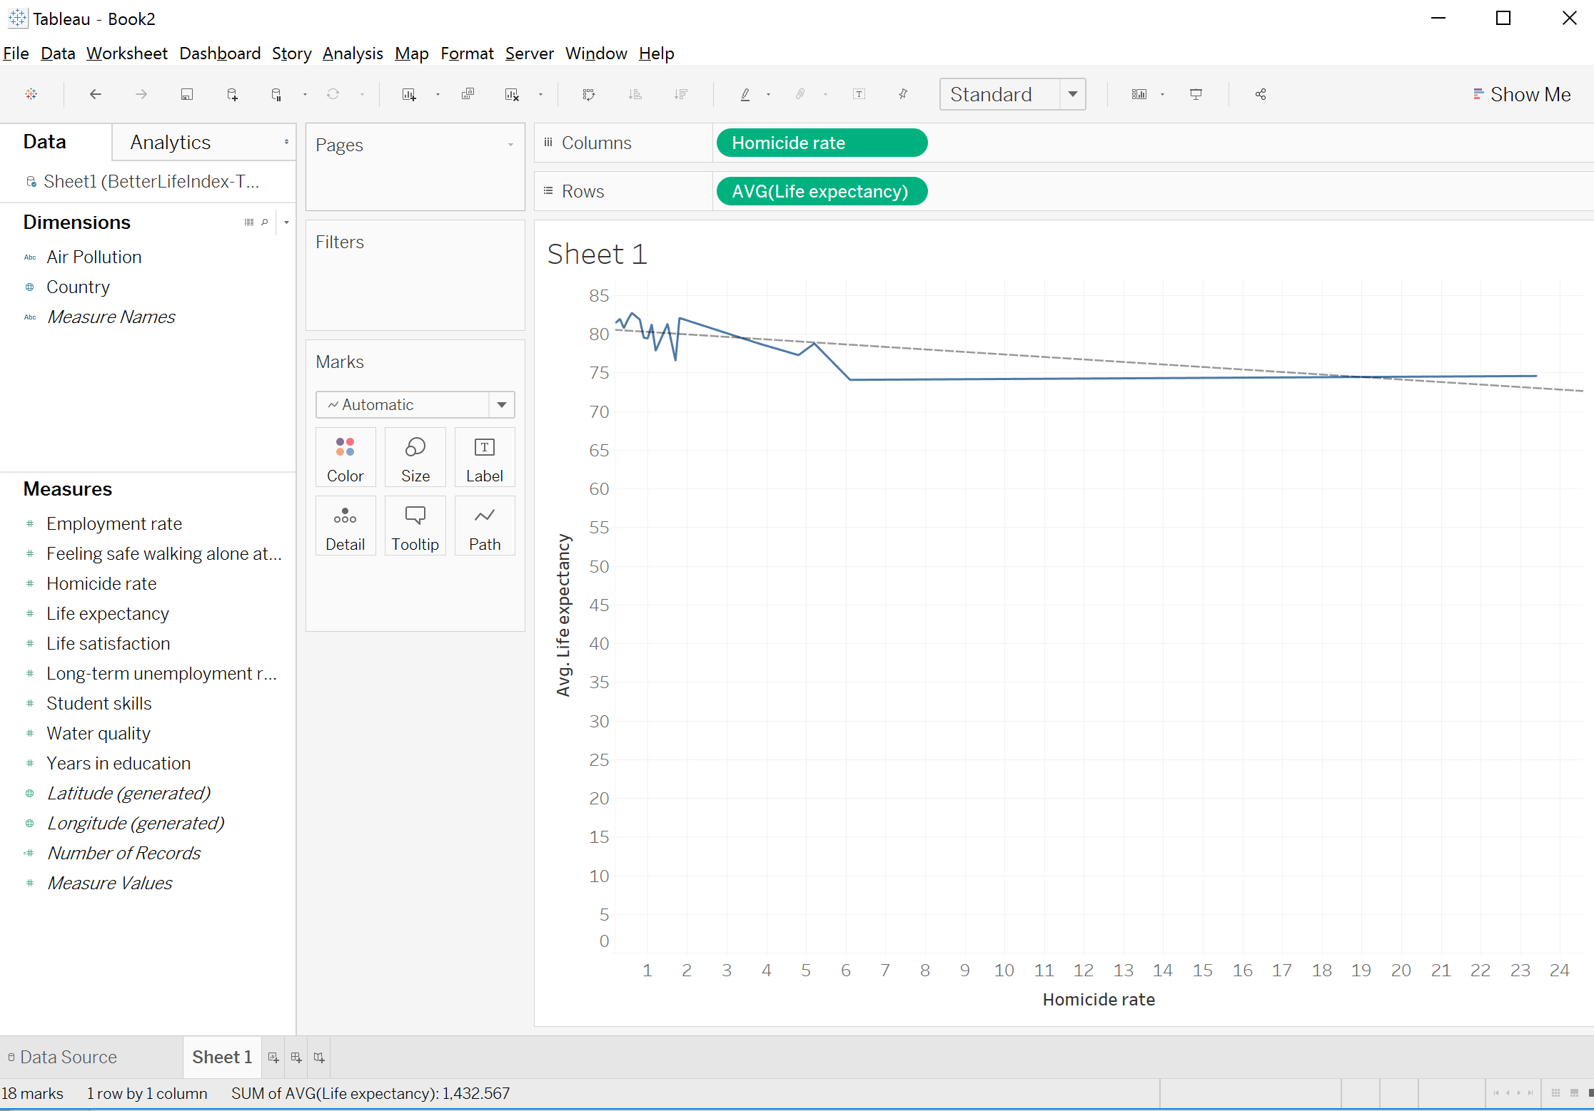
Trend Lines
Notes:
Lets see if there is a ny relation between homicide rate and life expectancy. We can do this easily from the analytics pane, selecting trend line and bringing it into the view
Change life expectancy to avg, homicide rate to dimension (marks)
(Line of best fit)

Slide 15
Dashboards
Let’s make a dashboard together!
Notes:
We’ve created some insightful views of this data set. Now, we want to share this with our team and compile a dashboard. Multiple individual views can be combined into a single dashboard. Click the new dashboard tab. All of our sheets are here to the left. Hovering brings up a preview.

Slide 16
Exercise - Use Tableau charts to show
Is there any relationship between life expectancy and life satisfaction? If yes, show the relation.
Notes:
Give students 3 minutes to finish this and let them explore Tableau
Col: life satisfaction - dimension, continuous
Row: avg life expectancy - measure(avg), continuous
Marks: label(country)
Analysis > trend lines
Attr: IF MIN([field]) = MAX([field]) THEN MIN([field]) ELSE "*" END the dimenesion becomes a label and not used to separate data

Slide 17
Exercise - Use Tableau charts to show
Is there any relation between unemployment and education?
Notes:
They can combine the factors in each column for education and for income
Give students 5-6 minutes
Column: years in education, dimensions, continuous
Rows: avg long term unemployment, continuous
Label: country
Or
Column: country
Rows: avg years in school (measure),
Filter: measure names: years in school and long term unemployment
Marks: avg long term unemployment: colors

Slide 18
Collaboration
Publish workbooks with Tableau Server or Tableau Online
Notes:
Now that we have gone from raw data to insight in this workbook, we want to think about how to distribute it to others. The most effective way to share a workbook is to publish it with Tableau Server or Tableau online. Published workbooks are fully interactive, up-to-date, secure, and can be accessed by browser or mobile app. To publish, open the Server menu and select Publish Workbook. We could also choose to publish the data source, if we only want to publish the data itself for others to use

Slide 19
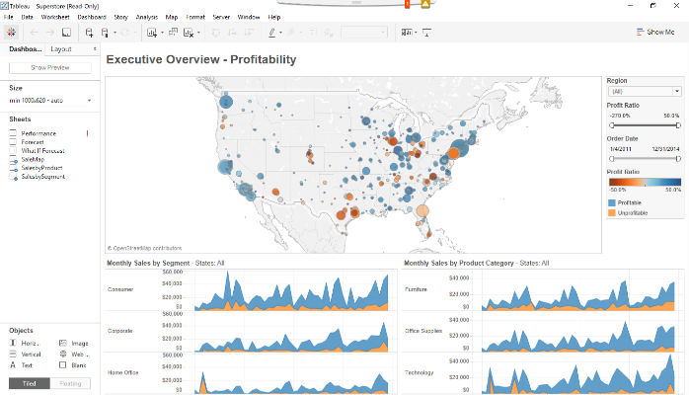
Story Points
Notes:
What if want to lead our audience through the path of our discovery of these profitability issues? Tableau Desktop offers a feature called Story Points that lets you assemble a series of specific views to walk the audience through an analysis. We can build a story by clicking the New Story tab. I’ll make mine size to automatic. Just like with a dashboard, we can bring in any visualizations we’d previously made.

Slide 20
Useful Links
http://onlinehelp.tableau.com/current/guides/get-started-tutorial/en-us/get-started-tutorial-home.html
Tableau tutorial

