Slide 1
Tutorial 13
Parallel coordinate and Rubber Banding
Fateme Rajabi
twwun@ucalgary.ca || frajabiy@ucalgary.ca

Slide 2
TODAY
Rubber Banding
Parallel Coordinate

Slide 3
Rubber Banding

Slide 4
Rubber Band Selection
Allows multiple items to be selected by defining an area with the mouse.
When selected, the Mouse pointer is displayed as cross hairs.
Clicking and dragging the mouse defines the selected area in grey.
Once confirmed the selected items are highlighted.
Notes:
Allows multiple items to be selected by defining an area with the mouse.
When selected, the Mouse pointer is displayed as cross hairs.
Clicking and dragging the mouse defines the selected area in grey.
Once confirmed the selected items are highlighted.
Same as brushing, which is to select a 2D area with the mouse (
Rubberbanding defines selection in an area (like a square - stretching out a rubber band)

Slide 5
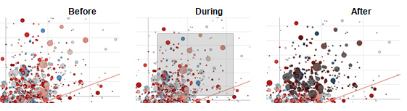

Slide 6
Rubber Band Zoom
Works in a similar manner to Rubber Band Selection.
When selected, the mouse pointer is displayed as a magnifying glass.
Clicking and dragging the mouse defines the zoomed area in grey.
Once confirmed the zoom occurs, and scroll bars are added to the visualization.
Notes:
Works in a similar manner to Rubber Band Selection.
When selected, the mouse pointer is displayed as a magnifying glass.
Clicking and dragging the mouse defines the zoomed area in grey.
Once confirmed the zoom occurs, and scroll bars are added to the visualization.

Slide 7
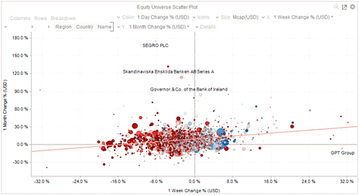
Before

Slide 8
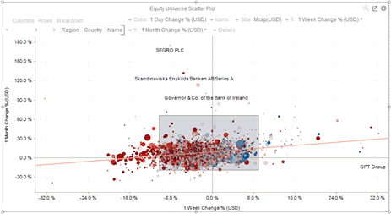
During
Notes:
Mouse pointer has been dragged to define an area of interest.

Slide 9
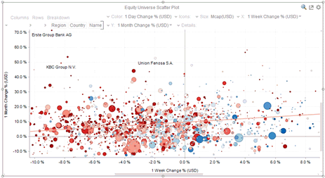
After
Notes:
Visualization is zoomed into the defined area.
Example: https://bl.ocks.org/mbostock/f48fcdb929a620ed97877e4678ab15e6

Slide 10
Parallel Coordinate

Slide 11
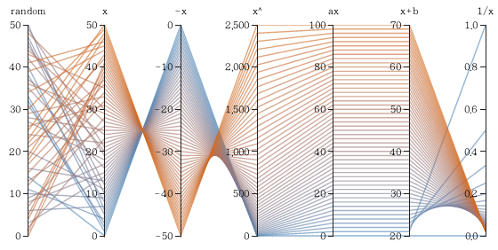

Slide 12
To show a set of points in an n-dimensional space, a backdrop is drawn consisting of n parallel lines, typically vertical and equally spaced.
Notes:
Parallel coordinate is used to show …
https://bl.ocks.org/jasondavies/1341281
VAST CHALLENGE:
http://vacommunity.org/VAST+Challenge+2017
Composite dataset
Dataset for obesity from:
https://catalog.data.gov/dataset/nutrition-physical-activity-and-obesity-behavioral-risk-factor-surveillance-system
Obesity Poverty - Obesity % seems to be a random value in that state in the next sheet for most values

Slide 13
USEFUL LINKS
http://docs.datawatch.com/designer/desktop/Interacting_with_Visualizations.htm
Interaction with visualization
http://bl.ocks.org/eesur/1a2514440351ec22f176
https://bl.ocks.org/jasondavies/1341281
Parallel coordinate with D3
https://bl.ocks.org/mbostock/f48fcdb929a620ed97877e4678ab15e6
Rubber banding + Zoming
https://catalog.data.gov/dataset/nutrition-physical-activity-and-obesity-behavioral-risk-factor-surveillance-system
CDC Obesity Dataset
http://vacommunity.org/VAST+Challenge+2017
VAST Student Competition Challenges

