Slide 1
More exercises with C#
Fateme Rajabi
#W6

Slide 2
Add an image to your project
Right click on your project name in solution explorer
Add -> Existing item -> browse and pick your image -> Ok
It will appear in the solution explorer

Slide 3
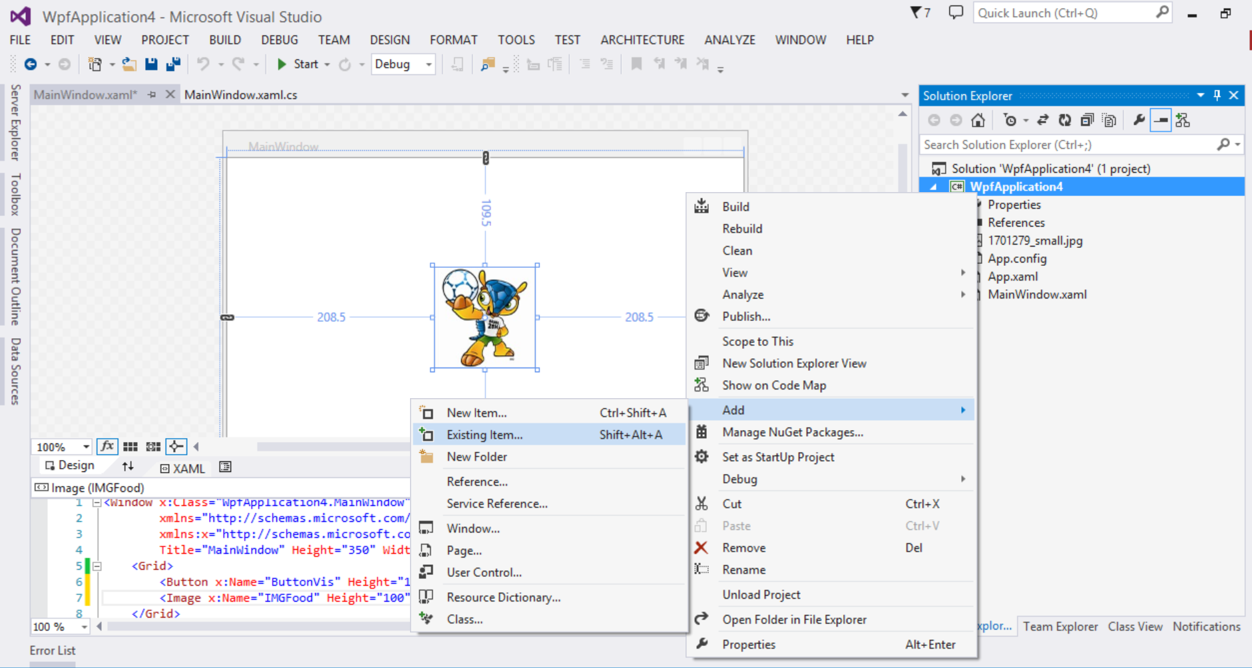
Add an image to your project
Notes:
Right click on your project name in solution explorer
Add -> Existing item -> browse and pick your image -> Ok
It will appear in the solution explorer

Slide 4
Now add img to XAML
Use <Image> tag
Set the properties: width, height, …
For defining your Img source
Press F4
Go to Common

Slide 5
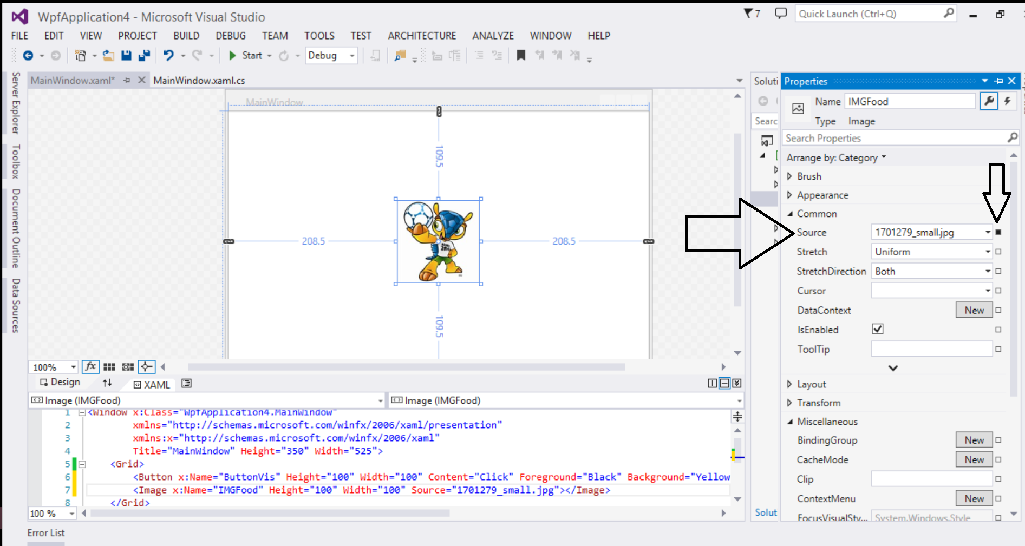
Click on square on the left side of source

Slide 6
Image tag - XAML
This is what visual studio will create:
<Image x:Name="IMGFood" Height="100" Width="100" Source=“img_small.jpg"></Image>

Slide 7
Visibility
This property is useful specially for creating pop up windows
All WPF controls have this property
It has three values:
Collapse
Hidden
Visible

Slide 8
Exercise
Import an image to your project and create a button that hides the image once it is clicked

Slide 9
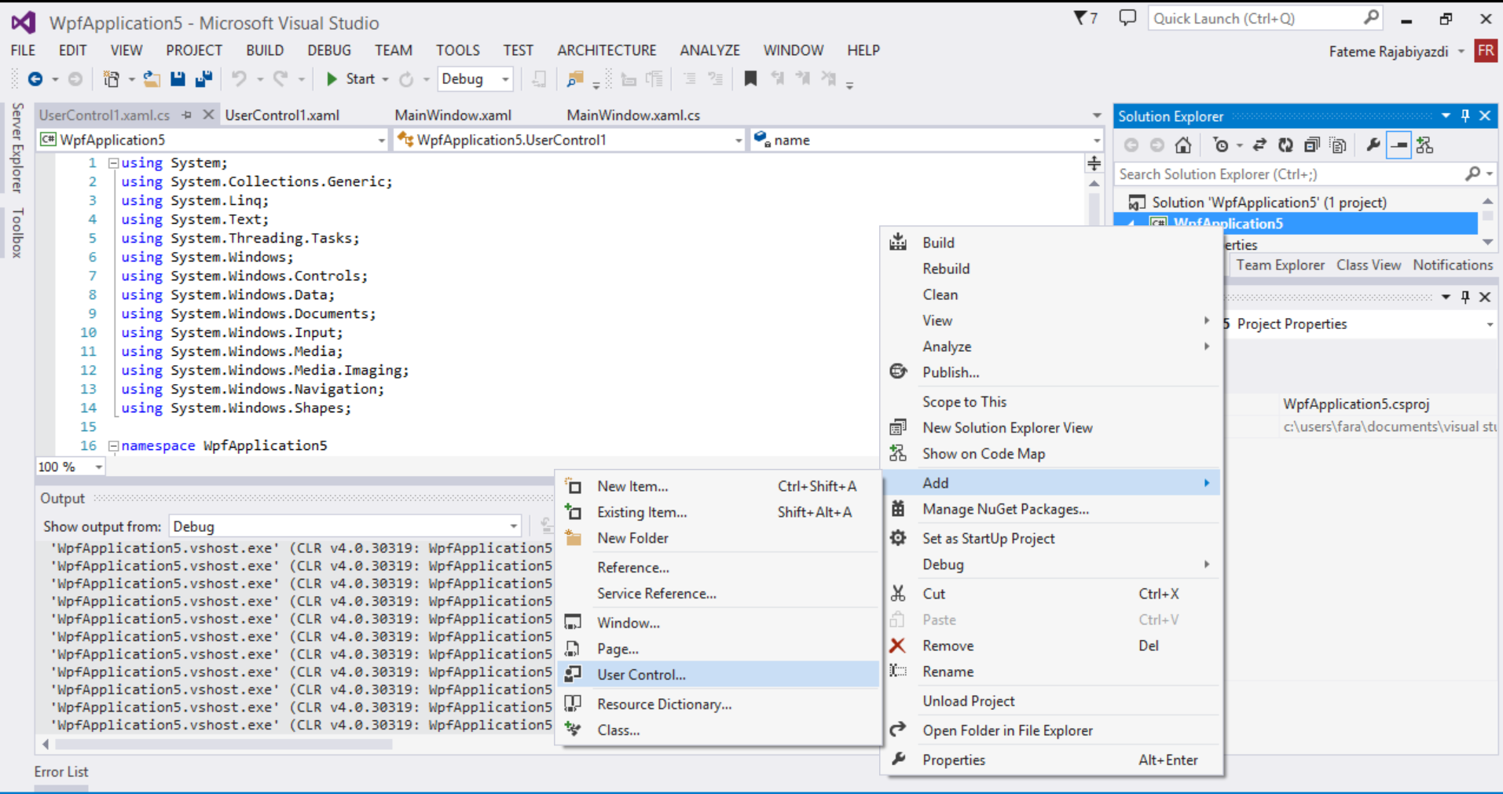
User Control
Creating Your Own Controls vs. Using Microsoft Controls

Slide 10
Exercise
Show 20 Emails containing
Sender name
Sender Image
Body of Email – text
Remove button

Slide 11
Solution – UIControl.xaml
<UserControl x:Class="WpfApplication5.UserControl1"
xmlns="http://schemas.microsoft.com/winfx/2006/xaml/presentation"
xmlns:x="http://schemas.microsoft.com/winfx/2006/xaml"
xmlns:mc="http://schemas.openxmlformats.org/markup-compatibility/2006"
xmlns:d="http://schemas.microsoft.com/expression/blend/2008"
mc:Ignorable="d" Height="157" Width="623">
<Grid>
<Grid.ColumnDefinitions>
<ColumnDefinition Width="389*"/>
<ColumnDefinition Width="234*"/>
</Grid.ColumnDefinitions>
<Ellipse Fill="#FFF4F4F5" HorizontalAlignment="Left" Height="89" Margin="23,32,0,0" Stroke="Black" VerticalAlignment="Top" Width="89"/>
<Label x:Name="SenderTextblock" Content="Sender" HorizontalAlignment="Left" Height="42" Margin="127,32,0,0" VerticalAlignment="Top" Width="417" Grid.ColumnSpan="2"/>
<Label Content="Body of the email" HorizontalAlignment="Left" Height="42" Margin="127,62,0,0" VerticalAlignment="Top" Width="417" Grid.ColumnSpan="2"/>
<Canvas x:Name="DeleteGroup" Margin="364,12,209,95" Grid.ColumnSpan="2">
<Ellipse Fill="#FFB61D1D" HorizontalAlignment="Left" Height="50" Stroke="Black" VerticalAlignment="Top" Width="50"/>
<Label Content="X" HorizontalAlignment="Left" Height="50" VerticalAlignment="Top" Width="40" FontSize="24" FontWeight="Bold" Canvas.Left="10" Foreground="White"/>
</Canvas>
</Grid>
</UserControl>

Slide 12
using System;
using System.Collections.Generic;
using System.Linq;
using System.Text;
using System.Threading.Tasks;
using System.Windows;
using System.Windows.Controls;
using System.Windows.Data;
using System.Windows.Documents;
using System.Windows.Input;
using System.Windows.Media;
using System.Windows.Media.Imaging;
using System.Windows.Navigation;
using System.Windows.Shapes;
namespace WpfApplication5
{
public partial class UserControl1 : UserControl
{
private string name;
public string Name
{
get { return name; }
set { name = value; this.SenderTextblock.Content = this.name;} }
public UserControl1()
{
InitializeComponent();
this.DeleteGroup.MouseLeftButtonDown += DeleteGroup_MouseLeftButtonDown;
}
void DeleteGroup_MouseLeftButtonDown(object sender, MouseButtonEventArgs e)
{
(this.Parent as Panel).Children.Remove(this);
}
}
}

Slide 13
MainWindow.xaml
<Canvas>
<ScrollViewer Height="200">
<StackPanel Name="Emails" Height="800" Width="600"/>
</ScrollViewer>
</Canvas>

Slide 14
MainWindow.cs
public MainWindow()
{
InitializeComponent();
for(int i = 0; i < 20; i++)
{
UserControl1 email = new UserControl1();
email.Name = "Pedro " + i.ToString();
this.Emails.Children.Add(email);
}
}

