Slide 1
Expression Blend Animation

Slide 2
How to create an animation?
→New Project
Choose WPF
→ Name it and Hit Ok

Slide 3
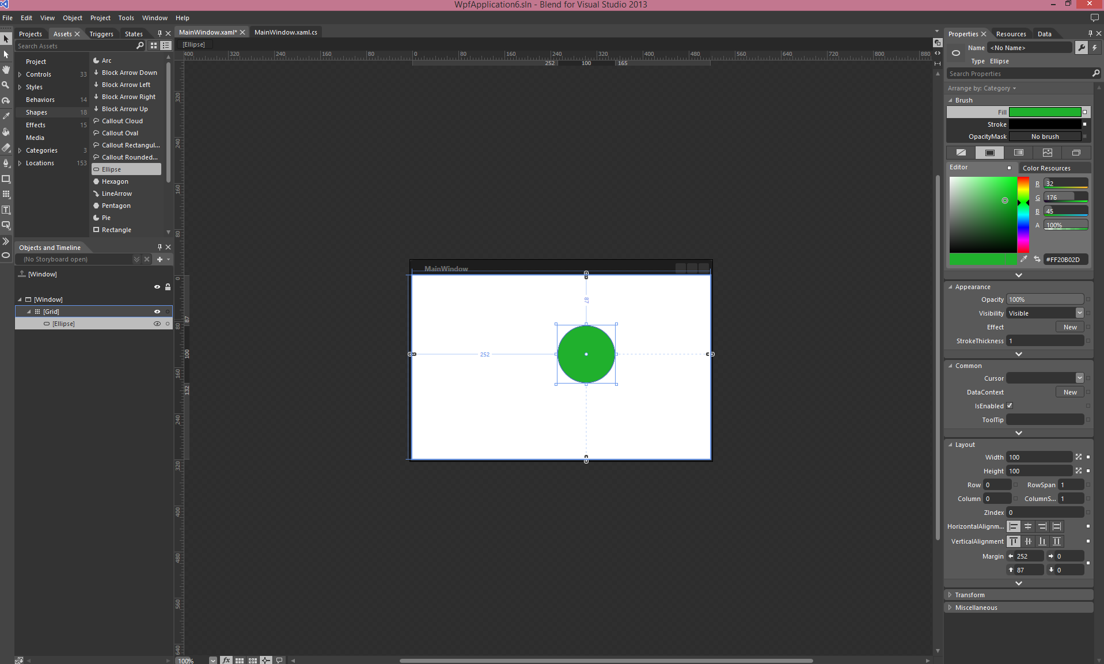
Assets → Shape → Ellipse

Slide 4
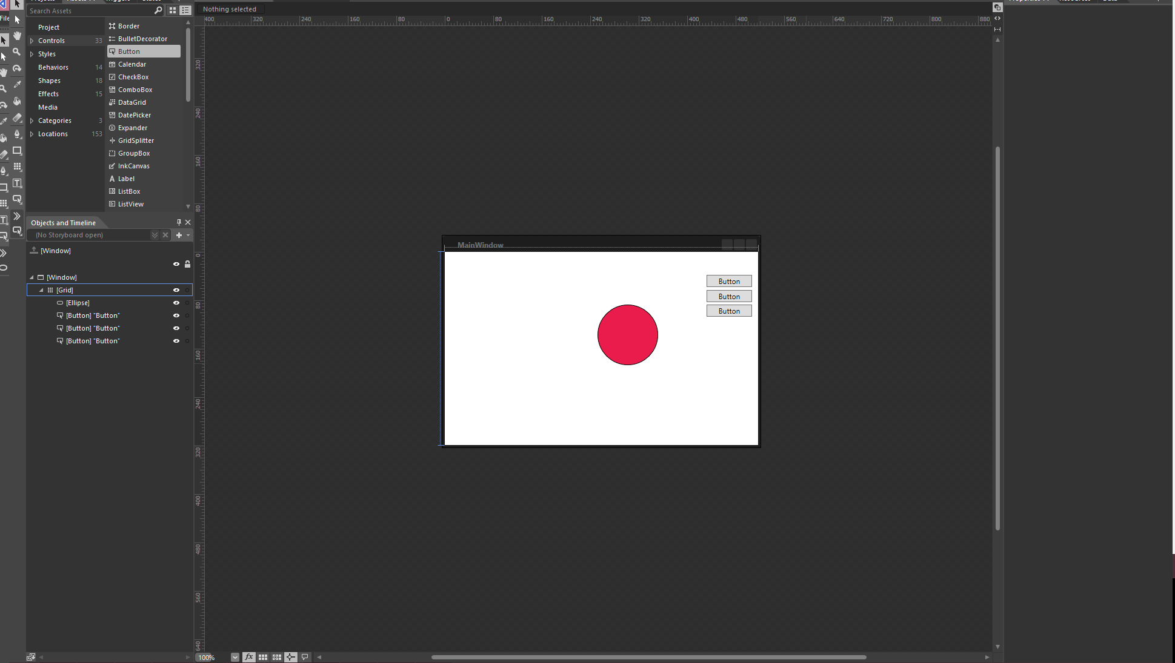
Assets→ Control → Button
Notes:
Note: Create 3 buttons

Slide 5
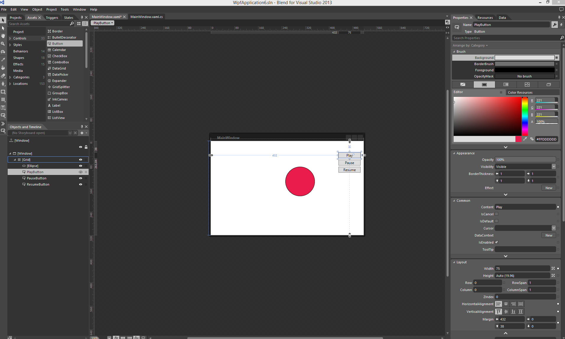
Name the Buttons & Change their Content

Slide 6
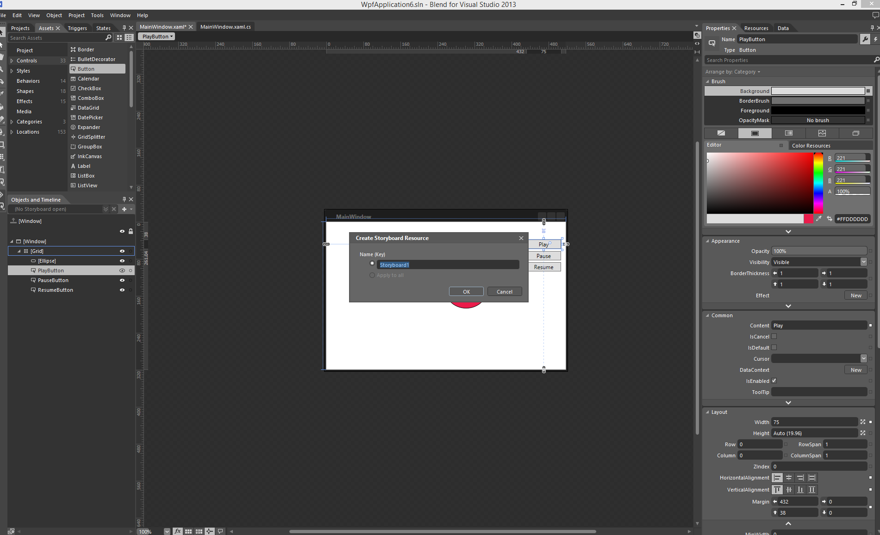
Click on + →Create Storyboard

Slide 7
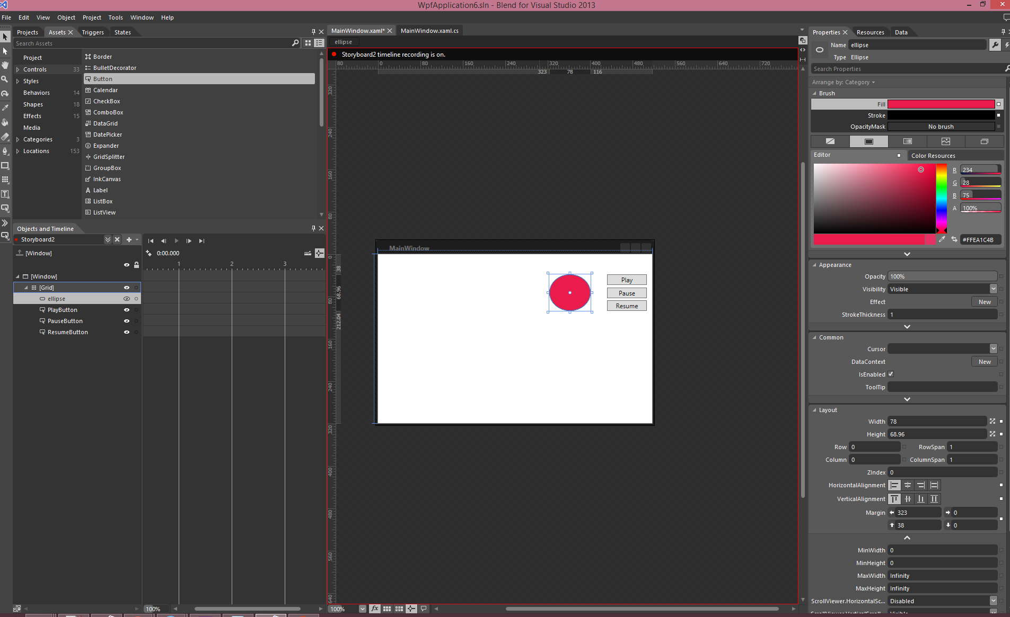
See Key Frame Editor
Notes:
You will see a Play

Slide 8
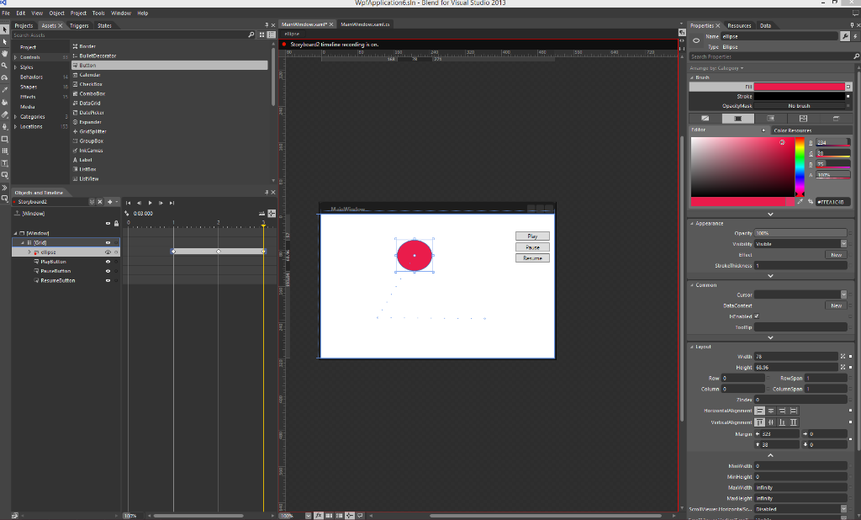
Animate
1. Click on the yellow line
2. Move it to the next step (step #1) – 1 second
3. Animate the circle
4. Repeat 1-3 for the rest of the animation

Slide 9
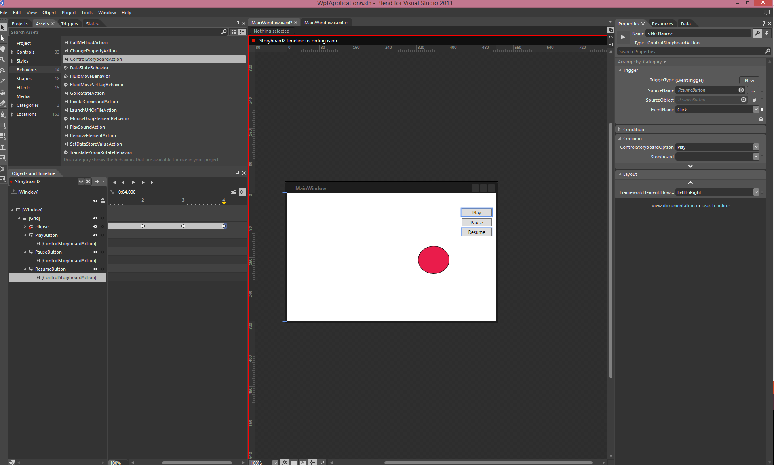
Assets → Behavior
Drag “ControlStoryboardAction” and Drop it on all three buttons one by one.

Slide 10
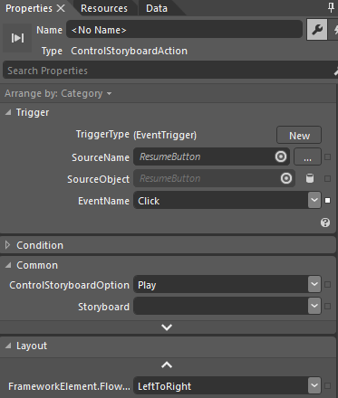
Go to Properties -> Common -> select your button
In the common section -> select Play for play button, Pause for pause button & Resume for resume button
Make sure you have selected your storyboard
storyboard1

Slide 11
Run the project
Press F5 or
Go to Project -> Run Project
Let the ball play once
Play another time, try Pause & Resume buttons

Slide 12
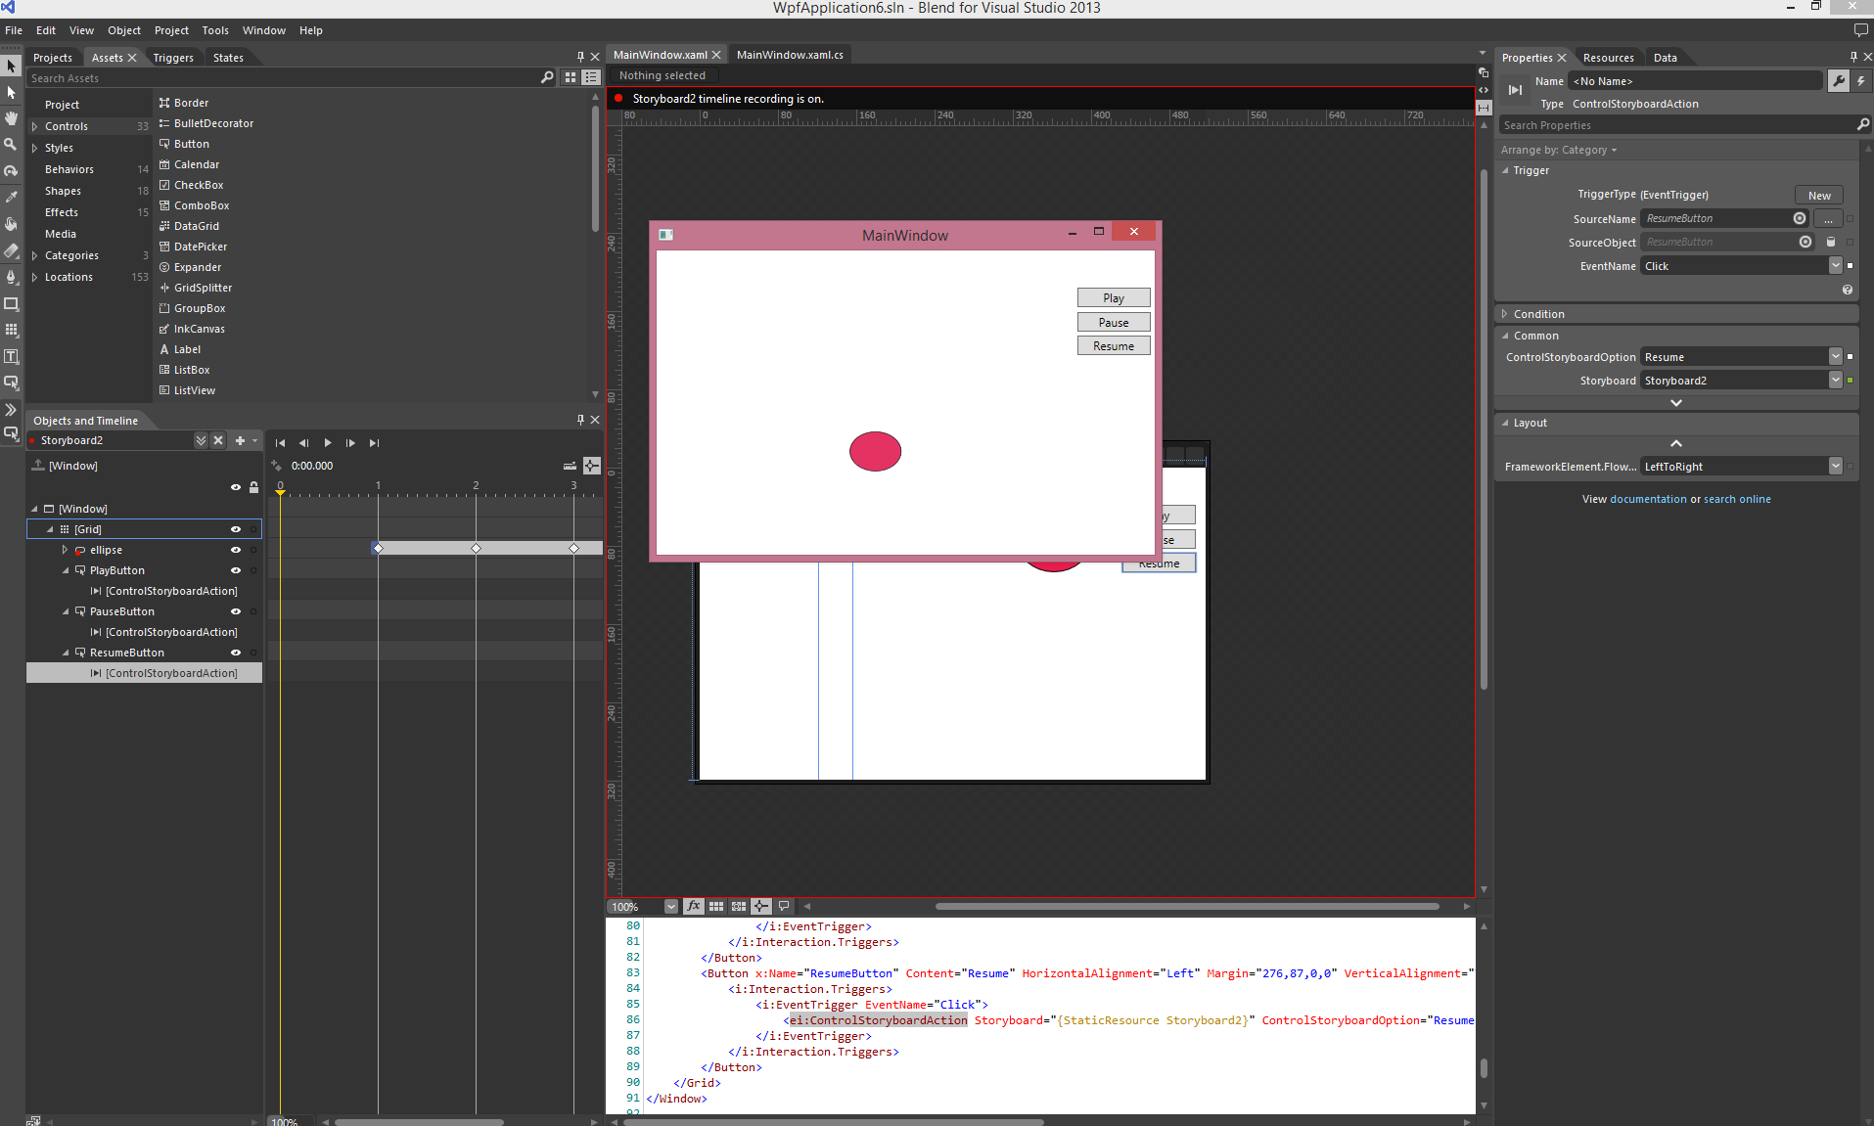
MainWindow View

