Slide 1
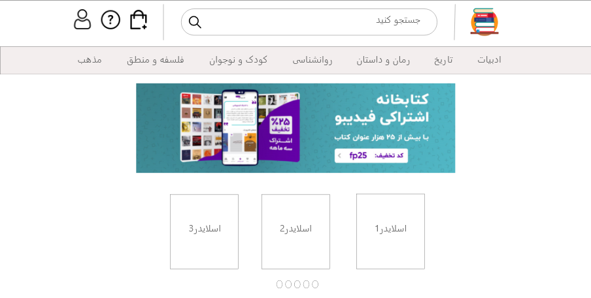

Slide 2
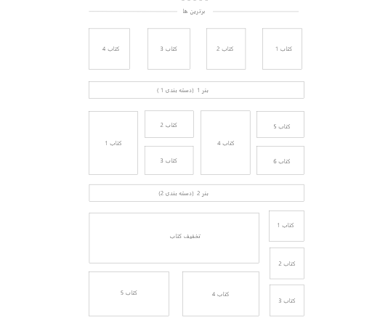
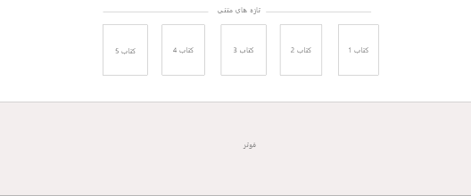

Slide 3
Admin panel
Home
50
کاربران ثبت شده
60
سفارشات
44
کتاب های فروخته شده
120000
درامد
customers
books
orders
تخفیفات
invoice
Invoice line

Slide 4
Book_Store
Book_store
Asgi.py
Settings.py
Urls.py
Wsgi.py
Template
Static
Css
Js
Main.css
Main.js
Base.html
Index.html
Assert
Books
Payment
User
Migrations
views.py
url.py
Tests.py
Admin.py
Models.py
Form.py
Migrations
views.py
url.py
Tests.py
Admin.py
Models.py
Form.py
Migrations
views.py
url.py
Tests.py
Admin.py
Models.py
Form.py
Managers.py

