Slide 1


Analyzing Healthcare Call Patterns During Emergencies
BDA 602 Statistics for Business Analytics
Muhammad - Yasir
Fatemeh - Shenavar
Piyush - Chowhan

Slide 2

Agenda
Introduction
Data Collection Details
Descriptive Analysis
Hypothesis Test Results
Regression Models
Business Implications
Discussion & Recommendations
References

Slide 3
Introduction
Research Question:
Analyze call volume, service requests (doctor/ambulance), and trends during emergencies.
Relevance and Significance:
Optimize resource allocation during crises (e.g., COVID-19).
Expected Impact:
Improve staffing, reduce bottlenecks, enhance patient satisfaction.

Slide 4
Data Overview
Source:
Kaggle dataset (Healthcare Call Data During Emergency Times).
Variables:
Total calls, doctor consultations, complaints, health information, service inquiries.
Limitations:
Extreme spikes during COVID-19 (e.g., June 2020: 2.3M calls).
No missing data but high variability.

Slide 5
Data Overview
Summary Statistics Table
Variable | Minimum | Maximum | Mean | Std_Dev
Total Number of Calls | 51,432 | 2,329,457 | 234,031.626 | 369,700.08
Total Number of Doctors Consultancy | 38,162 | 1,703,100 | 154,455.346 | 268,135.14
Number of Total Health Information | 3,010 | 173,306 | 15,714.729 | 23,104.17
Number of Total Ambulance Information | 220 | 91,751 | 9,240.318 | 15,330.68
Number of Total Complaints | 77 | 59,760 | 6,924.458 | 10,484.20
Number of Calls To Know About The Service | 4,075 | 34,2434 | 47,509.103 | 61,227.80

Slide 6
Descriptive Analysis
Summary Statistics:
Mean total calls: 234,031.626; SD: 369,700.08 (high variability).
Peak Demand:
June (~398K calls).
April–May (~344K calls).
Trough:
November–December (~130K calls).

Slide 7
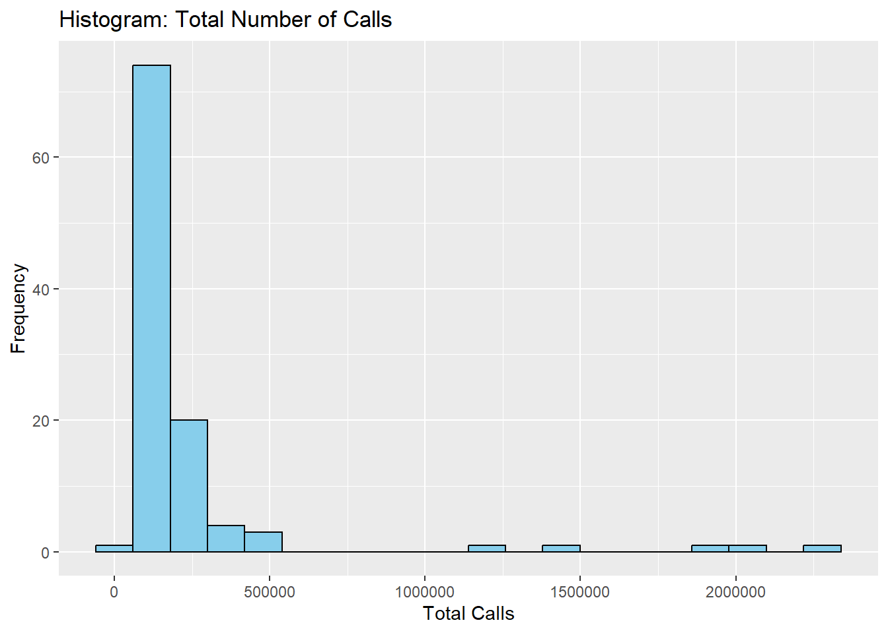
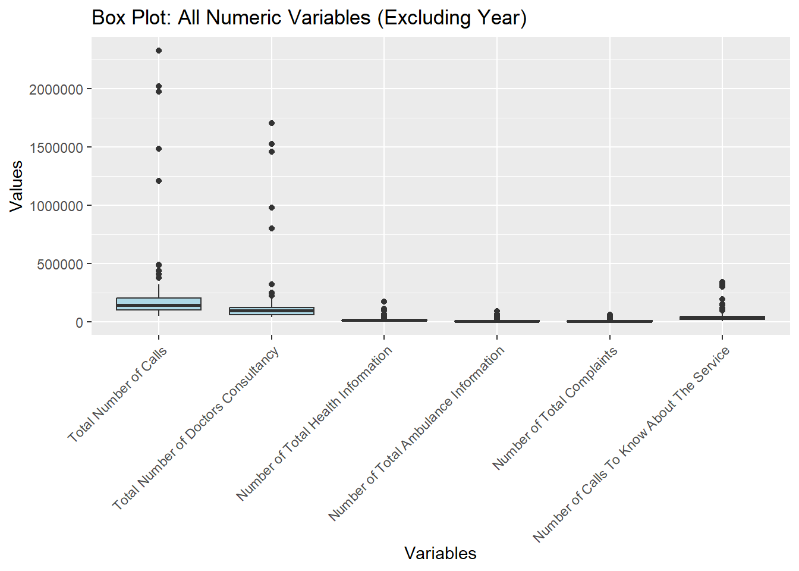
Descriptive Analysis
Histogram: The distribution of total call volumes is right-skewed, meaning most months had <500K calls, but rare surges exceeded 1.5M (likely during COVID-19). It confirms extreme variability in demand, with occasional massive spikes. Aligns with the report’s findings of pandemic-driven surges (e.g., June 2020: 2.3M calls).
Boxplot: Doctor Consultancy has the widest IQR (Interquartile Range), indicating the highest variability among services.

Slide 8
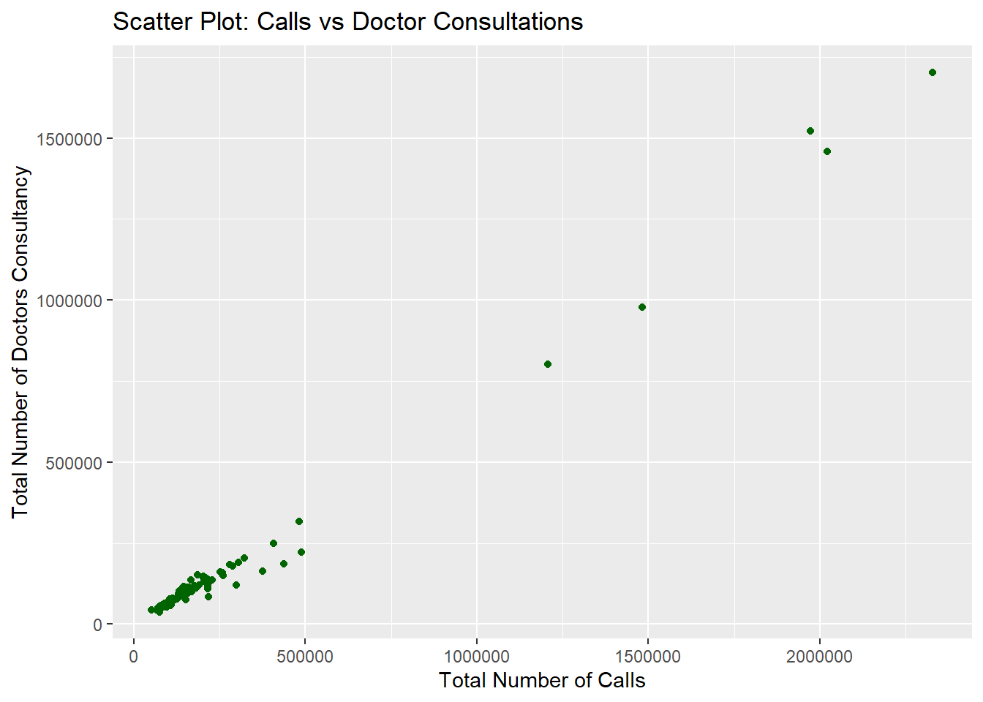
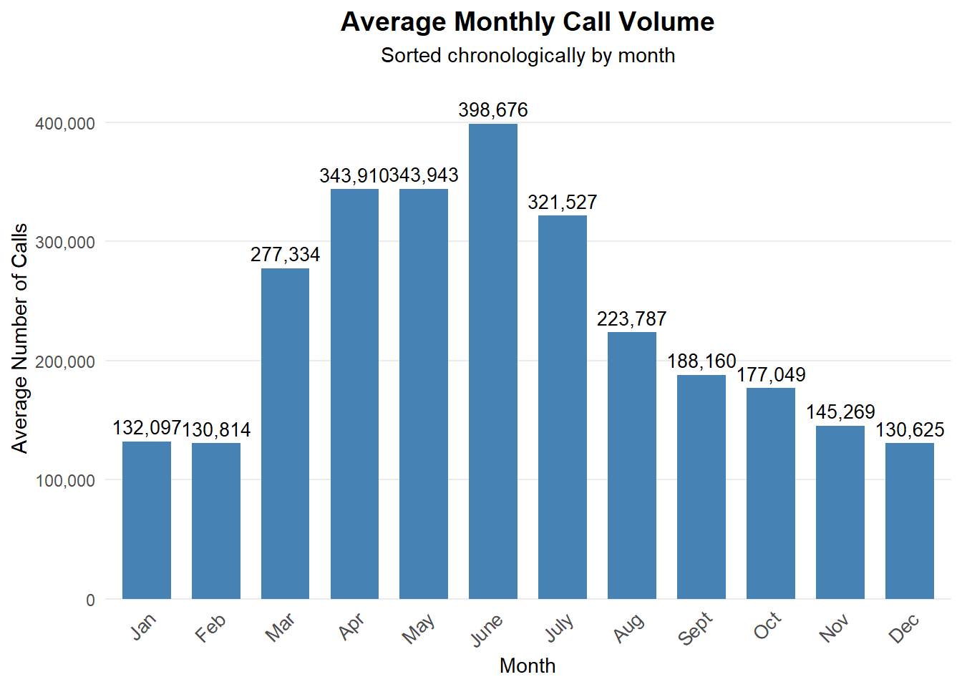
Descriptive Analysis
Scatterplot: Strong diagonal clustering—higher total calls correlate tightly with more doctor consultations. This proves doctor services are the core driver of call volume.
Bar Chart: Peaks in April–June (~344K–398K calls) and a secondary peak in August (322K), with troughs in Nov–Dec (~130K). It reflects seasonal/emergency patterns (e.g., COVID-19 waves). Aligns with the two-sample t-test confirming higher calls during crises (p=0.002).

Slide 9
Hypothesis Testing
One-Sample T-test:
Q: Is average complaint count ≠ 5000?
Result: p-value = 0.060 → Not significant.
While the p-value (0.060) is above 0.05, note that the sample mean (6,924 complaints) is 38% higher than the hypothesized 5,000.
Two-Sample T-test:
Q: Higher calls during COVID-19?
Result: p-value = 0.002 → Significant increase.
Even though the result is not statistically significant, the average number of complaints is still higher than 5,000, which could be important in real-life situations.
The 95% CI (4,915–8,933) does not include 5,000 at the lower bound, suggesting potential practical relevance.

Slide 10
One Sample T-test
t-statistic = 1.8987, df = 106, p-value = 0.06032
alternative hypothesis: true mean is not equal to 5000
95 percent confidence interval:
4915.004 8933.912
Sample estimates:
mean of x
6924.458
Result: p-value = 0.06031817 → Fail to reject the null hypothesis. No significant difference from 5000.

Slide 11
Two Sample T-test
Welch Two Sample T-test
t = 3.434, df = 23.061, p-value = 0.002258
alternative hypothesis: true difference in means is not equal to 0
95% percent confidence interval: 186,137.4 - 749,989.3.
sample estimates:
mean of x mean of y here
x (COVID-19 period): Mean = 597,108.8 calls, y (non-COVID-19 period): Mean = 129,045.5 calls. Significantly result confirms COVID-19 has drastically increased demand.
Result: p-value < 0.002258007 → Reject the null hypothesis (H₀).

Slide 12
Regression Model 1: Which type of healthcare inquiries contribute most to the total call volume received by the healthcare call center?
Regression Model 2:
What factors influence the number of complaints received by the healthcare call center over time?

Slide 13
Regression Model 1 – Total Call Drivers
R²:
0.99999 (near-perfect fit).
Key Predictors:
Doctor consultations (coeff. = 0.999).
Service inquiries (coeff. = 1.022).
.

Slide 14
Regression Model 1 – Total Call Drivers
Predictor | Coefficient | Std. Error | t-value | p-value | 95% Confidence Interval | Significance
Intercept | 41.69 | 156.23 | 0.27 | 0.79 | [-268.23, 351.61] | ❌
Doctors Consultancy | 0.9991 | 0.0013 | 786.87 | < 2e-193 | [0.9966, 1.0016] | ✅
Health Info | 0.9769 | 0.0124 | 78.91 | < 1.4e-92 | [0.9523, 1.0014] | ✅
Ambulance Info | 0.9503 | 0.0268 | 35.45 | < 8.4e-59 | [0.8971, 1.0035] | ✅
Complaints | 1.0112 | 0.0315 | 32.07 | < 9.3e-55 | [0.9487, 1.0738] | ✅
Service Info Calls | 1.0217 | 0.0089 | 115.39 | < 4.7e-109 | [1.0041, 1.0393] | ✅

Slide 15
Regression Model 2 – Complaint Drivers
R²:
0.990
Key Insights:
Complaints ↑ with total calls (system strain).
Complaints ↓ with doctor/service inquiries (proactive communication).

Slide 16
Regression Model 2 – Complaint Drivers
Predictor | Estimate | Std. Error | t value | p-value | Significance
Intercept | -25.64 | 147.46 | -0.174 | 0.862 | ❌
Doctors Consultancy | -0.9 | 0.028 | -32.26 | < 2e-16 | ✅
Health Info | -0.87 | 0.032 | -27 | < 2e-16 | ✅
Ambulance Info | -0.82 | 0.045 | -18.27 | < 2e-16 | ✅
Total Calls | 0.9 | 0.028 | 32.07 | < 2e-16 | ✅
Service Info Calls | -0.92 | 0.031 | -29.45 | < 2e-16 | ✅

Slide 17
Business Implications
Staffing:
Scale doctor consultation teams during emergencies.
Quality Control:
Address complaints linked to high call volumes.
Resource Allocation:
Use models to forecast demand.

Slide 18
Discussion & Recommendations
Limitations:
Excludes seasonality/multicollinearity.
Future Work:
Add temporal variables (month/year).
Sentiment analysis of call logs.

Slide 19
Conclusion
Confirmed pandemic-driven call surges.
Doctor consultations are the primary demand driver.
Dynamic resource allocation is critical for emergencies.

Slide 20
References
Basak, S. K. (2025). Healthcare Call Data Analysis DuringEmergencyTimes. Kaggle. doi:10.34740/KAGGLE/DSV/11067536

Slide 21
THANK YOU!

