Slide 1


Slide 2
مشکل چیست؟
در این مسئله عواملی که بر نتیجه ی 3 امتحان مختلف تاثیر دارد بررسی میشود و با توجه به نتیجه ی به دست آمده عواملی که تاثیر بیشتری روی نتیجه ی امتحانات دارد را بررسی کرده و بر این اساس برای بهبود نتایج امتحانات دانش اموزان از این فاکتور ها بهره می بریم.

Slide 3
سوال داده کاوی که برای حل مشکل مطرح شده چیست ؟(قرار است چه ستون یا اطلاعاتی را پیش بینی کنید؟قصد دارید از چه اقلام اطلاعاتی برای این پیش بینی استفاده کنید؟)
در این مسئله ستون مشخصی برای پیش بینی وجود ندارد و تنها عوامل موثر بر نتیجه ی امتحانات بررسی میشوند اما میتوان ستونی مبنی بر پاس شدن یا افتادن دانش اموز در درس را اضافه کرد و با استفاده از مدل مشخصی که از داده های اموزشی به دست می اید و تاثیر عوامل موجود در دیتاست بر نتیجه ی امتحان را بررسی میکند، این پیش بینی را انجام داد که با توجه به مقادیری که به فاکتورهای موثر بر نتیجه داده میشود، پاس شدن یا افتادن دانش اموز پیش بینی میشود.

Slide 4
داده های مسئله:
این دیتاست 3 ستون نمره شامل writing score , reading score , math score دارد و شامل ستون هایی به عنوان فاکتورهای موثر بر نتیجه ی امتحان است به عنوان مثال عوامل بررسی شده در این دیتاست شامل : امادگی شخص قبل از امتحان ، وضعیت ناهار(ناهار استاندارد خورده باشد یا ناهار نخورده باشد یا ناقص باشد) ، تحصیلات والدین دانش اموز، جنسیت ، قومیت

Slide 5
نحوه ی حل مسئله:
از انجاییکه هدف از این مسئله بررسی فاکتورهای موثر روی نتیجه ی امتحانات است ابزار اصلی مورد استفاده ی ما رسم نمودارها خواهد بود که با رسم نمودارهای مختلف ابعاد مختلف را بررسی و تاثیر عوامل مختلف را روی نتیجه هر امتحان به تفکیک و به طور کلی روی میانگین نمرات انها بررسی میکنیم .
در نهایت با بررسی مدل های مختلف پیش بینی، بهترین مدل را انتخاب و به منظور پیش بینی پاس شدن یا افتادن فرد در درس ان را روی داده ها اعمال میکنیم.

Slide 6
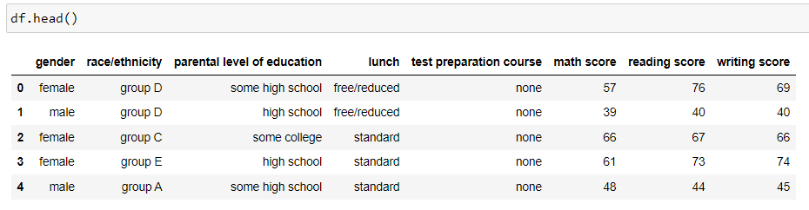
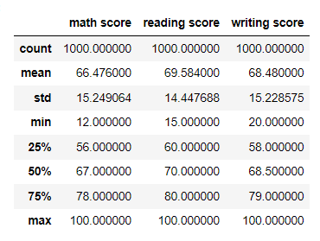
overview on dataset

Slide 7
Visualization

Slide 8
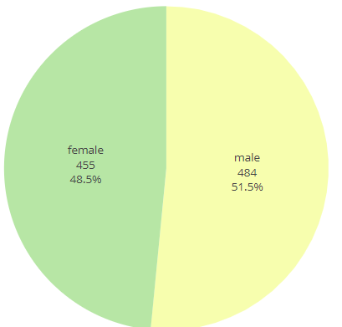
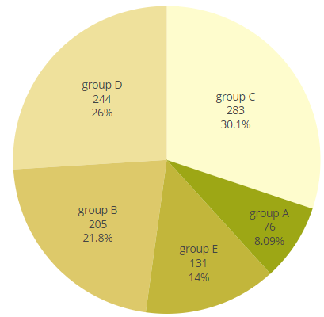
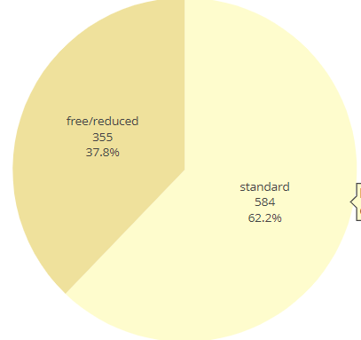
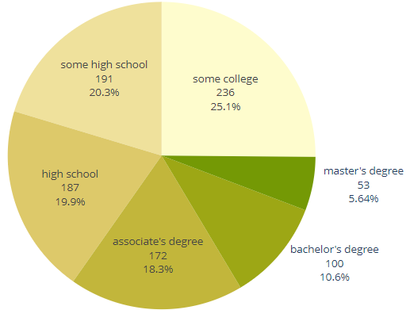
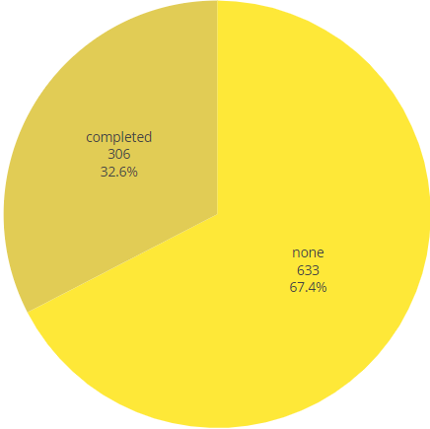
count of each feature
gender
race/ethnicity
lunch
parental level of education
test preparation course

Slide 9
The Distribution of Student's Test Scores For Each Subject
Distribution of scores
Distribution of grades
all Distributions together

Slide 10
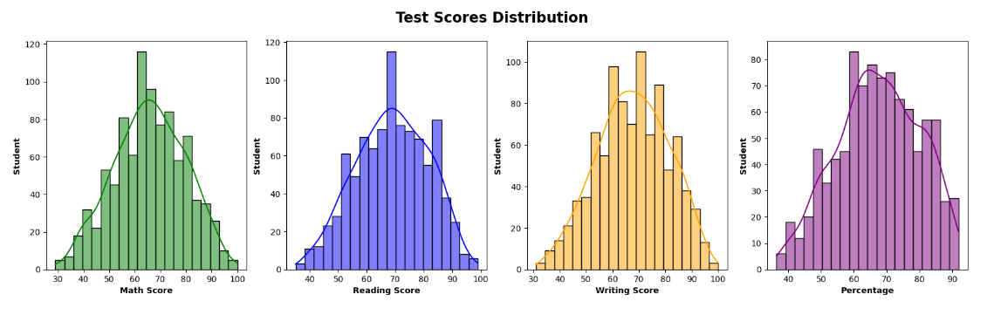
The Distribution of scores

Slide 11
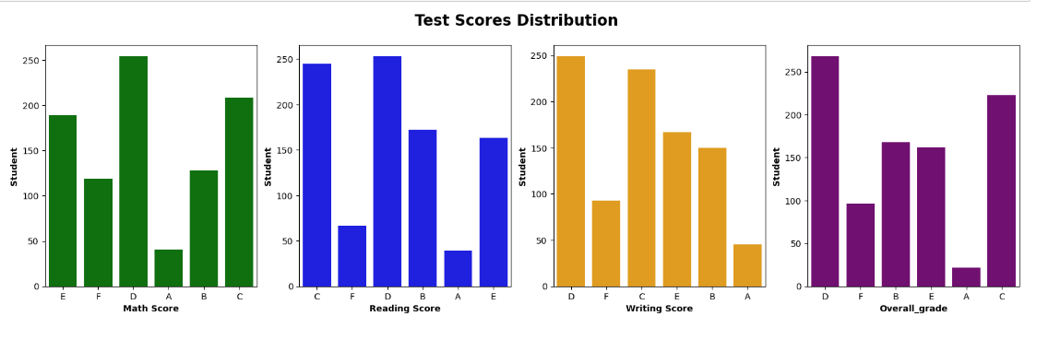
The Distribution of grades
marks >= 90 : grade = 'A'
marks >= 80 : grade = 'B'
marks >= 70 : grade = 'C'
marks >= 60 : grade = 'D'
marks >= 50 : grade = 'E'
marks < 50 : grade = 'F'

Slide 12
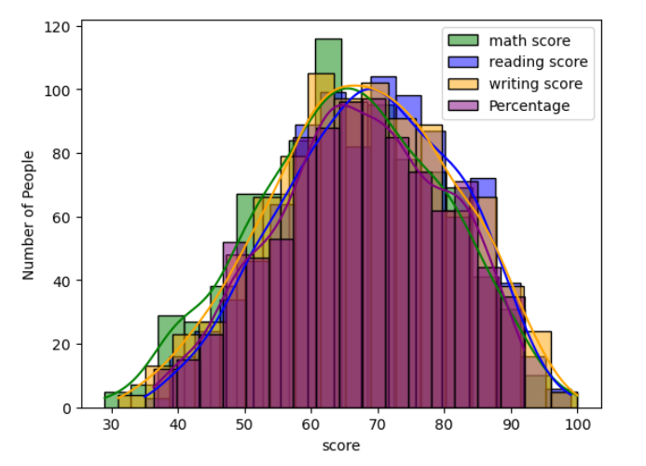
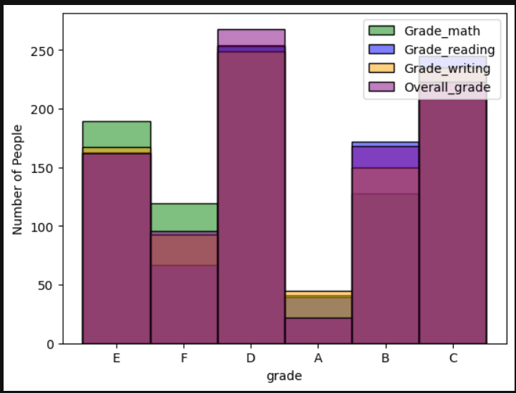
all the Distributions together

Slide 13
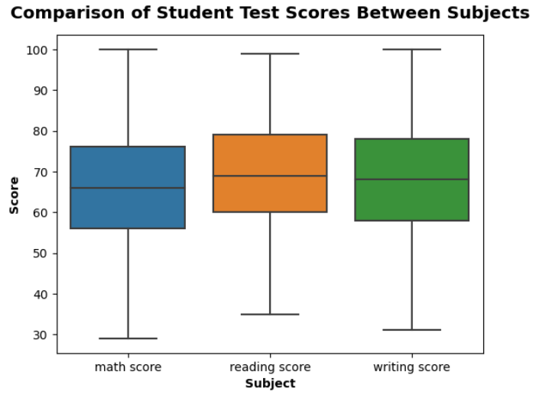
comparison of student test score between subjects
students performed worse in mathematics

Slide 14
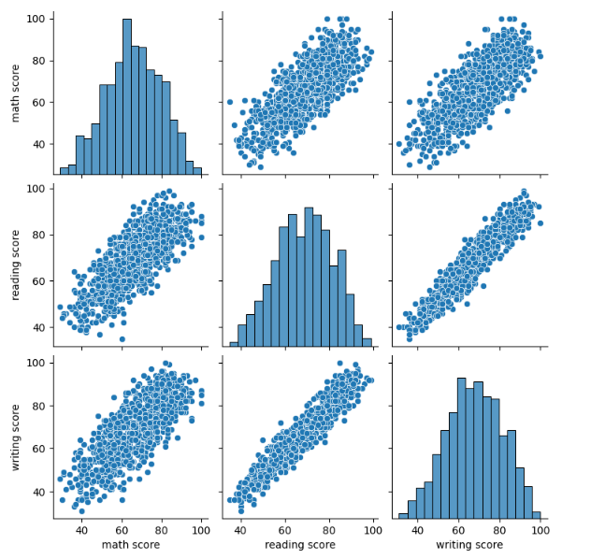
correlation
corrcoef(reading score, writing score)= 0.94
reading score and writing score are linearly related

Slide 15
influence of different factors on students performance
gender
Race / Ethnicity
lunch
test preparation course
parental level of education

Slide 16
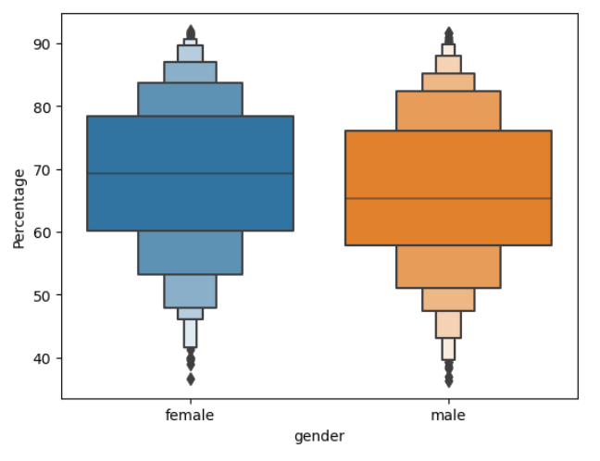
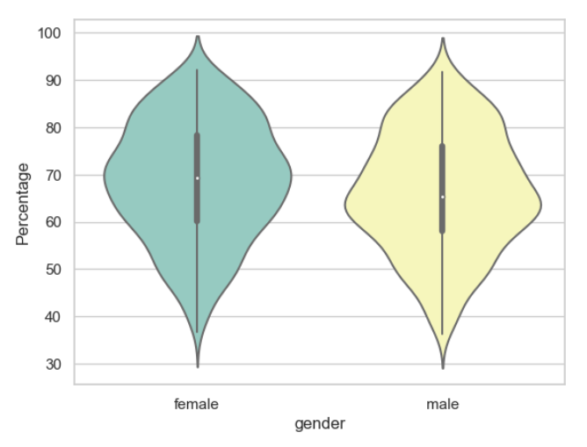
influence of different factors on students performance gender
students performance on mean of 3 scores

Slide 17
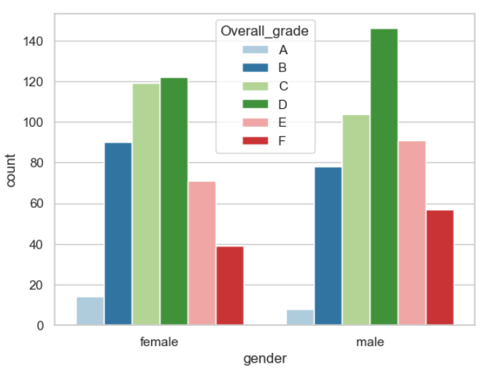
influence of different factors on students performance gender
students performance on mean of 3 scores
on average performance of female are better

Slide 18
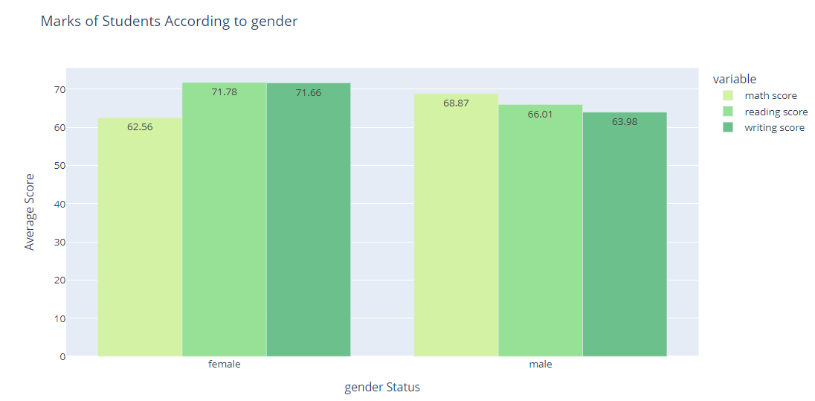
influence of different factors on students performance gender
in math, male performed better
in writing, female performed better
in reading, female performed better

Slide 19
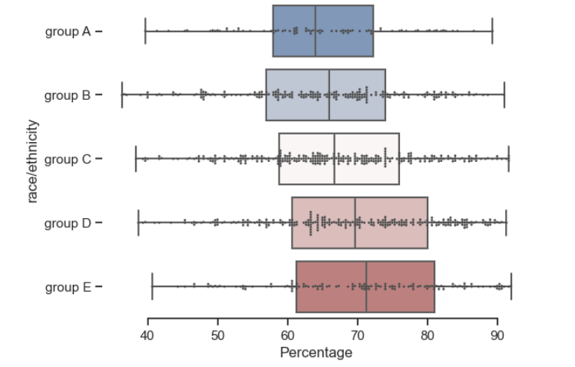
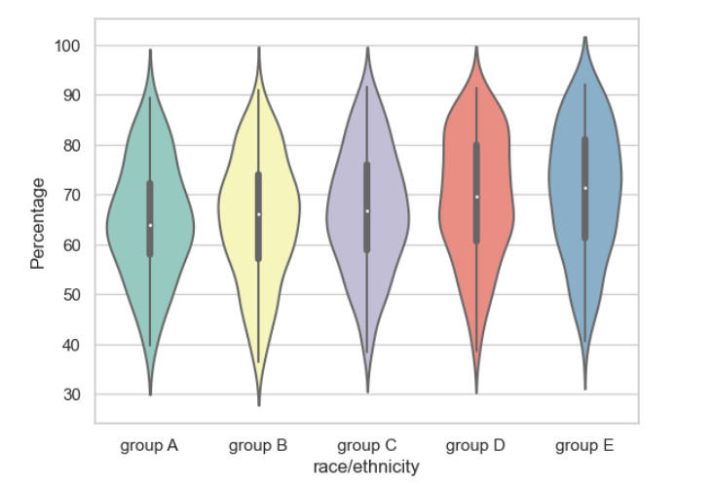
influence of different factors on students performance Race / Ethnicity
students performance on mean of 3 scores
on average performance of group E are better

Slide 20
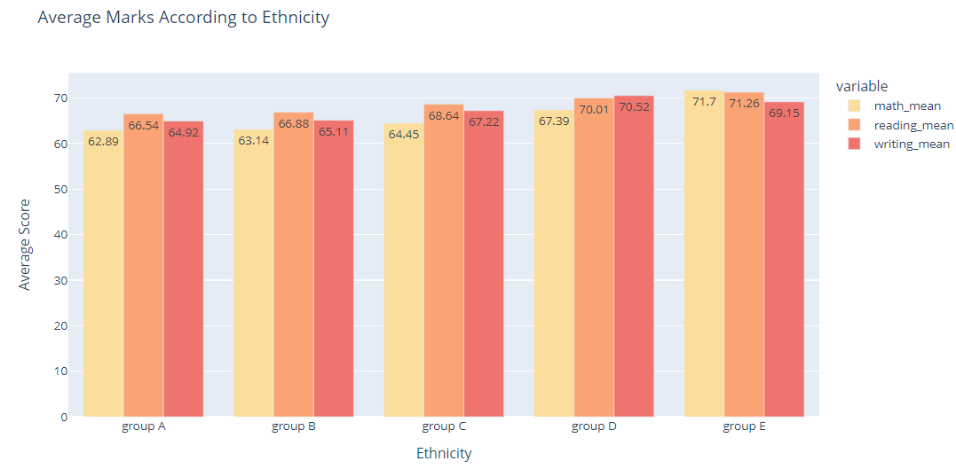
influence of different factors on students performance Race / Ethnicity
in math, group E performed better
in writing, group E performed better
in reading, group D performed better

Slide 21
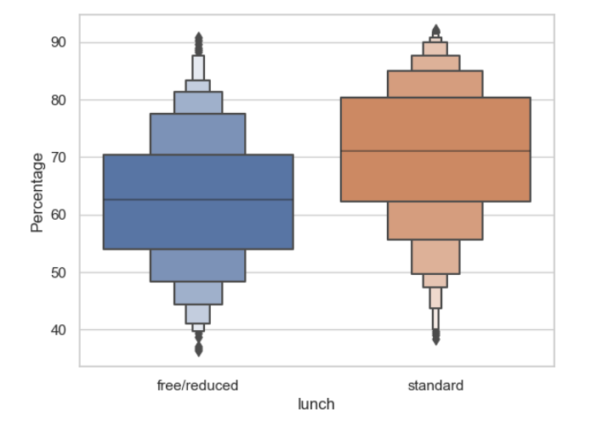
influence of different factors on students performance lunch
students performance on mean of 3 scores
on average performance of students who have standard lunch are better

Slide 22
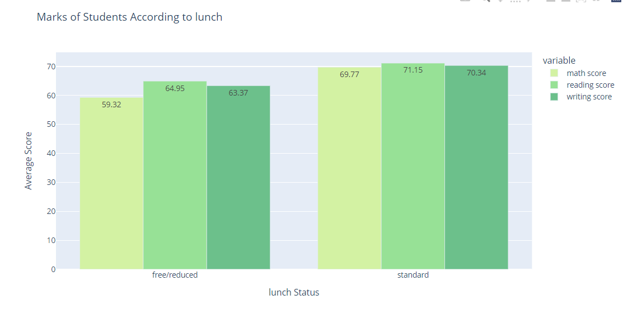
influence of different factors on students performance lunch
in all 3 exams students that have standard lunch performed better

Slide 23
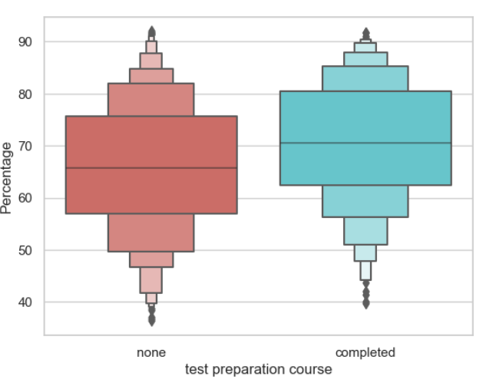
influence of different factors on students performance test preparation
students performance on mean of 3 scores
on average, performance of students who were completely prepared are better

Slide 24
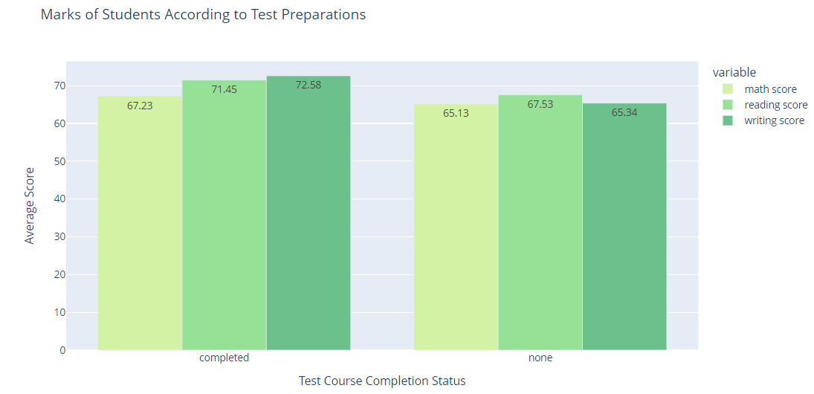
influence of different factors on students performance test preparation
in all 3 exams students that were completely prepared performed better

Slide 25
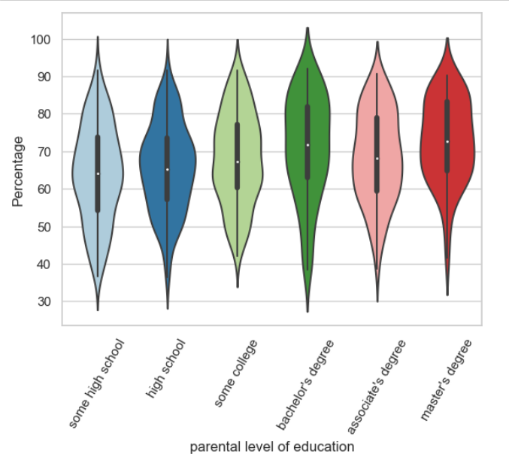
influence of different factors on students performance parental level of education
students performance on mean of 3 scores
on average, students whose parents have a master's degree or a bachelor's degree performed the best

Slide 26
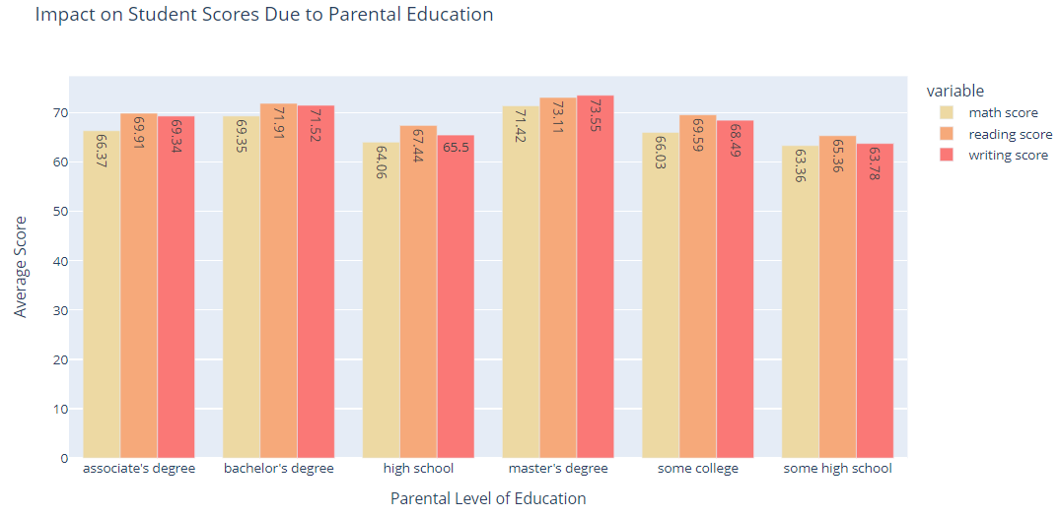
influence of different factors on students performance parental level of education
in all 3 exams students whose parents have a master's degree performed best

Slide 27
average count on "race/ethnicity"
parental level of education
test preparation course
lunch
gender

Slide 28
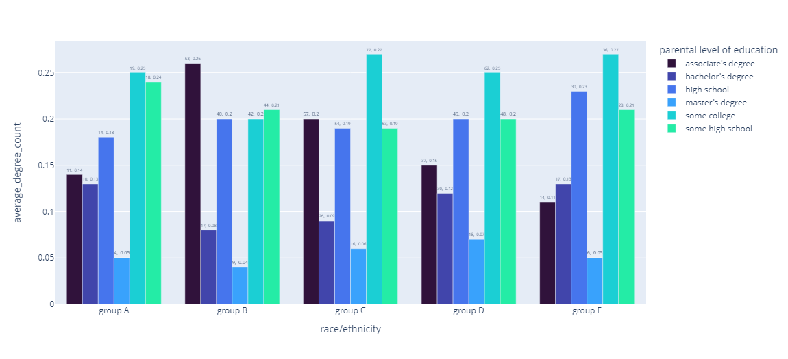
parental level of education

Slide 29
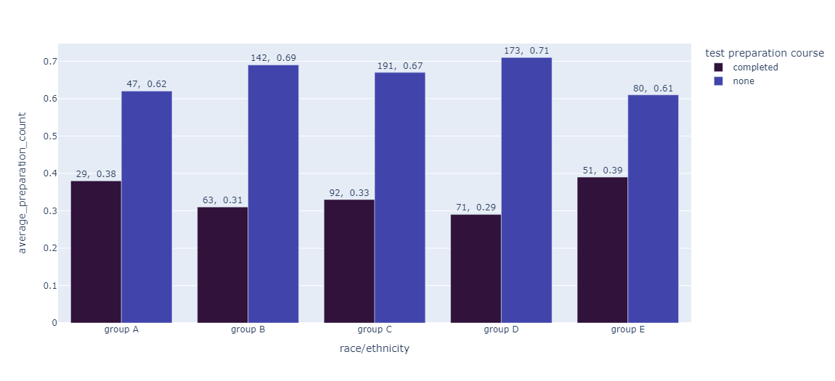
test preparation course

Slide 30
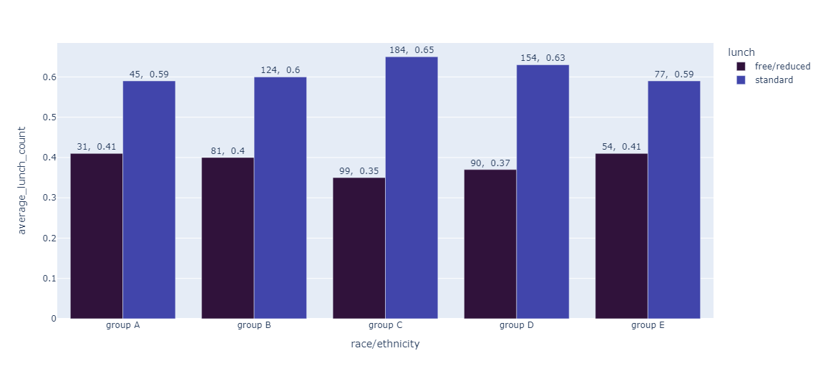
lunch

Slide 31
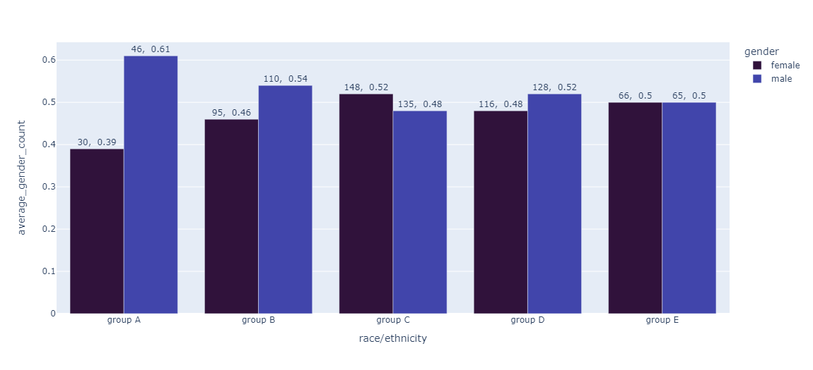
gender

Slide 32
Distribution of scores by column for each test score
test preparation course
lunch
gender
parental level of education
race/ethnicity

Slide 33
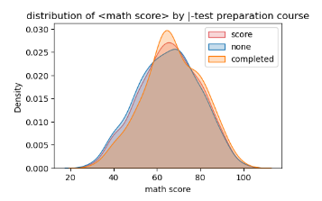
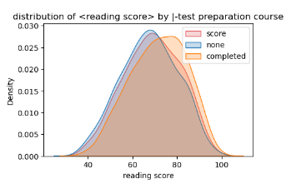
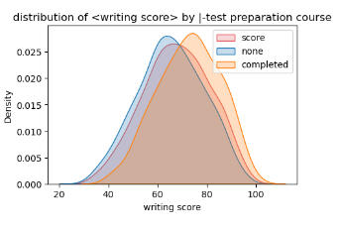
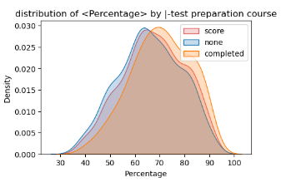
Distribution of scores by column for each test score test preparation course
Exam preparation has a greater effect on the result of reading and writing scores and does not have a significant effect on the math score
but on average has effect on performance

Slide 34
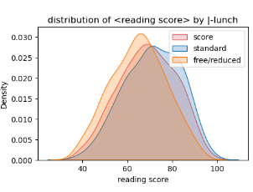
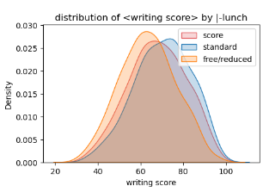
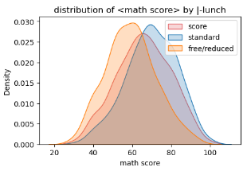
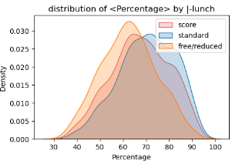
Distribution of scores by column for each test score lunch
standard lunch has positive effect on the result of each 3 scores but have a significant effect on math score
on average standard lunch has effect on performance

Slide 35
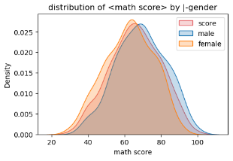
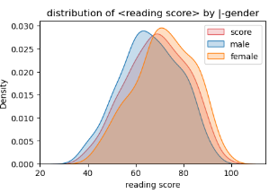
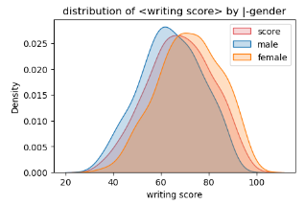
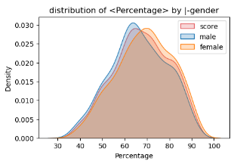
Distribution of scores by column for each test score gender
female performed better on reading and writing score but male performed better on math score
on average female performed better

Slide 36
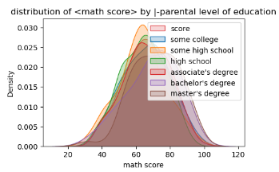
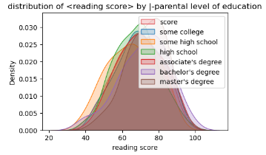
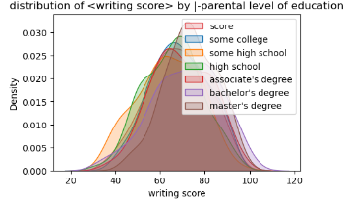
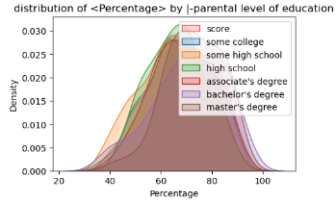
Distribution of scores by column for each test score
parental level of education

Slide 37
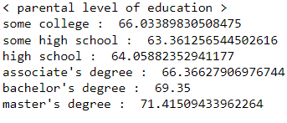
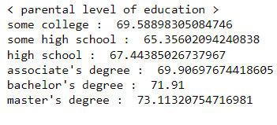
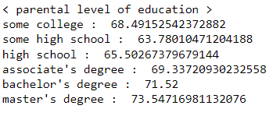
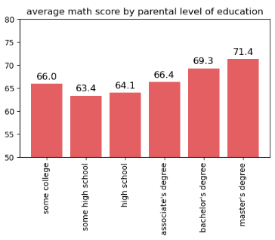


math score
reading score
writing score

Slide 38




race/ethnicity
Distribution of scores by column for each test score

Slide 39






math score
reading score
writing score

Slide 40
correlation
after Standardization of data and map a number to categorical features we can draw a heatmap correlation to understand relations between features

Slide 41

Standardization

Slide 42

correlation heatmap
bold results:
according to heatmap, lunch has most effect in scores and specially on math score
test preparation has least effect on math score compared to other scores and most effect on writing score

Slide 43
machine learning (and results)

Slide 44
machine learning
add column pass_or_nor
split : data & target / test & train
baseline
Compare models using k-fold cross validation
GaussianNB , SVC, KNN
results

Slide 45

add column pass_or_nor
1 if Percentage >= 0.6 else 0

Slide 46


split : data & target / test & train
target
features

Slide 47
baseline
Decision Tree Classifier
Train Accuracy: 0.8063943161634103
Test Accuracy: 0.648936170212766

Slide 48

Compare models using k-fold cross validation
GaussianNB , SVC, KNN have highest score in machine learning models with default tuning

Slide 49

GaussianNB , SVC, KNN

Slide 50
GaussianNB , SVC, KNN
As a result of scaling, it can be seen that the score of GNB is not significantly affected by the scaling model, but nevertheless obtains a high score. Although the SVC and KNN machine learning models were affected, it can be seen that both SVCs scored higher.
only the GNB and SVC models was an efficient method Through the Data scaling, Got the same score in GNB Model.

Slide 51
models
Gaussian Naive Bayes
Random Forest Classifier
according to characteristic of this model and features of this dataset RFC can be prepare model by setting optimal parameter

Slide 52

RFC vs GNB

Slide 53
RFC vs GNB
The previous results show that the Naive Bayes model scored the highest score without tuning, and also the accuracy obtained by finding the optimized tuning value of the Naive Bayes model showed higher accuracy than the tuned Random Forest Classifier. Therefore, since the results may vary depending on the tuning method and parameter setting method of each model, so it is the most efficient way to find a machine learning model that is best suited to the data by improving understanding of the characteristics and performance of each model.

Slide 54
conclusion

Slide 55
conclusion
reading score and writing score are linearly related with coef=0.94
on average female performed better than male but male has better performance in math score and female has better performance in reading/writing score.
group E performed better in math and reading score and group D performed better in writing score . generally group E has best performance .
lunch has the most effect on scores comparing with other features, especially on math score.
test preparation has the least effect on math score and most effect on writing score .but generally people who prepared completely for test performed better.
students whose parents have a master's degree performed better

Slide 56
03.
What would be the best way to improve student scores on each test?
overall lunch has the best effect on scores, so according to results having a standard lunch has positive effect on scores improvement.
sectin name

Slide 57
references
http://roycekimmons.com/tools/generated_data/exams
https://www.kaggle.com/code/nihar14/analysis-on-factors-affecting-students-scores
https://github.com/AzT3Risk/Students-performance-in-Exams
https://www.kaggle.com/code/kagleo123/student-perform-in-exam-eda-ml-prediction
https://www.kaggle.com/code/victorferino/student-s-performance-in-exams-eda-ml#Multiple-Linear-Regression-Model

