Slide 1

Computer Security DD2395
Relational
Database
Roberto Guanciale

Slide 2

Questions
Raise your hand
www.quizsocket.org
  roberto_kth
  56463546

Slide 3
Data
"Informatics: Automatic Information Processing"
Processing
  Transforming
  Analyzing
  …
  Storing
  Retrieving

Slide 4
Data
"Informatics: Automatic Information Processing"
Processing
  Transforming
  Analyzing
  …
  Storing
  Retrieving

Slide 5
Database
All systems have to store and retrieve information (data)
Management SW
  Keep the list of employees, their salary, leave of absence
  Retrieve the employees hired more than four years ago and with few absences to offer them a monetary reward
University SW
  Keep the list of students, courses, grades, …
  Find all students that passed both “networking” and "computer security” with good grades to offer them a job.
...

Slide 6
Database
A large collection of integrated data
Model the information belonging to a system
Database Management System (DBMS)
  Software designed to store and manage databases
  Implement common functionality, freeing SW developer from reinventing the wheel

Slide 7
Inevitable example
Entities
KTH Students
  have name, surname, nationality, birthday
  take courses (and eventually get grades)
KTH professors
  have name, surname, nationality, birthday, salary
  teache courses
KTH courses
  have name, teaching material
  are taught by professors and taken by students

Slide 8
Inevitable example
Entities
KTH Students
  have name, surname, nationality, birthday
  take courses (and eventually get grades)
KTH professors
  have name, surname, nationality, birthday, salary
  teache courses
KTH courses
  have name, teaching material
  are taught by professors and taken by students

Slide 9
Inevitable example
Attributes
What do we know about the entities?
KTH Students
  have name, surname, nationality, birthday
  take courses (and eventually get grades)
KTH professors
  have name, surname, nationality, birthday, salary
  teache courses
KTH courses
  have name, teaching material
  are taught by professors and taken by students

Slide 10
Inevitable example
Relations
Who teaches what
Who takes what
KTH Students
  have name, surname, nationality, birthday
  take courses (and eventually get grades)
KTH professors
  have name, surname, nationality, birthday, salary
  teache courses
KTH courses
  have name, teaching material
  are taught by professors and taken by students

Slide 11
Students
Name | Surname | Nationality | Birthday
Roberto | Guanciale | Italian | 08/12/1979
Jhon | Doe | American
King | Sweden
AAA | BBB
CCC | DDD
A relation (or table) is a multiset of tuples having attributes

Slide 12
Students
Name | Surname | Nationality | Birthday
Roberto | Guanciale | Italian | 08/12/1979
Jhon | Doe | American
King | Sweden
AAA | BBB
CCC | DDD
A relation (or table) is a multiset of tuples having attributes
Multiset is an unorsered list (set with duplicates)

Slide 13
Students
Name | Surname | Nationality | Birthday
Roberto | Guanciale | Italian | 08/12/1979
Jhon | Doe | American
King | Sweden
AAA | BBB
CCC | DDD
A relation (or table) is a multiset of tuples having attributes
An attribute (or column) is a (typed) data entry present in each tuple
Types are: integer, float, double, date, time, string, binary blob (e.g. student selfie), money

Slide 14
Students
Name | Surname | Nationality | Birthday
Roberto | Guanciale | Italian | 08/12/1979
Jhon | Doe | American
King | Sweden
AAA | BBB
CCC | DDD
A relation (or table) is a multiset of tuples having attributes
An entity (or row) is a single entry in the table having the attributes specified by the schema

Slide 15
Students
Name | Surname | Nationality | Birthday
Roberto | Guanciale | Italian | 08/12/1979
Jhon | Doe | American
King | Sweden
AAA | BBB
CCC | DDD
Table not too different from a single sheet in a spreadsheet (e.g. Excel)
Fixed number attributes and types => schema

Slide 16
Students
Name | Surname | Nationality | Birthday
Roberto | Guanciale | Italian | 08/12/1979
Jhon | Doe | American
King | Sweden
AAA | BBB
CCC | DDD
How can we identify one student in the table?
Can we have two Roberto?
Can we have two Erikson?
Can we have two Swedish?
Can we have two students with the same birthday?

Slide 17
Students
Name | Surname | Nationality | Birthday
Roberto | Guanciale | Italian | 08/12/1979
Jhon | Doe | American
King | Sweden
AAA | BBB
CCC | DDD
How can we identify one student in the table?
Can we have two Roberto Guanciale? (Erik Erikson?)
Can we have two Erik Erikson born the same day?

Slide 18
Students
Name | Surname | Nationality | Birthday
Roberto | Guanciale | Italian | 08/12/1979
Jhon | Doe | American
King | Sweden
AAA | BBB
CCC | DDD
A key is a minimal subset of attributes that acts as a unique identifier for tuples in a relation
Name, Surname, Birthday

Slide 19
Students
PN | Name | Surname | Nationality | Birthday
7912081671 | Roberto | Guanciale | Italian | 08/12/1979
8762438462 | Jhon | Doe | American
4238746287 | King | Sweden
4287436827 | AAA | BBB
3872623874 | CCC | DDD
A key is a minimal subset of attributes that acts as a unique identifier for tuples in a relation
Name, Surname, Birthday
Personnumber

Slide 20
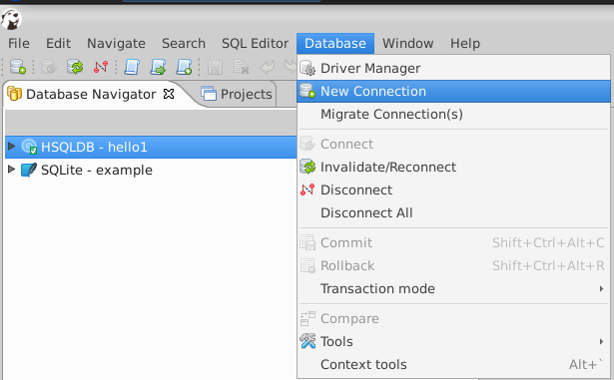
CREATE

Slide 21
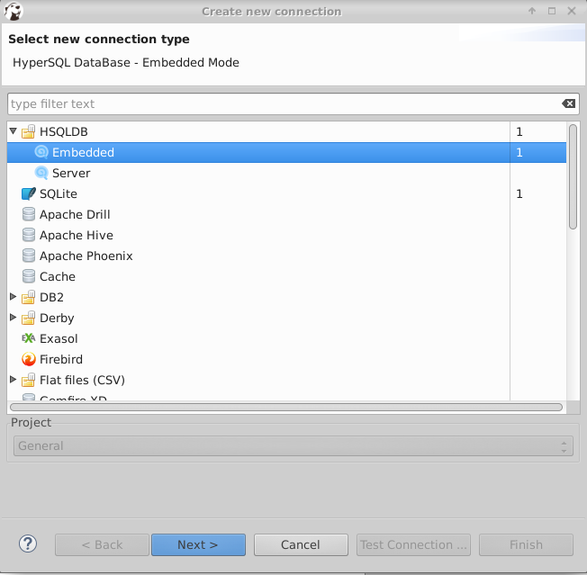
CREATE

Slide 22
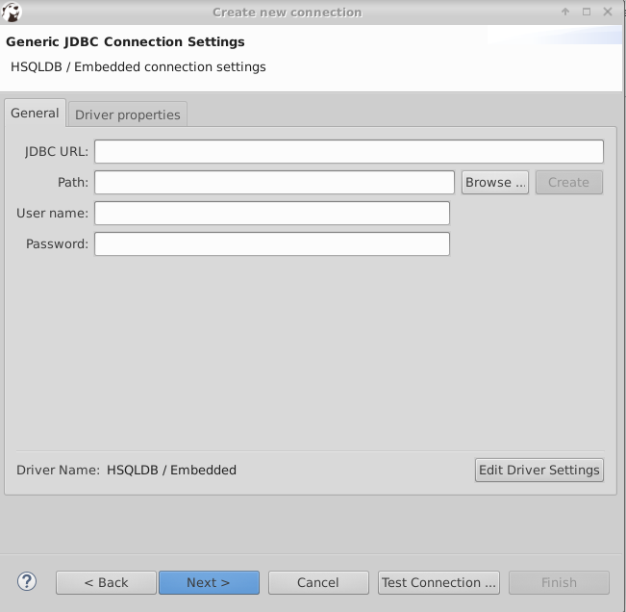
CREATE

Slide 23
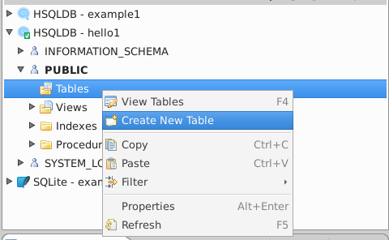
CREATE

Slide 24
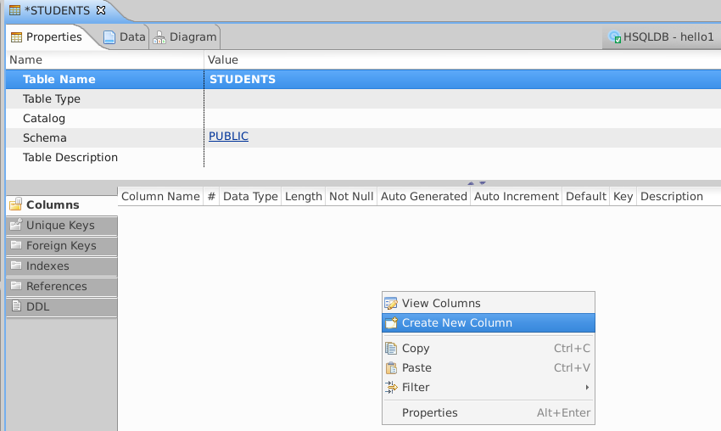
CREATE

Slide 25
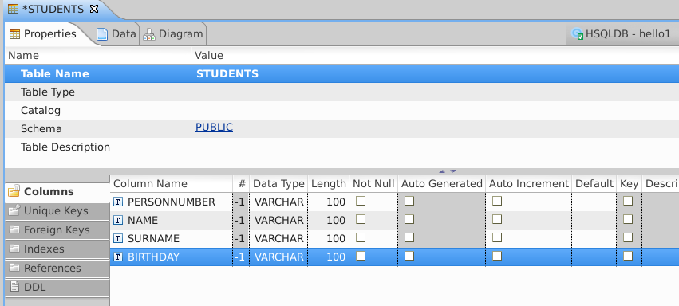
CREATE

Slide 26
CREATE
Ctrl + s

Slide 27
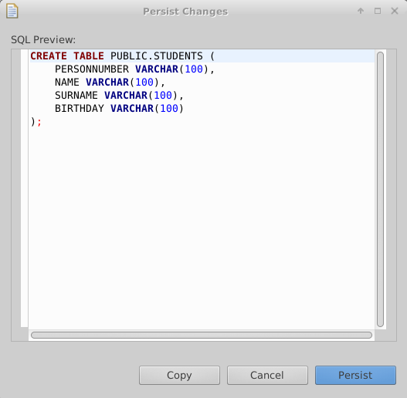
CREATE

Slide 28
CREATE
CREATE <tablename> (
  <attr1> <type1>,
  <attr2> <type2>,
  <attr3> <type3>,
  <attr4> <type4>
  );
  Currently we know only one type varchar(<x>):
    strings with at most x chars

Slide 29
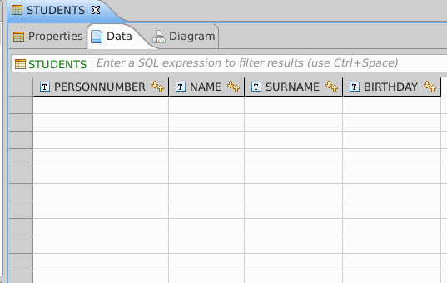
ADD DATA

Slide 30
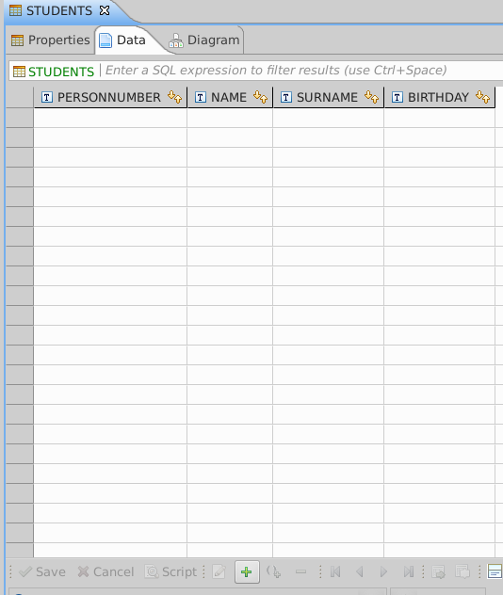
ADD DATA

Slide 31
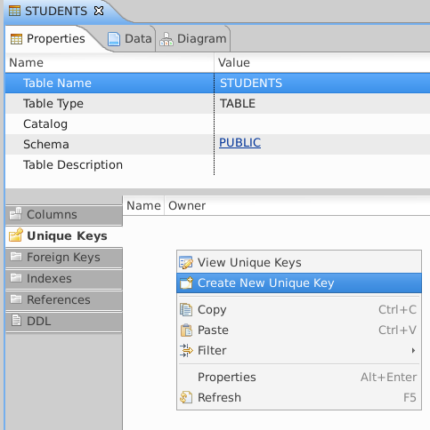
DEFINE KEY

Slide 32
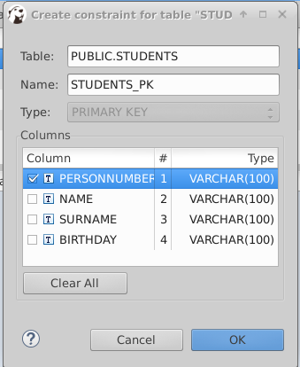
DEFINE KEY

Slide 33
INSERT
INSERT INTO <tablename> (
  <attr1-value>,
  <attr2-value>,
  <attr3-value>,
  <attr4-value>
  );
  If the attribute is a string, we must quote the value: 'Roberto'

Slide 34
TYPES
VARCHAR(100)
INTEGER
FLOAT
DATE
TIME
Delete column birthday
Add columns
  bithday (date)
  width
  height
  nationality

Slide 35
SQL
Structured Query Language
Special-purpose
Domain-specific language
Designed for managing data held in a relational database management system (RDBMS)
Standardized
Platform/vendor independent
  CREATE
  INSERT

Slide 36
SELECT from a single table
SELECT * FROM <tablename>

Slide 37
SELECT from a single table
SELECT * FROM <tablename>
SELECT <attr1>,<attr2>,… from <tablename>
Projection is the operation of producing an output table with tuples that have a subset of their prior attributes

Slide 38
SELECT from a single table
SELECT * FROM <tablename>
SELECT <attr1>,<attr2>,… from <tablename>
SELECT … FROM <tablename> WHERE <condition>
Selection is the operation of filtering a relation of tuples on some condition

Slide 39
SELECT from a single table
Input schema
query
Output schema

Slide 40
SQL syntax details
SQL commands are case insensitive
  SELECT=Select=select
  INSERT=inSerT
Values are case sensitive
  `Italian <> italian`
  Do an experiment
    (add an entity with `italian` nationality)
    Query for all `Italians`
Use single quote for strings 'a' and not “a”

Slide 41
JDBC
A Java API that can access any kind of tabular data
Platform/Vendor independent
Connect to a data source, like a database
Send queries and update statements to the database
Retrieve and process the results received from the database in answer to your query
Two parts
  JDBC API
  JDBC driver (DBMS specific)

Slide 42
Common SQL commands
SELECT…
INSERT INTO <table> VALUES (<val1>, …, <valn>)
DELETE FROM <table> WHERE <condition>
UPDATE <table> SET <attr1>=<val1>, … , <attrn=valn>
WHERE <condition>

Slide 43
JDBC
A Java API that can access any kind of tabular data
Platform/Vendor independent
Connect to a data source, like a database
Send queries and update statements to the database
Retrieve and process the results received from the database in answer to your query
Two parts
  JDBC API
  JDBC driver (DBMS specific)

Slide 44
THANKS!
Any questions?
You can find me at robertog@kth.se

