Slide 1





Case-control matching
By: Fatemeh Torabi

Slide 2

Cases
Age: 18+ at diagnosis
Coverage: had at least 6 months of available General Practitioner (GP) data prior to their epilepsy diagnosis date
Follow up: had at least 180 days of follow-up data
Mediator
EIAED and non-EIAED
Outcome
Major cardiovascular events:
cardiac arrest, stroke, onset of heart failure or cardiovascular death
Exposure
Diagnosed Epilepsy

Slide 3
Case-control matching
This example demonstrates matching with replacement and randomization on a 4 to 1 ratio.
Cases
Control
Age
Gender
WIMD(Deprivation quintile)
Year of entry into the study
1:4 ratio
Notes:
For the 10,241 cases with epilepsy, control cohort was obtained from all eligible individuals in Wales without a diagnosis of epilepsy and matched on a 1:4 ratio based on age (week of birth), gender, deprivation and year of entry into the study. To allow a sufficient number of possible matches on year of entry into the study, controls were returned into the matching pool after meeting matching criteria, allowing matching with replacement and randomization , where four controls were randomly selected from all possible matches for each case. Some individuals within the control cohort were therefore matched to more than one case.

Slide 4
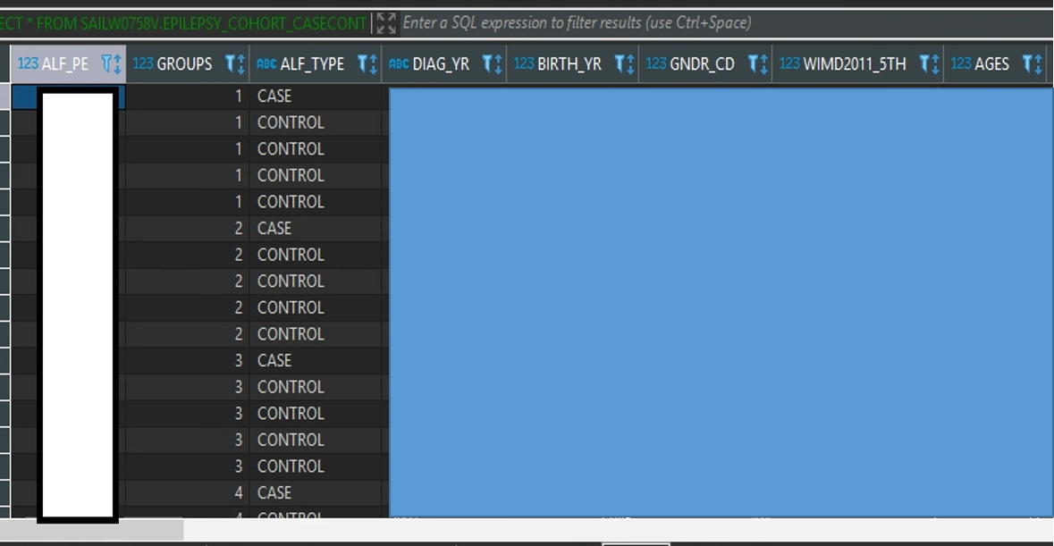
Final table

Slide 5
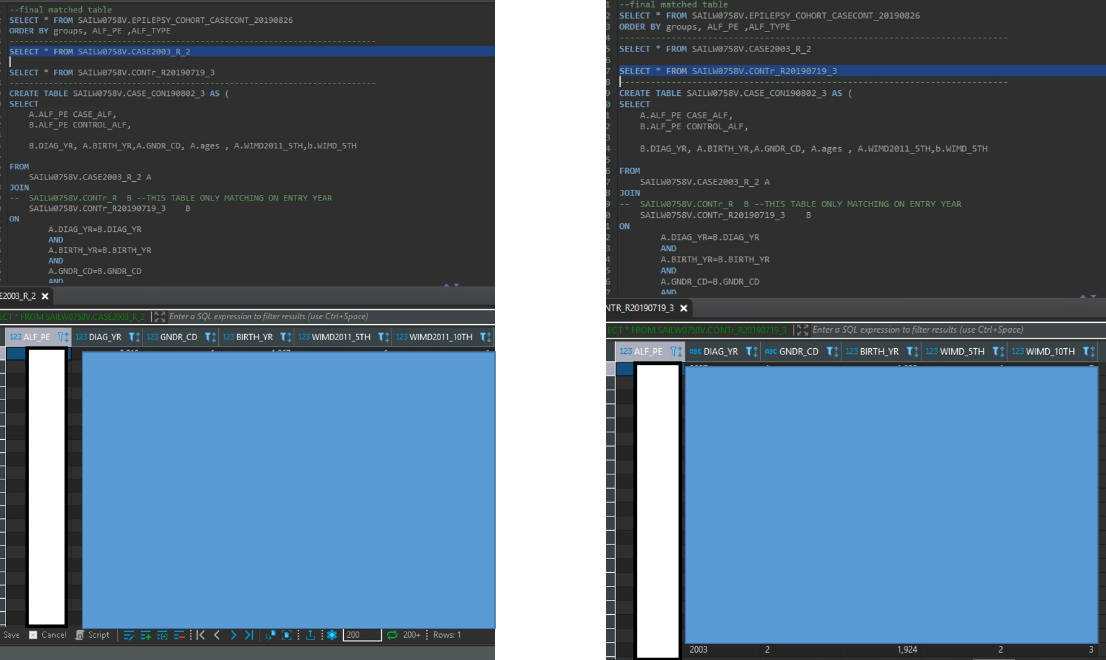
Case table
Control table

Slide 6
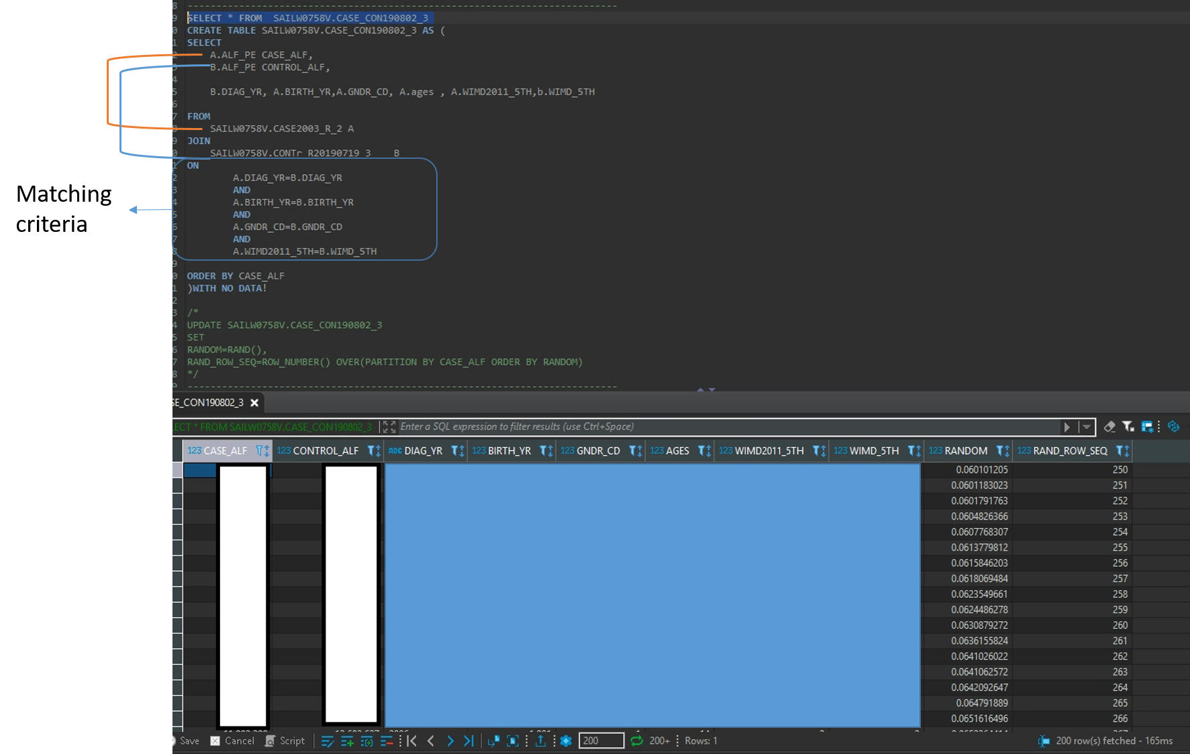

Slide 7
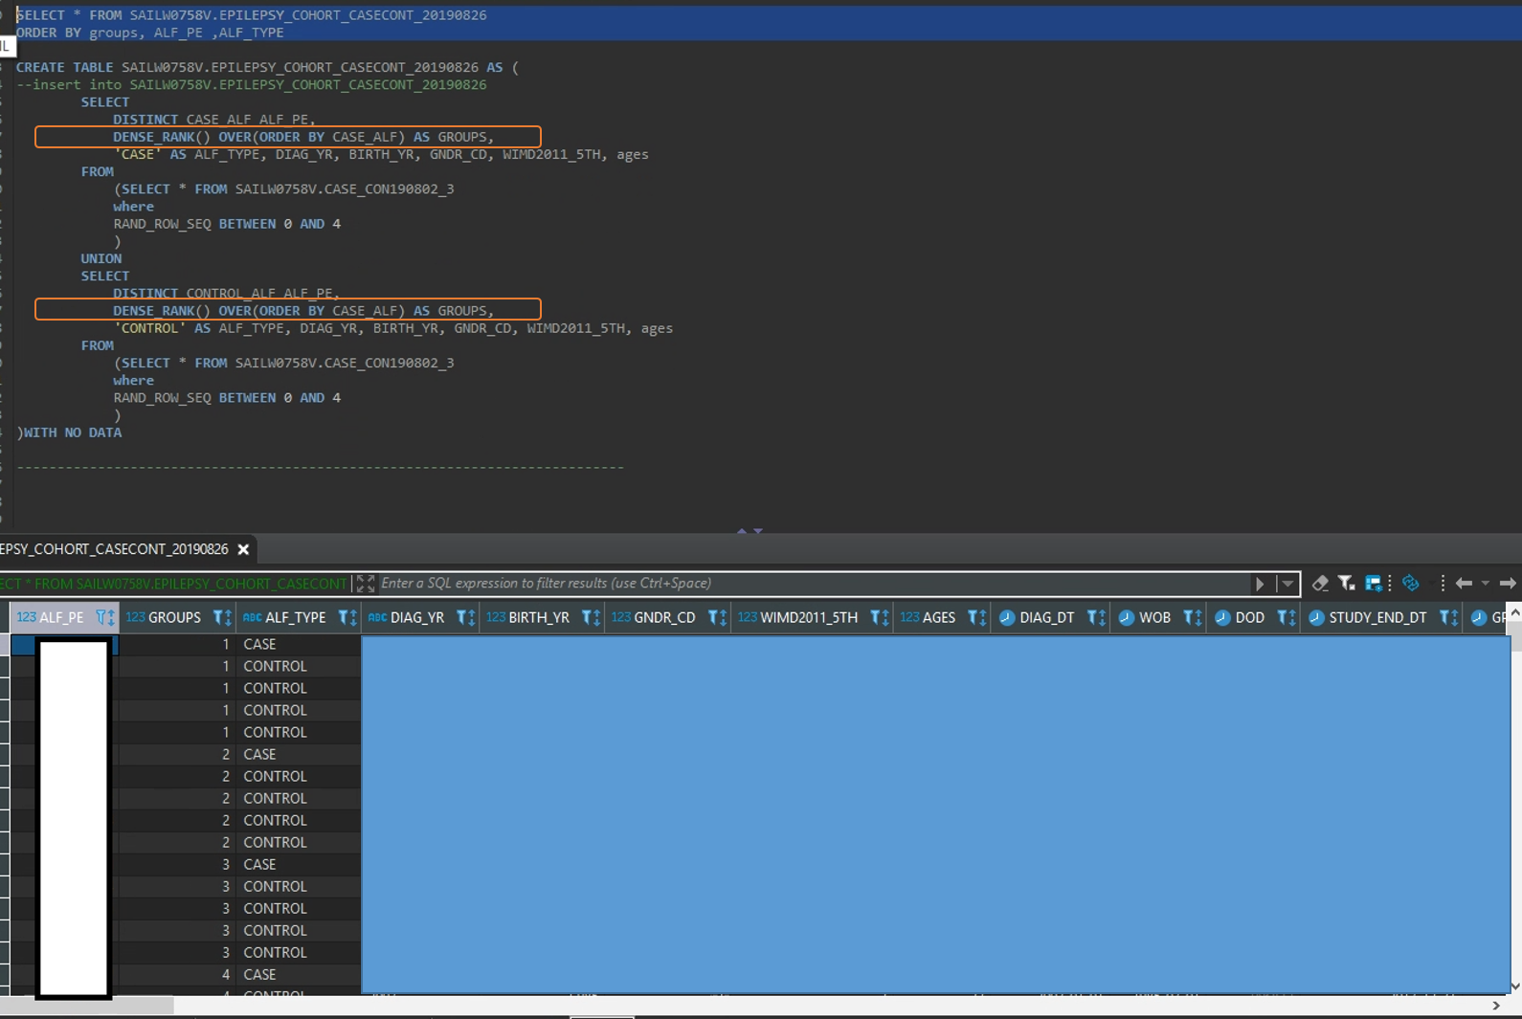
Final table

