Slide 1
Crash Fatality Inspector
Group 7
Trends in Fatal Crash Data by State
Presentation Specialist: Kendall Zettlmeier
Writing and Analytics Specialist: Tom Phillips
Programming Specialist: Matthew Runde
Aesthetic Specialist: James Kimball
Organization & People Specialist: Sukhdip Sangha

Slide 2
Crash Fatality Inspector: Personas
[organization & people specialist]
Background:
  Ages 16-45
  Drives an average of 50 miles per week
  Lives in a heavy populated area with lots of traffic
Personality:
  Big “texter and driver”
  Always in a hurry
  Loves their cellphone
Frustrations:
  Hates traffic
Description:
  This person is always last minute.
  Loves technology and is using it constantly.
  Has a habit of being more concentrated on social life.
Usage scenario:
  Sitting at the DMV waiting to renew license and sees the application over by the window.
  Trys application and learns about all the traffic fatalities

Slide 3
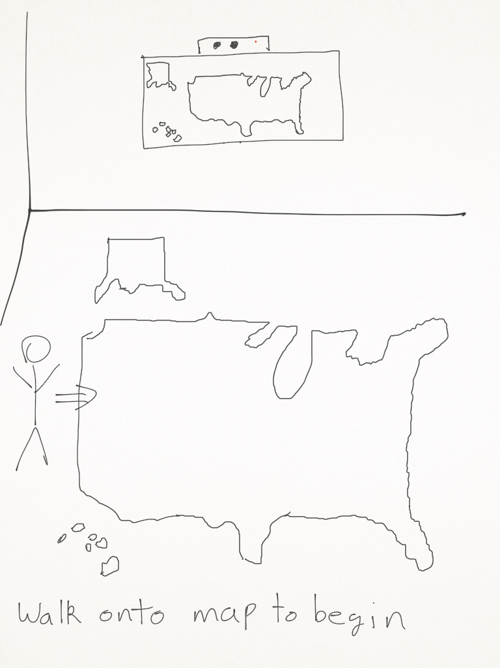
Crash Fatality Inspector: Storyboard
Context: Located at a DMV
[presentation specialist]

Slide 4
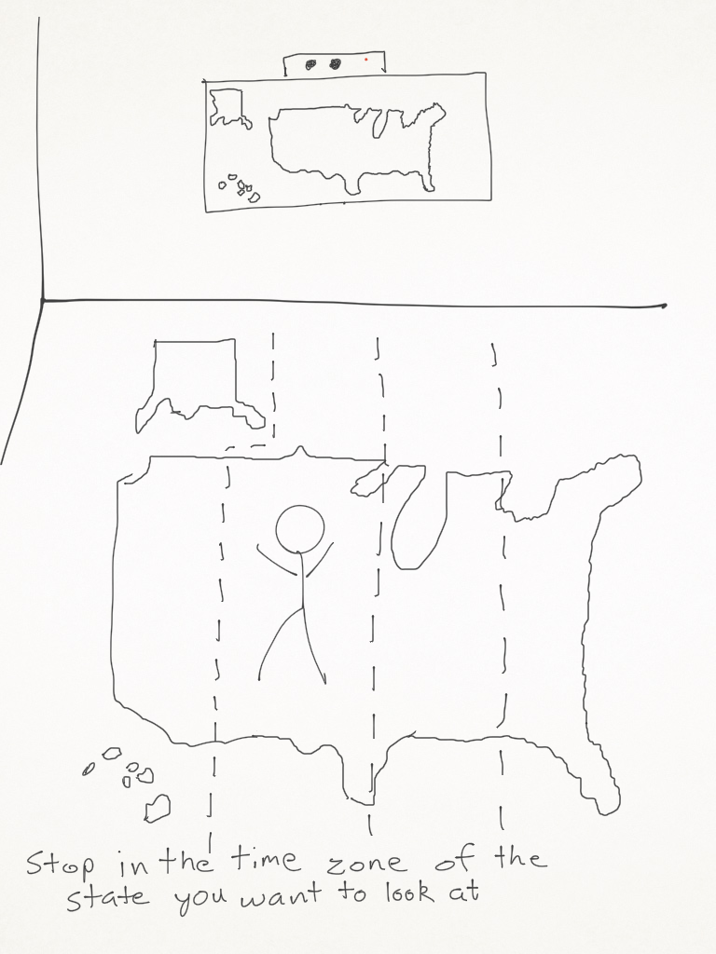
Crash Fatality Inspector: Storyboard
Context: Located at a DMV
[presentation specialist]

Slide 5
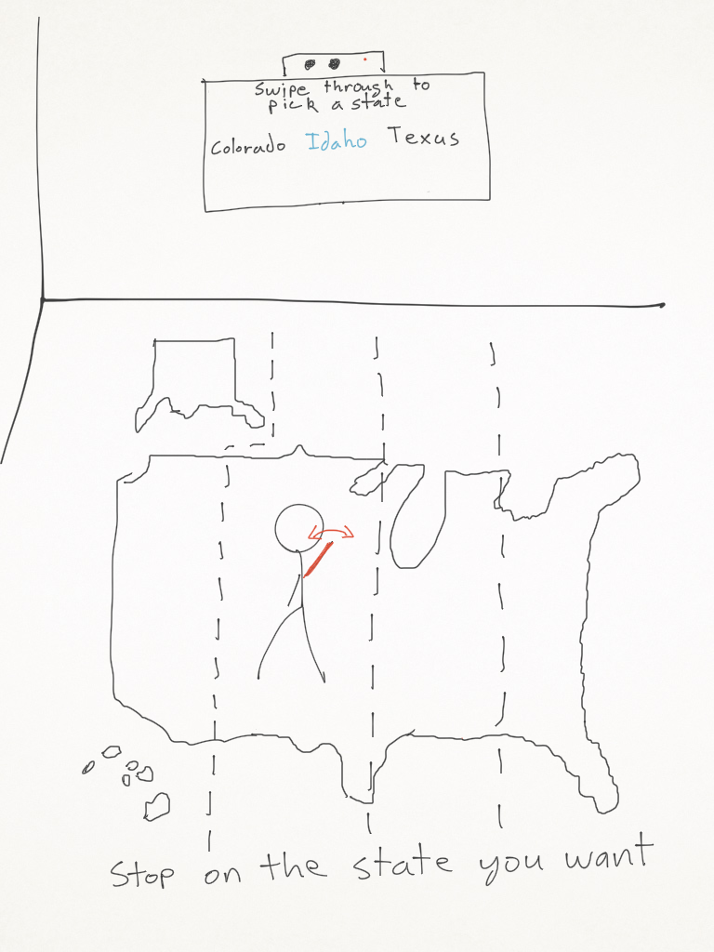
Crash Fatality Inspector: Storyboard
Context: Located at a DMV
[presentation specialist]

Slide 6
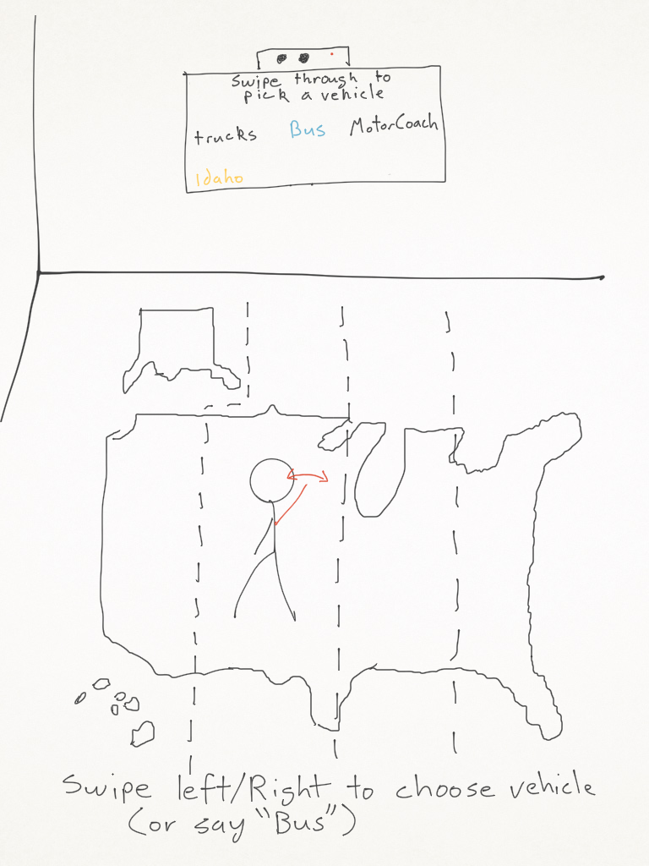
Crash Fatality Inspector: Storyboard
Context: Located at a DMV
[presentation specialist]

Slide 7
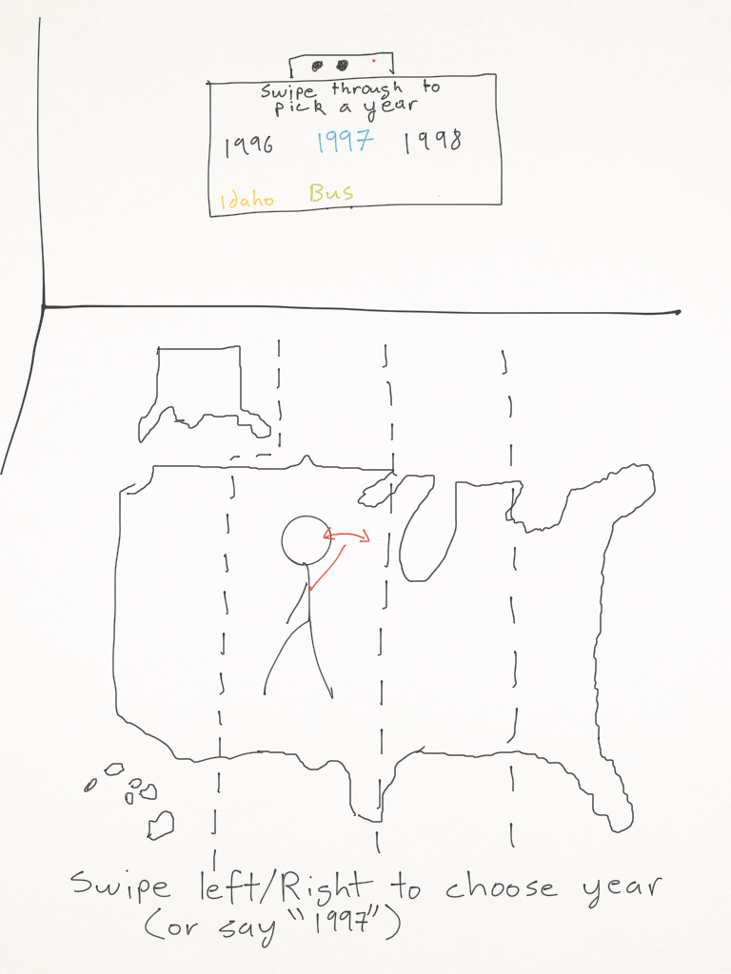
Crash Fatality Inspector: Storyboard
Context: Located at a DMV
[presentation specialist]

Slide 8
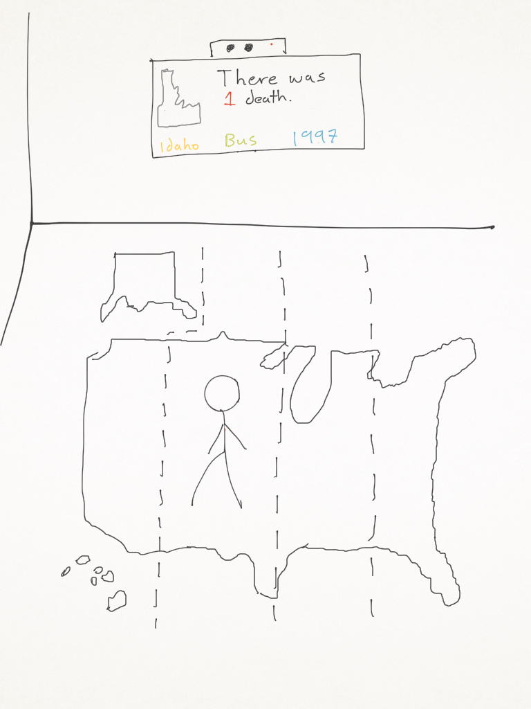
Crash Fatality Inspector: Storyboard
Context: Located at a DMV
[presentation specialist]

Slide 9
Focus Group Results
[Writing and Analytics Specialist]
We may need to come up with a couple of different gestures when choosing data to view.
When choosing a year to view, if none is chosen then default to the most recent year.
Idea was brought up to separate the data by state instead of by vehicle for easier data parsing (Use each state as a .csv file).
Instead of placing text for vehicle use pictures.
Quotes:
  “Using the user's body to move about a scaled map is the highlight of the design and looks promising. Additionally, a voice command is also helpful during the selection phase.”
  “The floor map is a very good idea. People would definitely be engaged by that.”
  “The arm gestures seemed simple but yet not trivial. With both voice and body movement it will be engaging.”

Slide 10
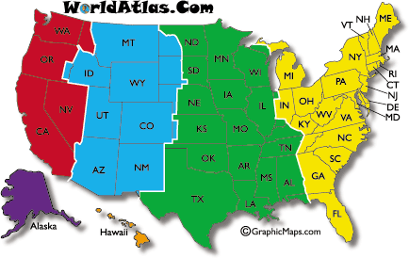
Redesign
[Aesthetic Specialist]

Slide 11
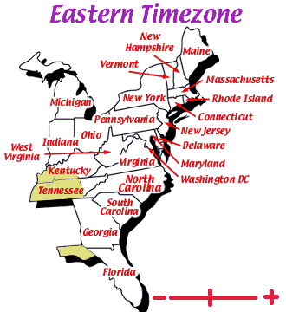
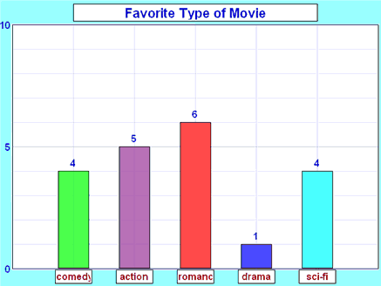
Redesign
[Aesthetic Specialist]

Slide 12
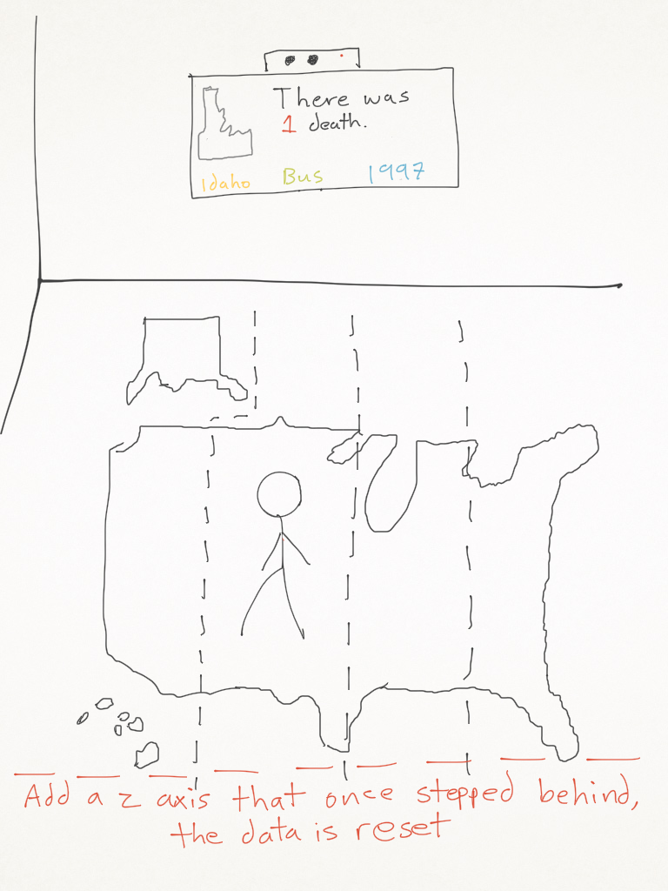
Redesign
[Aesthetic Specialist]

Slide 13
Initial Implementation Plan
[Programming Specialist]
We are going to program the application in C# using the built in 2D graphics libraries.
Convert Excel file from .xlvs to .csv and parse the information and separate it by state.
  Will have 50 state .csv files
  Load all data into memory when application starts
May research graphing libraries:
  Oxyplot (Open Source)

Slide 14
Feedback
Any Questions?

