Slide 1
Team 10
Tom Phillips
Ian Swift
Mike Berg
Dustin Bullard

Slide 2
Fates United www.fatesunited.com
Project Lead
Tom Phillips
Art Lead
Dustin Bullard
Programming Lead
Ian Swift
Hybrid Programmer/Artist COMANDANTE
Mike Berg

Slide 3
Goals & Rules
- Collect resources
- Unlock new tech.
-Build an army
- Eliminate the other player’s space station
- 1v1 on up to 3 maps
- 1 base/space station
- 3 tiers for tech. advancement
- 9 customizable ship classes

Slide 4

Storyboards: Initial Map Concept

Slide 5
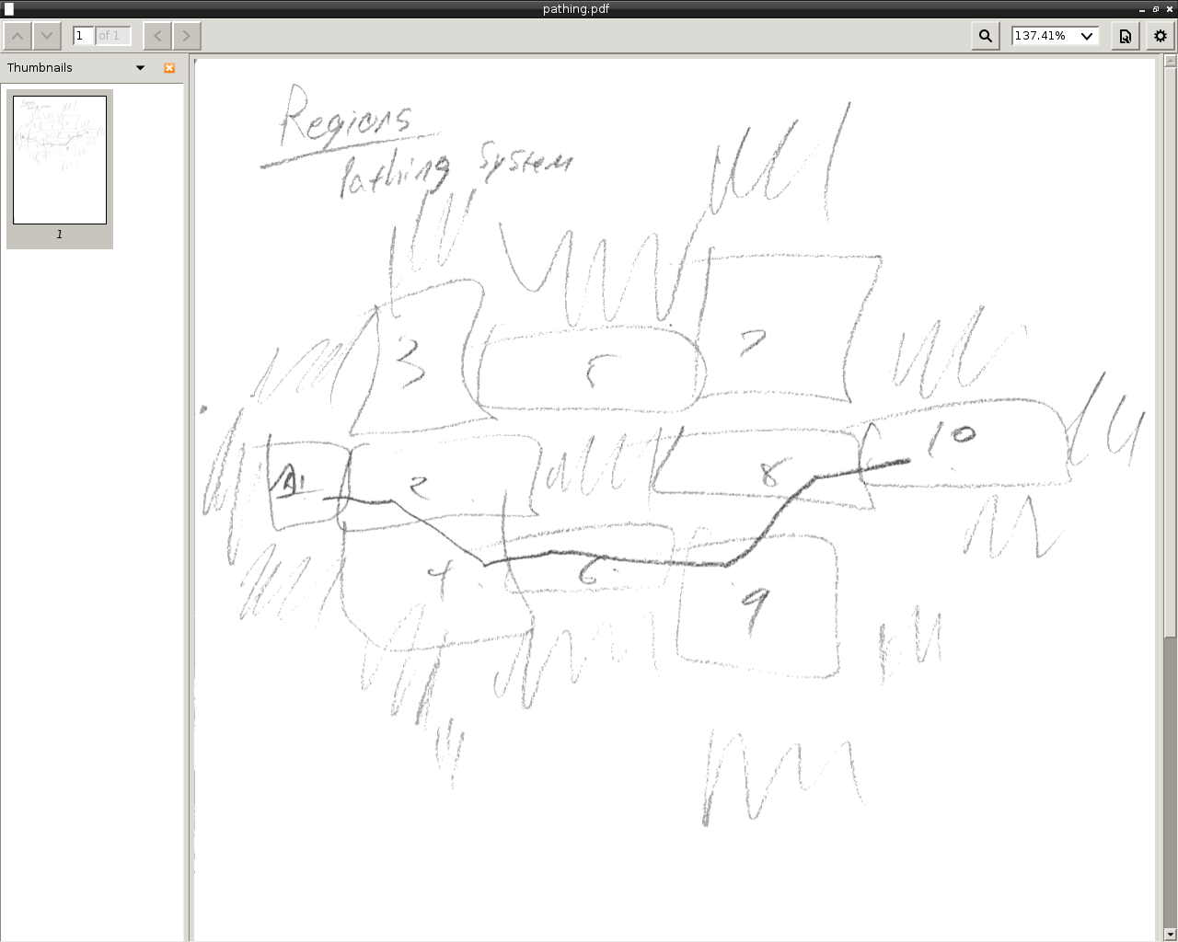
Storyboards: Initial Pathing Concept

Slide 6
Storyboards: Tech. Advancement
Tier 1: Tier 2: Tier 3:
Mining Ship Unlocked Support Ship Unlocked Dreadnought Unlocked
Scout Ship Unlocked Striker Researchable Siege Ship Researchable
Cruiser Researchable Artillery Researchable (Requires Artillery)
Anti-Tank Researchable
(Requires Striker)

Slide 7
Storyboards: Base Management
- Everything is modular
Base Add-ons:
- Ship Factory
- Defense Structures
- Ship Workshops
- Population Buildings
- Scanner

Slide 8
Storyboards: Ship Statistics
- Total Integrity - Speed
- Shield type - Abilities
- Weapon
- Type
- Damage
- Rate of Fire

Slide 9
Storyboards: Ability Concepts
- Cloaking
- Repair bots/drones
- Warp Drive/Jump Drive
- SELF-DESTRUCT
- EMP
- Gravity Manipulation (i.e. Tractor Beam)

Slide 10
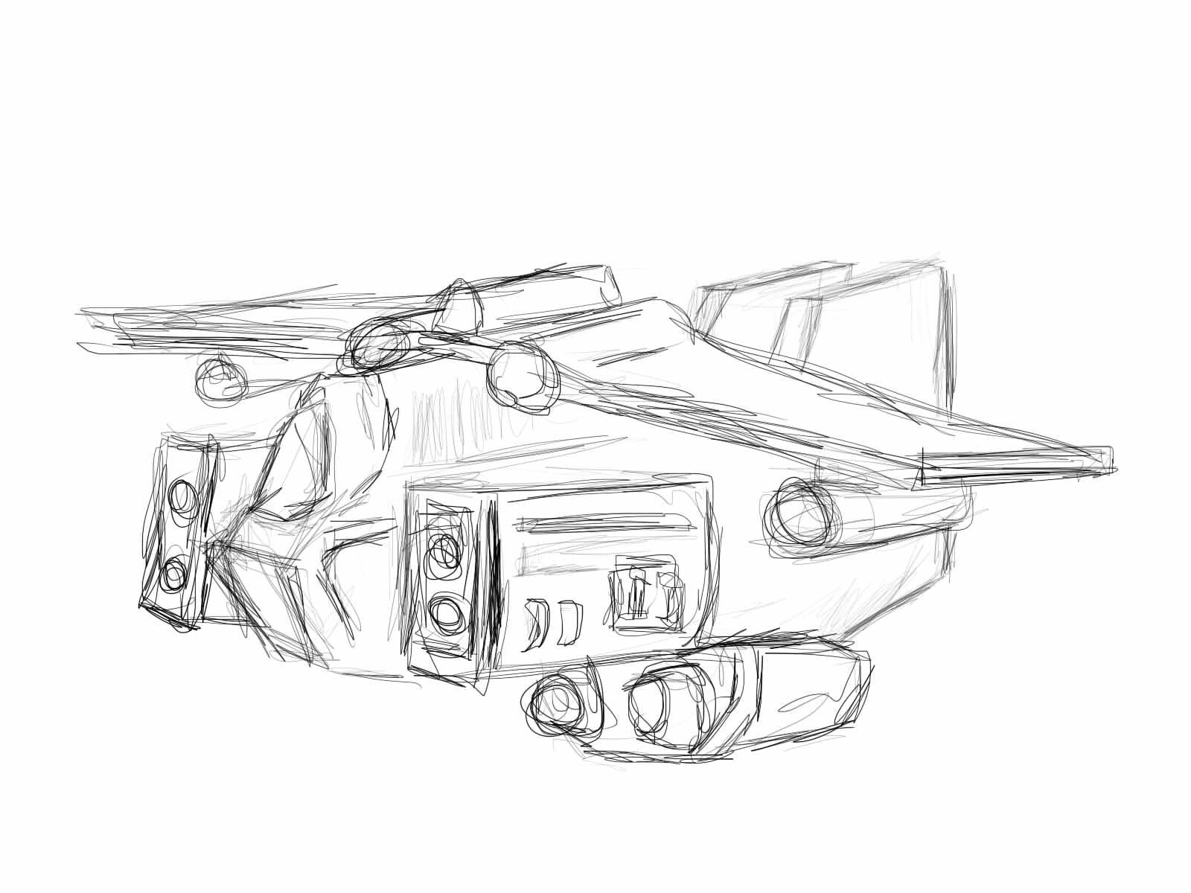
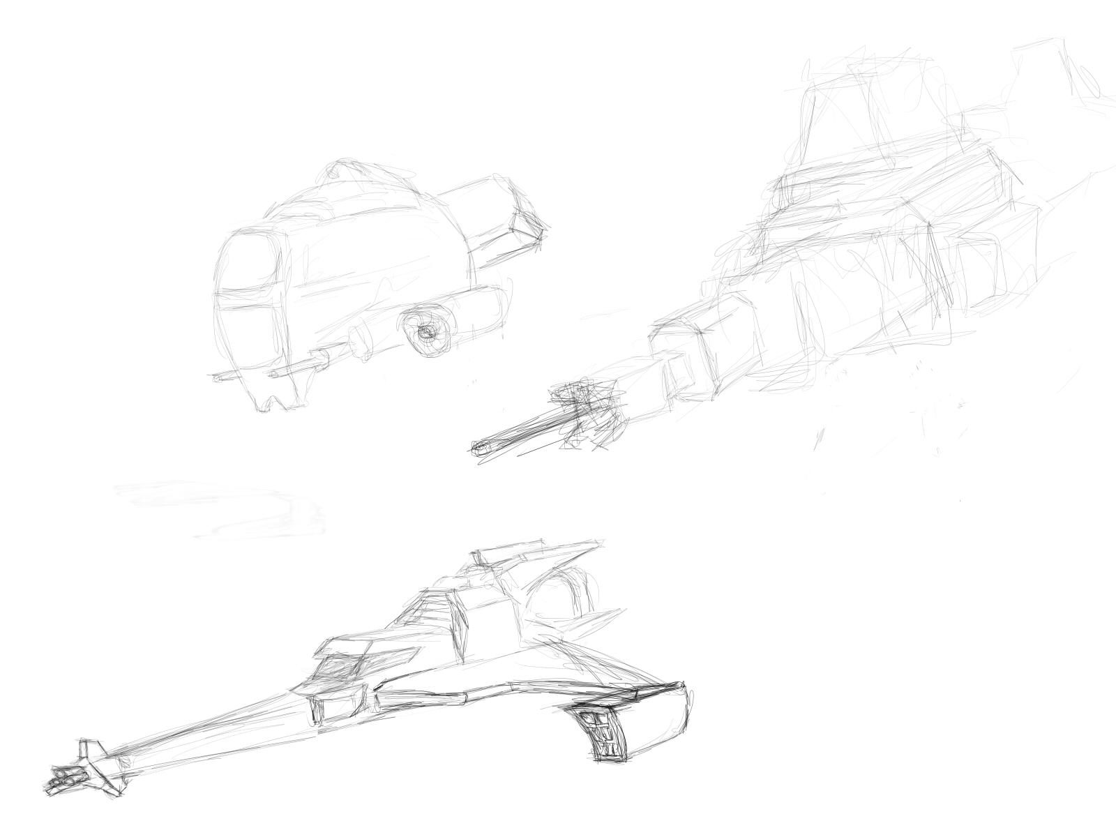
Storyboards: Ship Sketches

Slide 11
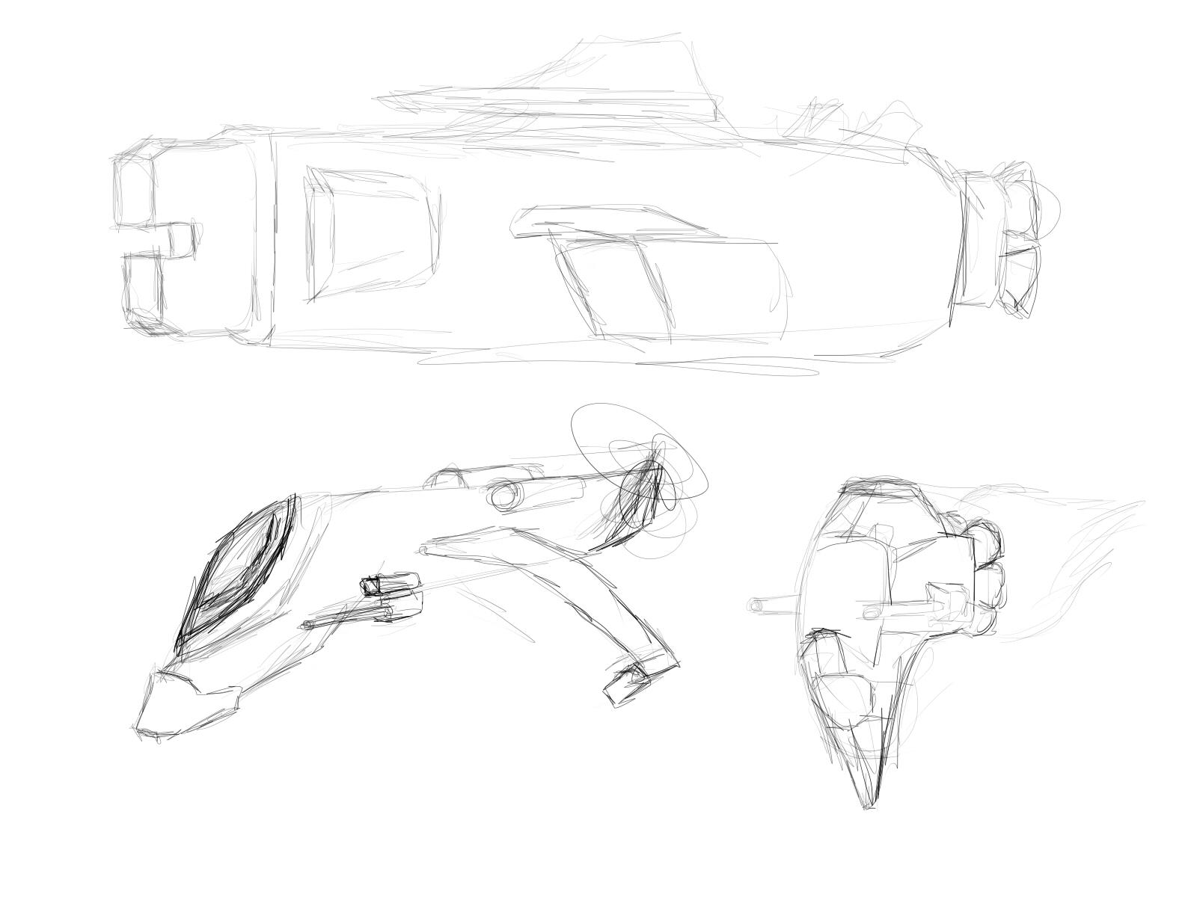
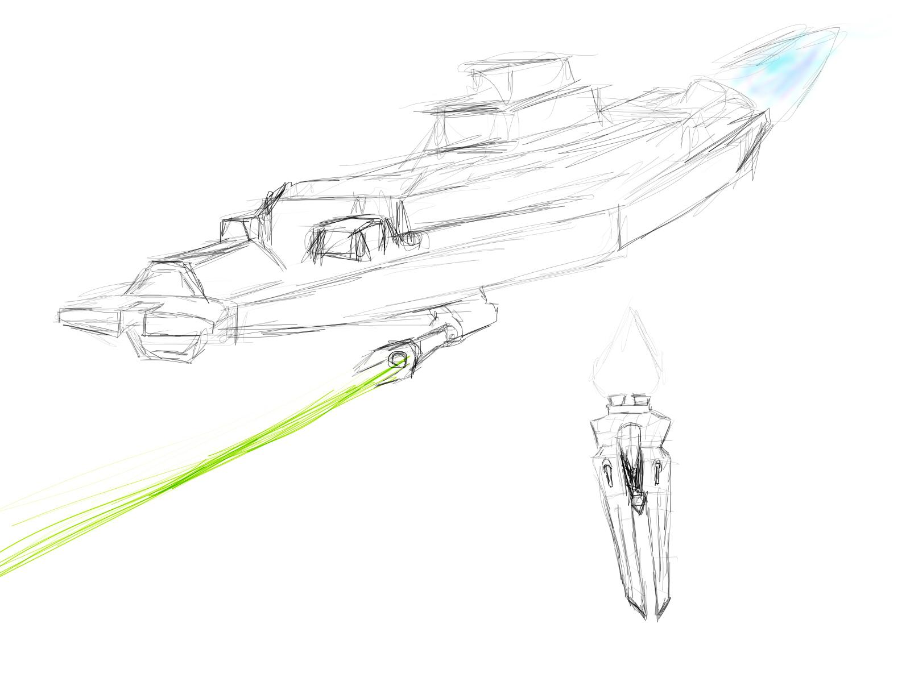
Storyboards: Ship Sketches cont.

Slide 12
RTS Design Resources
http://content.gpwiki.org/index.php/RTS_Design_Guide
http://futurewarstories.blogspot.com/2011/03/fws-topics-military-spaceship-classes.html

