Slide 1
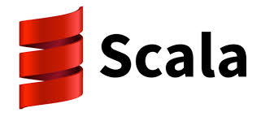

Store Sales Prediction with Apache Spark (using Scala)
By
Anirudha Deepak Bedre
Laksh Lumba

Slide 2
Goals of the Project
To predict the daily sales of Rossman Drug stores for upto next 6 weeks.
To develop Apache - Spark Scala code to parse, clean, model the data.
To use Apache - Spark Scala Mlib(Machine Learning Library) to predict the sales.

Slide 3
Data Source
1,017,210 record dataset containing sales history of 1115 Rossman Stores(drug store like CVS).
Kaggle (https://www.kaggle.com/c/rossmann-store-sales)

Slide 4
Overall Design / Methodology
Data
Cleaning and Aggregating
Fitting/Training the data to the model
Make predictions based on the fitted model
Save predictions and test accuracy of the model
Training
Dataset
Predictions

Slide 5
Code Walkthrough (Important classes and their functions)
RossmanSalesPrediction (main class)
Call the Spark Context and initiate the other functions by providing the dataset
Model/StoreSalesDataFrame:
Format and datatypes of the dataframe.
Clean/DataAggregatorUtil:
Loading the training dataset and saving it to a dataframe.
Loading the test dataset and saving it to to a dataframe.
Clean/DataCleanerUtil:
Filtering the missing values and header records
Conversion to correct data formats
Algo/SalesPredictionUsageUtil:
Encoding of data columns (indexer/one hot encoder to convert labels to dummy variables).
Preparing pipelines for the respective models (linear regression/random forest regression).
Preparing and fitting the model.
Make predictions and save it as a file.

Slide 6
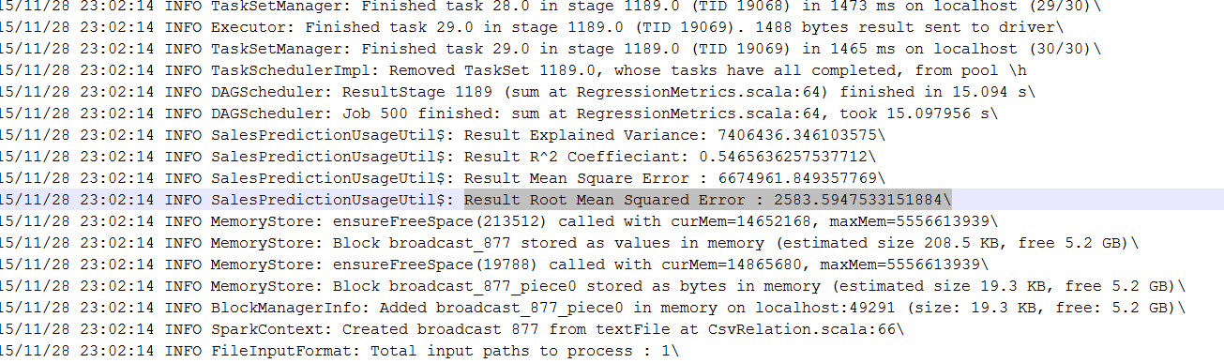
Output

Slide 7
Test Cases Implemented
Spark Context should not be null
Training dataset should not be null
Test dataset should not be null
Training dataframe should not be null
Test dataframe should not be null
Random Forest Pipeline should have trainValidationSplit
Linear Regression Pipeline should have trainValidationSplit

Slide 8
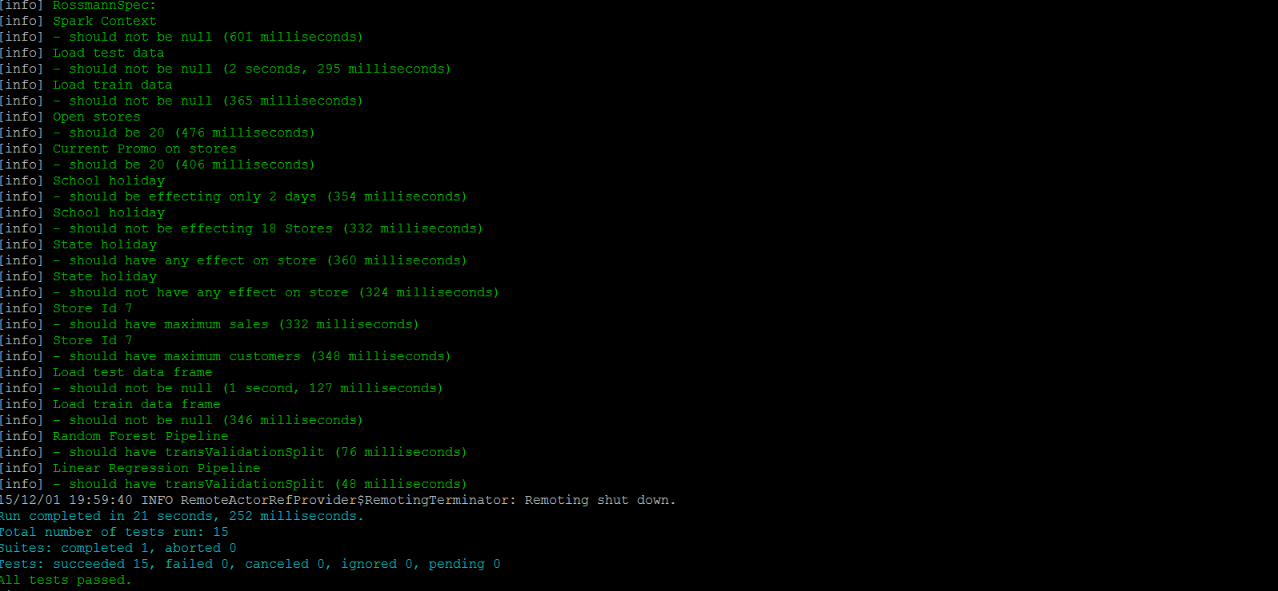
Test Cases Output

Slide 9
Acceptance Criteria
We had targeted an RMSPE of 0.20
We ended up achieving an RMSPE of 0.45

Slide 10
Thank you !!!

