Slide 1
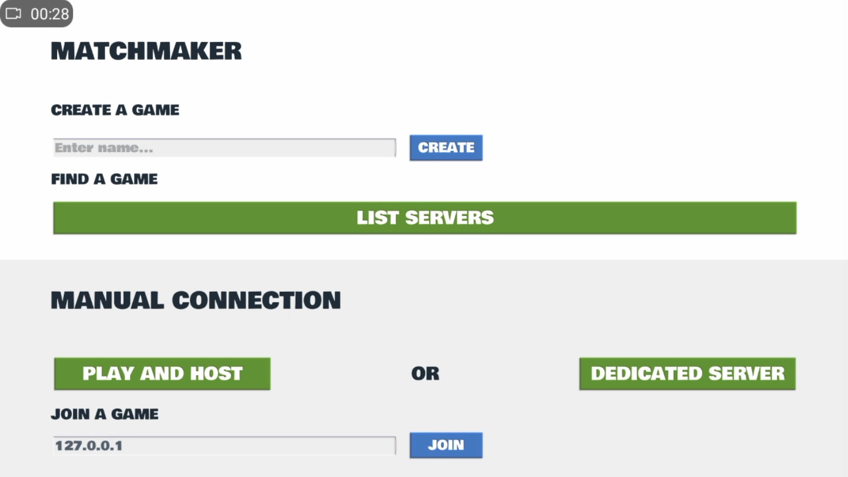
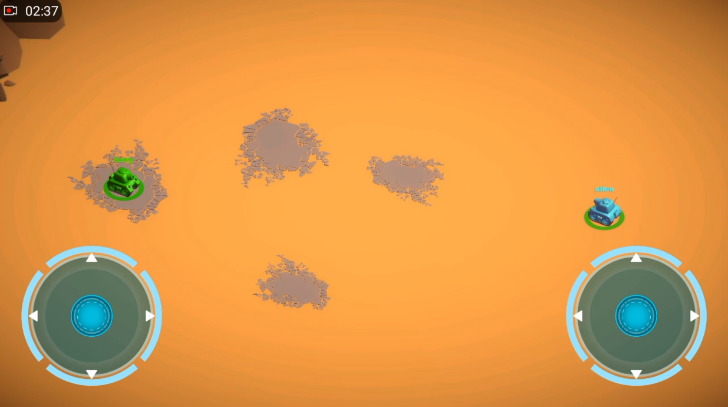
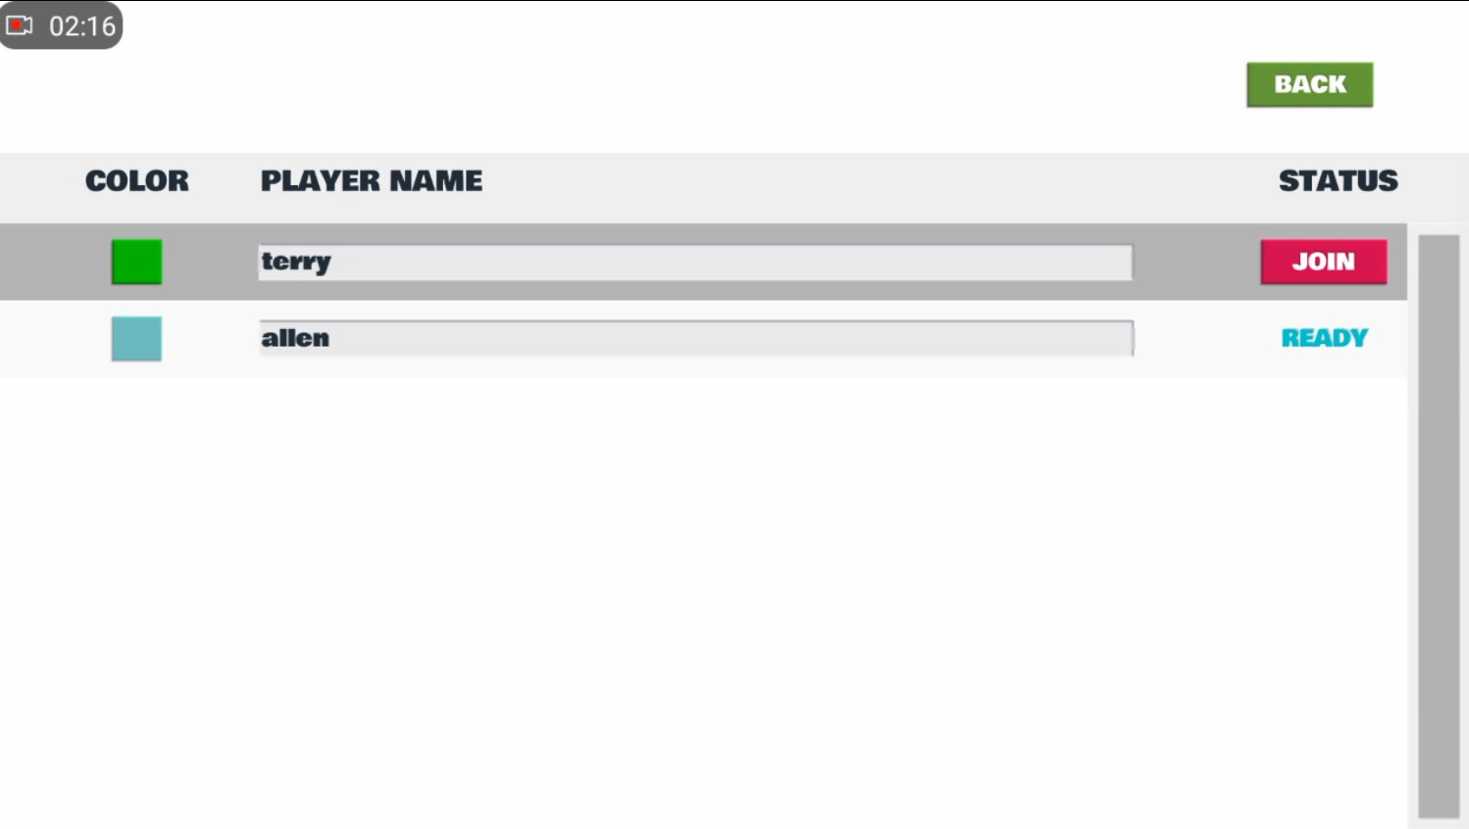
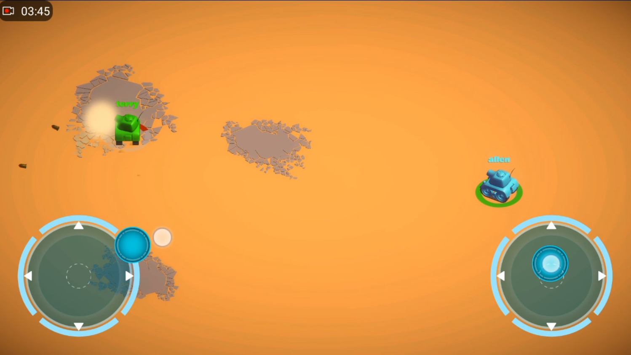
Mobile application based on Unity3d
S: Dyce O: Weifeng E: KP
Wang Guoquan 1430003024
Notes:
Good afternoon everyone, this is my FYP. Mobile application based on Unity3d. My supervisor is Dyce. You can see, the screenshot of my project here. It is a two-mobile phone tank shooting game.

Slide 2
CONTENT
01
Introduction
02
Software Design
03
Problem Discussion
04
Demo
Notes:
I divided my FYP into 4 parts. Introduction, software design, problem discussion, demo.

Slide 3
PART
ONE
Introduction
Notes:
Background (what you are doing)
Motivation (why do you do it?)

Slide 4
Background
Unity is the ultimate game development platform. Use Unity to build high-quality 3D and 2D games, deploy them across mobile, desktop, VR/AR, etc.
This project is a two-mobile phone two players 3D tank shooting game.
13

Slide 5
Software
Unity3D
Monodeveloper C#
Android studio
05
Notes:
Then these are the software we need to install.
Unity3D is using C# language.
Monodeveloper is use to edit and debug C# file I write.
Android studio is use to build and run the android version of my game. It provide a android SDK and JDK, which is the necessary thing about build in .apk file.

Slide 6
Motivation
Computer games are cool
Mobile games are cool
05
Notes:
The motivation of my project is that I like to play computer games. The motivation is similar as I select CST as my major. So, I finished my FYP and I am the best.

Slide 7
PART
TWO
Software Design
Lobby Scene
Game Scene
Notes:
Then I am going to say my amazing Software Design.
You can see, my entire game contains 2 different scenes, one is lobby scene, the other one is Game Scene.
Lobby scene is use to let the computer know you two player are going to solo. Once two players connect in the same game, this game can be played.
My lobby scene is very powerful, there are two different way to connect the game.

Slide 8
Lobby Scene
Match Maker
Mechanism Protocol: UNET
Create Room
Lobby
Match Maker
Game Scene
List Room
Join
Room
Notes:
The first connection is matchmaker. This connection is based on UNET mechanism protocol. When one player go into the matchmaker, it can create a room. After the player create a room. The other player can list the room and select which room he is going to connect. After 2 players join the room and ready for the game. Two player are going to the same game scene in the same time.

Slide 9
Lobby Scene
Manual Connection
Create
Room
Lobby
Manual
Connection
Game Scene
Join
Room
Mechanism Protocol: TCP/IP
Notes:
The second connection is manual connection. This connection is based on TCP/IP mechanism protocol. When one player go into the manual connection, it has to create a room. After the player create a room. The other player can only join the room by typing the physical address. Also, after 2 players join the room and ready for the game. Two player are going to the same game scene in the same time.

Slide 10
Lobby Scene
Match Maker
Manual Connection
List Room
Match Maker
Join
Room
What’s their difference?
Create Room
Lobby
Game Scene
Create
Room
Manual
Connection
Join
Room
08
Notes:
So we can draw a conclusion like this. If you already understand how my lobby work. You may ask, why you choose 2 different way to connect the player? As I said, the mechanism protocol is different, matchmaker is UNET and Manual Connection is TCP/IP. If we use the matchmaker, this connection stability depends on the quality of network. If the network doesn't work well, they may have a large amount of trouble. However, manual connection doesn't care about your network quality. It can work this game scene offline because the creating room player is the host. SOOOO, after connected, we are going to play the tank shooting game.
5:38

Slide 11
Game Scene
Tank Prefab
Model
Prefabs
Tank
Actions
Notes:
After we done some fussy lobby. We are going to create our major character tank. Unity3d give us a chance to create major character by prefab, which is very convenient for us to develop game. For every prefabs has one or many actions, some of them has a model. Here, I am going to show the action this tank prefab have.

Slide 12
Actions
Setup
Instantiate
Move
Shoot
Prefab Shell
Health
Die
play
Prefab TankExplosion
Notes:
At the beginning, game scene create 2 tanks on the levelart. The tank can move because I create a tankmovement.cs script drag to tank prefab. The tank can shoot because I create a tankshooting.cs script drag to tank prefab. The tank can die because I create a tankhealth.cs script drag to tank prefab.
The script tells the detail how the tank do and how to generate other prefabs. For example, tank shoots has to create a new shell prefab. The shell need to know, where am I going to instantiate and where should I shoot. For other example, after the tank dies, the prefab TankExplosion has to play immediately.

Slide 13
Game Scene
Shell Prefab
Model
Prefabs
Shell
Actions
Notes:
After we done tank prefab, what we need to do is shell prefab. Also, it has a model and many actions

Slide 14
Actions
Instantiate
Hit something related rigidbody
Calculate
Physic
Forces
Hit something not related rigidbody
Or do not hit something
Die
play
Prefab ShellExplosion
Notes:
Once player hit on fire bottom, the shell automatically instantiate from the mouse of the tank. If hit something not related rigidbody Or do not hit something, the shell will die and play the prefab ShellExplosion. If the shell Hit something related rigidbody and has a tankhealth.cs associate with rigidbody, it will calculate the damage and play a physic force to tank. Finally shell dies and play the prefab shellExplosion. And everything is over.
8:41
OK?
I know you don’t know what I am talking about,
My project contains other 30 different prefabs(like tank and shell) to guarantee the mobile game to play. what you need to do is play my game and have fun.
If you can understand

Slide 15
How Shell damage tank HP?
Find hit rigidbody
related
How to deal with the damage
Other detail
1. If they don’t have a rigidbody, go on to next collider
2. Find the tankHealth.cs associate with rigidbody(if not, go to next collider)
1. Create a vector from shell to target, calculate the distance from the shell to the target.
2. Calculate the damage at the point according to the distance
1. Minimum is always 0, maximum is 100
2. Deal the damage to tanks.
JUN
JUL
AUG
SEPT
OCT
NOW
RECENT MONTHS
09
Notes:
After we know the prefab tank and shell, how Shell damage tank HP?

Slide 16
How Shell makes Tank Physic Forces
Find the shell explosion point
How to deal with the Physic Forces
Other detail
Minimum is always 0. Physic forces can stop.
Create a vector from shell to tank, calculate the distance from the shell to the tank.
Calculate the Physic Forces speed at the point according to the distance, tank Mass
Physic Forces direction （far from shell explosion point）
JUN
JUL
AUG
SEPT
OCT
NOW
RECENT MONTHS
09
Notes:
Also, how shell makes tank physic forces??
After all this things. We are going to play this game on computer.

Slide 17
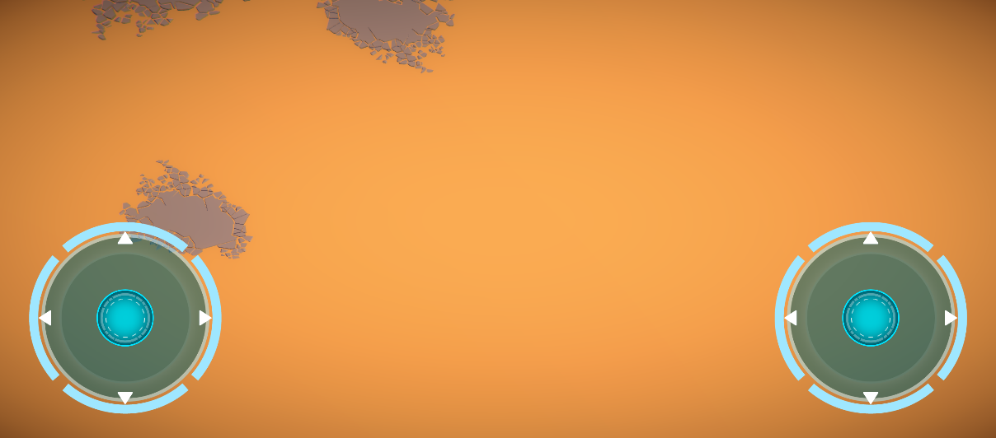
Joysticks
Movement
Shooting
Create a vector in joystick, read the distance between joystick to the center, according to this, linear judgment of the tank moving direction.
Read to the round angle, control the direction of shell
Notes:
If this game don’t have a joystick, this game is not a mobile game.
The left to control the tank movement
The right side controls the tank shooting
喝水

Slide 18
PART
THREE
Problem Discussion

Slide 19
Database
What’s saved on the server?
HP, Position, angle,… (sync)???
04
Notes:
You may say, HP, Position, angle,… (sync), etc. however, I tell you, those are wrong. The mechanism of my network manager prefab is different so that you know what is save on the unity server.

Slide 20
Database
The mechanism about my database
1. Network manager create need to add component network manager& network manager HUD
2. Create network identity &network transform (sync transform) & Tankshooting script(net version) in tank prefab
3. Create network identity & shellcontroller script(net version) & network transform (sync transform) in shell prefab /spawnable object in networkmanager
Notes:
In my network manager 读第一点，here，

Slide 21
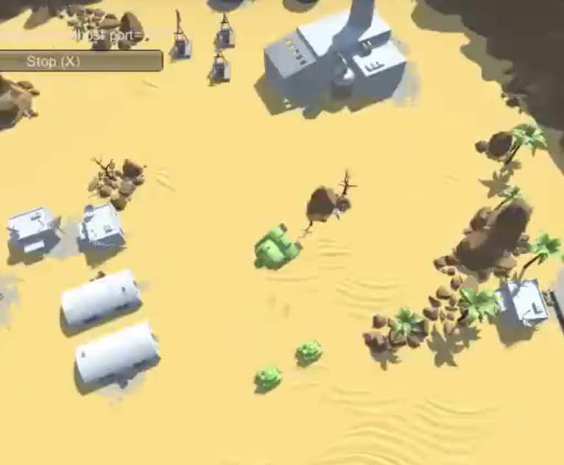
Add component Network start position Tank spawn info , set the method Round Robin
Notes:
After I play this game many times, I found a weird bug sometime appear. Which is a tank fly on the sky and cannot fall down unless turn off the game. This problem appears because two tanks network start position on the same point, when one tank already set there, the other tank do not have chance to set there.
so the tank does not work like what I want. So 开始读PPT.
This round robin will make the game weird at the beginning, but it works perfectly every time.
OK?
I will show you how it works on my demo.
15:57

Slide 22
PART
FOUR
Demo

Slide 23
Thank you
Mobile application based on Unity3d
S: Dyce O: Weifeng E: KP
Wang Guoquan 1430003024

