Slide 1
Clinical Decision Support System (CDSS)
Topic4
18436617 王国全

Slide 2
Tools and data
01.
03.
Sails is a popular computer language with MVC framework
Data using Topic3
02.
04.
Bootstrap is a quick solution for making front-end
Processing data with WEKA tools

Slide 3
Why choose this
Make patient more intuitive understanding of their illness (lung cancer)
Clinicians interact with a CDSS to help to analyze, and reach a diagnosis based on patient data.

Slide 4
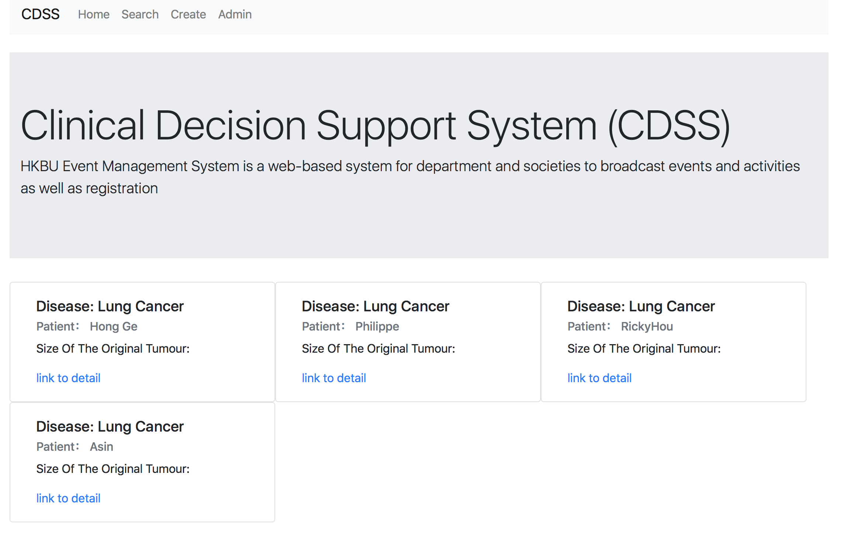
Some basic functions on my CDSS (index)

Slide 5
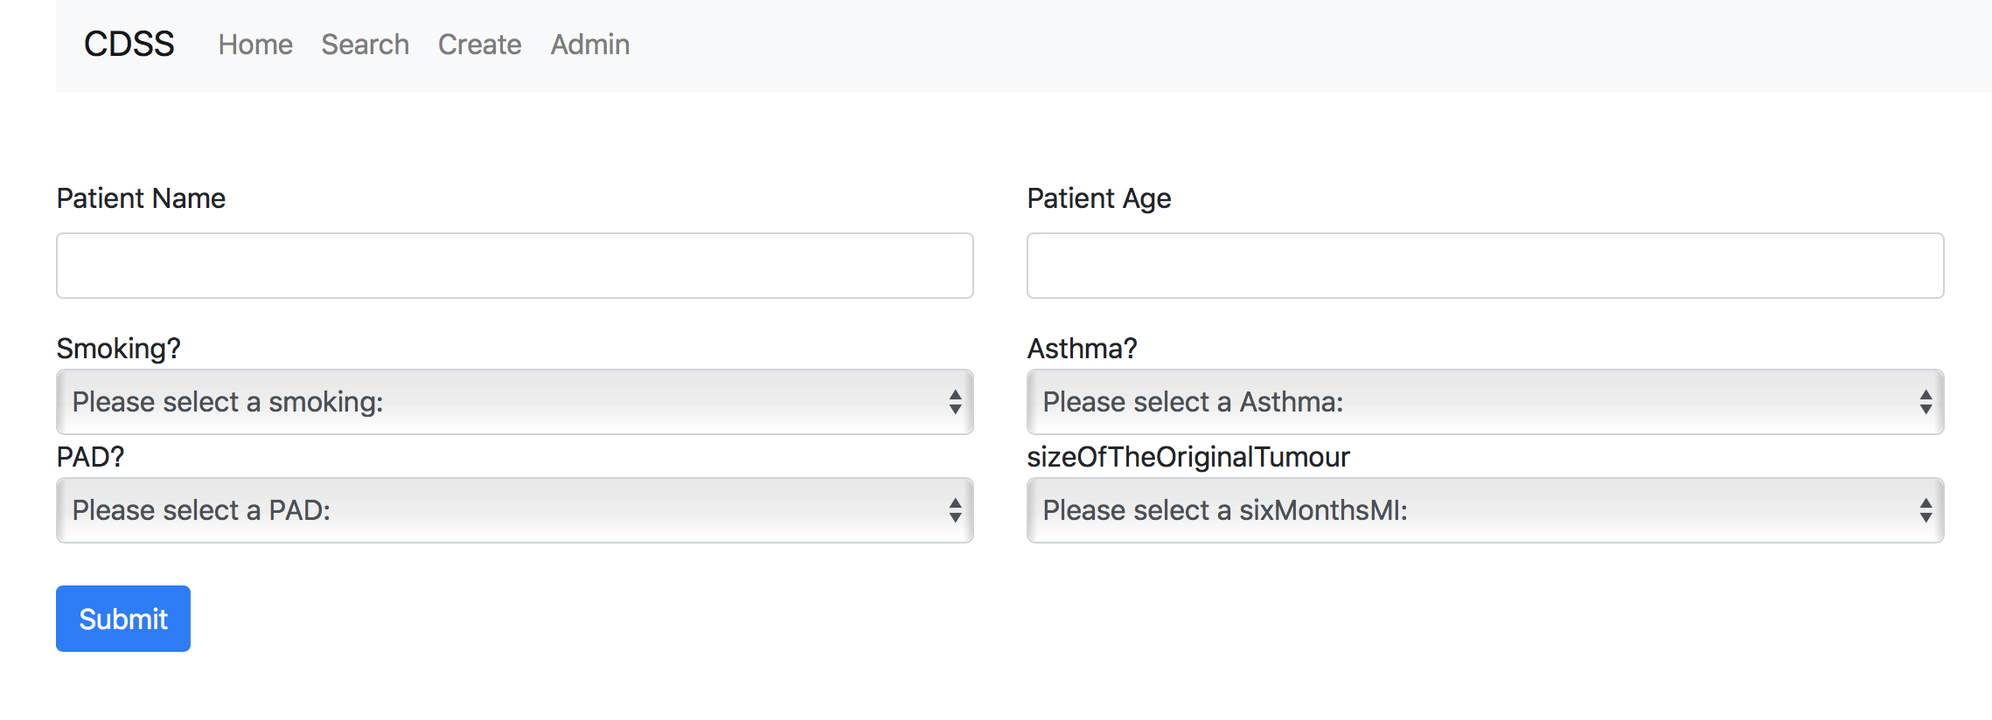
Some basic functions on my CDSS (create)

Slide 6
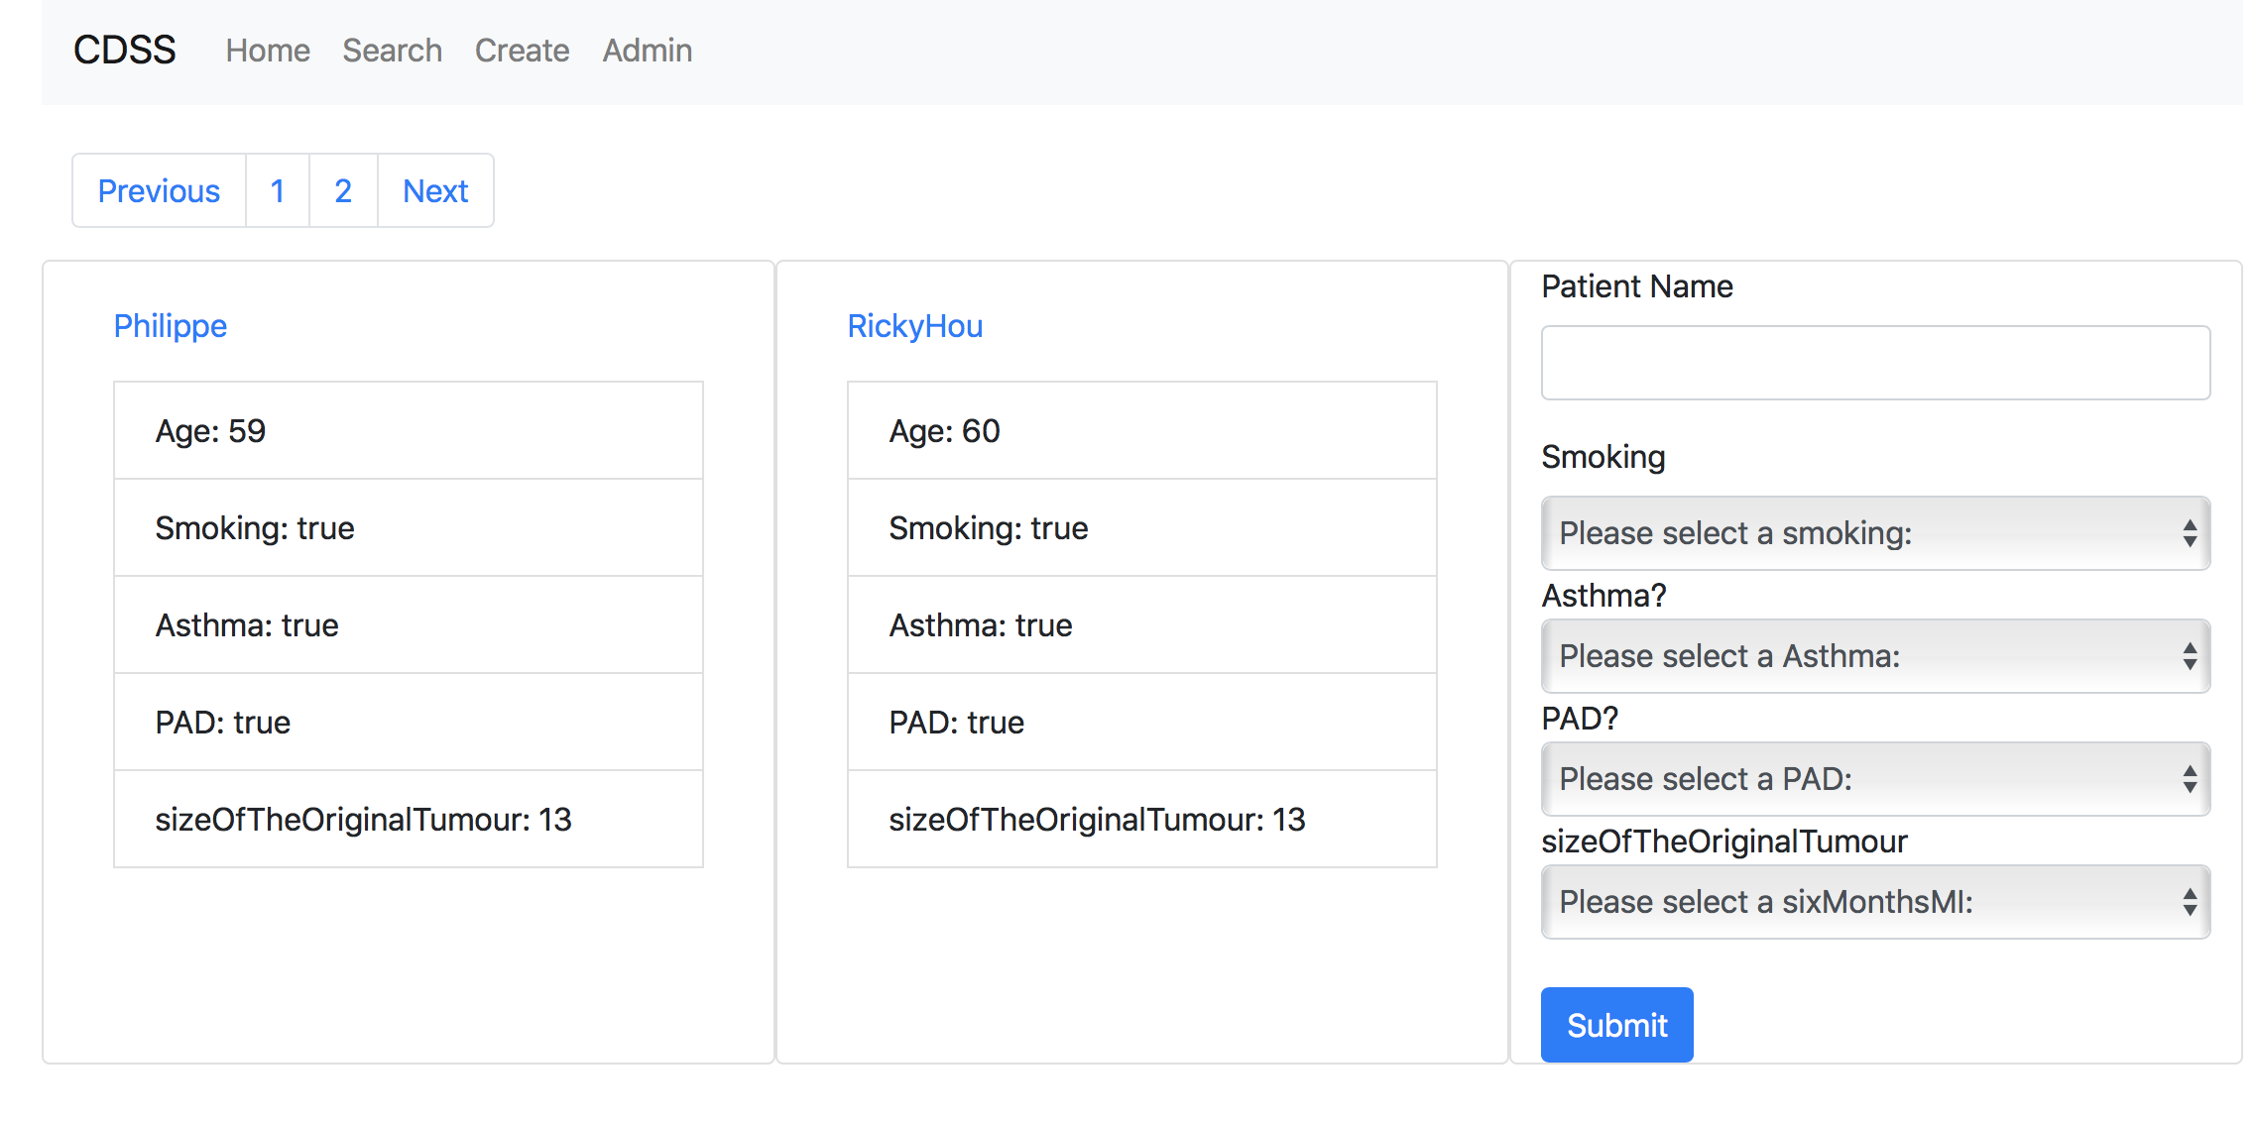
Some basic functions on my CDSS (search)

Slide 7
4 independent variables were chosen
Smoking
Asthma
VARIABLES
Size Of The Original Tumour
PAD

Slide 8
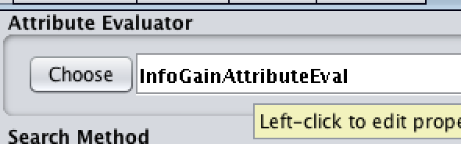

Why 4 of the 16 independent variables were chosen?
Several different algorithms are used to synthesize the four results. The most important algorithm is InfoGainAttributeEval
With the help of WEKA, the reliability of these variables can be easily calculated. After calculate, this 4 independent variables are the most reliable.
The results obtained by using these four independent variables are the most representative.
Notes:
用Resample bias选1.0
sampleSize按照需要填

Slide 9
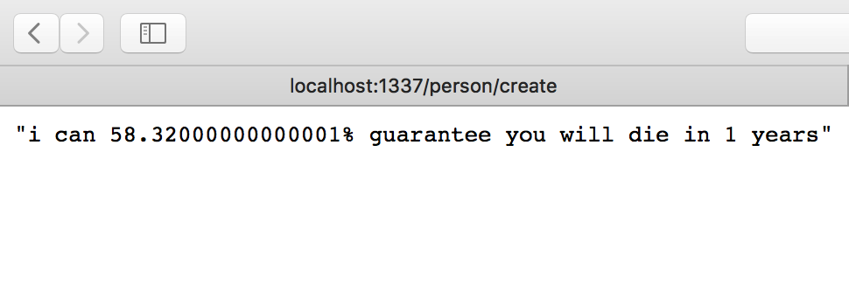
Examples of results

Slide 10
DEMO

Slide 11
Thanks for watching

