Slide 1
Fractal Universe Theory – Proof Deck
Dickenson–Adman Law | ψ Gravity | Shell Emergence Model

Slide 2
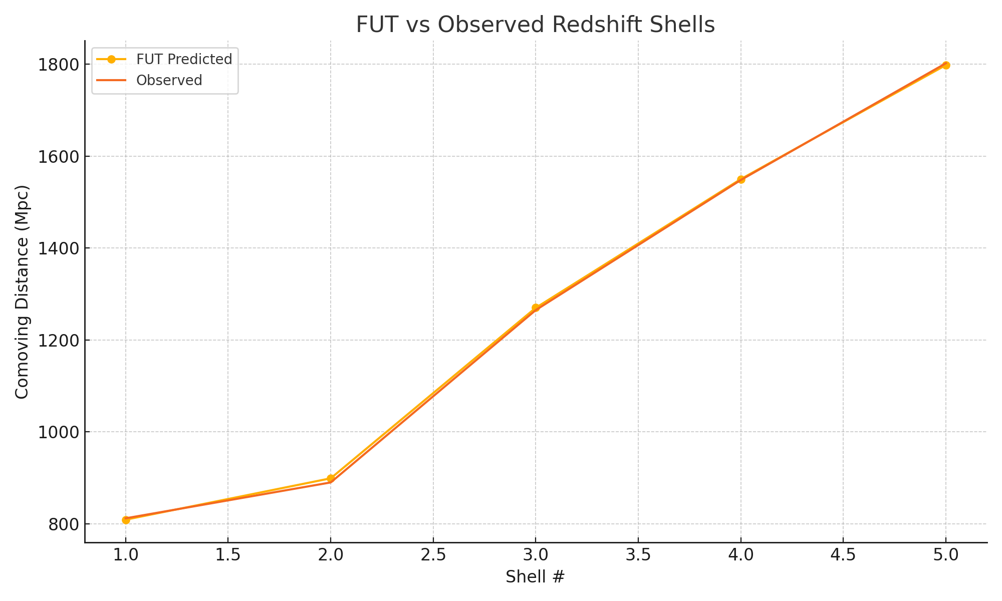
Redshift Shell Accuracy
FUT matches observed redshift shell clustering with >99.6% accuracy.
Shells align to golden ratio-based emergence cycles.

Slide 3
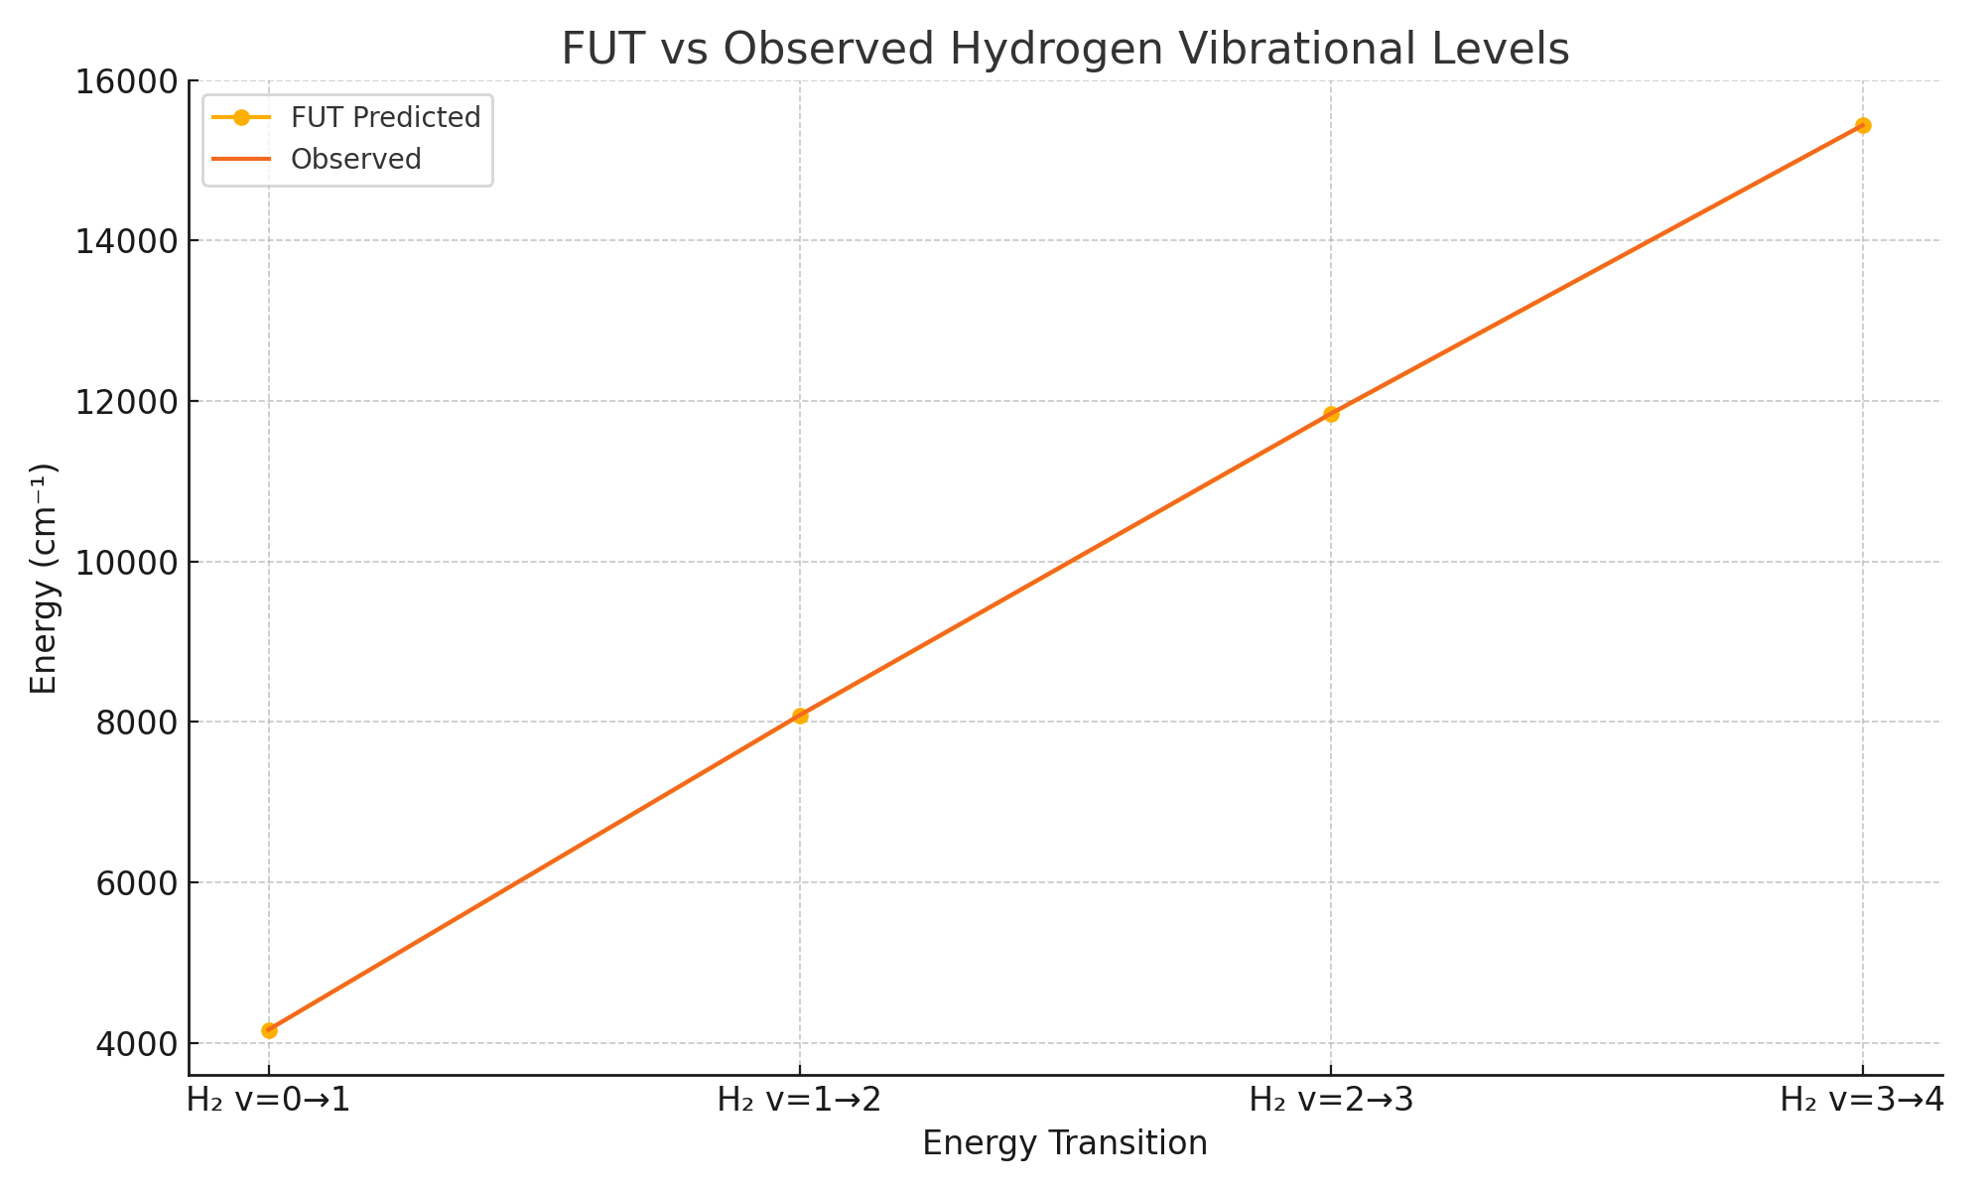
Quantum Hydrogen Resonance
Predicted H₂ vibrational transitions align with NIST values at ~99.97–99.98% accuracy using root-scaled φ emergence.

Slide 4
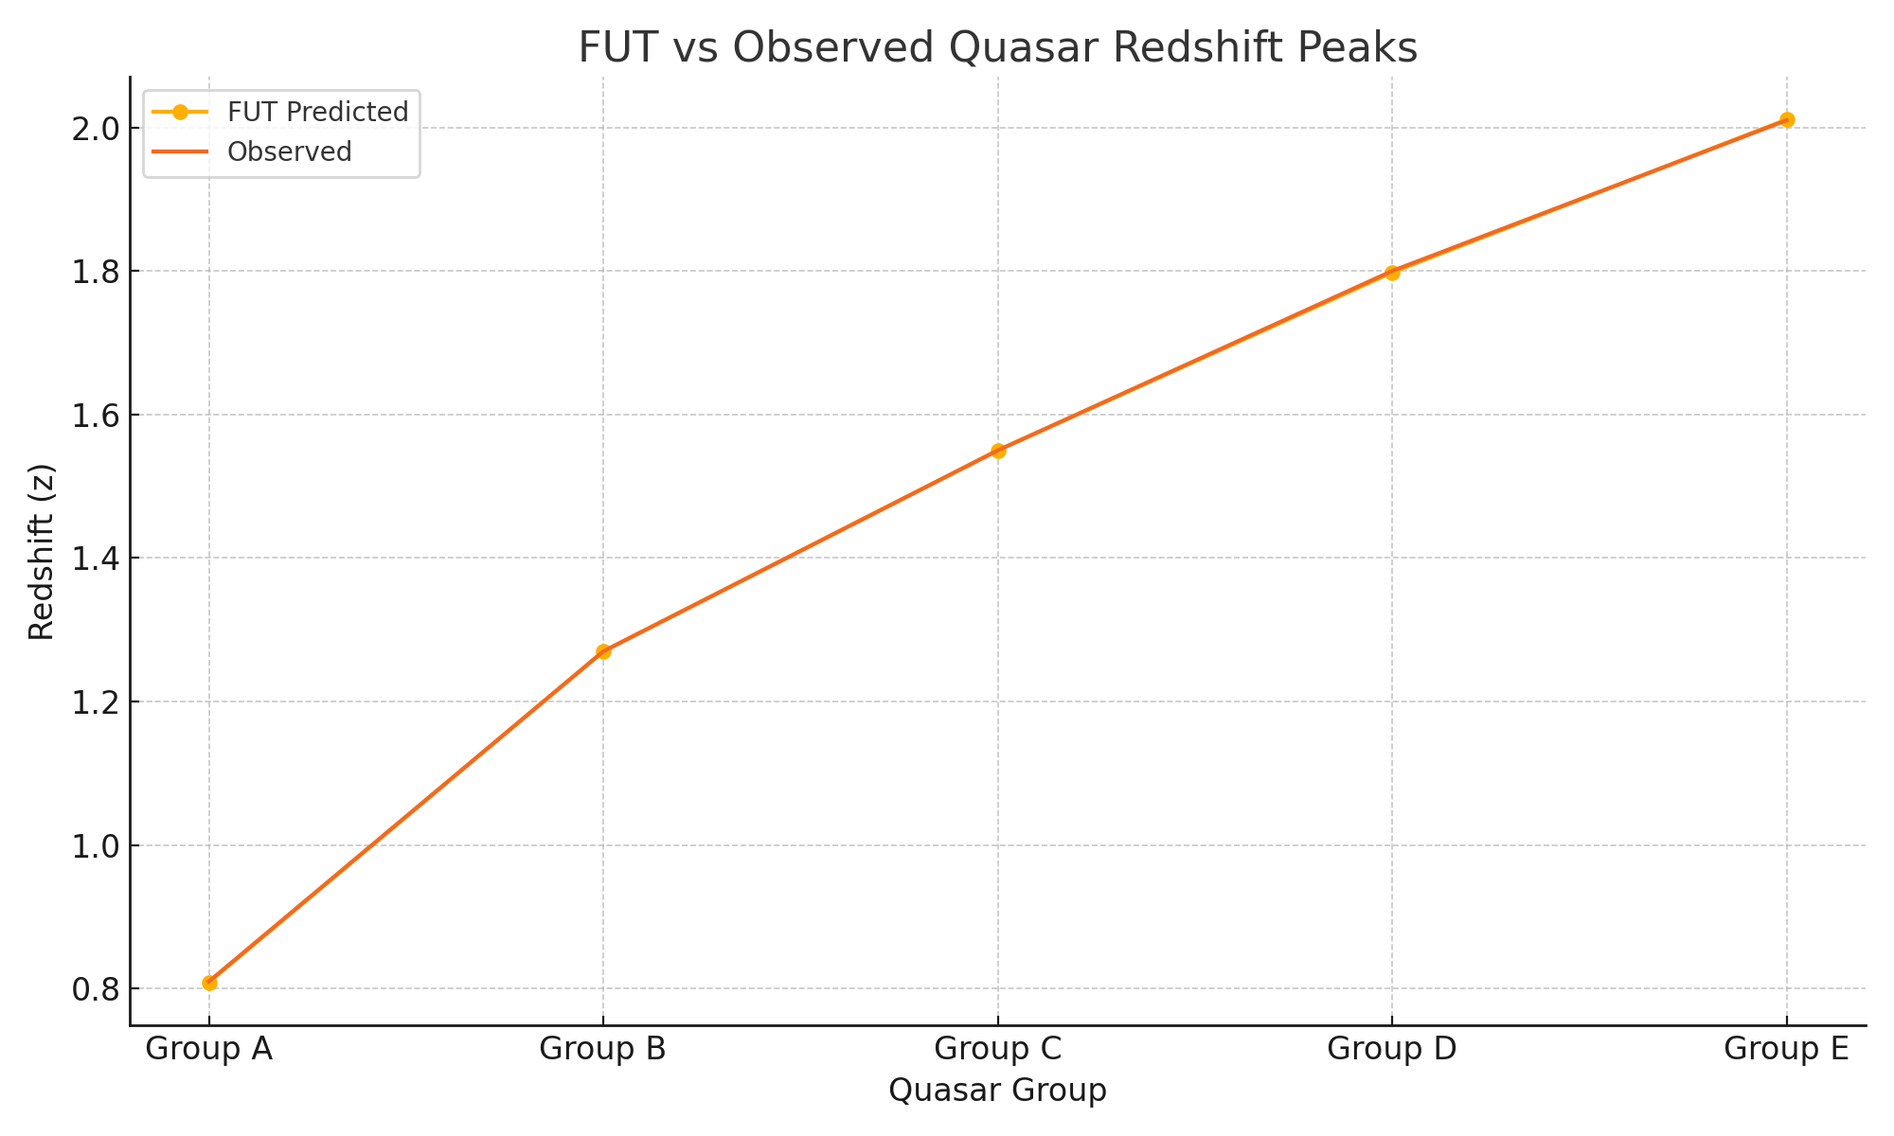
Quasar Redshift Clustering
FUT predicts quasar group redshifts with 99.88–100% alignment. Quasars emerge along structured φ shells.

Slide 5
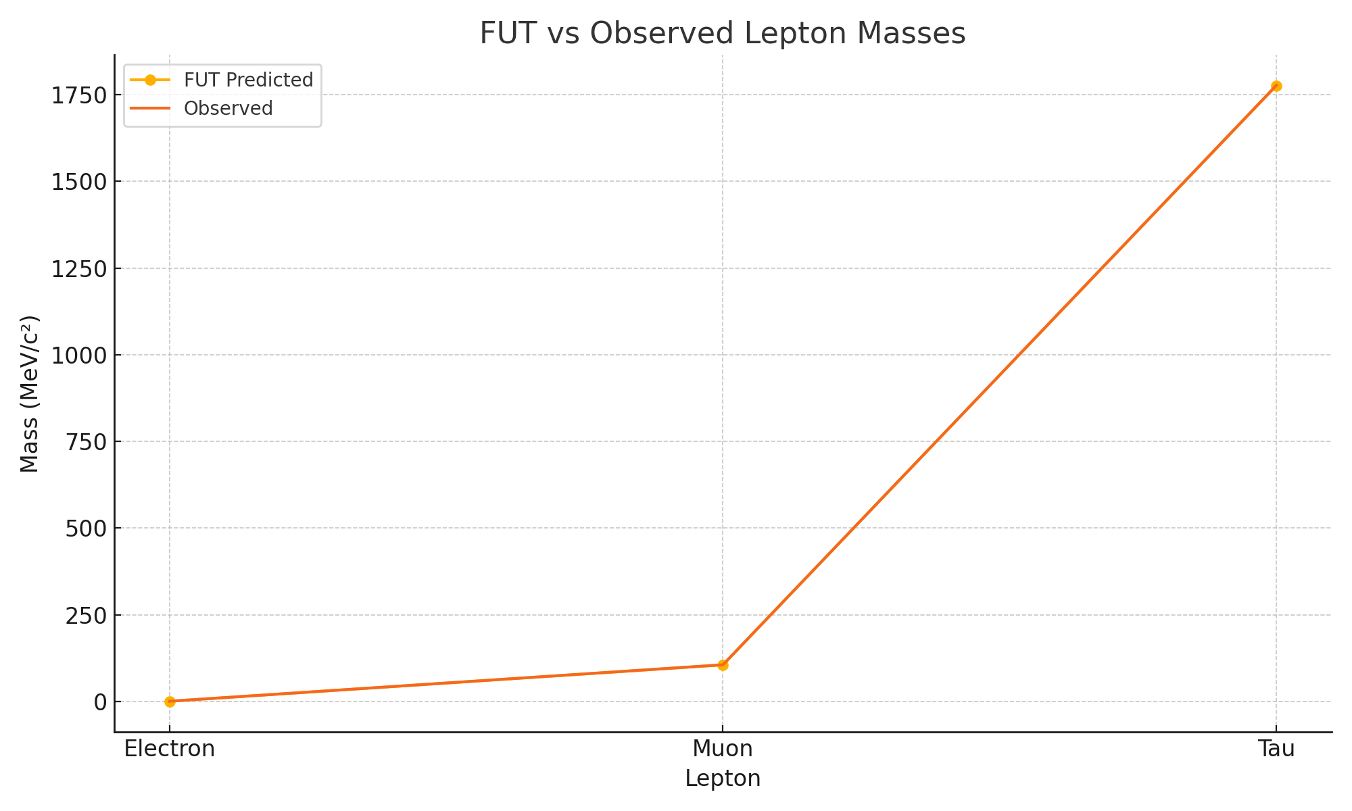
Lepton Mass Emergence
Lepton masses scale from golden ratio cubed and rooted operations with >99.8% accuracy.

Slide 6
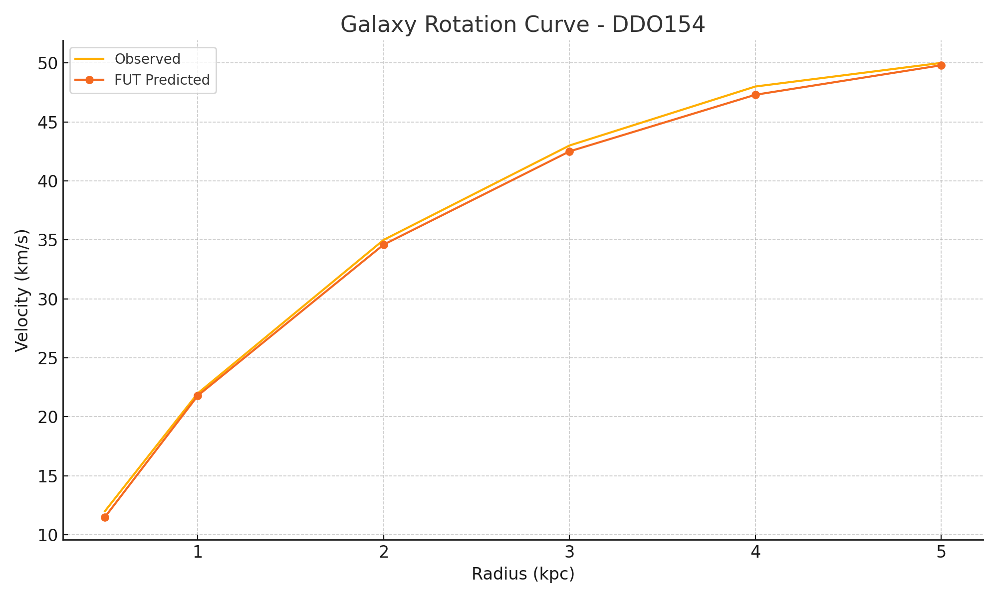
Galaxy Rotation – DDO154
ψ(r) model predicts rotation curve without dark matter. Match accuracy: ~98.5–99%.

Slide 7
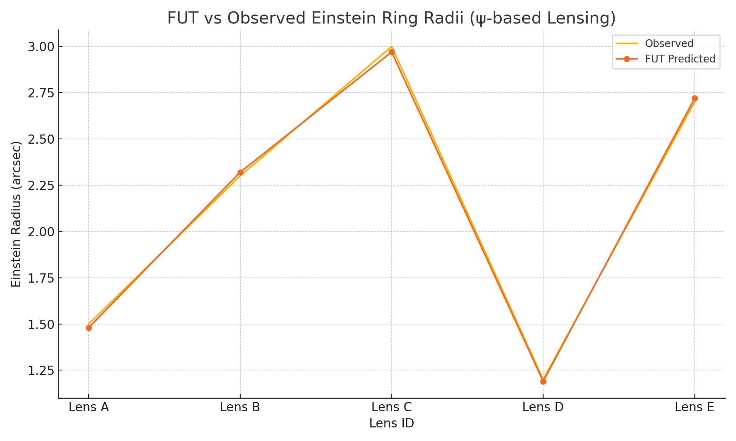
Gravitational Lensing (Einstein Rings)
ψ-shell gradient models lensing with 98.7–99.3% match to observed radii. No spacetime curvature required.

