Slide 1

Shiny app for COVID-19 Analysis in Missouri
By: Fathieh Qakei

Slide 2

Literature review
The dataset provided by The New York Times is an extensive compilation of COVID-19 data for the United States at the state level. It includes historical data on cumulative counts of coronavirus cases and deaths, tracked and updated since January 2020. This dataset has been crucial for researchers, public officials, and journalists in understanding the spread and impact of the pandemic at a state level.
Several studies have utilized similar datasets to analyze COVID-19 trends, evaluate public health responses, and predict future outbreaks. For instance, research has focused on the correlation between social distancing measures and the reduction in case numbers, the disparities in COVID-19 impact among different demographics, and the effectiveness of vaccination campaigns (Prakash et al., 2021). The granularity of the data at the state level allows for detailed regional analyses, which can inform localized public health strategies.

Slide 3
Data collection & description
The data comes from The New York Times' COVID-19 data repository (GitHub - nytimes/covid-19-data: A repository of data on coronavirus cases and deaths in the U.S.). It provides detailed and up-to-date information on COVID-19 cases and deaths across all U.S. states from January 21, 2020, to March 23, 2023.
The dataset has 5 variables, which are:
Date: The date of the report.
State: The state where the data is reported.
Cases: Total number of cumulative COVID-19 cases.
Deaths: Total number of cumulative COVID-19 deaths.
FIPS (Federal Information Processing Standards) Codes: Standard geographic identifiers for states.

Slide 4

Design/objective
This project aims to develop a Shiny app that is designed to cluster COVID-19 data from Missouri state using K-means clustering. The primary goal is to analyze and visualize trends in COVID-19 cases and deaths over time, allowing users to interact with and explore the data in various ways.

Slide 5
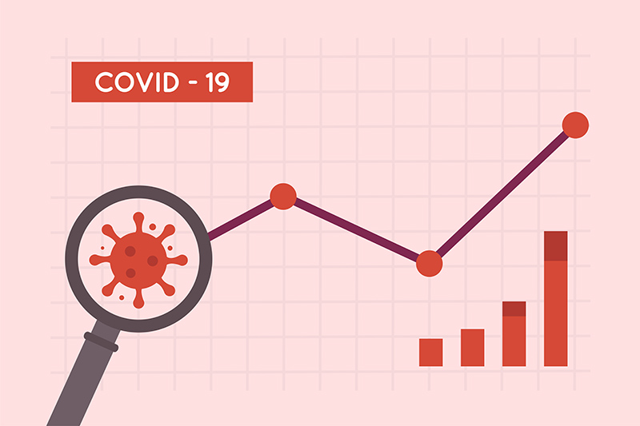
Data analysis
Methodology:
Filtering data for Missouri.
Normalizing 'cases' and 'deaths' columns.
Applying Gap Statistic and Elbow method to determine the optimal number of clusters.
Applying K-means clustering with a selectable number of clusters.
Generating visualizations using ggplot2 and plotly.
Tools:
R programming language.
Shiny for interactivity.
ggplot2 for plotting.
plotly for interactive plots.

Slide 6
structure and features of the app
File Input: allows users to upload the COVID-19 data file (States.csv). This file should contain columns such as date, state, cases, and deaths.
Number of Clusters Slider: users can select the number of clusters for the K-means algorithm, ranging from 2 to 10.
Date Range Selector: enables users to filter the data within a specific date range. This helps in analyzing data over particular periods of interest.
Update Clustering Button: after selecting the number of clusters and date range, users can click this button to update the clustering and related visualizations.

Slide 7
Tabs & visualizations
Data Table: Displays the filtered data in a tabular format for users to review the raw data.
Summary Table: Provides a summary of the filtered data, showing basic statistics such as mean, median, and standard deviation for cases and deaths.
Gap Statistic Plot: Helps in determining the optimal number of clusters by comparing the total within intra-cluster variation for different numbers of clusters with their expected values under the null reference distribution of the data.

Slide 8
Elbow Plot: Another method to determine the optimal number of clusters by plotting the total within-cluster sum of squares against the number of clusters.
Cluster Plot: Visualizes the clusters formed by the K-means algorithm. Each cluster is color-coded, and data points are plotted based on their similarity.
Silhouette Plot: Evaluates the quality of the clustering by measuring how similar each point is to its own cluster compared to other clusters.
Parallel Coordinates Plot: Displays the standardized values of cases and deaths for each cluster, allowing users to compare the variables across clusters.

Slide 9
Cluster Centers Table: Shows the center values of each cluster for cases and deaths, indicating the average profile of each cluster.
Cases vs Deaths Scatter Plot: Plots the number of cases against the number of deaths for the filtered data, highlighting the relationship between these two variables.
Interactive Line Plot: Shows the progression of cases and deaths over time in an interactive format, allowing users to zoom in and explore specific trends.

Slide 10
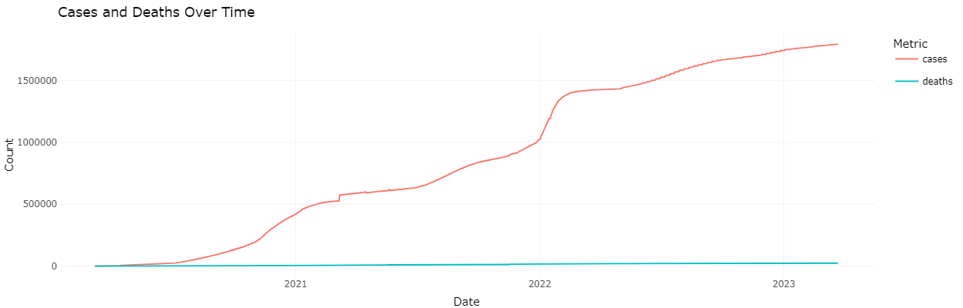
Key Insights from the Analysis from 2020-03-07 to 2023-03-23
Trend Analysis of Cases and Deaths:
The trend analysis of COVID-19 cases and deaths in Missouri from the displayed plot shows a cumulative increase in both metrics over time, with several distinct phases of rapid case growth likely corresponding to waves of infections. The initial outbreak in 2020 saw a steady rise, followed by significant surges in mid-2020, late 2020 to early 2021, and another in late 2021, indicating the impact of different virus variants and public health measures. The deaths curve appears relatively flatter than the cases curve, suggesting improvements in managing severe cases and medical treatments over time. Overall, while the rate of new cases seems to have slowed slightly in 2022, the data reflects ongoing challenges and responses in controlling the pandemic.

Slide 11
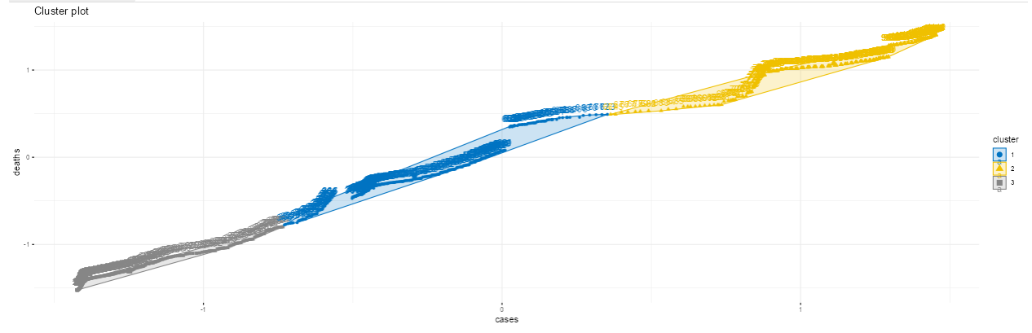
Cluster Analysis:
The cluster plot visualizes the relationship between the number of COVID-19 cases and deaths in Missouri, segmented into three distinct phases using k-means clustering. Cluster 1, represented by blue circles, includes data points with lower cases and deaths. Cluster 2, depicted by yellow triangles, consists of data points with higher cases and deaths compared to Cluster 1. Cluster 3, shown by gray squares, has a wider spread in both cases and deaths, generally encompassing the lower end of the cases and deaths compared to Cluster 2. Each cluster demonstrates a linear trend, indicating a direct relationship between the number of cases and deaths within that group. Overall, the plot highlights how different groups of regions experienced varying levels of COVID-19 impact, with each cluster displaying a distinct pattern in the relationship between cases and deaths.

Slide 12
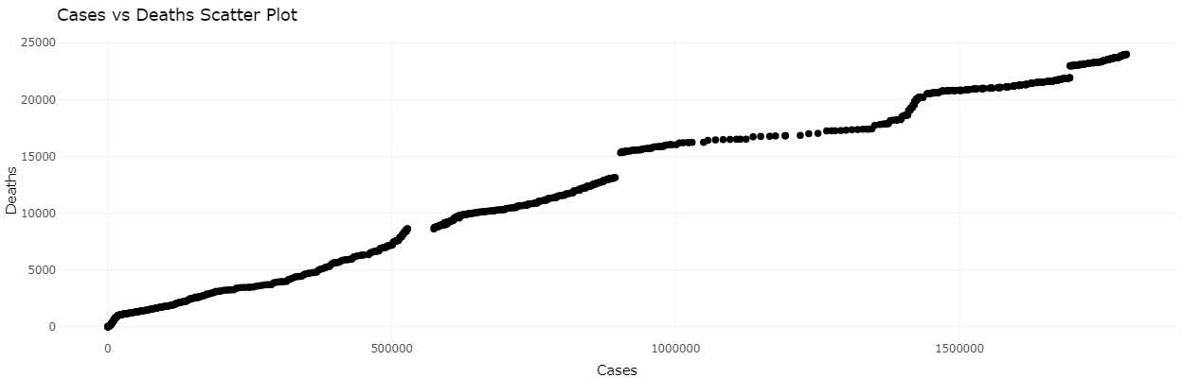
Scatter Plot Analysis:
The scatter plot illustrates the relationship between COVID-19 cases and deaths in Missouri, revealing a clear positive correlation where increases in the number of cases generally correspond to increases in the number of deaths. The relationship is non-linear, with varying slopes indicating different rates of mortality at different stages of the pandemic. Distinct clusters along the curve suggest specific periods with unique patterns, likely corresponding to different waves or phases of the pandemic. Notably, there are plateaus where the number of deaths remains stable despite rising cases, possibly reflecting effective interventions or improvements in treatment. Towards the higher end, the plot shows points with very high case and death counts, emphasizing the cumulative impact of the pandemic over time. This visualization effectively captures the evolving dynamics between cases and deaths throughout the pandemic in Missouri.

Slide 13
Implications/ FUTURE WORK
Resource Allocation:
Understanding the periods of rapid increase in cases and deaths can help public health officials allocate resources more effectively. During identified surges, hospitals and healthcare facilities can be better prepared with necessary equipment, staff, and support systems to manage increased patient loads.
Public Health Interventions:
The identification of distinct phases with varying rates of increase in cases and deaths suggests that targeted public health interventions, such as lockdowns, social distancing mandates, or vaccination drives, may have been effective during certain periods. Analyzing these phases can help refine strategies for future outbreaks.

Slide 14
Policy Making:
Policymakers can use the insights from this analysis to develop data-driven policies that are responsive to the changing dynamics of the pandemic. For instance, observing plateaus in death rates despite rising case numbers may indicate effective treatment protocols or public health measures that should be continued or expanded.
Predictive Modeling:
The trend data can be used to build predictive models that forecast future waves of infection and mortality. These models can inform proactive measures to mitigate the impact of future surges, including preemptive resource distribution and public advisories.

Slide 15
Long-term Planning:
The cumulative impact shown towards the high end of the case and death counts underscores the need for long-term planning in public health infrastructure. Investments in healthcare capacity, ongoing research for treatments and vaccines, and strategies for dealing with prolonged pandemics can be prioritized based on these insights.
Disparities in Impact:
Further analysis can reveal disparities in the impact of COVID-19 across different demographics and regions within Missouri. Addressing these disparities is crucial for equitable healthcare provision and ensuring that vulnerable populations receive adequate support.

Slide 16

This project successfully developed a Shiny app for analyzing and visualizing COVID-19 data in Missouri using K-means clustering. The app provides interactive tools to explore trends in cases and deaths, assess public health interventions, and compare the pandemic's impact over time.
Key insights from this analysis highlight distinct phases of the pandemic, emphasizing the importance of targeted public health responses. The interactive visualizations, including cluster plots and time-series analysis, offer valuable resources for researchers and policymakers.
The findings can guide future public health strategies, resource allocation, and policy-making. The Shiny app remains a valuable tool for ongoing analysis, adaptable to other regions and datasets.
Thank you for your interest in this project.
Fathieh Qakei

Slide 17
References:
Prakash N, Srivastava B, Singh S, Sharma S, Jain S. Effectiveness of social distancing interventions in containing COVID-19 incidence: International evidence using Kalman filter. Econ Hum Biol. 2022 Jan;44:101091. doi: 10.1016/j.ehb.2021.101091. Epub 2021 Dec 2. PMID: 34894622; PMCID: PMC8638209.

