Slide 1
SECURE DATA HIDING IN IMAGES USING STEGANOGRAPHY
CAPSTONE PROJECT
Presented By:
Student Name : Fathima Jemina M
College Name & Department : B.S.Abdur Rahman Crescent Institute of Science and Technology, B.Tech CSE(Cyber Security)

Slide 2
OUTLINE
Problem Statement
Technology used
Wow factor
End users
Result
Conclusion
Git-hub Link
Future scope

Slide 3
Problem Statement
Sensitive information is at risk of interception in the digital world. Traditional encryption can appear suspicious, drawing attention. Steganography hides messages inside images, making them nearly undetectable. This project embeds a password-protected message within image pixels, ensuring only authorized access.

Slide 4
Technology used
Software Requirements:
✅ Programming Language: Python 🐍 ✅ Libraries Used:
OpenCV (cv2) – Image processing
os – File handling ✅ Platform: Local execution (Python environment)
Hardware Requirements:
✅ Windows 11 Laptop

Slide 5
Wow factors
Steganography-Based Data Hiding – Unlike traditional encryption, data remains invisible inside an image.
Password-Protected Decryption – Only authorized users can access hidden messages.
Lossless Image Modification – Uses blue color channel to hide data while keeping the image visually unchanged.
Secure Storage – Uses null terminator (\0) to prevent data leaks or corruption.

Slide 6
End users
Cybersecurity Professionals – Secure communication without detection.
Journalists & Whistleblowers – Hide sensitive information inside images.
Forensic Experts – Steganography for digital evidence handling.
Developers & Researchers – Experiment with data hiding techniques.

Slide 7
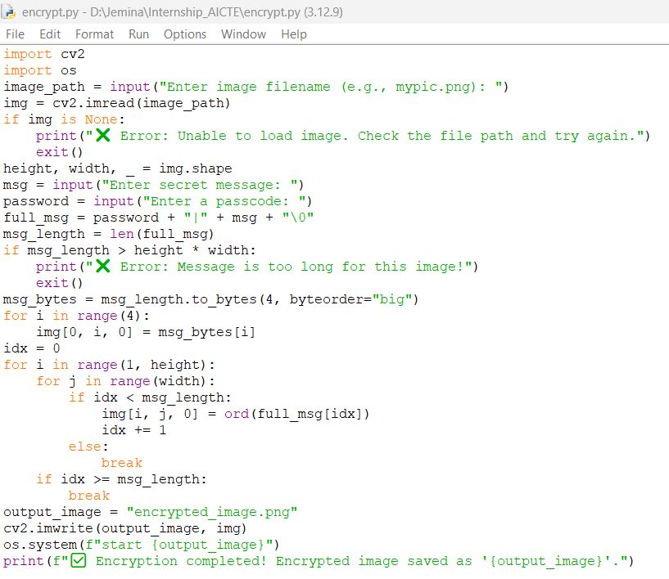
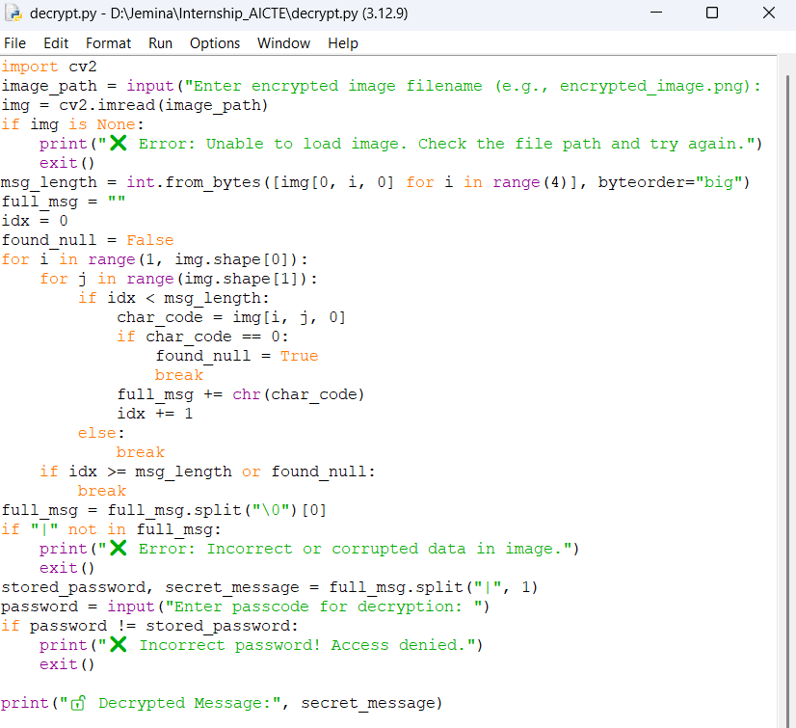
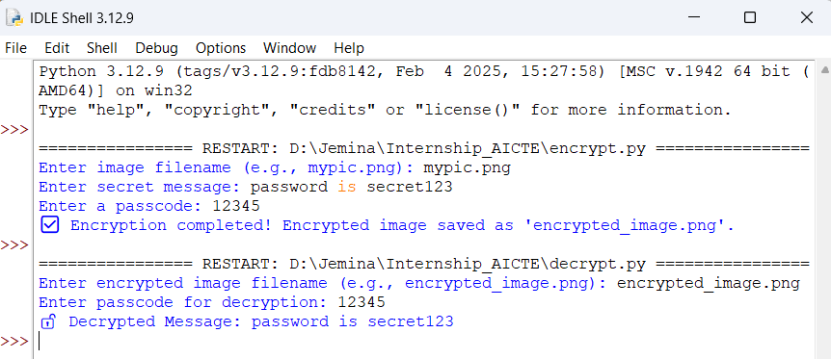
Results

Slide 8
Conclusion
This project provides a secure, undetectable method to hide sensitive messages inside images using steganography. It enhances data confidentiality without drawing attention, unlike traditional encryption. The system ensures only authorized users can retrieve hidden messages using a password.

Slide 9
GitHub Link
Github Link: https://github.com/Fathijem/Steganography.git

Slide 10
Future scope(optional)
Enhancements for More Security:
AES Encryption Integration – Encrypt the message before embedding it.
Cloud-Based Storage – Securely store encrypted images online.
Mobile App Implementation – A steganography tool for smartphones.
AI-Based Detection Prevention – Improve resistance against steganalysis tools.

Slide 11
THANK YOU

