Slide 1




Ba
NEXT GEN EMPLOYABILITY PROGRAM
Creating a future-ready workforce
College Name
JP college of engineering
Student Name: Mydeen Fathima.U
Student ID:au951221104027

Slide 2

CAPSTONE PROJECT SHOWCASE
Project Title
Voting Web Application using Django Framework
Abstract | Problem Statement | Project Overview | Proposed Solution | Technology Used | Modelling & Results | Conclusion

Slide 3
Abstract
The ‘Online Voting System’ is a web based voting platform for conducting elections online. This system seeks to use face recognition algorithm for voter identity authentication to enhance the security of the electioneering process and ultimately providing an online platform which enables all eligible voters to exercise this activity from any location. The user must sign in/login using their respective credentials and they will be logged in into the system only after the face recognition authentication is successful. Thereafter, the voter can cast their vote securely and logout of the system. Hence, this project based on Online Voting System could be used for conducting secure and fair elections online.
Source :

Slide 4
Problem Statement
The present voting system applicable has proved inefficient as the voters' registration process is slow, the manual collation of results takes time and gives room for result manipulation, also the inaccessible nature of election venues which includes the long distances to be covered by voters' to their registered location increases voters apathy towards the election processes, and finally the issues of ballot box snatching and damage
Source :

Slide 5
Project Overview
Voting as a term encompasses a broad range of voting systems that apply elements in one or more steps of the cycle. There are many levels to voting in a broad sense which could be collation, verification, internet voting, remote online voting e.t.c. Following the definition of a system as anything that takes an input and gives an output, an voting system is any system that can offers both electronic and online voting. It could also incorporate registration, verification, collation, remote online voting and real-time result display. An voting system generally comprises the following for it to work efficiently:
An interactive voting user interface on an device which provides a friendly environment for voters to authenticate and cast their votes, it also serves as a means of collection the individual votes and storing them in the local and central database.
An administrative dashboard for voters registration, details update and coordination and monitoring.
A database management system for the storage of election, voting and voters data.
A result display interface.
Source :

Slide 6
Proposed Solution
Maintain all information of all the candidates and votes.
Check whether voter have voted or not.
Increase the voting percentage.
To make voting an easy process by avoiding problems like.
• Security
Booth capturing
.
Source :

Slide 7
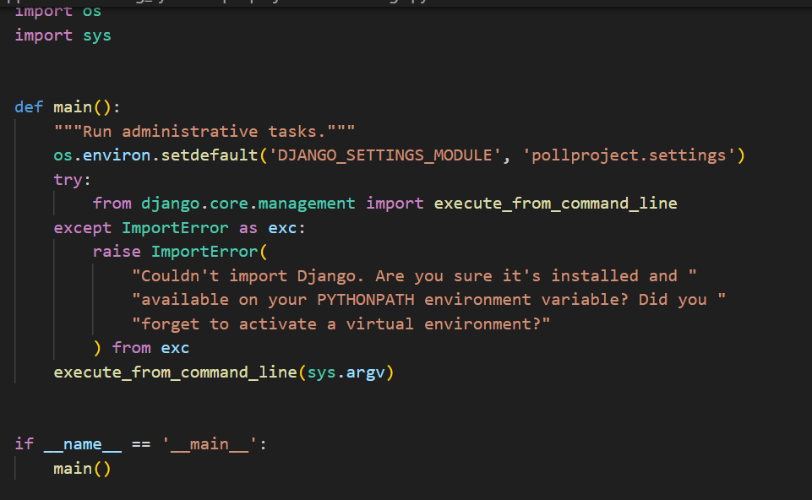
coding:
Source :

Slide 8
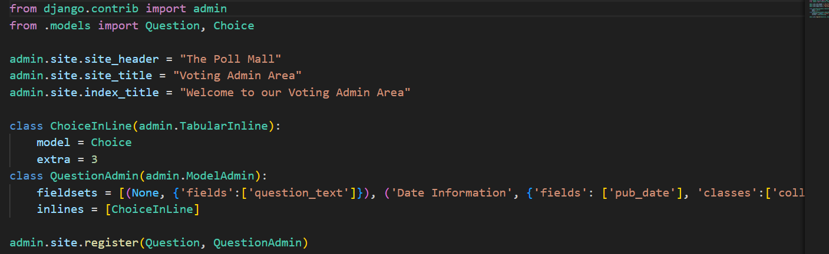
Source :

Slide 9


Technology Used
Front-end
Back-end
Source :

Slide 10
Modelling & Results
In the voting web application developed using the Django framework, the data model
encompasses entities such as Users, Voting Events, Ballots, Candidates, and Votes. Users
register and authenticate securely, gaining access to active voting events where they can cast
their votes on customizable ballots featuring various voting methods. Real-time result
updates are provided, displaying the current status of the voting process and the accumulated
votes for each candidate. The application implements stringent security measures to protect
the integrity of the voting process, including encryption techniques and authentication
mechanisms.
Source :

Slide 11
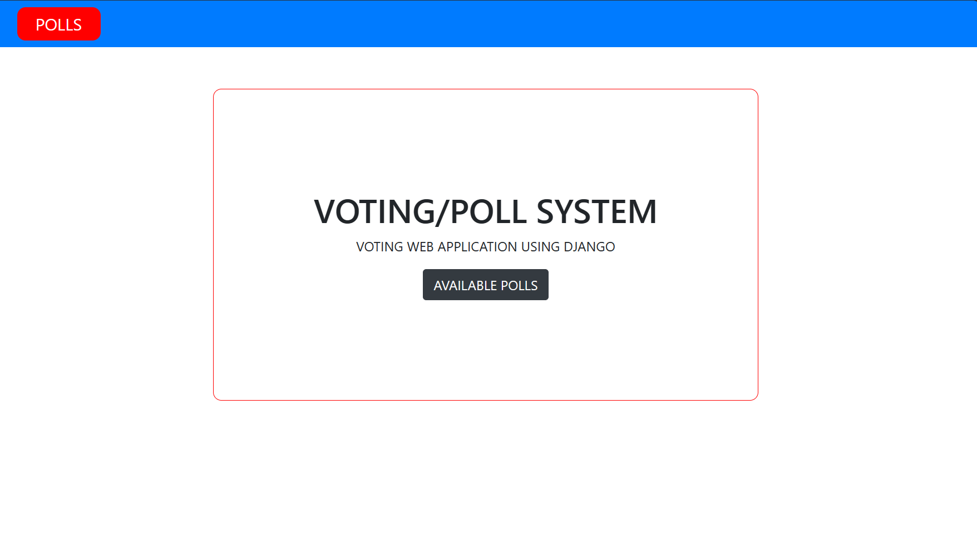
Homepage

Slide 12
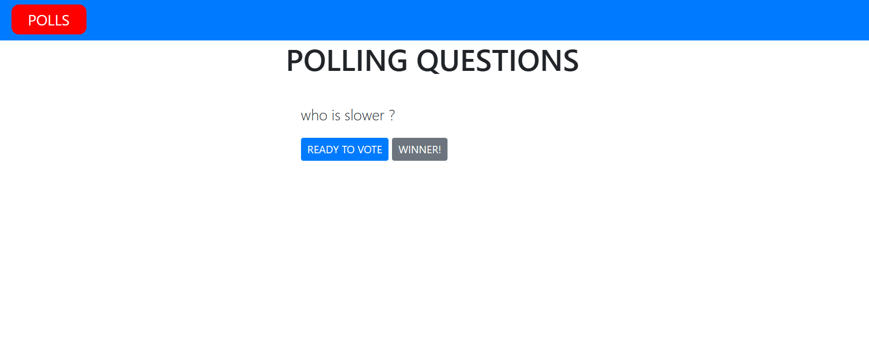

Slide 13
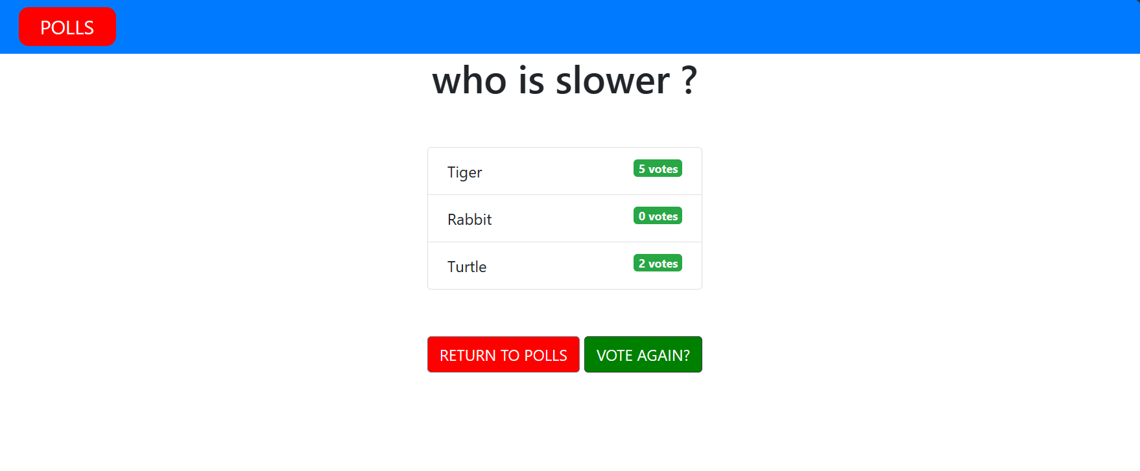

Slide 14
Future Enhancements:
For future enhancements, the voting web application built on the Django framework
could incorporate advanced features such as blockchain-based voting for enhanced
security and transparency, integration with biometric authentication systems for secure
user verification, and support for mobile voting applications to increase accessibility and
participation. Additionally, implementing machine learning algorithms could improve
the accuracy of result predictions and identify potential anomalies or irregularities in
voting patterns. Furthermore, enhancing the user interface with interactive data
visualization tools could provide users with deeper insights into voting trends and
results. Overall, these enhancements would further elevate the voting web application's
capabilities, ensuring its effectiveness, security, and inclusivity in democratic decisionmaking processes.

Slide 15
Conclusion
 | ReplyForward Add reaction
In conclusion, the voting web application developed using the Django framework
represents a significant advancement in facilitating democratic decision-making processes.
Through robust security measures, intuitive user interface design, and scalable architecture,
the application provides a reliable platform for users to participate in voting events securely
and transparently. The utilization of Django's built-in functionalities, coupled with
potential future enhancements such as blockchain integration and machine learning
algorithms, ensures the continuous evolution and effectiveness of the application in
meeting the evolving needs of democratic societies.
Source :

Slide 16
Thank You!
Notes:
Thank You !!

