Slide 1
INDUSTRIAL HUMAN RESOURCE GEO – VISUALIZATION
Name: Fathima Raasikha A
Batch: MDE85
Course: Data Science

Slide 2
Problem Statement :
In India, the industrial classification of the workforce is essential to understand the distribution of the labor force across various sectors. The classification of main workers and marginal workers, other than cultivators and agricultural laborers, by sex and by section, division, and class, has been traditionally used to understand the economic status and employment trends in the country. However, the current data on this classification is outdated and may not accurately reflect the current state of the workforce. The aim of this study is to update the information on the industrial classification of the main and marginal workers, other than cultivators and agricultural laborers, by sex and by section, division, and class, to provide relevant and accurate data for policy making and employment planning.

Slide 3
Technologies and Tools:
Python
Pandas
NLP
Matplotlib and folium
Streamlit

Slide 4
Project Workflow :
Data scraping: Use Pandas to load and merge all human resource data
to make a data frame.
Preprocessing: Clean the data by handling the null values and preprocess data,
by splitting and merging and dropping the unwanted columns .
Analyzing : Use Natural Language Processing for analyzing the various core industries and group the business categories like Retail, Poultry, Agriculture, Manufacturing, etc.
Visualization: Using the matplotlib library to plot the various types of charts for the analyzed data and by the use of Folium, create an interactive map for human resource distribution among the country.
Streamlit : By using streamlit, create a user friendly interface to visualize and view the Human Resource information among various districts of the various states.

Slide 5
EDA - EXPLORATORY DATA ANALYSIS
Key Findings:
Total no of state & district workers(Main & Marginal).
Distribution of main workers in rural, main and urban areas.
Male female ratios among workers.
Visualization of marginal workers in rural and urban areas.

Slide 6
NLP_ Analyze:
Main workers and Marginal workers in different States .
Rural and Urban workers of different districts of the states.
Various NIC Name sectors.

Slide 7
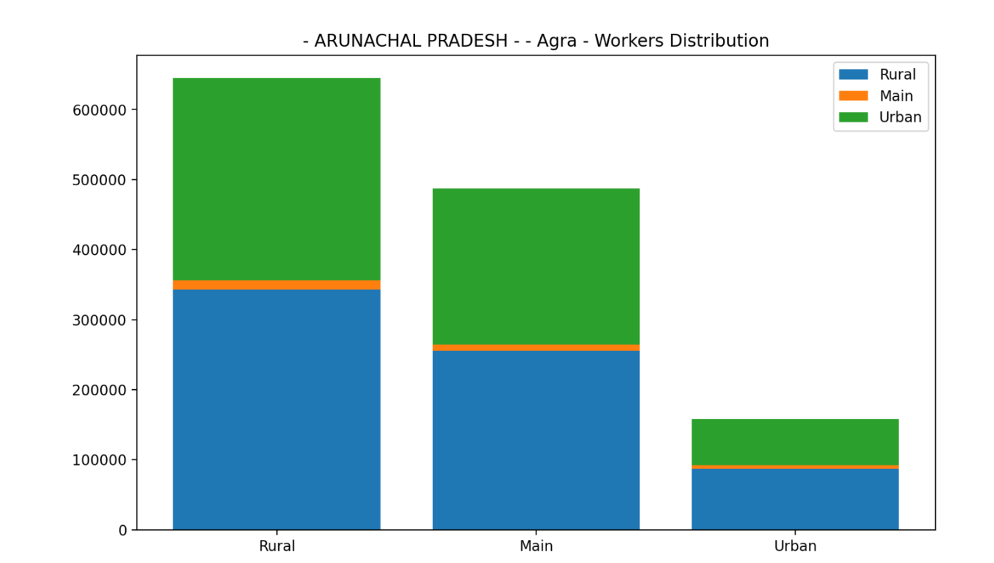
Distriburion of Rural,Main,Urban workers:

Slide 8
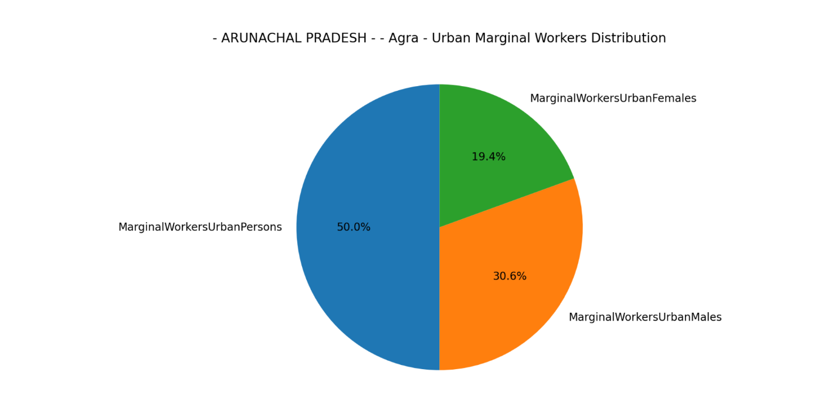

Slide 9
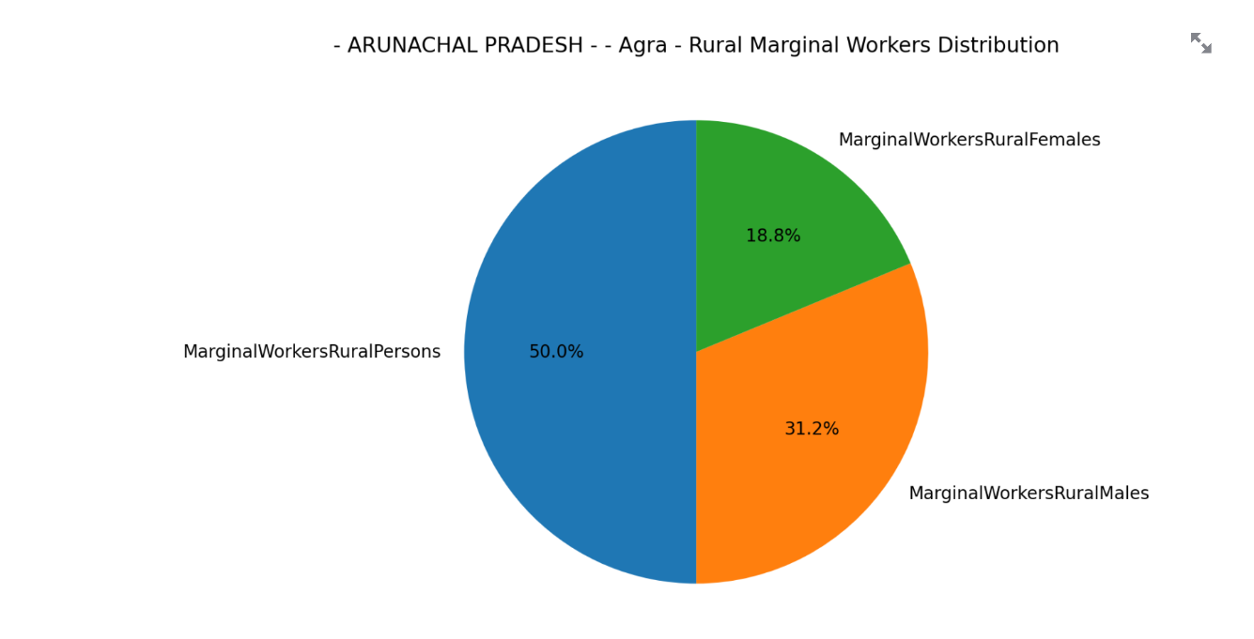

Slide 10
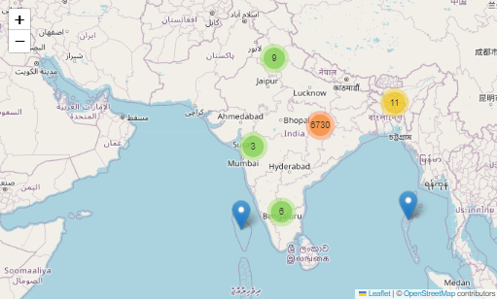

Slide 11
THANK YOU!

