Slide 1
Mathematical Foundation Presentation
Edge Detection
Team 5
Sourav Sen
Fathima Hafeez
Venkatesh Rachabathuni
Sharath Kumar TR

Slide 2
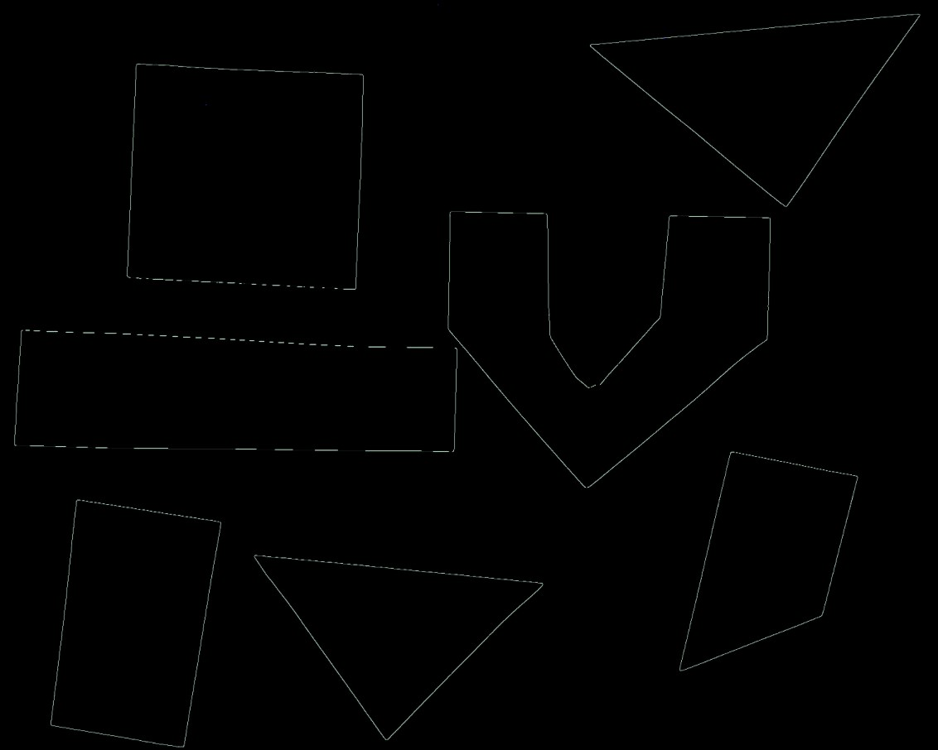
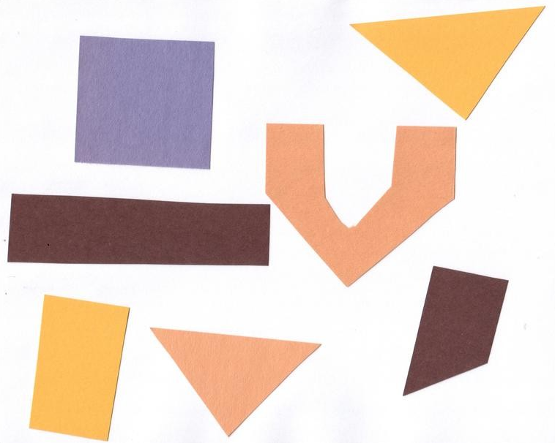
What is an Edge ?
Edges are where there is Significant local changes of Intensity in an image
An edge can be defined as a set of connected pixels that forms a boundary between two disjoint regions
Generally edges are of three types:
Horizontal edges
Vertical Edges
Diagonal Edges

Slide 3
Why Edge Detection ?
Most of the shape information of an image is enclosed in edges.
Edge detection is a fundamental tool in
Image Processing
Machine Vision and Computer Vision
Feature detection and Feature extraction
First step in most of the image processing algorithms to extract ROI (Region of Interest)
Reduce unnecessary information in the image
Some Application Examples of Edge detection are
Background suppression in video calls, Face Recognition
Portrait photos, Medical Imaging (MRI), Study of Anatomy
Image modification tools like Photoshop, Counting of objects

Slide 4
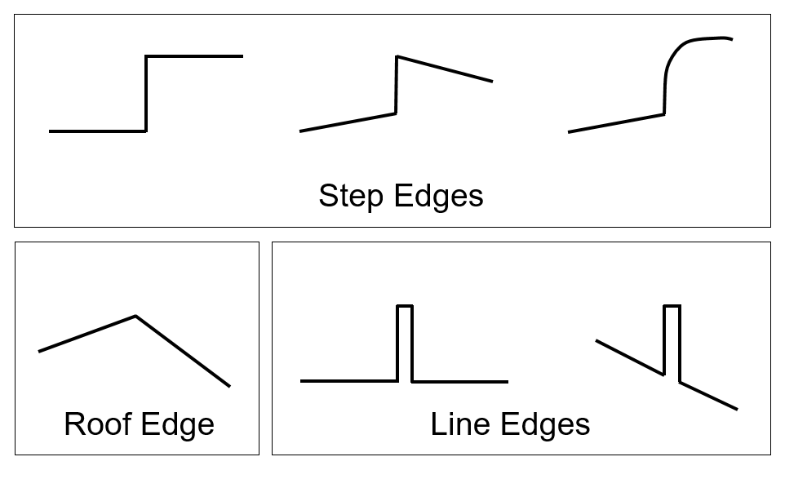


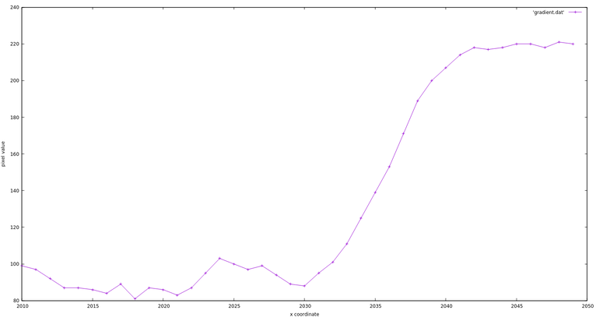
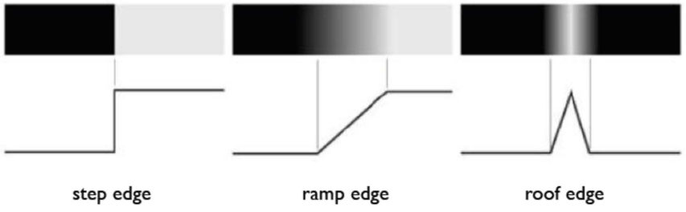
Different Type of Edges

Slide 5
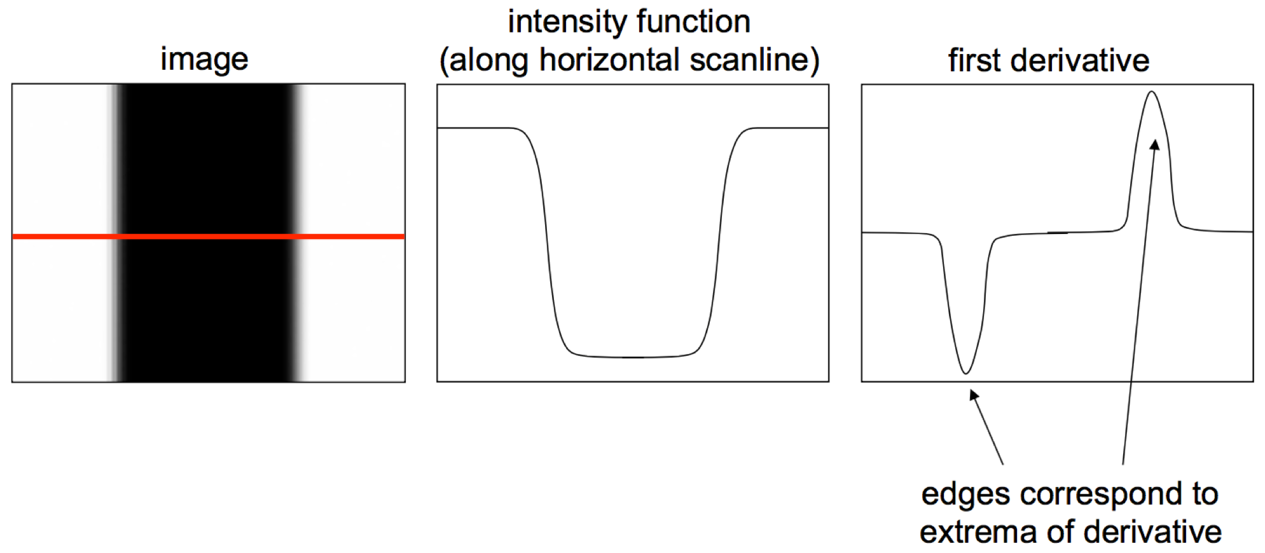
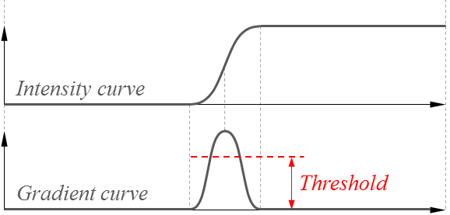
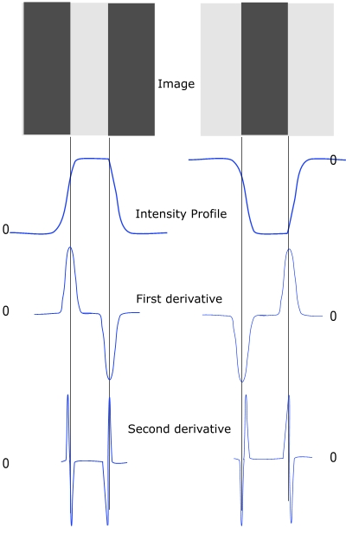
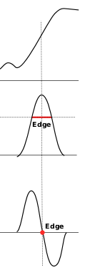
Edge Detection Operators
Gradient Based :
Uses first-order derivative
Sobel operator
Prewitt operator
Robert operator
Gaussian Based :
Uses second-order derivative
Canny edge detector
Laplacian of Gaussian

Slide 6
Selected Paper
Global Journal of Computer Science and Technology Graphics & Vision Volume 12 Issue 13 Version 1.0 Year 2012
Study and Comparison of Different Edge Detectors for Image Segmentation
By Pinaki Pratim Acharjya, Ritaban Das & Dibyendu Ghoshal
Abstract:
In the present study, comparative analyses of different edge detection operators in image processing are presented.
a) Sobel b) Prewitt
c) Roberts d) Laplacian of Gaussian (LOG)
e) Canny Edge Detector
It has been observed from the present study that the performance of canny edge detection operator is much better then Sobel, Roberts, Prewitt, Zero crossing and LoG (Laplacian of Gaussian) in respect to the image appearance and object boundary localization.
The software tool that has been used is MATLAB
(https://computerresearch.org/index.php/computer/article/view/306)

Slide 7
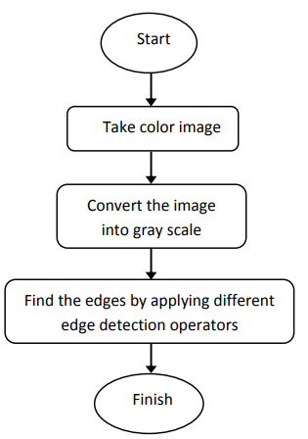
Experimental Approach
In proposed approach at very beginning a colored image is chosen and inserted into the Mat Lab software for processing
The image is converted into gray scale in the immediate step.
A gray scale image is mainly combination of two colors, black and white.
It carries the intensity information where, black have the low or weakest intensity and white have the high or strongest intensity
In final step different edge detection operators are applied to detect the object boundaries and edges.

Slide 8
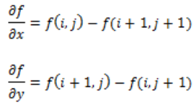

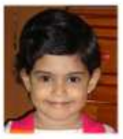
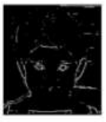
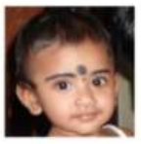
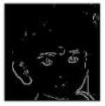
Roberts Operator
Based on First Order Derivatives, founded in 1965
In Robert edge detection, the vertical and horizontal edges bring out individually and then put together for resulting edge detection.
The Roberts edge detector uses the following masks to approximate digitally the first derivatives as differences between adjacent pixels.
Method:
It is a simple and computationally efficient approach to measure the spatial gradient of an image.
The pixel value at that point in the resultant image characterizes estimated absolute magnitude value of the spatial gradient of the inputted image at that point. It takes input image as grey scale image and produces edges involving in that image.
The Robert operator contains the pair of 2x2 convolution masks which are illustrated in Figure. One mask is just to other rotated by 90 degrees.
Advantage: Produces more accurate position of edges
Disadvantage :
It can’t detect that type of edges which are multiplies of 45 degrees and it is not symmetric.
Not reliable to extract the edge in presence of noise because of short support of filters.
The partial derivative of Robert operator is given as follows:

Slide 9
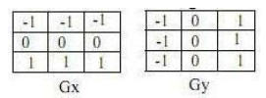

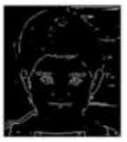


Prewitt Operator
Based on First Order Derivatives, founded in 1970
Prewitt operator edge detection masks are the one of the oldest and best understood methods of detecting edges in images
The Prewitt edge detector uses the following mask to approximate digitally the first derivatives Gx and Gy.
Method:
1> It evaluates the edge directions directly with the maximum response from the mask.
2> It is having 8 directions. However, sometimes most direct directions approximation is not much perfect.
3> The pair of 3x3 convolution masks for 8 directions are illustrated in Fig. One mask is just
to other rotated by 90 degrees.
The organization of pixels about central pixel is as follows:
The partial derivatives of Prewitt operator are measured as:
Advantage: Masks have longer support, Prewitt is less vulnerable to noise. Because it differentiates in one direction and make average in another direction.
Disadvantage : Produce sometimes noisier result.

Slide 10


Sobel Operator
Based on First Order Derivatives, founded in 1970.
• This operator is just like a Prewitt operator, despite of difficulties in implementation it produces less noisier results.
• The Sobel kernel depends on the central difference, but while averaging it gives more weight to central pixel.
Method:
1> It evaluates the edge directions directly with the maximum response from the mask.
2> It is having 8 directions. However, sometimes most direct directions approximation is not much perfect.
3> The pair of 3x3 convolution masks for 8 directions are illustrated in Fig. One mask is just to other rotated by 90 degrees.
4> The operator Gx and Gy is for transforming the image by convolution.
Advantage: Produces less noisier result than Prewitt.
Disadvantage : Difficult to implement than Prewitt.
Note: Threshold on Gradient magnitude result in filtering less intense edges and peak gradients result in localization of edges.

Slide 11

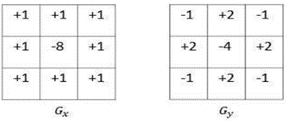
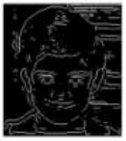
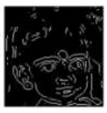
Laplacian of Gaussian (LOG)
Based on Second Order Derivatives, founded in 1982
This detector finds edges by looking for zero crossings after filtering f(x, y) with a Laplacian of Gaussian filter.
In this method, the Gaussian filtering is combined with Laplacian to break down the image where the intensity varies to detect the edges effectively.
It finds the correct place of edges and testing wider area around the pixel.
Method
It smoothens the image first then calculate Laplacian producing the double edge image.
It locates edges then search the zero crossing between the double edges.
The LOG edge detection method contains the pair of 3x3 convolution mask which is illustrated in Figure
Advantage: Having fixed characteristics in all the directions, detects good edges and its orientations
Disadvantage: Sensitive to noise, generate closed and non-realistic contour.

Slide 12

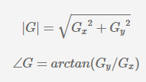
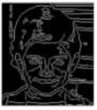

Canny Edge Detector
John Canny introduced the canny edge detection technique in 1983.
Canny Edge Detection is Gaussian based Second Order Derivatives.
It is the standard, powerful and usually used edge detection method.
It separates the noise from the image before extracting edges.
The main steps are as follows:
Step 1 - Grayscale Conversion
Step 2 - Gaussian Blur
Step 3 - Determine the Intensity Gradients
Step 4 - Non Maximum Suppression
Step 5 - Double Thresholding
Step 6 - Edge Tracking by Hysteresis
Step 7 - Cleaning Up

Slide 13


Experiment Metrices
Entropy: Entropy is defined as corresponding states of intensity level which individual pixels can adapt.
PSNR: Peak signal to noise ratio Is the ratio between the maximum possible power of a signal and the power of corrupting noise that affects the fidelity of its representation. It is the logarithmic function of the peak value of the image and the mean square error.
MSE: MSE specifies the average difference of the pixels throughout the original ground truth image with edge detected image.
Execution Time: Time to compute edges

Slide 14
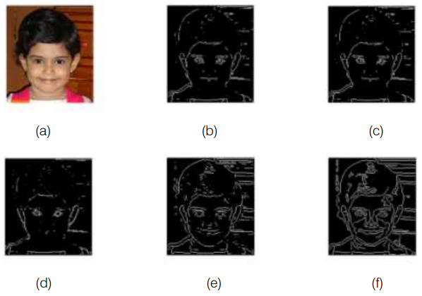
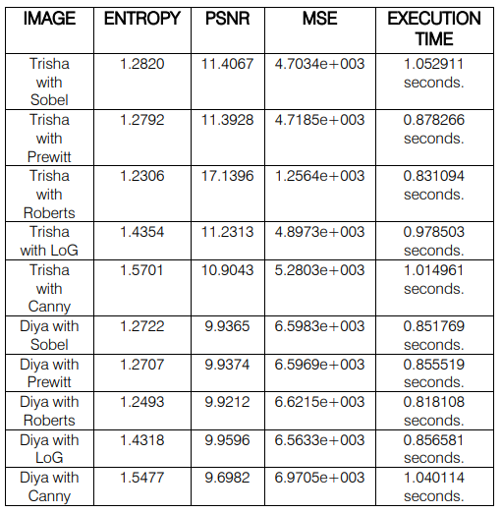
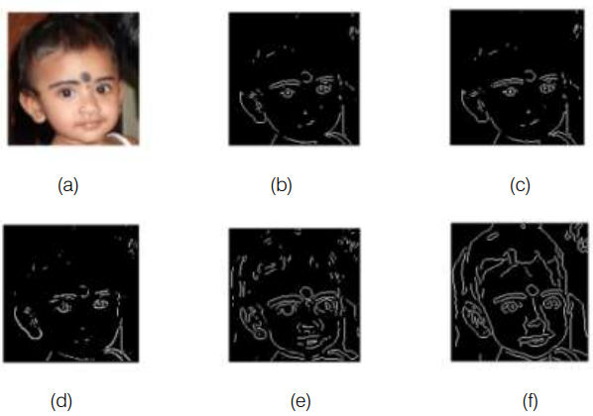
Summary
Statistical measurement

Slide 15
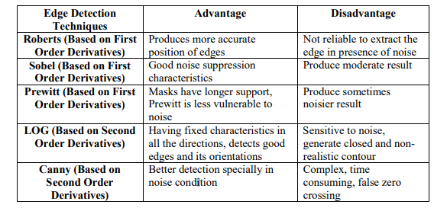
Advantages and Disadvantages

Slide 16
Conclusion
Since edge detection is the initial step in object boundary extraction and object recognition, it is important to know the differences between different edge detection operators.
In this paper an attempt is made to review the edge detection techniques which are based on discontinuity intensity levels.
The relative performance of various edge detection techniques is carried out with two images by using MATLAB software.
It have been observed that that the Canny edge detector produces higher accuracy in detection of object edges with higher entropy, MSE and execution time and lesser PSNR compared with Sobel, Roberts, Prewitt and LOG.

Slide 17
Other References
https://www.geeksforgeeks.org/image-edge-detection-operators-in-digital-image-processing/
https://datacarpentry.org/image-processing/aio/index.html
https://en.wikipedia.org/wiki/Edge_detection
https://www.google.com

Slide 18
PYTHON DEMO

Slide 19
THANK YOU

