Slide 1
SQL Lag() function
Problem
Analytics in the Health Care industry requires locating previous visits or claims that indicate if a patient/member is being readmitted to a hospital or rehab facility.
Solution
The LAG functions in SQL help find a previous record related to the key fields. The addition of these functions help with readability and simplicity.
The following is a view of the Claims structure. Our date columns used will be StartDate and EndDate.

Slide 2
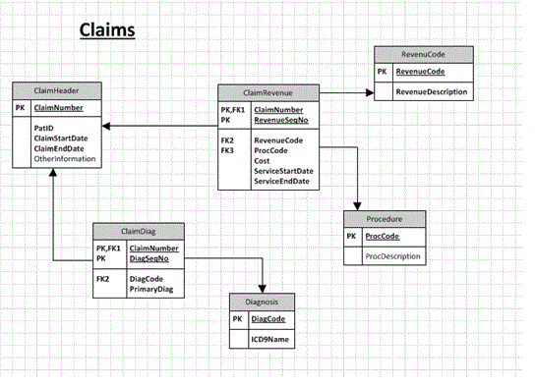

Slide 3
Scripts
Here are the CREATE TABLE and INSERT statements for this example
CREATE TABLE db1.ClaimHeader ( ClaimNumber varchar(20) NOT NULL,
PatID varchar(50) NOT NULL, ClaimStartDate date NOT NULL, ClaimEndDate date NOT NULL ) ;
INSERT INTO db1.ClaimHeader VALUES(123,'AB0123','2014-01-21','2014-01-28’);
INSERT INTO db1.ClaimHeader VALUES (124,'AB0123','2014-03-01','2014-03-09’);
INSERT INTO db1.ClaimHeader VALUES ('125','AB0123','2014-03-28','2014-03-31’);
INSERT INTO db1.ClaimHeader VALUES ('126','AB0123','2014-03-31','2014-04-10’);
select * from db1.ClaimHeader;

Slide 4
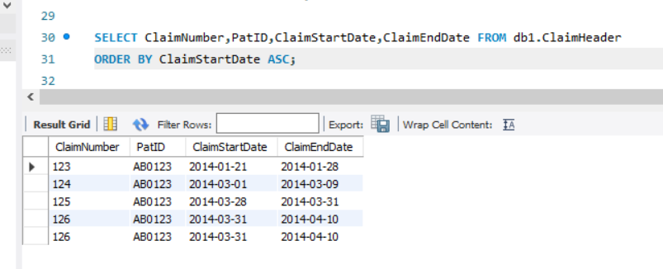
A Look at the Data
We are going to use the ClaimEndDate and ClaimStartDate to find our readmissions. Here is a view of some of the data and what we are trying to accomplish.
SELECT ClaimNumber,PatID,ClaimStartDate,ClaimEndDate FROM db1.ClaimHeader ORDER BY ClaimStartDate ASC;

Slide 5
Using the SQL Server LAG Function to get Previous End Date
If you look closely, you will see that the first claims started on 1/21/14 and ended 1/28/14. The next claim starts on 3/1/14. This indicates that the second admission did not happen within 30 days of the previous claim. Thus, it is not a readmission within 30 days.
But, the third claim started on 3/28/14 and the previous (2nd claim) ended 3/9/14 which is within 30 days of each other.
Let’s use the LAG functions to get the days between claims. The first parameter in the function is the date we are using in the current row - ClaimEndDate. The second parameter (i.e. 1) is the previous occurrence in the set returned with Null being used for the last parameter for the return value if nothing is found by the LAG function.

Slide 6
script
SELECT ClaimNumber, PatID AS PatientID,
ClaimStartDate, ClaimEndDate,
LAG( ClaimEndDate, 1, Null) OVER (PARTITION BY PatID ORDER BY ClaimStartDate, ClaimEndDate) AS PreviousClaimEndDate FROM db1.ClaimHeader;
OVER divides the data into partitions (PARTITIONED BY - PatID) containing a rowset from the FROM (ClaimHeader) clause using ORDER BY (StartDate and EndDate) to sort the set. This is how we get claims for a Patient ordered by ClaimEndDate ascending.

Slide 7
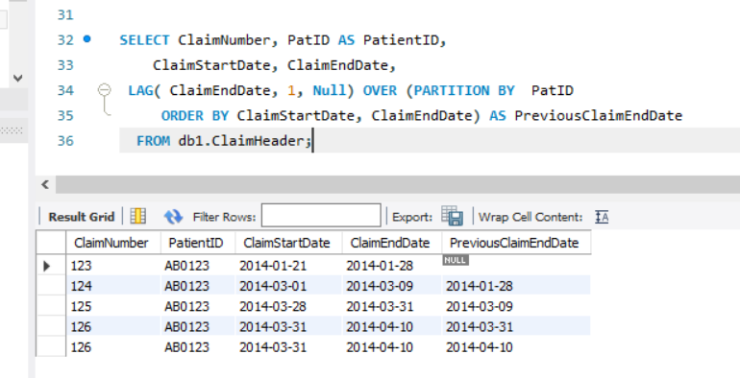

Slide 8
This use of the LAG function gives us the Previous ClaimEndDate and with this we can calculate the day difference between Start and End.
SELECT *, DATEDIFF ( day, PreviousClaimEndDate, ClaimStartDate) AS DiffDays FROM ( SELECT ClaimNumber, PatID AS PatientID,
ClaimStartDate, ClaimEndDate,
LAG( ClaimEndDate, 1, Null) OVER (PARTITION BY PatID ORDER BY ClaimStartDate, ClaimEndDate) AS PreviousClaimEndDate
FROM db1.ClaimHeader);

Slide 9
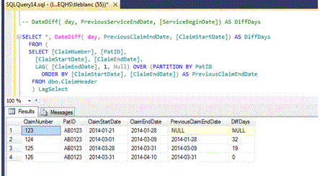

Slide 10
Conclusion
From this output, we can see the first Claim does not have a previous claim, so it is not a re-admit within 30 days. The second claim can be excluded from readmit count because the DiffDays is 32 days.
Now, the third claim is within 19 days of the previous, so it will be included in the 30 readmit count, but 4th claim has a DiffDays of 0. This was interesting because it would seem the patient went home and was re-admitted the same day of discharge. The Metrics team took note of this and examined the data more closely and was able to find other columns in the claim that indicated a transfer to a different facility, thus excluding it from the count.
So, the LAG (and possibly the LEAD) functions can really help in looking at before and after records to compute date differences from a single MY-SQL statement that is more readable and logical than previous methods for gathering this information.

Slide 11
Thank you
Fathima Hafeez

