Slide 1
EXCEPTION CLASSES IN JAVA

Slide 2
Exception Handling in Java
Exception
An exception is an event that disrupts the normal flow of the program
Exceptions are used to indicate many different types of error conditions.
      OutOfMemoryError
      StackOverflowError
      Network Breakdown
Exception Handling
The Exception Handling in Java is one of the powerful mechanism to handle the runtime errors so that normal flow of the application can be maintained.
Avalaible in java.lang.Exception
All exceptions and errors extend from a common java.lang.Throwable parent class

Slide 3
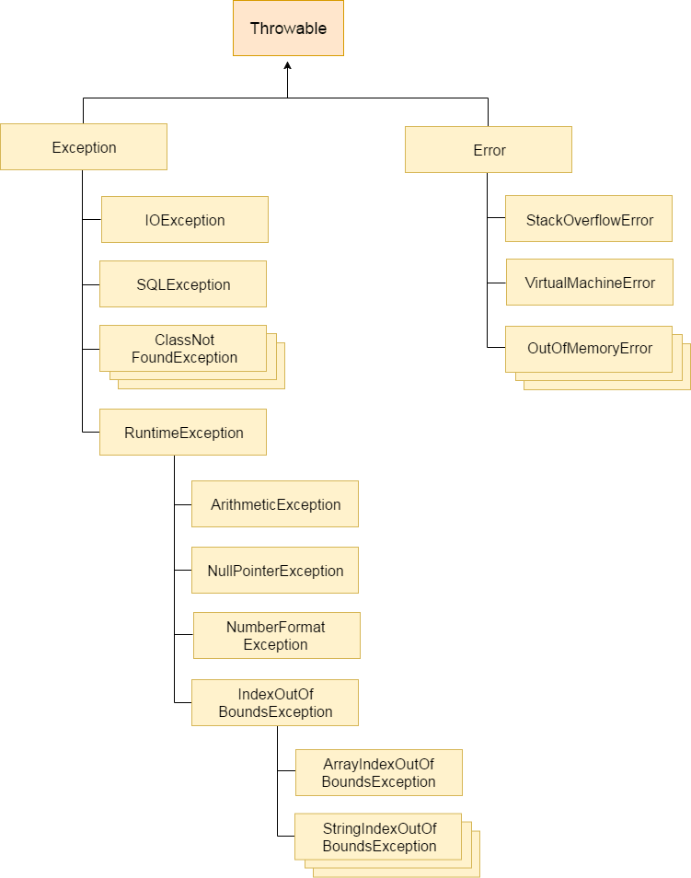
Hierarchy of Java Exception classes
UNCHECKED

Slide 4
Types of Java Exceptions
Checked Exception:are the exceptions that are checked at compile time.
  e.g. IOException, SQLException
Unchecked Exception:The classes which inherit RuntimeException
  e.g. ArithmeticException, NullPointerException, ArrayIndexOutOfBoundsException
Error:Error is irrecoverable
  e.g. OutOfMemoryError, VirtualMachineError, AssertionError etc.
Java Exception Keywords
try
catch
finally
throw
throws

Slide 5
Common Scenarios of Java Exceptions
int a=50/0;//ArithmeticException
String s=null;
System.out.println(s.length());//NullPointerException
String s="abc";
int i=Integer.parseInt(s);//NumberFormatException
int a[]=new int[5];
a[10]=50; //ArrayIndexOutOfBoundsException
File file = new File("E://file.txt");
FileReader fr = new FileReader(file); //FileNotFoundException

Slide 6
Java try block
Syntax of Java try-catch
Syntax of try-finally block
try{
//code that may throw an exception
}catch(Exception_class_Name ref){}
try{
//code that may throw an exception
}finally{}
public class TryCatchExample1 { public static void main(String[] args) { int data=50/0; //may throw exception System.out.println("rest of the code"); } } Exception in thread "main" java.lang.ArithmeticException: / by zero | public class TryCatchExample2 { public static void main(String[] args) { try { int data=50/0; //may throw exception } //handling the exception catch(ArithmeticException e) { System.out.println(e); } System.out.println("rest of the code"); } } java.lang.ArithmeticException: / by zero rest of the code

Slide 7
Java Multi-catch block
public class MultipleCatchBlock1 {
public static void main(String[] args) {
try{
int a[]=new int[5];
a[5]=30/0;
}
catch(ArithmeticException e) {
System.out.println("Arithmetic Exception occurs"); }
catch(ArrayIndexOutOfBoundsException e) {
System.out.println("ArrayIndexOutOfBounds Exception occurs"); }
catch(Exception e) {
System.out.println("Parent Exception occurs"); }
System.out.println("rest of the code");
} }
A try block can be followed by one or more catch blocks. Each catch block must contain a different exception handler. At a time only one exception occurs and at a time only one catch block is executed.
Arithmetic Exception occur
rest of the code

Slide 8
Java Nested try block
class NestedTry {
public static void main(String args[])
{
try { // Main try block
int a[] = { 1, 2, 3, 4, 5 };
System.out.println(a[5]);
// try-block2 inside another try block
Try {
int x = a[2] / 0; }
catch (ArithmeticException e2) {
System.out.println("division by zero is not possible"); }
} //end of main try block
catch (ArrayIndexOutOfBoundsException e1) {
System.out.println("ArrayIndexOutOfBoundsException");
System.out.println("Element at such index does not exists"); }
} }
ArrayIndexOutOfBoundsException
Element at such index does not exists

Slide 9
Java finally block
Java finally block is a block that is used to execute important code
Java finally block is always executed whether exception is handled or not.
Example:
class TestFinallyBlock{
public static void main(String args[]){
try{
int data=25/5;
System.out.println(data);
}
catch(NullPointerException e){System.out.println(e);}
finally{System.out.println("finally block is always executed");}
System.out.println("rest of the code...");
}
}
finally block is always executed
rest of the code...

Slide 10
Throw and Throws Keyword
Java throw example
Java throws example
Java throw and throws example
void m(){
throw new ArithmeticException("sorry");
}
void m()throws ArithmeticException{
//method code
}
void m()throws ArithmeticException
{
throw new ArithmeticException("sorry");
}

Slide 11
ExceptionHandling with MethodOverriding in Java
If the superclass method does not declare an exception
If the superclass method does not declare an exception, subclass overridden method cannot declare the checked exception. | If the superclass method does not declare an exception, subclass overridden method cannot declare the checked exception but can declare unchecked exception.
import java.io.*; class Parent { void msg() {System.out.println("parent")} } class TestExceptionChild extends Parent { void msg()throws IOException { System.out.println("TestExceptionChild"); } public static void main(String args[]) { Parent p=new TestExceptionChild(); p.msg(); } } | import java.io.*; class Parent { void msg() {System.out.println("parent");} } class TestExceptionChild1 extends Parent { void msg()throws ArithmeticException { System.out.println("child"); } public static void main(String args[]) { Parent p=new TestExceptionChild1(); p.msg(); } }
Output:Compile Time Error | Output:child

Slide 12
ExceptionHandling with MethodOverriding in Java
If the superclass method declares an exception
If the superclass method declares an exception, subclass overridden method can declare same, subclass exception or no exception but cannot declare parent exception. | in case subclass overridden method declares same exception
import java.io.*; class Parent { void msg()throws ArithmeticException {System.out.println("parent"); } } class TestExceptionChild2 extends Parent { void msg()throws Exception {System.out.println("child");} public static void main(String args[]) { Parent p=new TestExceptionChild2(); try{ p.msg(); }catch(Exception e){} } } | import java.io.*; class Parent { void msg() throws Exception {System.out.println("parent");} } class TestExceptionChild1 extends Parent { void msg()throws Exception { System.out.println("child"); } public static void main(String args[]) { Parent p=new TestExceptionChild1(); p.msg(); } catch(Exception e) {} }
Output:Compile Time Error | Output:child

Slide 13
Java Custom Exception
class MyException extends Exception
{
public MyException(String s)
{
// Call constructor of parent Exception
super(s);
}}
// A Class that uses above MyException
public class Main
{
public static void main(String args[])
{
try
{
// Throw an object of user defined exception
throw new MyException("GeeksGeeks");
}
catch (MyException ex)
{
System.out.println("Caught");
// Print the message from MyException object
System.out.println(ex.getMessage());
}
}}
Output:Caught
GeeksGeeks

Slide 14
