Slide 1


ML22/23-13 Investigate Influence of parameter MaxNewSynapseCount
Team: TEAM AS
MD Fathir Ahmed Shishir (1344477)
Akash Saha (1345829)

Slide 2
Objective
Understand Multisequence Learning
Use of MaxNewSynapseCount in Temporal Memory
Influence of MaxNewSynapseCount while learning
Create report and provide some analysis

Slide 3
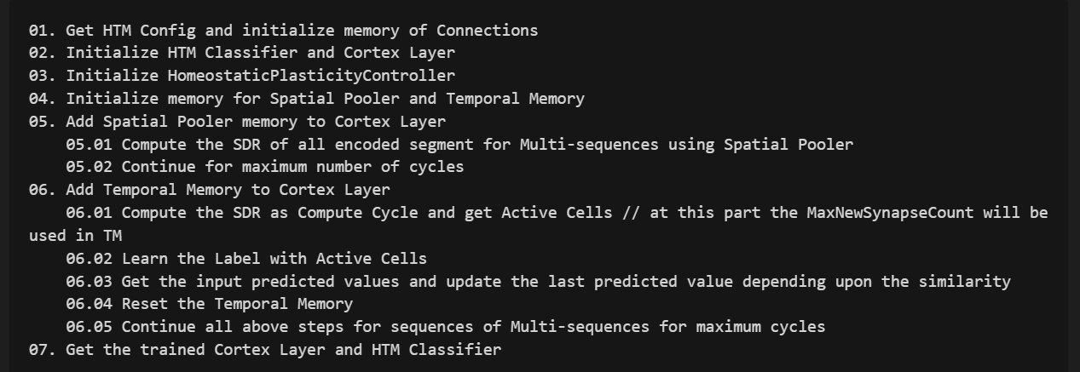
Approach
Understanding Multisequence Learning

Slide 4
Approach (continued)
Understanding TM and identify where MaxNewSynapseCount is being used
Creating logs, report and analysis to showcase the influence

Slide 5

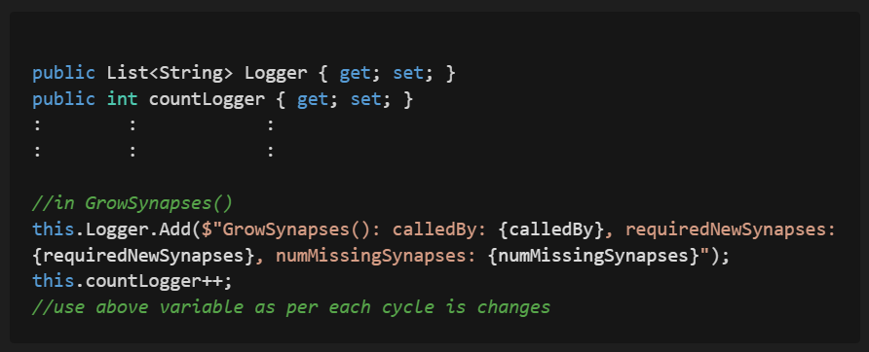

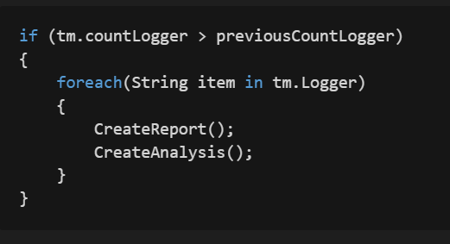
Implementation
Create report and analysis in MultisequenceLearning.cs
Logging TM changes in TemporalMemory.cs
Create report and analysis in MultisequenceLearning.cs

Slide 6
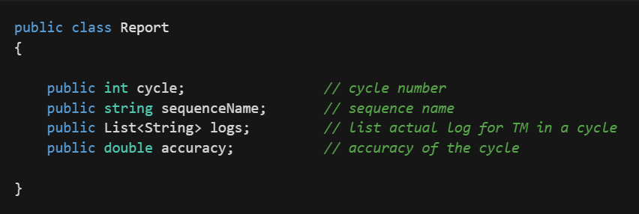
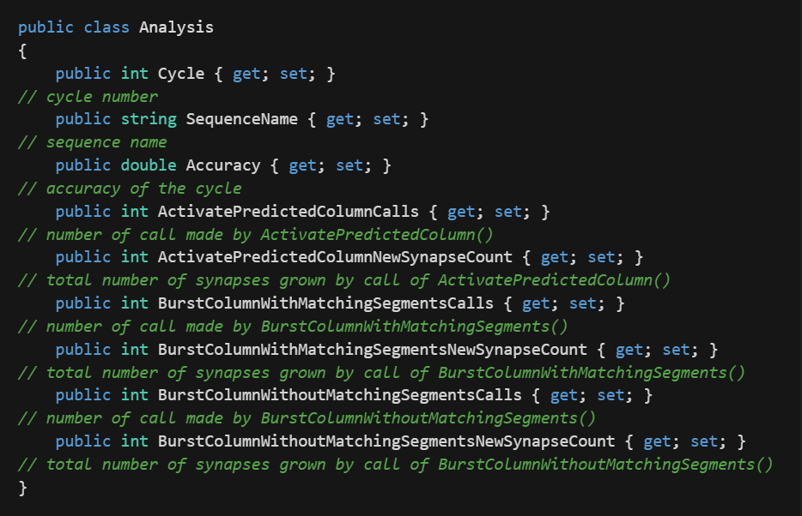
Implementation (continued)
Model of report:
Model of Analysis:

Slide 7
Results
MaxNewSynapseCount value changes in ActivatePredictedColumn() if we have active column and active segment and the positive difference in MaxNewSynapseCount and active potential synapse is addition of synapse
MaxNewSynapseCount value changes in BurstColumn() if we have active column and no active segment and the positive difference in MaxNewSynapseCount and last active potential synapse is addition of synapse
The accuracy of each cycle changes (goes up usually) even if we do not add any new synapses, but it does not assure that adding synapses with increase the accuracy

Slide 8


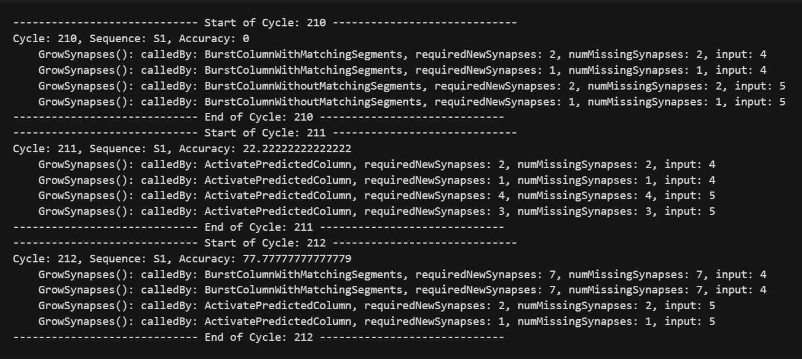
Results (continued) : Report

Slide 9
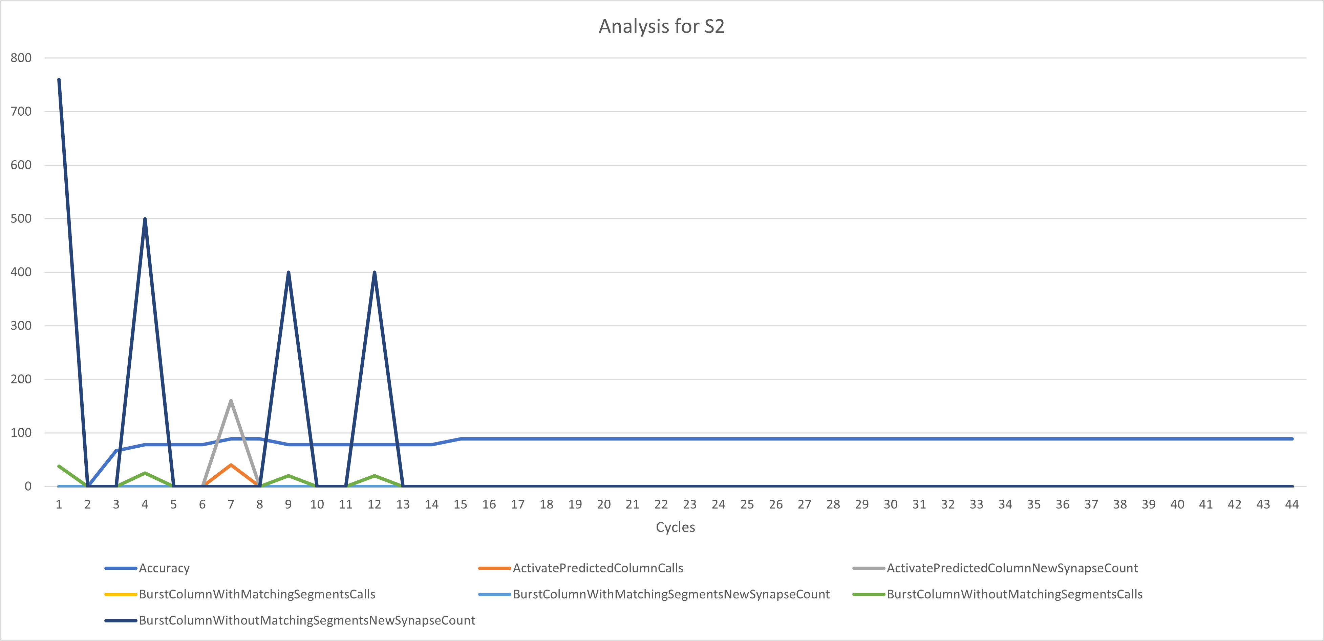
Results (continued) : Analysis

Slide 10
Discussion
Need to run with different dataset
Need to run in cloud for fast results

