Slide 1

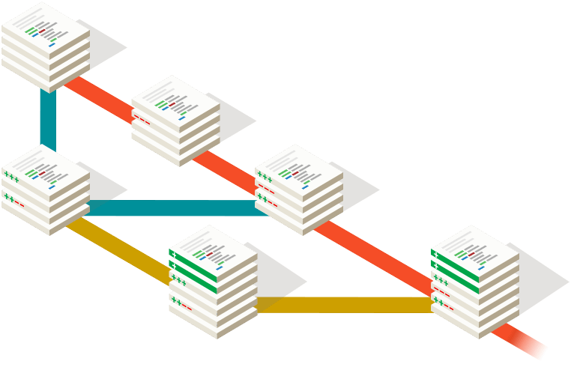
What is git?

Slide 2
What is system version control?

Slide 3
System version control
The main of git
Tracking changes
Reverting a previous
version
Collaborative development

Slide 4

مثال ملموس
مفاهیم کلیدی در گیت :
The main of git
یادگیری تغیرات
بازیابی نسخه ی قبلی
همکاری تیمی
High
performance
System version control
distributed
3 .
1 .
2.

Slide 5
مثال ملموس
The main of git :
1.Reapository
2.commit

Slide 6
The main of git :
1.Reapository
2.commit

Slide 7


Slide 8
What is github?

Slide 9


گیت هاب چیست ؟

Slide 10


Slide 15
The main of github

Slide 17


Slide 18
Issue management

Slide 19
Pull Request

Slide 20
Documentation maintenance project

Slide 21
Fecilitating team collaboration

Slide 22
Creating public and private repositories

