Slide 1

NoSQL - mongoDB

Slide 2
NoSQL
Used by companies such as Facebook, Google, Amazon.com
Used in big data and real-time web apps
A NoSQL database provides a mechanism for storage and retrieval of data which is modeled in means other than the tabular relations used in relational databases

Slide 3
NoSQL advantages
Simplicity of design
Simpler horizontal scaling
Some operations are faster in NoSQL

Slide 4
NoSQL characteristics
Classic relation model is not applicable
Does not store data in tables and SQL queries are not provided

Slide 5
Nosql
Key-value: Apache casandra, Dynamo, memcached, Redis, BigTable
Document: Apache CouchDB, MongoDB, SimpleDB

Slide 6

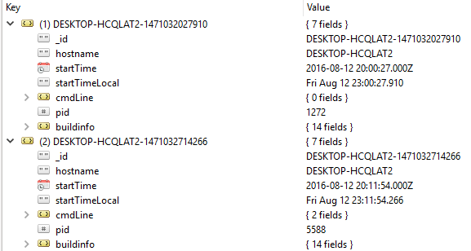
NoSQL

Slide 7
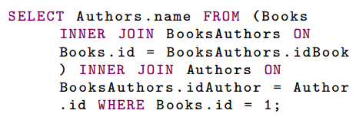
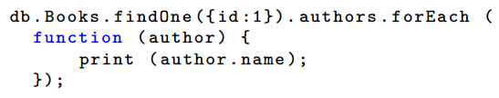
NoSQL

Slide 8
Nosql
SQL definitions
  Relation (table)
  Row
  Attribute – column
  Keys
  Normalisation
NoSQL definitions
  Document – row
  Collection - table

Slide 9
MONGO
https://docs.mongodb.com/manual/tutorial/install-mongodb-on-windows/
https://www.mongodb.com/
https://robomongo.org/
https://www.npmjs.com/package/mongodb

Slide 10
MongoDB Server
http://www.mongodb.org/downloads
Cmd – mongod starts the server as a demon
Default storage location /data/db
  Change path via dbpath
  Possible to change the port (default is 27017)

Slide 11
Mongo Shell
Cmd – mongo start the mongo shell
  Address and port should be given
  Default: localhost:27017
Shell helpers
  Show dbs
  Show collections
  Use <dbname>

Slide 12
Mongo Shell Create Collection/DB
DB is created automatically when collection is added
Collection is created automatically when document is added

Slide 13
Mongo shell INSERT
Adds document to a collection
db.collection.insert() - add one or more documents
Each document has at least _id – can be passed or generated automatically
  Generated _id is from type ObjectId.ObjectId
    Contains timestamp, machine ID, process ID, local counter

Slide 14
Mongo shell
db.collection.save()
  Adds or updates document
    If _id is provided – updates the document with this _id
    If id is not provided – works as INSERT
find/findOne – searches for a document
db.collection.remove(query) – removes all documents selected with the query
Drop – removes collection from the db

Slide 15
Mongo shell UPDATE
db.collection.update(query, update, options) - updates one document, selected via the query, and replaces it with the update object
  To update only selected fields – use $set or $inc
  Options:
    Multi:true – updates all fields, selected from the query
    Upsert:true – will be added new document if no fields are queried

Slide 16
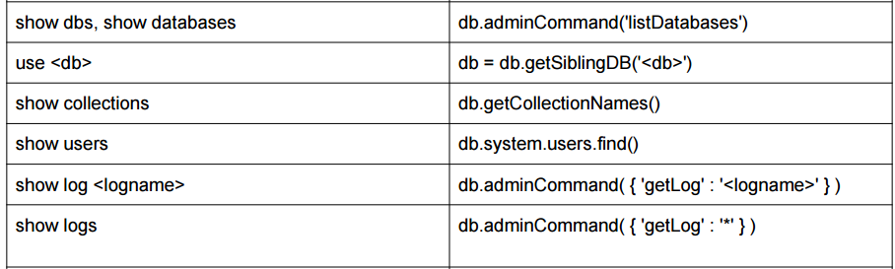
JS Scripts
mongo javaScriptFile.js – runs js file
Some differences mongo-shell functions

Slide 17
db.collection.find()
Does not return value
Returns cursor
Cursor.next() - return data
Cursor.hasNext() - checks if data exists
The cursor returns the smaller between 100 documents and 4mb.
If there is more data – second request will occur
db.collection.findAndModify()

