Slide 1
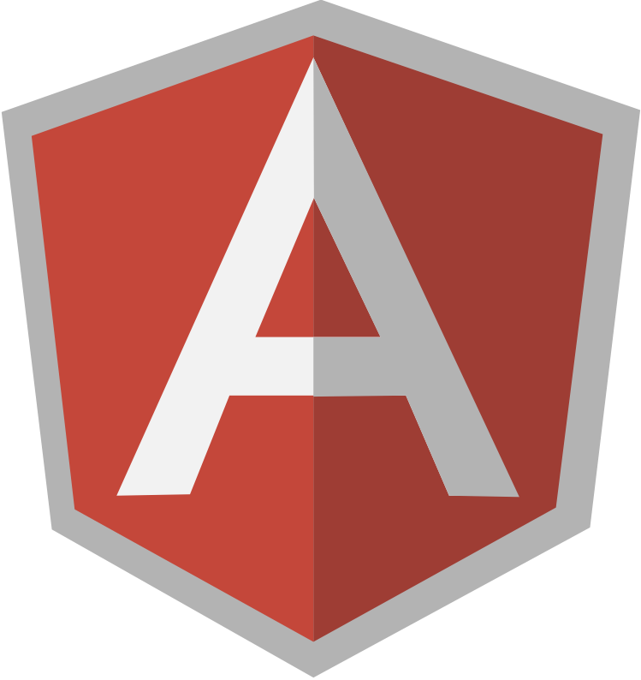
AngularJS - SPA architecture and routing

Slide 2
Table of contents
What is SPA
SPA with Angular
ngRouter
AngularJS Bootstrap

Slide 3
What is SPA
According to wikipedia
  v1: A spa is a location where mineral-rich spring water (and sometimes seawater) is used to give medicinal baths.
  V2: A single-page application (SPA) is a web application or web site that fits on a single web page with the goal of providing a more fluid user experience similar to a desktop application.
    all necessary code – HTML, JavaScript, and CSS – is retrieved with a single page load, or the appropriate resources are dynamically loaded and added to the page as necessary, usually in response to user actions.
    The page does not reload at any point in the process, nor does control transfer to another page,
    the location hash can be used to provide the perception and navigability of separate logical pages in the application, as can the HTML5 pushState() API.
    Interaction with the single page application often involves dynamic communication with the web server behind the scenes.

Slide 4
Routing in Angular
Ui-router – 3rd party. Includes functionality from ngRouter, with extra functions (nested views, multiple named views etc.)
  Organised around states
NgRoute – angular module, developed by angularjs team
  Ogranised around URL routes

Slide 5
How to include ngRouter in ng App
https://www.npmjs.com/package/angular-route
npm install angular-route
<script src="*PathToPackagesFolder*/angular-route/angular-route.js"></script>
angular.module('myApp', ['ngRoute']);

Slide 6
How to run app with ngRoute
Turn index.html into “layout template” - common for all views in our application
  <div ng-view></div>
Other "partial templates" are then included into this layout template depending on the current "route" - the view that is currently displayed to the user.

Slide 7
Adding routes to the app
Routes are defined in app config via $routeProvider
$routeProvider.when(path, route) – adds a new route definition

Slide 8
Route Path
Matches against $location.path
Can contain params with :paramName
Can contain params with slashes :paramName*
Can contain optional param :paramName?

Slide 9
Route – Route config object
Syntax, similar to directive config object
  Template/templateUrl - html template that should be used by ngView
  Controller - Controller fn that should be associated with newly created scope or the name of a registered controller if passed as a string

Slide 10
Access routes data
NgRouter exposes 2 services:
  $route – contains app's routing data
    Current route
    All defined routes
    Reload() - reinstantiates the controller
  $routeParams
    Is used to retrieve current route parameters
    $routeParams are only updated after a route change completes successfully.

Slide 11
Routing events
$routeChangeStart - broadcasted before a route change
$routeChangeSuccess - broadcasted after a route change has happened successfully
$routeChangeError - broadcasted if a redirection function fails or any redirection or resolve promises are rejected.

Slide 12
Navigation
From the view:
  NgHref - Using Angular markup like {{hash}} in an href attribute will make the link go to the wrong URL if the user clicks it before Angular has a chance to replace the {{hash}} markup with its value. Until Angular replaces the markup the link will be broken and will most likely return a 404 error. The ngHref directive solves this problem.
From the controller:
  $location.path is used
    example: $location.path('simple/3);

Slide 13
Route Config resolve
An optional map of dependencies which should be injected into the controller
If any of these dependencies are promises, the router will wait for them all to be resolved or one to be rejected before the controller is instantiated
In the controller resolved data is accessible from $route.current.locals

Slide 14
Adding default route
$routeProvider.otherwise(Obj/string) – Mapping information to be assigned to $route.current. If called with a string, the value maps to redirectTo

Slide 15
Bootstrap demo
https://angular-ui.github.io/bootstrap/
npm install angular-ui-bootstrap
angular.module('myModule', ['ui.bootstrap']);

