Slide 1
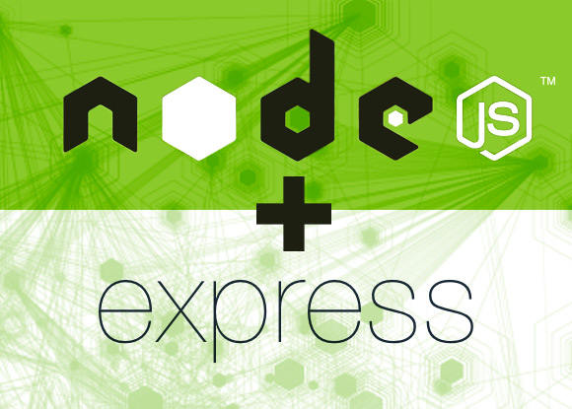
NodeJS and Express

Slide 2
Table of contents
Nodejs & NPM
ExpressJS
Templating Engines
Routing
Databases
Setting up Gulp

Slide 3
NodeJS
Node.js is a JavaScript runtime built on Chrome's V8 JavaScript engine.
Event-driven, Non-blocking I/O
CommonJS module system
NPM (node package manager) - ecosystem of open source libraries
Runs standart JavaScript
Es2015 support: http://node.green/

Slide 4
Node Installation
https://nodejs.org - download from here
Check if installed in cmd line
  node –-version
  node
Hello world
  node filename.js

Slide 5
Node's Event Loop
Constantly listens for events on the server side
  External
    Http requests
  Internal
    Filesystem
    Process
    Database
Does not pause and wait for any of these requests to complete

Slide 6

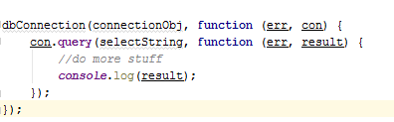
Node convention for writing async code
  Sync
  Async
  Last argument of invoked function is the callback
  First argument of the callback function is the error object

Slide 7

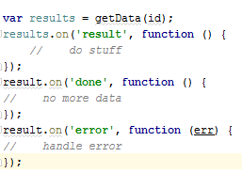
Node convention for writing async code 2
  Using callbacks
    Request/Reply
    No result until all results
    Either error or results
Using events
Publish/subscribe
Act on result as they arrive

Slide 8
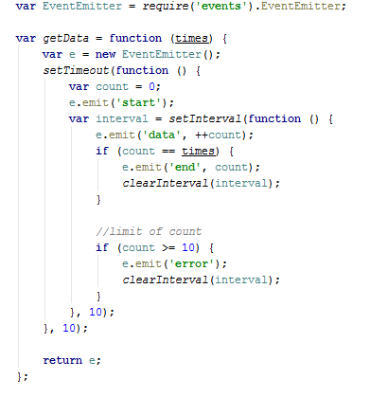
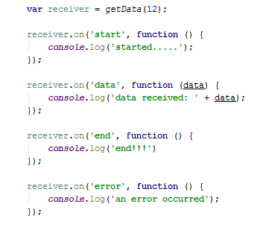
EventEmitter class

Slide 9
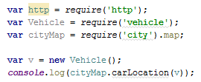
Module system
Modules are imported with require method
Module sources:
  Built-in Modules: fs, http, crypto, os
  Your project's files
  3rd party modules from NPM

Slide 10
Streams
Streams are instances/extensions of/to EventEmitter with agreed "interface"
A unified abstraction for managing data flow
  Network traffic
  File I/O
Streams:
  ReadableStream
  WritableStream
  Both
A ReadableStream can be pipe()'d to a WritableStream

Slide 11
Streams 2
Readable Stream
readable(bool)
Events
  Data
  End
  Error
  Close
Methods
  Pause
  Resume
  Destroy
  Pipe
Writable Stream
writable(bool)
Events
  Drain
  Close
  Error
Methods
  Write
  End
  destroy

Slide 12
File system
Require('fs')
Can operate with files via sync/async methods
Provides fs.watch()

Slide 13
Using for the Web
As client
As a web server
Real-time integration using Socket.IO

Slide 14
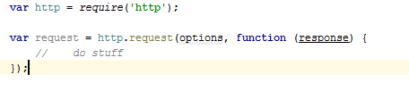
Making web requests in Node
Options can be
  Url string
  Object, specifying host,port,method,headers etc.
Http.get() - simplified interface for GET

Slide 15
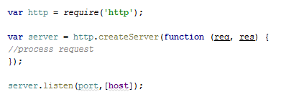
Web Server in Node
Each request is provided via callback or as a "request" event on the server object

Slide 16
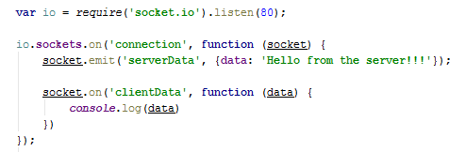
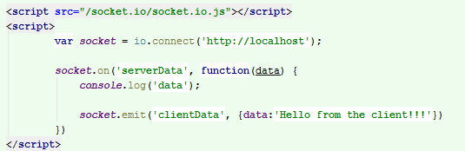
Socket.IO

Slide 17
Connect Middleware
https://github.com/senchalabs/connect#readme

Slide 18
ExpressJS
Built on top of Connect Middleware
Adds functionality to Connect:
  Request / Response enchancements
  Routing
  View support
  HTML helpers
Exposes Connect Middleware
MVC -> Model Vew Router

Slide 19
Routing
Demo
Demo with params
Demo with regex
Demo routing – express.Router()

Slide 20

Views
npm install express-handlebars

Slide 21
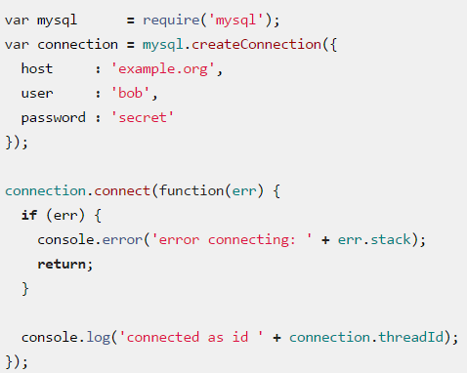
MySql
https://www.npmjs.com/package/mysql#install
npm install mysql
The recomended
way to establish
connection

Slide 22
MySql
Terminating connection:
Performing queries
Escaping query identifiers
Streaming query rows

Slide 23
Setting up gulp/nodemon for nodeJS
https://www.npmjs.com/package/gulp-nodemon
http://nodemon.io/

Slide 24
REST
Stands for REpresentational State Transfer
General Meaning – convention for web services which treat every entity in a web service as a resource
REST defines rules for API arhitecture
Url | Method | Description
/test | GET | Displays the list of items
/test | POST | Stores new record
/test/{id} | GET | Displays a item with id equal to $id
/test/{id} | PUT/PATCH | Updates the record in the database
/test/{id} | DELETE | Deletes the record from the database

Slide 25
Express framework
  Express is minimalistical web framework for nodejs.
  Good for Web Applications
  Good For Apis
  Installation
$ npm install express --save

Slide 26
Express Getting Started
const express = require('express');
const app = express();
app.get('/', function (request, response) {
response.send('Hello Express!');
});
app.listen(3000, function() {
console.log('Started' + "\n");
})

Slide 27
Express Getting Started
const express = require('express');
const app = express();
app.get('/', function (request, response) {
response.send('Hello Express!');
});
app.get('/html', function (request, response) {
response.send('Hello Express!');
});
app.listen(3000, function() {
console.log('Started' + "\n");
})

