Slide 1
Rockbuster Stealth Data Analysis Project
Fatima ISA
31/07/2022

Slide 2
Background and objectives of Analysis
Background
Rockbuster Stealth LLC is a movie rental company with stores across the world. The company is facing stiff competition from streaming companies such as Netflix and Amazon Prime. To keep up with the competition, the management is planning to launch an online video rental service from existing licences.
Objective
The aim of the analysis is to explore and investigate several objectives and business questions for the company:
What was the average rental duration and rate for all videos?
Which countries are Rockbuster customers based in?
Where are customers with a high lifetime value based ?
Which movies contributed the most/least to revenue gain?
Do sales figures vary between geographic regions?
Tools used for analysis
Data analyses was conducted using Excel, SQL and tableau

Slide 3
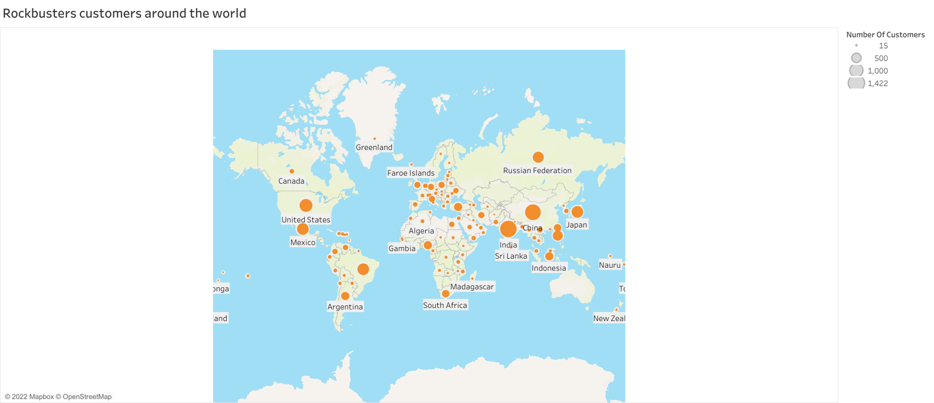
Which countries are Rockbuster Stealth customers based in?
The Rockbuster Stealth customers are based across the world.
The map shows the total number of customer in different country.
The circle in the map represents the number of customers. The higher the number of customers the bigger the circle.
High numbers of customers observed in India, China and the United States.
Across the globe the average number of number customer 135 and number of custmers varies from 15 to 1422

Slide 4
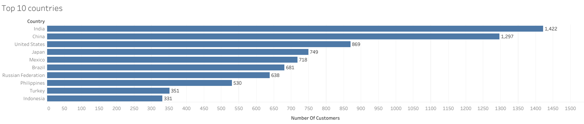
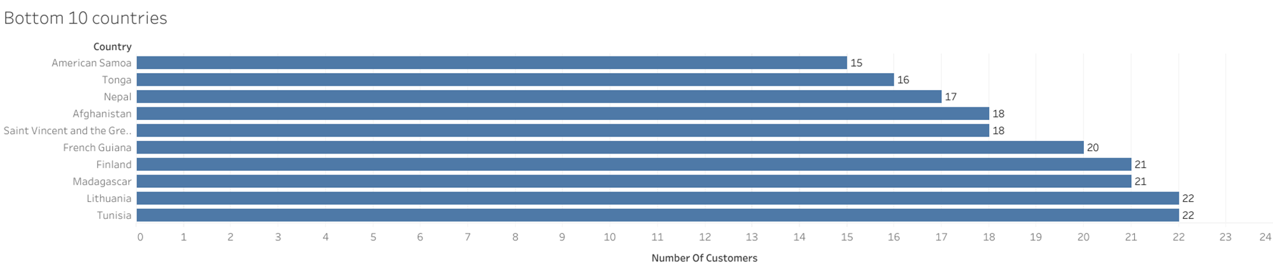
Top 10 countries and bottom 10 countries for Rockbuster Stealth in terms of customer numbers
Number of Rockbuster Stealth customers varies across the globe:
India has the highest number of customers ( a total of 1,422 customers )
American Samoa has the lowest number of customer ( a total of 15 customers).

Slide 5
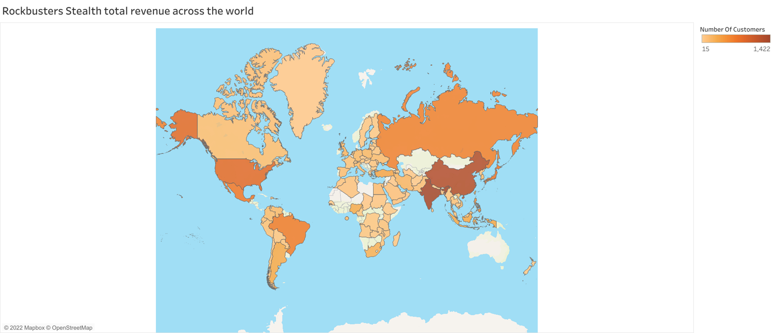
What is the total revenue across the globe?
High numbers of customers observed in India, China and the United States.
Increase in customers increase total revenue
Across countries average total revenue is £538 and varies from £48 to £6038

Slide 6
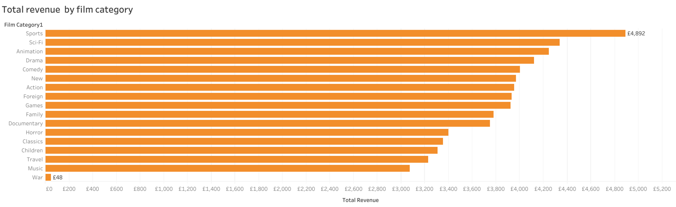
What is the total revenue by film category?
Across the world it was noted that sports film category has the highest total revenue of £4,892

Slide 7
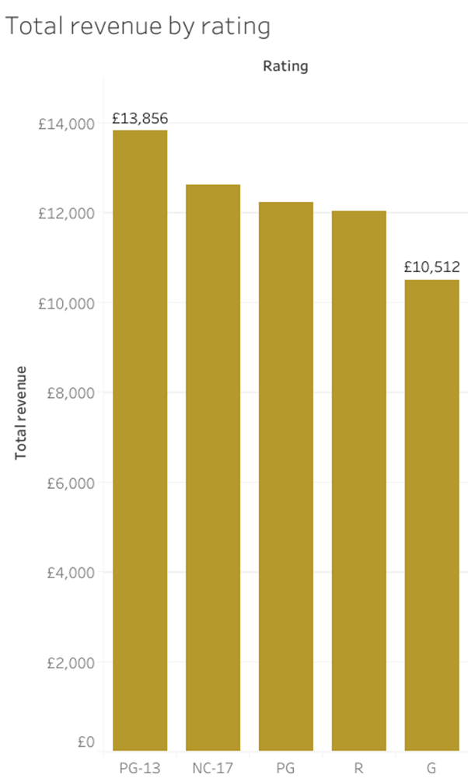
What is the total revenue by film rating?
Across the world:
The highest revenue was observed in the rating PG13 (£13,856) and the lowest in G rating (£10,512)

Slide 8
What is the distribution of rental duration and rental rate across all videos?
Distribution across all videos
Measure | Average value | Minimum value | Maximum value
Rental rate | 2.98 | 0.99 | 4.99
Rental duration | 4.98 | 3 | 7
Most frequently watched film
Rating | Title | Description
PG-13 | Academy Dinosaur | A Action-Packed Character Study of a Astronaut And a Explorer who must Reach a Monkey in A MySQL Convention
Across all Rockbuster stores the following points were noted:
The average rental rate was £2.98, varying between 0.99p and £4.99.
The average rental duration was 4.98 days, varying between 3 to 7 days.
Most frequently watched film was the Academy Dinosaur and the rating was PG-13.

Slide 9
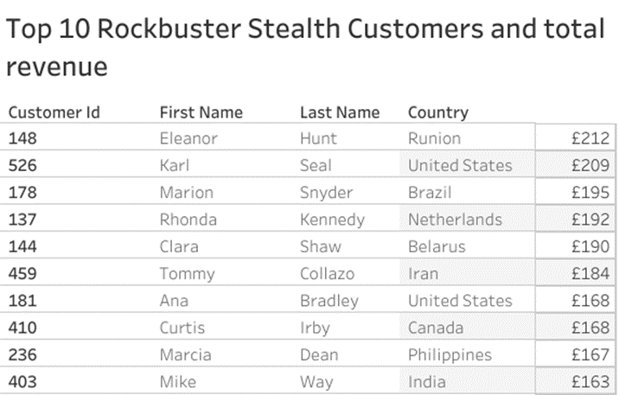
Rockbuster Stealth top 10 customers
The customer with the highest total revenue is Eleanor Hunt based in Runion.

Slide 10
Conclusion
Summary of key findings
Rockbuster Stealth Stores the following key findings were observed:
India has the highest number of customers (a total of 1422).
Total revenue range £48 to £6038 and average total revenue was £538 across Rockbuster Stealth.
The highest total revenue was observed in sport film category ( Total revenue - £4892).
PG13 rating has the highest total revenue (£13,856) and G has the lowest rating (£10,512).
The average rental rate was £2.98
Average rental duration was ~ 5 days
Recommendation
Gaining more customers: By partnering with other rental companies
Increase technology efficiency and quality on online rental: Rockbuster Stealth should ensure the technology is efficient to improve customers satisfaction.
Conducting a survey analysis/qualitative studies to understand the experience of customers
Tableau link :Edit | 3.10 (tableau.com)

