Slide 1
Stack Overflow Developer Survey: Current Usage, Future Trends & Demographics
IBM Data Analyst Capstone • 2025-08-29
Prepared by:Fatemeh Kermani

Slide 2
Outline
Executive Summary
Introduction (Purpose, Audience, Value)
Methodology (Data Sources & Wrangling)
Programming Languages - Current Top 10
Programming Languages - Next-Year Trends
Databases - Current Top 10
Databases - Future Demand
Job Postings(job-postings.xlsx)
Dashboard - Current Technology Usage
Dashboard - Future Technology Trends
Dashboard - Demographics
Insights from Dashboards
Overall Findings & Implications
Conclusion
Appendix

Slide 3
Executive Summary
Programming languages (current): JavaScript/TypeScript lead everyday use in your chart, with C# and Python forming the next tier.
Programming languages (next year): Intent clusters around Python and modern typed JS (TypeScript); these show the clearest “Want > Have” signal for upskilling.
Databases (current): PostgreSQL and MySQL dominate, followed by Microsoft SQL Server and MongoDB; SQLite and MariaDB are also visible, with Redis appears in the long tail.
Databases (next year): Interest continues to favor PostgreSQL/MongoDB and moves toward managed/cloud-friendly options; hands-on experience lags stated intent.
So what: Prioritize a short learning sprint on Python and TypeScript, and build a small project on PostgreSQL/MongoDB to close the gap quickly.

Slide 4
Introduction
Purpose: Present clear signals from the Stack Overflow Developer Survey to guide what to learn, what to build, and where to focus hiring.
Scope: Current usage vs. next-year intent for programming languages and databases, plus job-market signals
Audience: Students and stakeholders in analytics/engineering/product who make training, tooling, and recruiting decisions
Value: Turn charts into actions-prioritize skills with the largest Want-Have gaps and align projects with roles that show the most postings
Limitations (brief): Self-reported survey data; sample bias; next-year “intent” is not guaranteed adoption

Slide 5
Methodology
Data sources: Stack Overflow Developer Survey (course dataset) and Job-posting.xlsx for role counts.
Cleaning: Dropped blanks and duplicates, fixed label inconsistencies (e.g., “MS SQL Server” => “Microsoft SQL Server”), trimmed extra spaces.
Multi-select columns: Turned the multi-choice fields (LanguageHaveWorkedWith, LanguageWantToWorkWith, DatabaseHaveWorkedWith, DatabaseWantToWorkWith) into one selection per row so we could count them properly.
How we ranked Top 10: Counted responses, converted to shares (% of respondents), sorted descending, and kept the top ten for each chart.
Gap metric: For each technology we computed Want − Have to spot the biggest upskilling opportunities
Job postings chart: Read Job-posting.xlsx and plotted roles in descending order of postings.
Tools: Prepped data in Python (Pandas/Matplotlib); built dashboards in Cognos/Looker Studio with three tabs (Current, Future, Demographics)
Consistency & fairness: We kept the same filters, names, and sorting across all charts so the comparisons stay fair and easy to read
Limitations: This is self-reported survey data from a sample of the community; what people plan to use next year doesn’t always turn into real adoption

Slide 6
Programming Languages (Current Top 10)
JavaScript and TypeScript rank #1 and #2 by current use.
C# and Python make up the next tier in everyday development.
The rest of the top ten sit in a smaller long tail.
Takeaway: Keep JS/TS as core skills and maintain working proficiency in C# and Python for backend/data work.

Slide 7
Programming Languages (Next-Year Trends)
Top intent: Python and TypeScript attract the most “want to use next year.’’
Momentum: Python’s interest grows across roles; TypeScript keeps rising with modern JS stacks.
Steady vs softening: JavaScript stays high and steady; C# sits a bit behind the top cluster for forward intent.
Skill gaps (Want − Have): Biggest gaps show up for Python and TypeScript-clear targets for upskilling.
Action: Run a short 2–3 week sprint: one small Python project (data/automation) and one TypeScript project (frontend or API). Add both to the portfolio

Slide 8
Databases (Current Top 10)
PostgreSQL and MySQL lead current use.
Microsoft SQL Server and MongoDB make up the next cluster.
SQLite and MariaDB show up for lightweight/embedded or legacy needs; Redis appears in the long tail.
Takeaway: Standardize on PostgreSQL/MySQL for most workloads; keep playbooks for SQL Server and MongoDB where they fit best

Slide 9
Databases (Future Demand)
Top intent: PostgreSQL and MongoDB attract the strongest “want to use next year.
Momentum: Interest shifts away from purely on-prem toward managed/cloud-friendly databases
Skill gaps (Want − Have): Biggest gaps sit with PostgreSQL and MongoDB-prime targets for hands-on practice.
Action: Spin up a small sandbox-one relational project on PostgreSQL and one document-store project on MongoDB

Slide 10
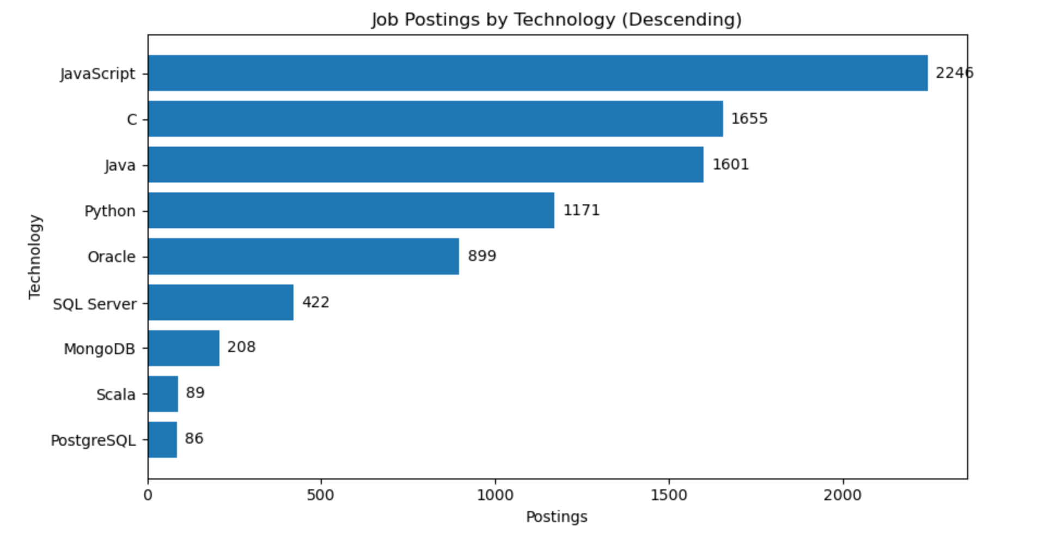
Job Postings by Technology (Descending)
Top technologies: JavaScript (2,246), C (1,655), Java (1,601), Python (1,171).
Distribution: Sharp drop after the top group; the rest form a long tail (Oracle ~899, SQL Server ~422, MongoDB ~208, Scala ~89, PostgreSQL ~86).
Takeaway: Showcase JavaScript plus one backend language (C/Java/Python) in projects, and include a database example that mirrors demand.

Slide 11
Methods ↔ Findings Cross-Reference
Multi-select → Rankings: Splitting the multi-choice fields let us build true Top-10 lists in Slides 6–9.
Cleaning → Fair comparisons: Label fixes and consistent casing/filters keep the charts apples-to-apples.
Gap metric → Actions: The Want − Have metric directly drove the actions on Slides 7 and 9.
Job postings tie-in: The postings chart supports the earlier language signals (JavaScript, Java, Python).
Dashboards ↔ Slides: The three dashboard tabs (Slides 12–14) use the same logic, so screenshots line up with the results.
See S5 for methods; see S6–10 for results

Slide 12
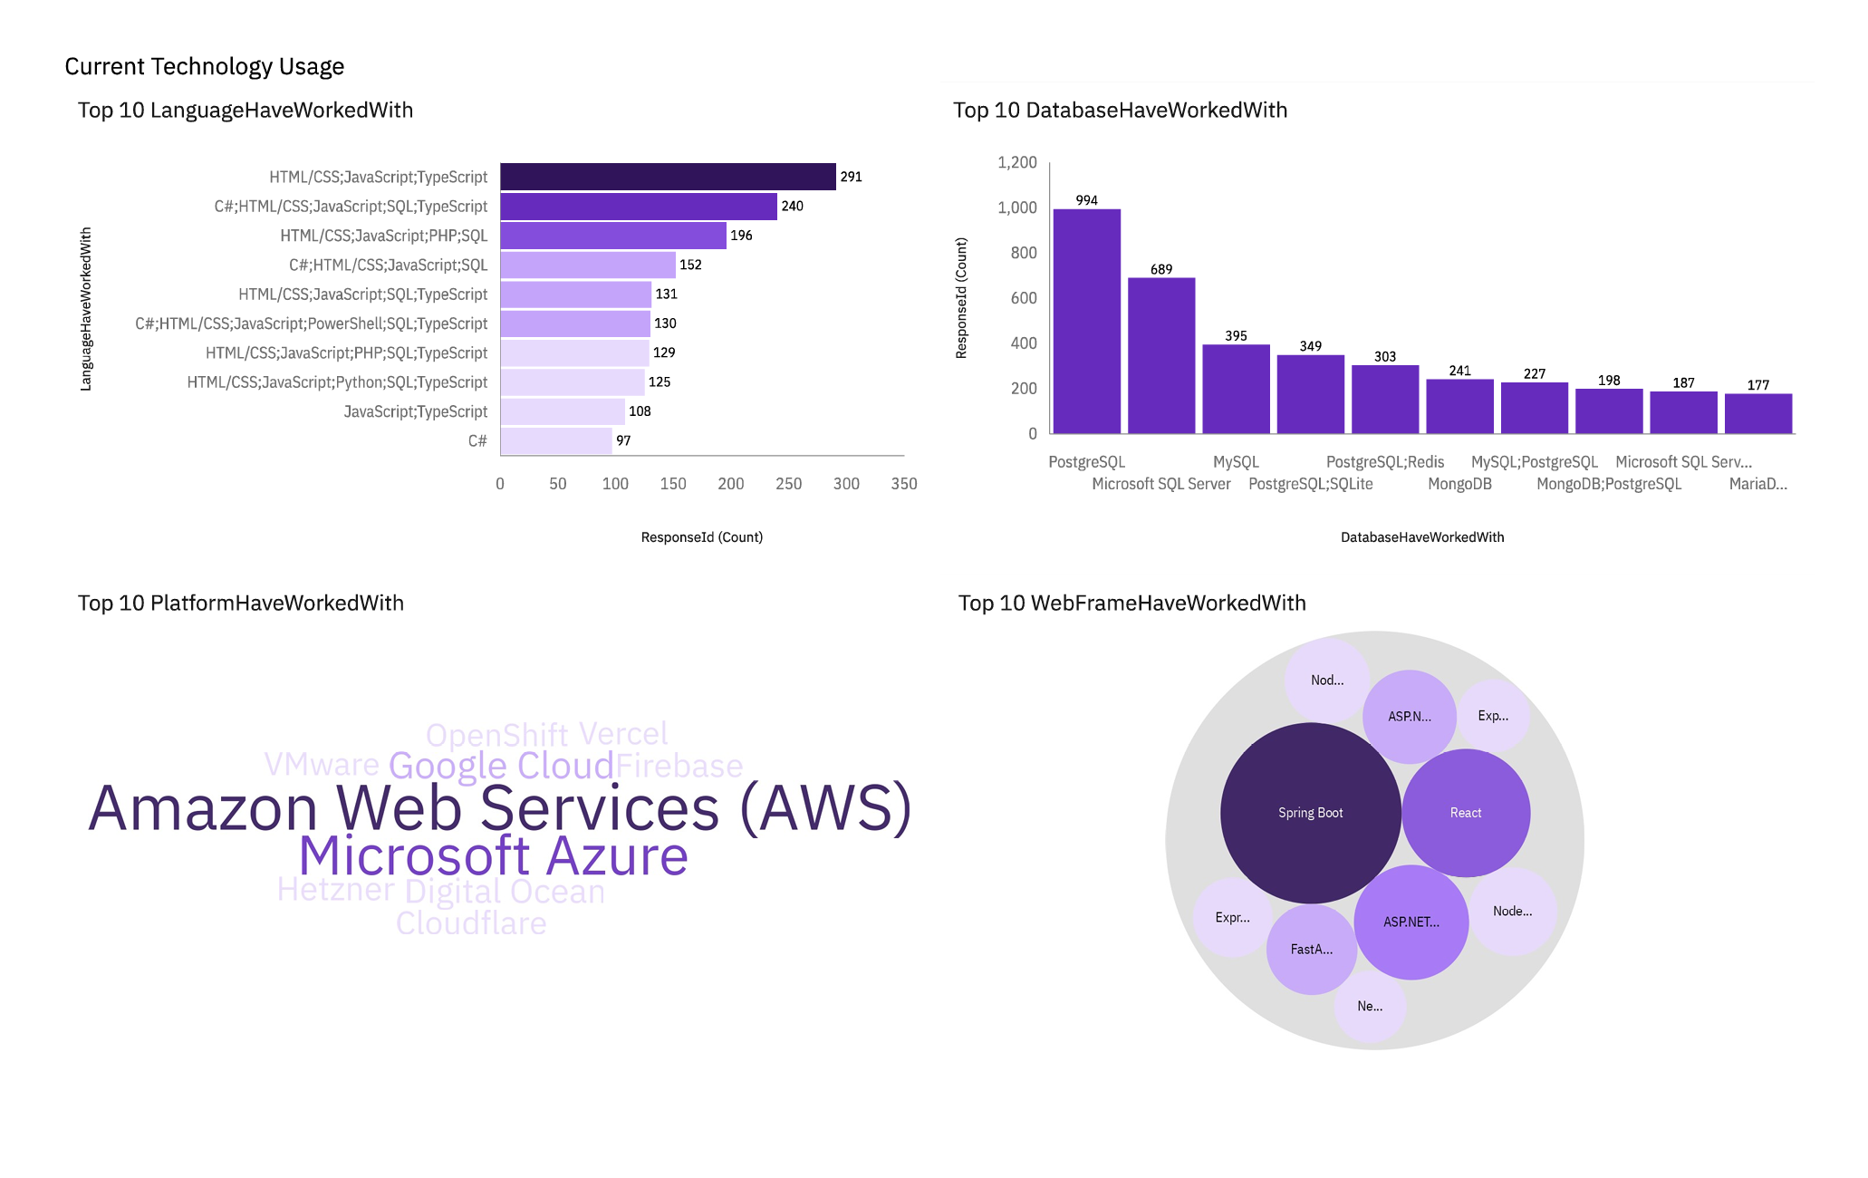
Dashboard: Current Technology Usage
What’s shown: Current usage across languages, databases, platforms, and web frameworks (Top-10 in each chart).
Languages: JavaScript + TypeScript + HTML/CSS appear in most stacks; C# and Python are also common.
Databases: PostgreSQL, SQL Server, and MySQL are the main workhorses; MongoDB shows up alongside them.
Platforms: AWS is the default choice, with Azure next; Google Cloud is present but smaller.
Web frameworks: React and Spring Boot stand out in the framework chart

Slide 13
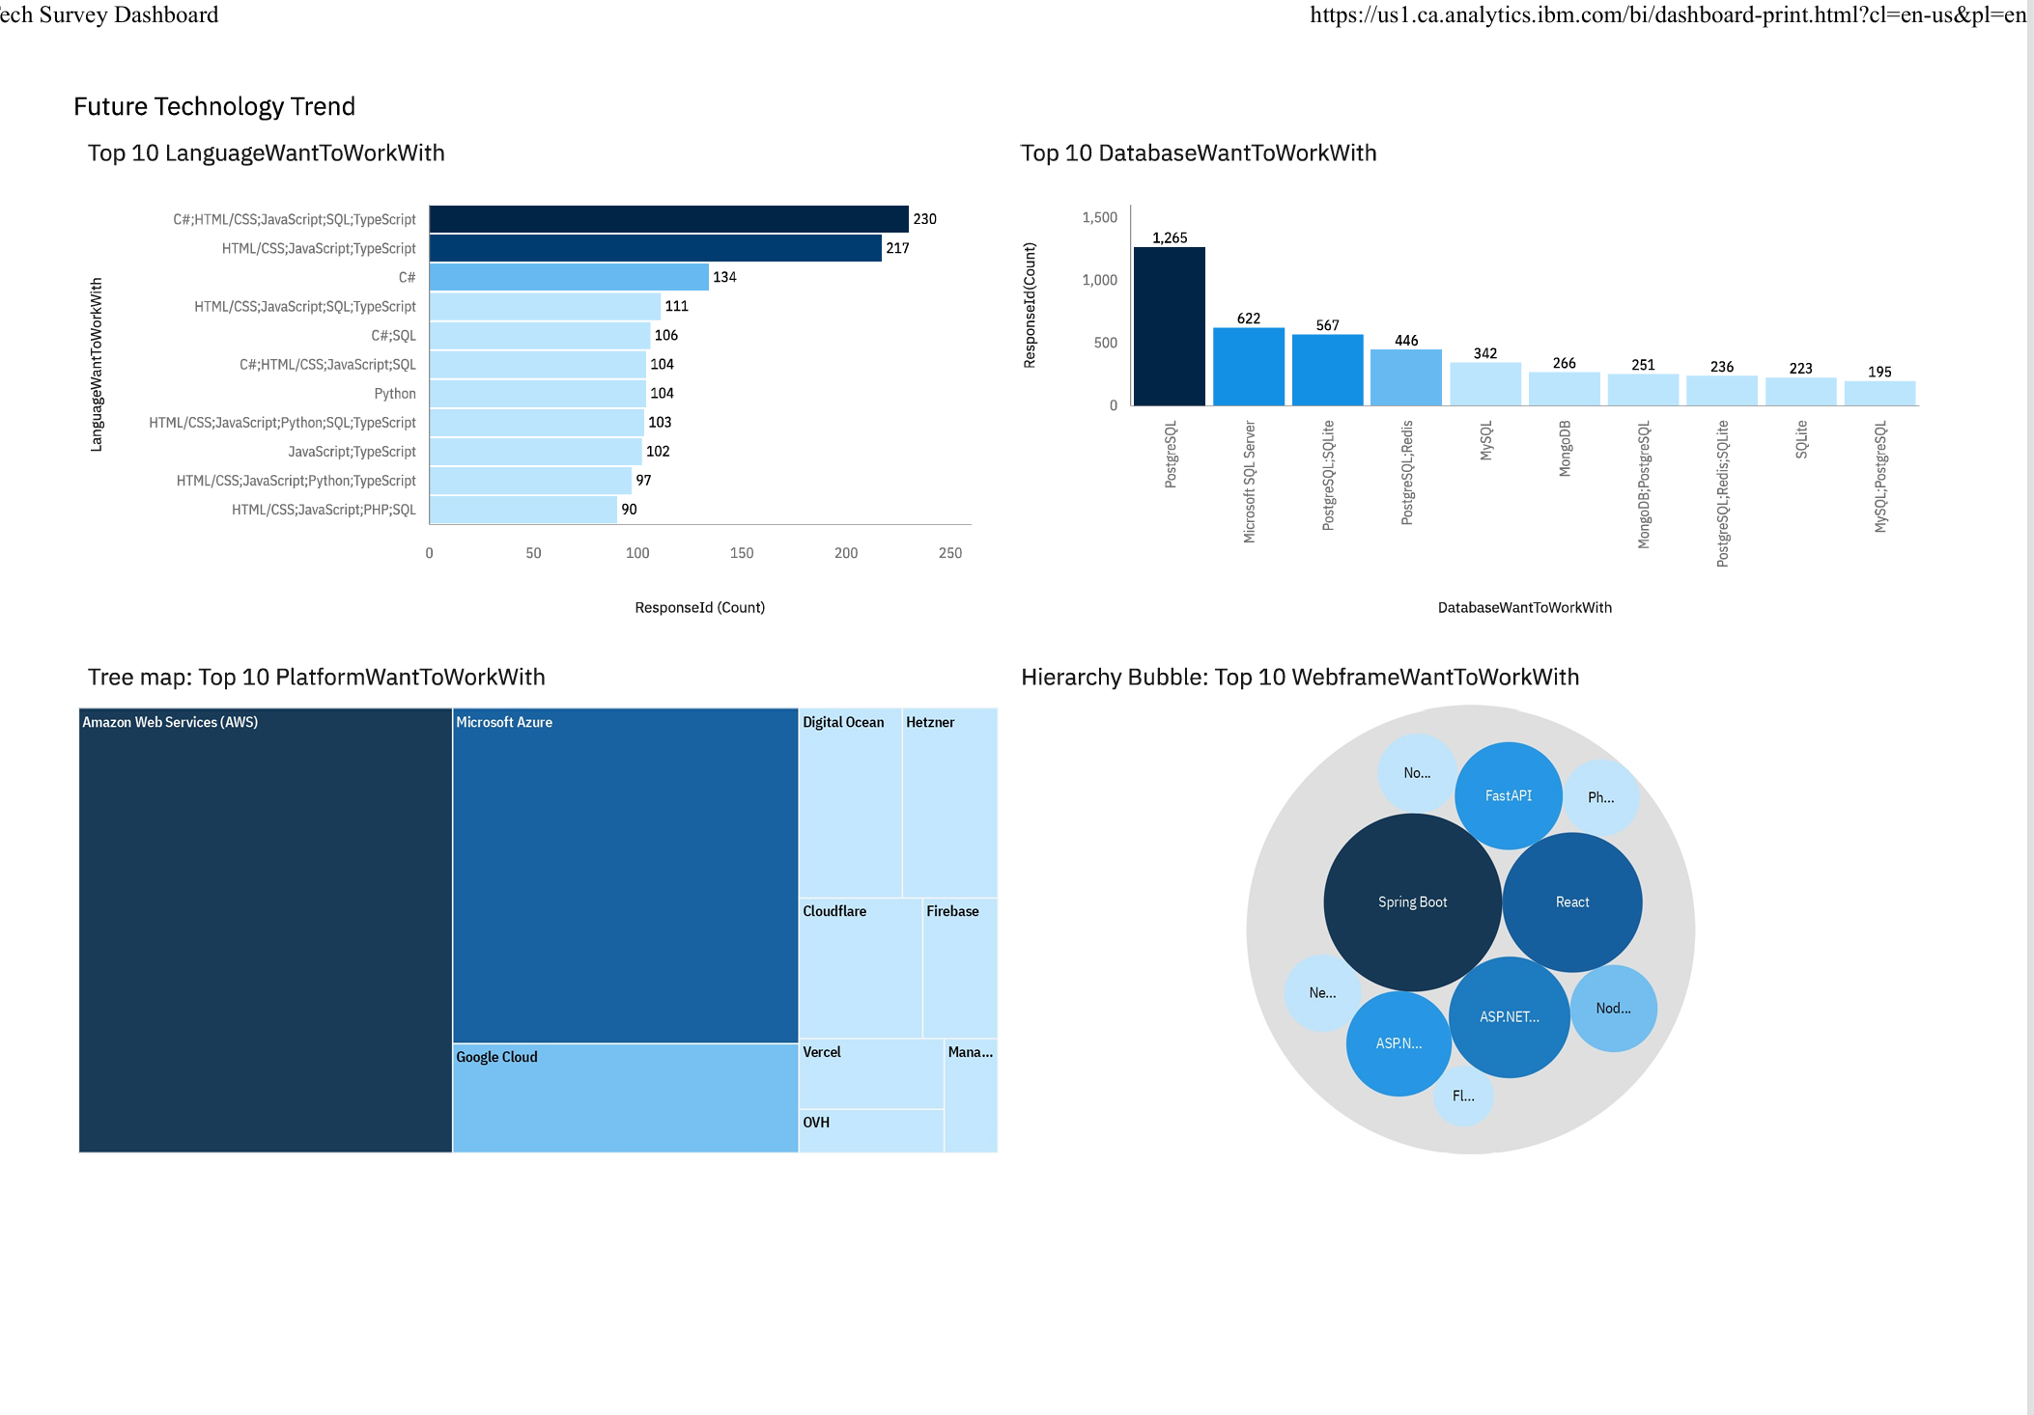
Future Technology Trends
What’s shown: Next-year intent across languages, databases, platforms, and web frameworks (Top-10 each).
Languages: JS/TypeScript stacks and C# sit at the top; Python is a clear riser
Databases: PostgreSQL is #1 by a wide margin, with Microsoft SQL Server next; MySQL and MongoDB follow.
Platforms: AWS leads, Azure is second; Google Cloud is visible, with smaller interest in DigitalOcean, Vercel, Cloudflare, OVH, Hetzner.
Web frameworks: Spring Boot and React stand out; FastAPI, ASP.NET, and Node show up as secondary choices.
Skill gaps → action: Upskill on TypeScript/JS + Python and get hands-on with PostgreSQL/MongoDB; plan one small project for each

Slide 14
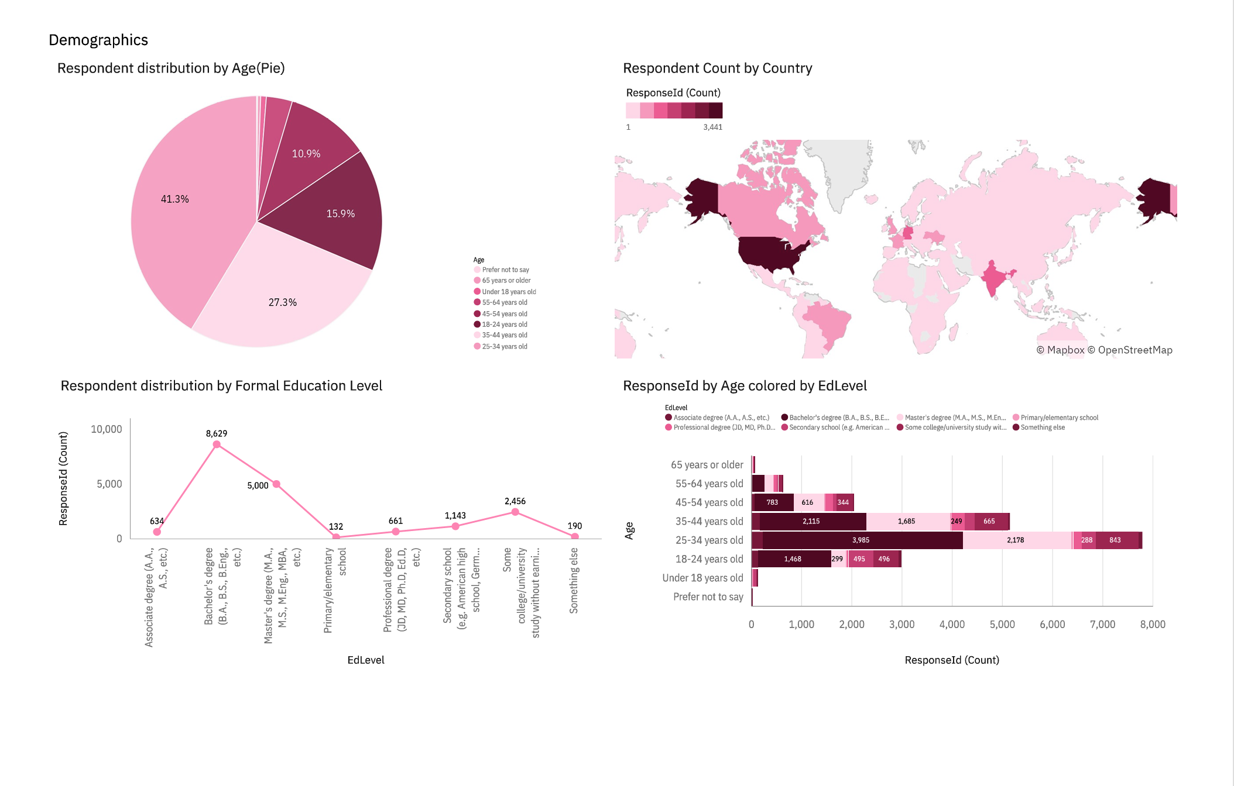
Dashboard: Demographics
What’s shown: Age bands, country map, education levels, and the age × education cross-tab.
Age: Responses cluster around early-career bands; there’s a taper into +35.
Geography: A few countries account for most responses; regional mix can shape which tools get adopted first.
Education: Bachelor’s is most common; Master’s is sizable; self-taught/bootcamps also appear.
Cross-cut: Younger groups skew Bachelor’s/undergrad, while graduate degrees rise in older bands

Slide 15
Insights from Dashboards
Now vs next: Today’s stack is JS/TS + relational DBs; next-year intent adds momentum for Python and PostgreSQL/MongoDB.
Skill gaps worth closing: The biggest Want − Have gaps sit on Python, TypeScript, and PostgreSQL => fastest ROI for upskilling.
Framework reality check: React and Spring Boot anchor most projects; FastAPI/ASP.NET look like smart second bets.
Cloud pattern: AWS is the default, Azure second; having “AWS + one other” in the toolkit covers most cases.
Demographics lens: A young, US-leaning sample helps explain the strong JS/React and AWS presence; results may weight early-career preferences.
So what: Prioritize one portfolio project in Python + PostgreSQL and one in TypeScript/React; deploy on AWS to match market signals

Slide 16
Overall Findings & Implications
Core today: JS/TS + HTML/CSS dominate; PostgreSQL/MySQL/SQL Server are the workhorse DBs; React/Spring Boot show up often; AWS leads cloud use.
Where interest is heading: Python and TypeScript gain momentum; PostgreSQL/MongoDB trend up; cloud-first/managed tools grow.
Skill gaps: Largest Want − Have on Python, TypeScript, and PostgreSQL =>fastest wins from focused upskilling.
Hiring signal: Postings favor JS plus one backend (Java/Python/C) with SQL and a major cloud (AWS/Azure).
Implications: Short term-ship projects in Python + PostgreSQL and TypeScript/React on AWS. Medium term-document when to choose PostgreSQL vs MongoDB. Long ter--track intent vs adoption in the next survey.
Limits & risk: Self-reported data; intent is not adoption; de-risk with small pilots and measure usage

Slide 17
Conclusion
What we know now: JS/TS lead current use; Python is rising; PostgreSQL/MySQL/SQL Server are core; AWS leads cloud use.
What to do next: Ship two small portfolio projects: (1) Python + PostgreSQL, (2) TypeScript + React on AWS.
Hiring signal: Most postings ask for JS plus one backend language, SQL, and a major cloud.
Risks and limits: The survey is self-reported and intent is not adoption. Start with small pilots and measure actual usage.
Closing line: These choices match both the survey signals and the job market right now.

Slide 18
Appendix
Extra charts: Full Top 10 tables not shown in the main slides (languages, databases, platforms, frameworks).
Job postings data: Table with Technology and Postings used for Slide 10.
Data dictionary: Brief notes for LanguageHaveWorkedWith, LanguageWantToWorkWith, DatabaseHaveWorkedWith, DatabaseWantToWorkWith.
Method notes: Filters applied, label cleanup rules, and the Want - Have formula.
Reproducibility: Tool versions (Python, Pandas, Matplotlib) and the dashboard tool; date of data pull.

