Slide 1
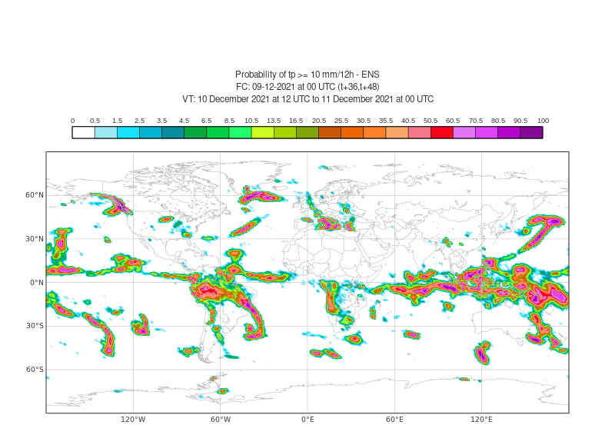
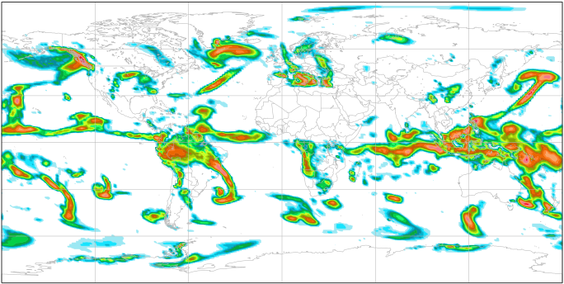
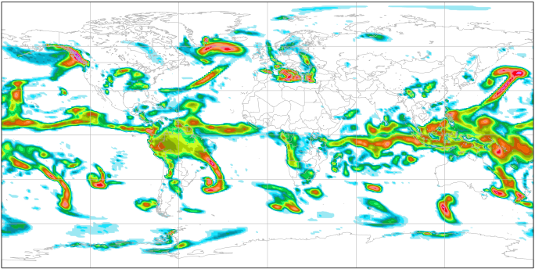
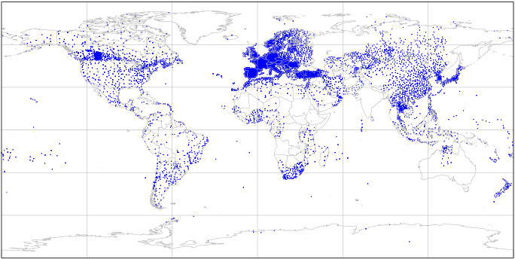
Probability [%] of tp >= 10 mm/12h
ENS
Single-WT ecPoint
a
c
Multiple-WT ecPoint
b
d
Rain gauge locations

