Slide 1
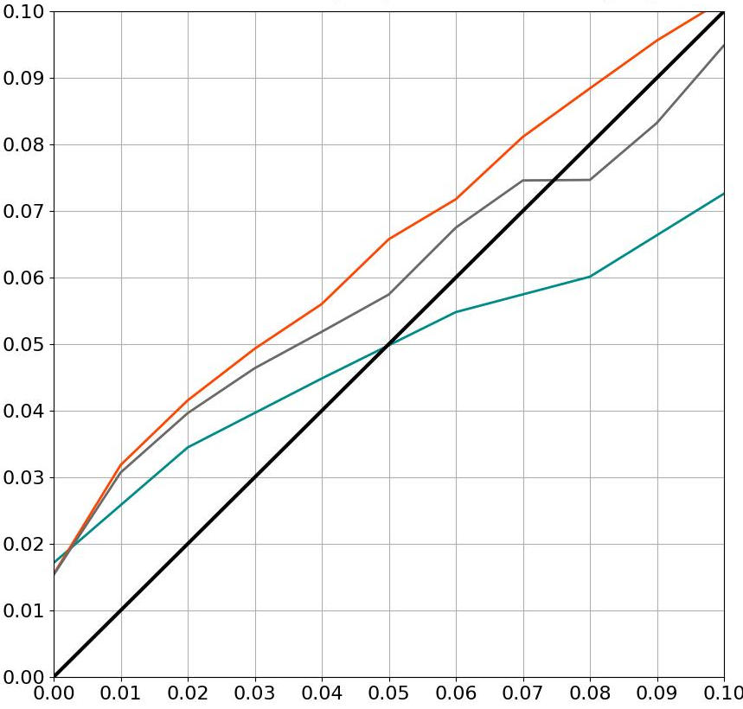
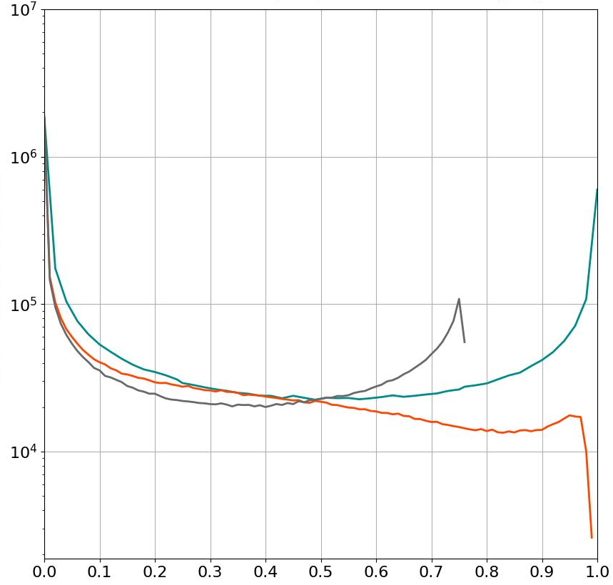
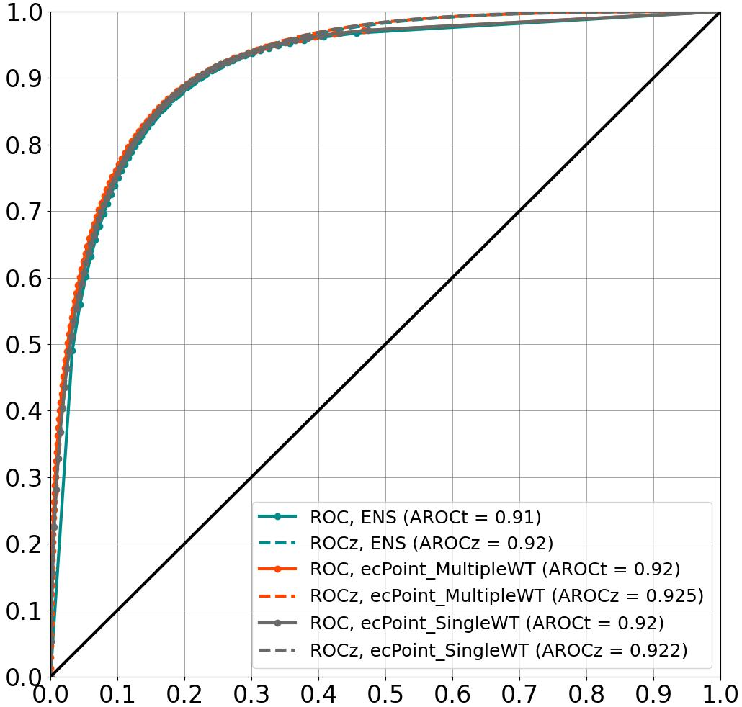
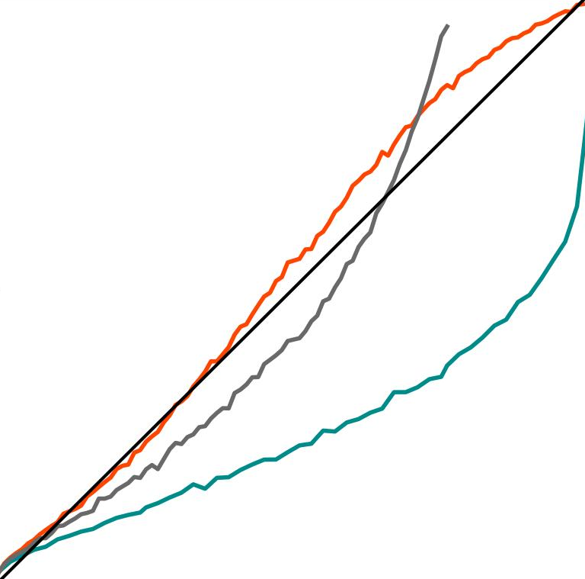
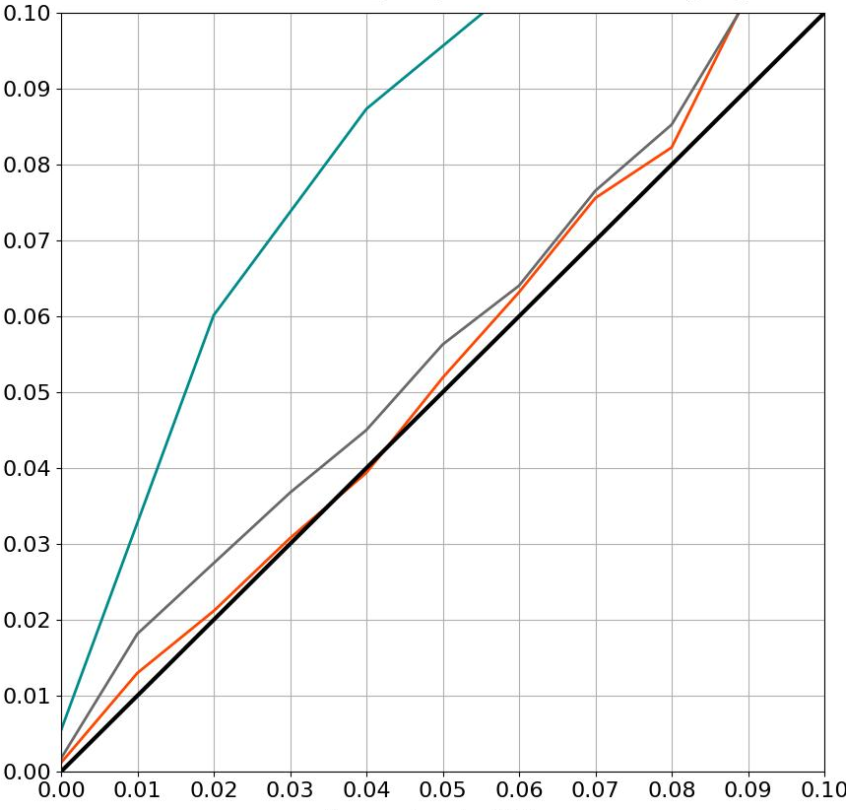
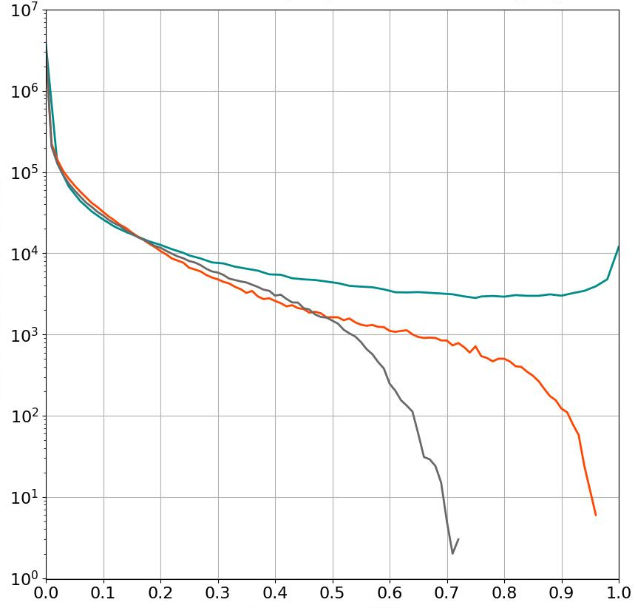
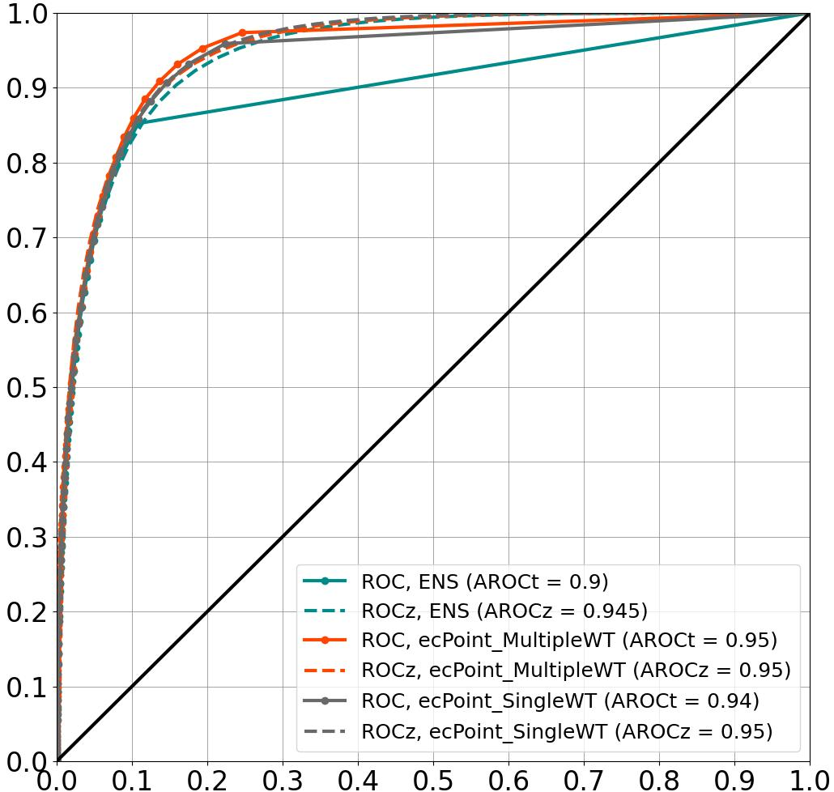
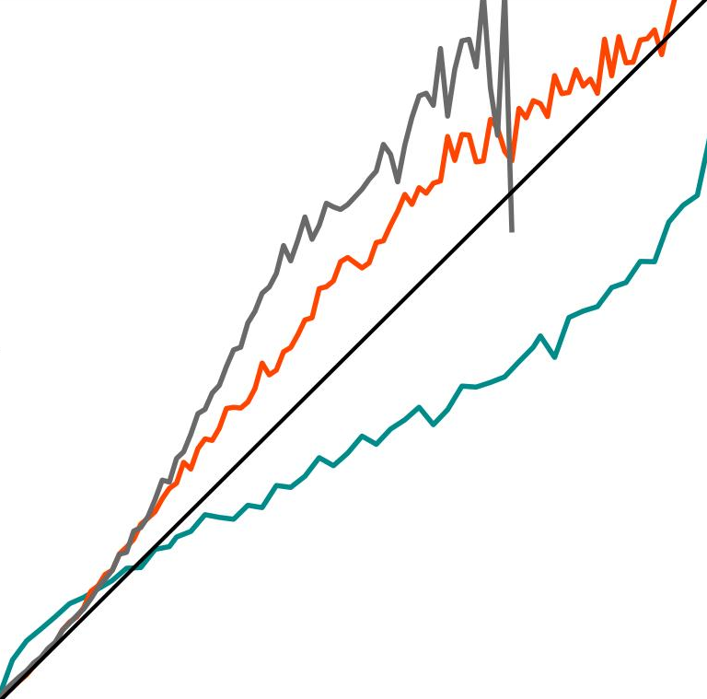
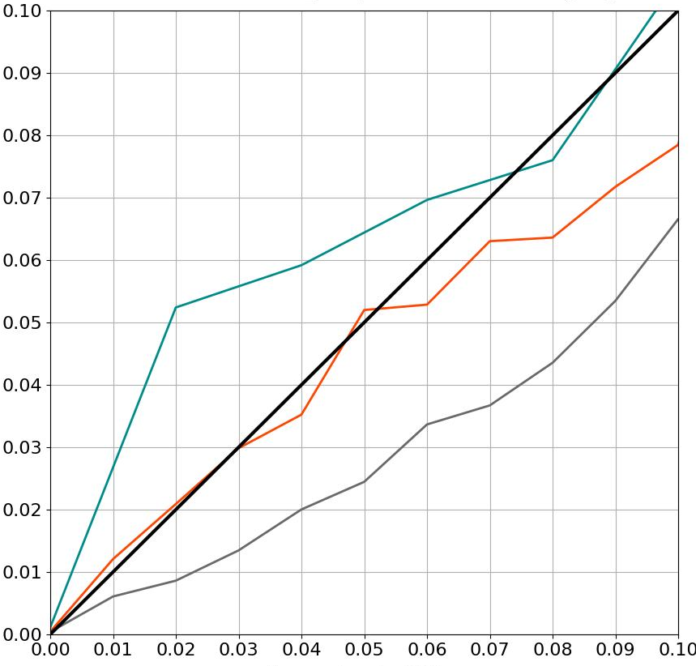
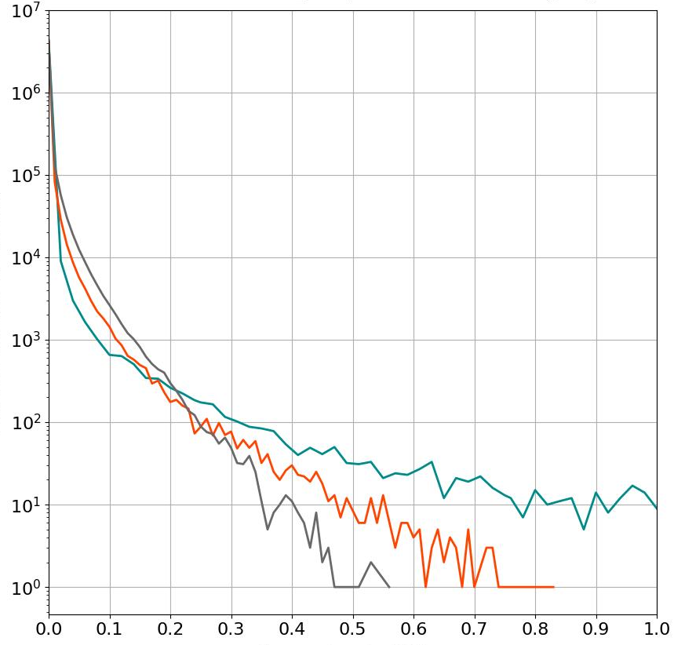
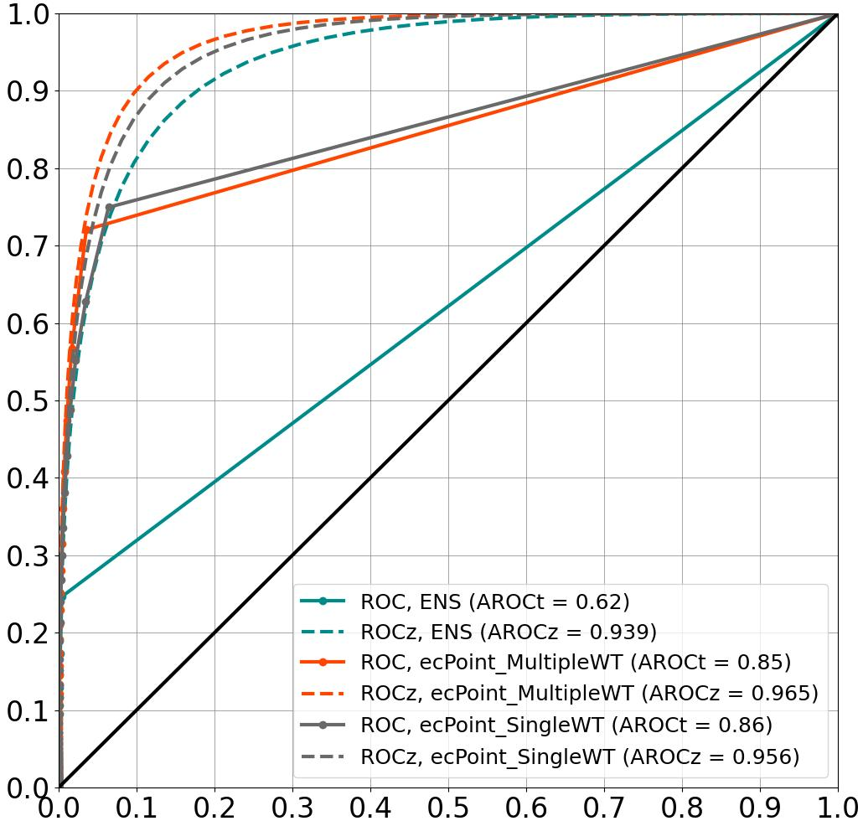
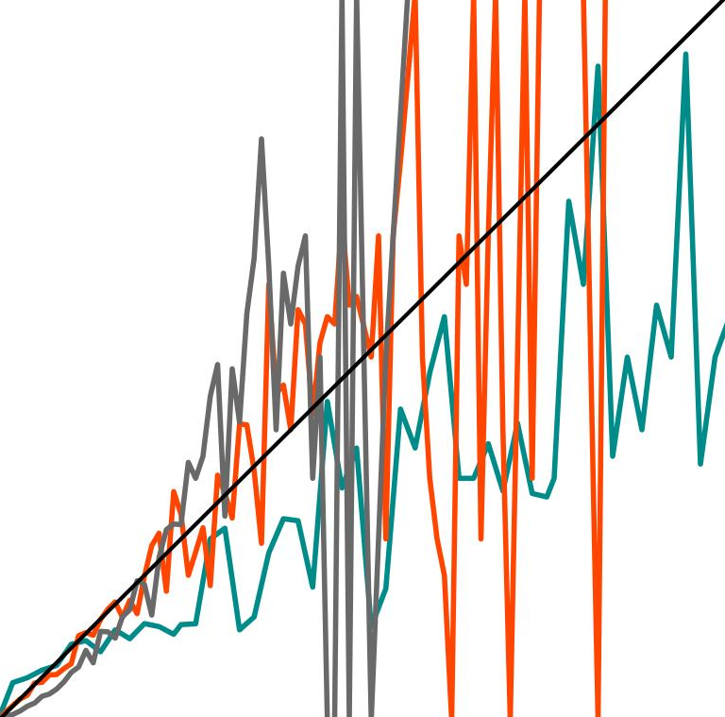
Reliability diagrams, t+24
Sharpness diagrams, t+24
ROC curves, t+24
ENS
Multiple-WT
ecPoint
Single-WT
ecPoint
ENS
Multiple-WT
ecPoint
Single-WT
ecPoint
ENS
Multiple-WT
ecPoint
Single-WT
ecPoint
Real ROC
Binormal ROC
VRT >= 0.2 mm/12h
Observation relative frequency
a
Forecast absolute frequency
d
Hit rates
1
g
.5
AROCt = 0.91 - AROCz = 0.92
AROCt = 0.92 - AROCz = 0.925
AROCt = 0.92 - AROCz = 0.922
0
0
.5
1
Forecast probabilities
Forecast probabilities
False alarm rates
VRT >= 10 mm/12h
Observation relative frequency
Forecast absolute frequency
Hit rates
C
b
e
B
A
1
h
.5
AROCt = 0.9 - AROCz = 0.945
AROCt = 0.95 - AROCz = 0.95
AROCt = 0.94 - AROCz = 0.95
0
0
.5
1
Forecast probabilities
Forecast probabilities
False alarm rates
VRT >= 50 mm/12h
Observation relative frequency
1
Forecast absolute frequency
f
Hit rates
.5
C
B
0
0
.5
1
i
A
AROCt = 0.62 - AROCz = 0.939
AROCt = 0.85 - AROCz = 0.965
AROCt = 0.86 - AROCz = 0.956
c
Forecast probabilities
Forecast probabilities
False alarm rates

