Slide 1
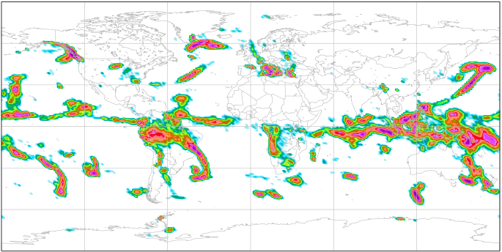
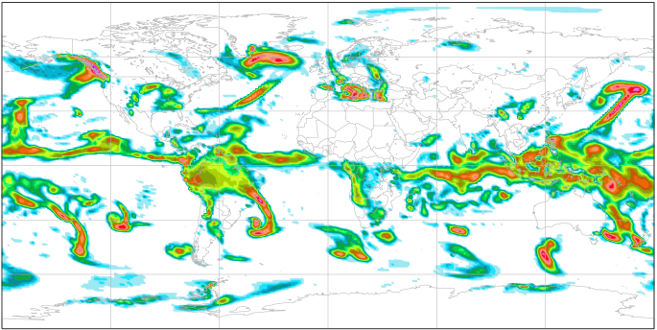
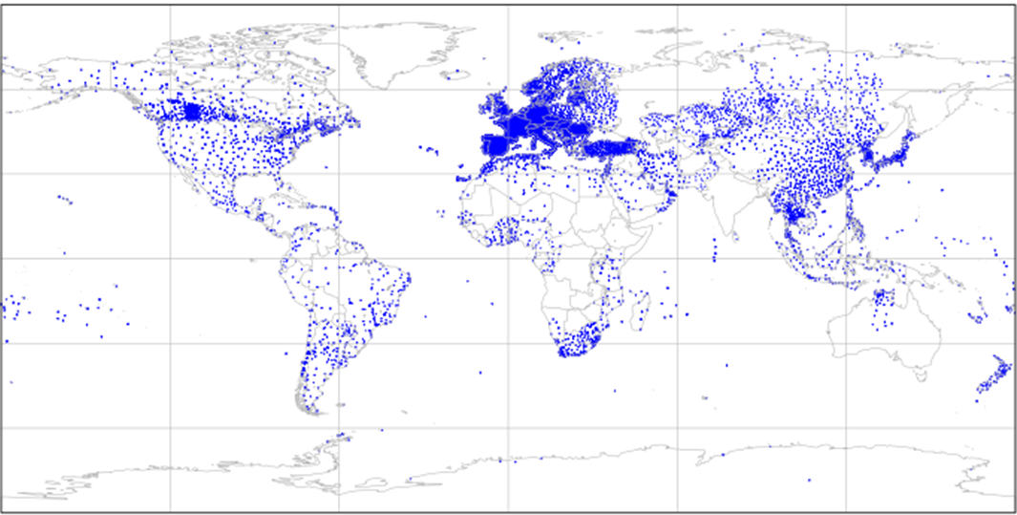
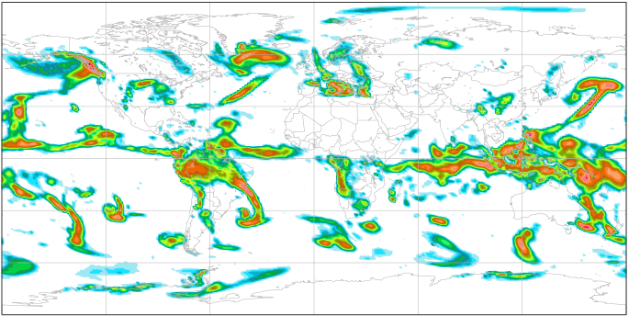
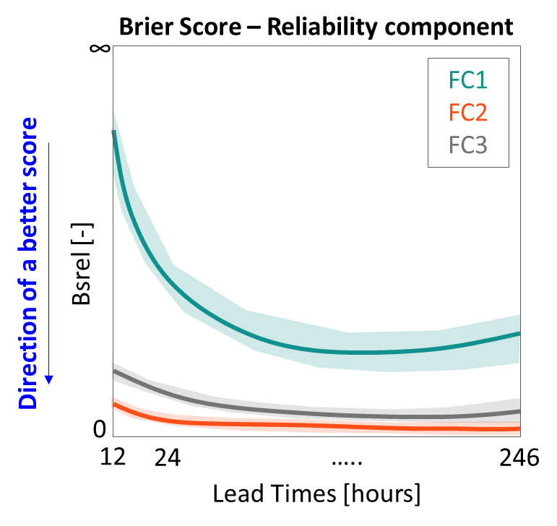
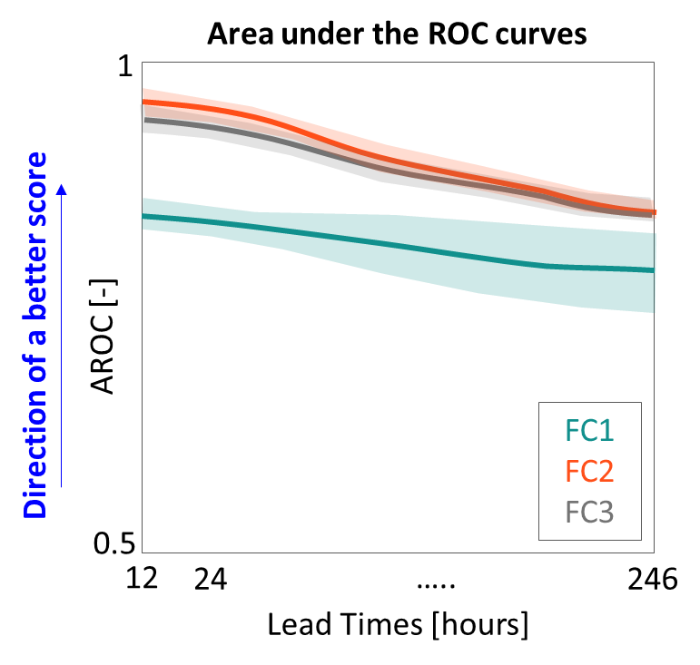
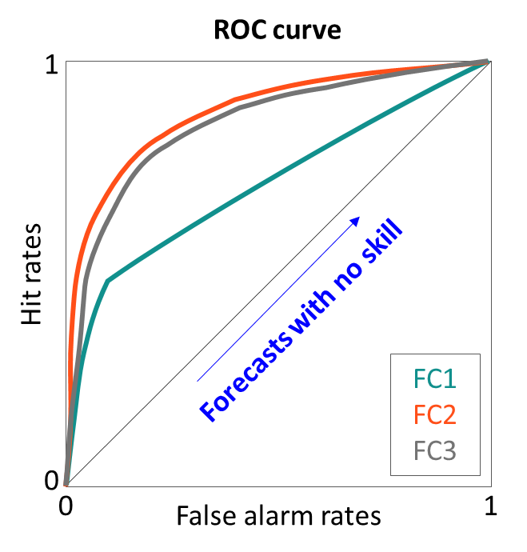
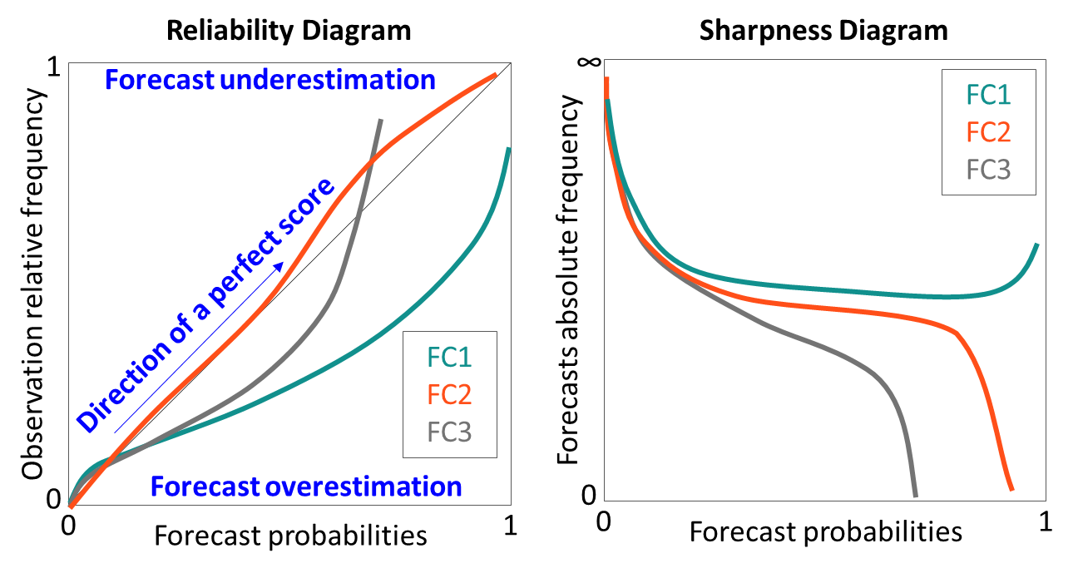
START - Research Question (RQ)
Is it worth bearing the cost of adopting a statistical weather-scenario-based approach to post-process NWP model outputs or would similar improvements be achievable with a no-weather-scenario-based approach?
FC1
FC2
Read forecasts
(Section 2.1 & Figure 2a-c)
Read observations
(Section 2.2 & Figure 2d)
FC3
OBJECTIVE VERIFICATION
Compute scores to compare main forecast properties:
RELIABILITY
(Section 3.1)
DISCRIMINATION ABILITY
(Section 3.2)
Summary score
(for all probability thresholds, for each lead time, for each VRT)
Reliability component of the Brier Score (BSrel)
Breakdown score
(for each probability threshold, for each lead time, for each VRT)
Reliability/sharpness diagrams
Summary score
(for all probability thresholds, for each lead time, for each VRT)
Area under the ROC curve
Breakdown score
(for each probability threshold, for each lead time, for each VRT)
ROC curves
a
b
c
d
(Section 4.1 &
Figures 4a-c)
(Section 4.1 &
Figures 5a-f)
(Section 4.2 &
Figures 4d-f)
(Section 4.2 &
Figures 5g-i)
END - Answer to RQ
Estimation of discrimination ability for
“Real” forecasting system configuration (Real ROC curves, AROC with trapezium approximation)
&
“Potential” forecasting system configuration, e.g. more members (binormal approximation for ROC curves and AROC)

Slide 3
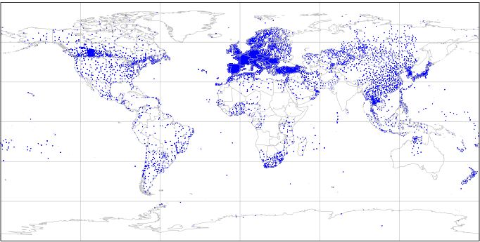

Slide 4
Brier Score – Reliability component
∞
Direction of a better score
Bsrel [-]
FC1
FC2
FC3
0
12
24
…..
246
Lead Times [hours]

Slide 5
Reliability Diagram
Sharpness Diagram
1
∞
Observation relative frequency
Forecast underestimation
Forecasts absolute frequency
FC1
FC2
FC3
Direction of a perfect score
FC1
FC2
FC3
0
Forecast overestimation
0
0
1
0
1
Forecast probabilities
Forecast probabilities

Slide 6
Area under the ROC curves
1
Direction of a better score
AROC [-]
FC1
FC2
FC3
0.5
12
24
…..
246
Lead Times [hours]

Slide 7
ROC curve
1
Hit rates
Forecasts with no skill
FC1
FC2
FC3
0
0
1
False alarm rates

