Slide 1
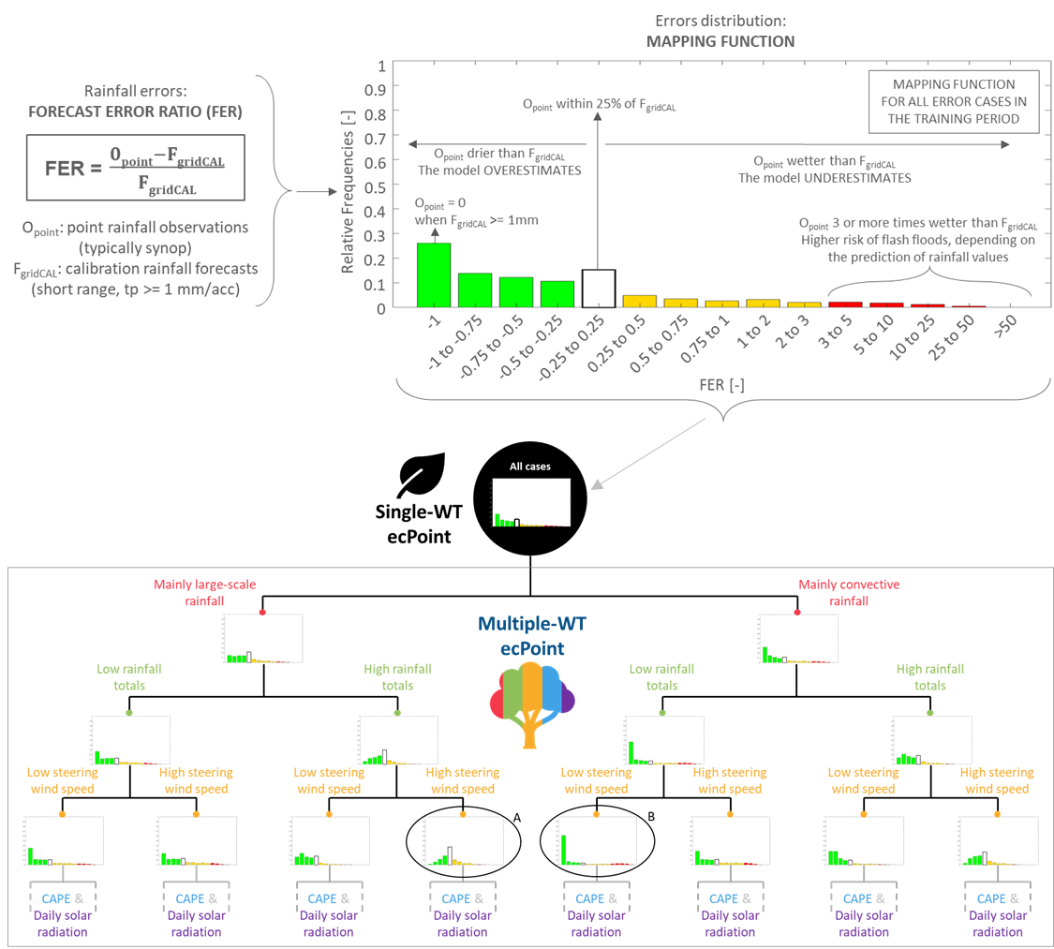
Errors distribution:
MAPPING FUNCTION (MF)

