Slide 1
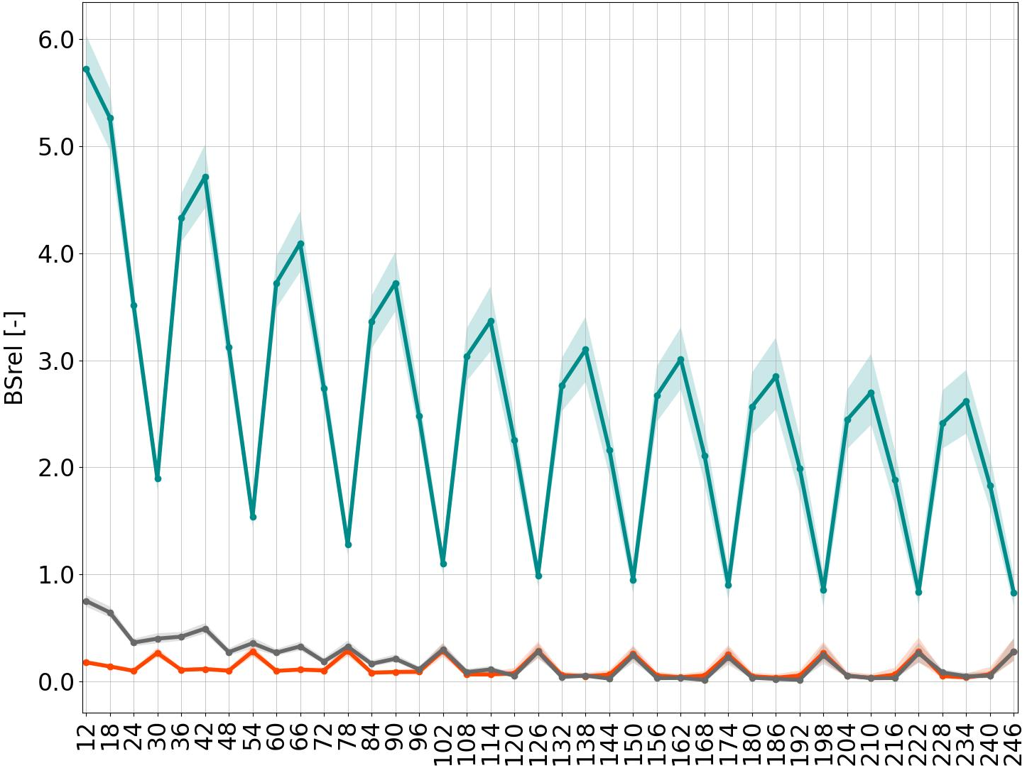
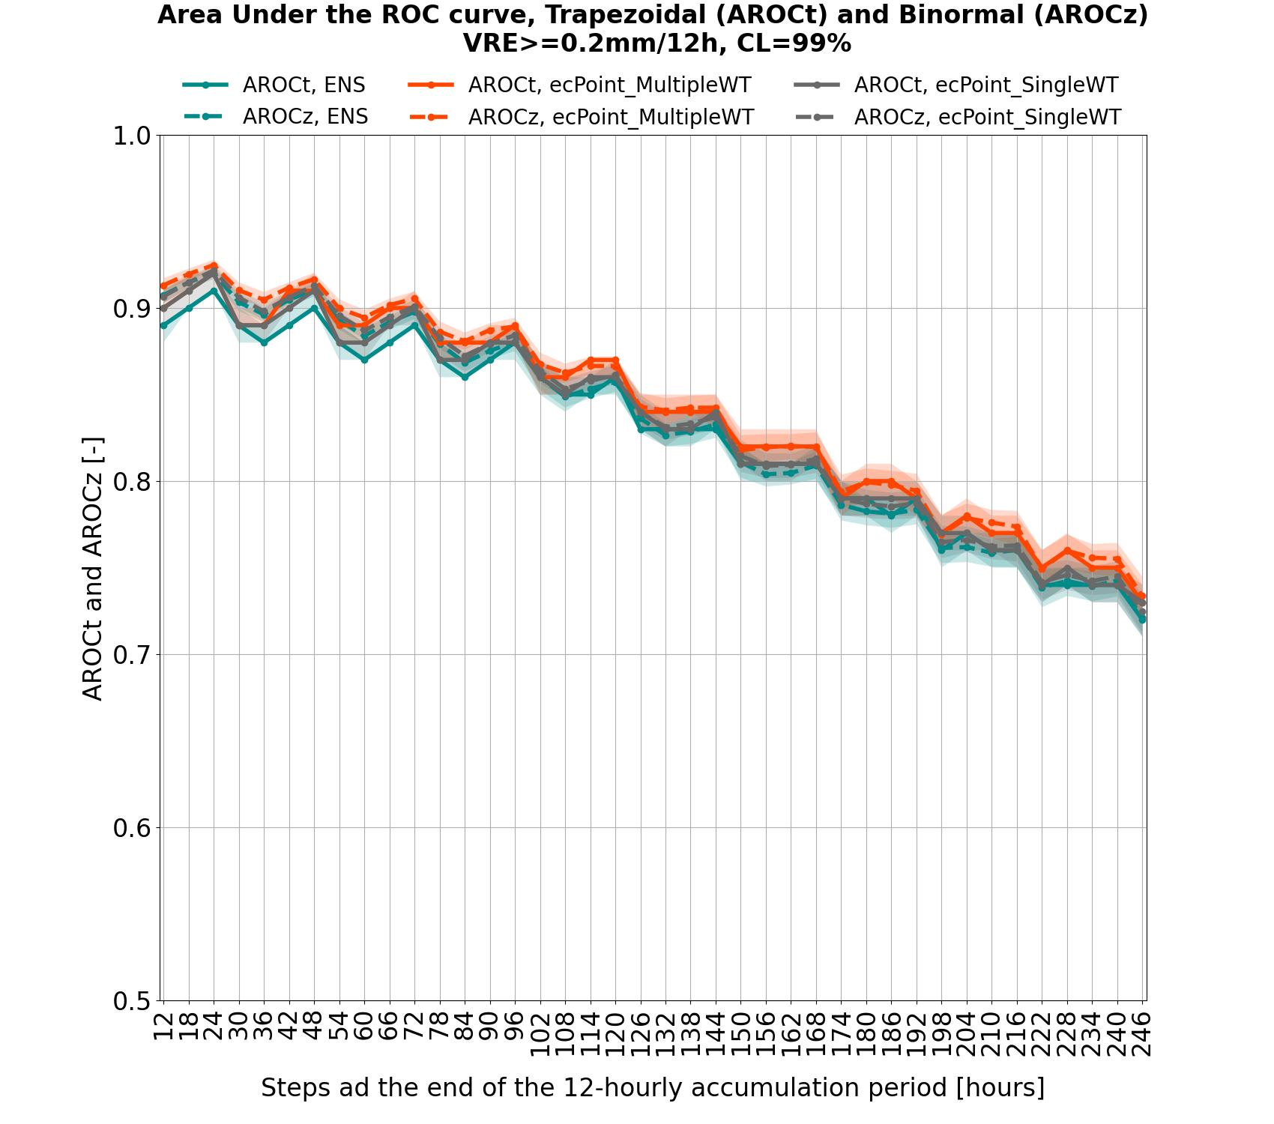
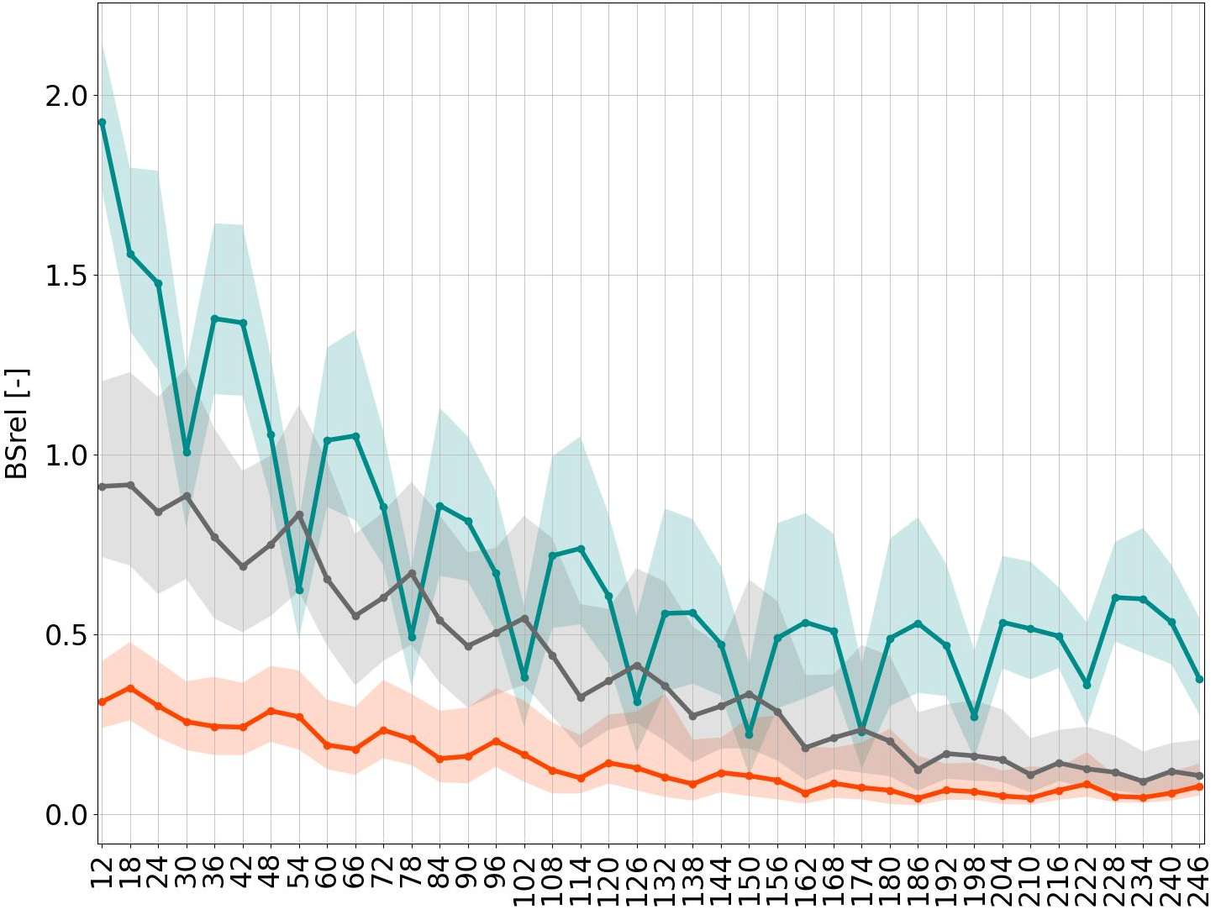
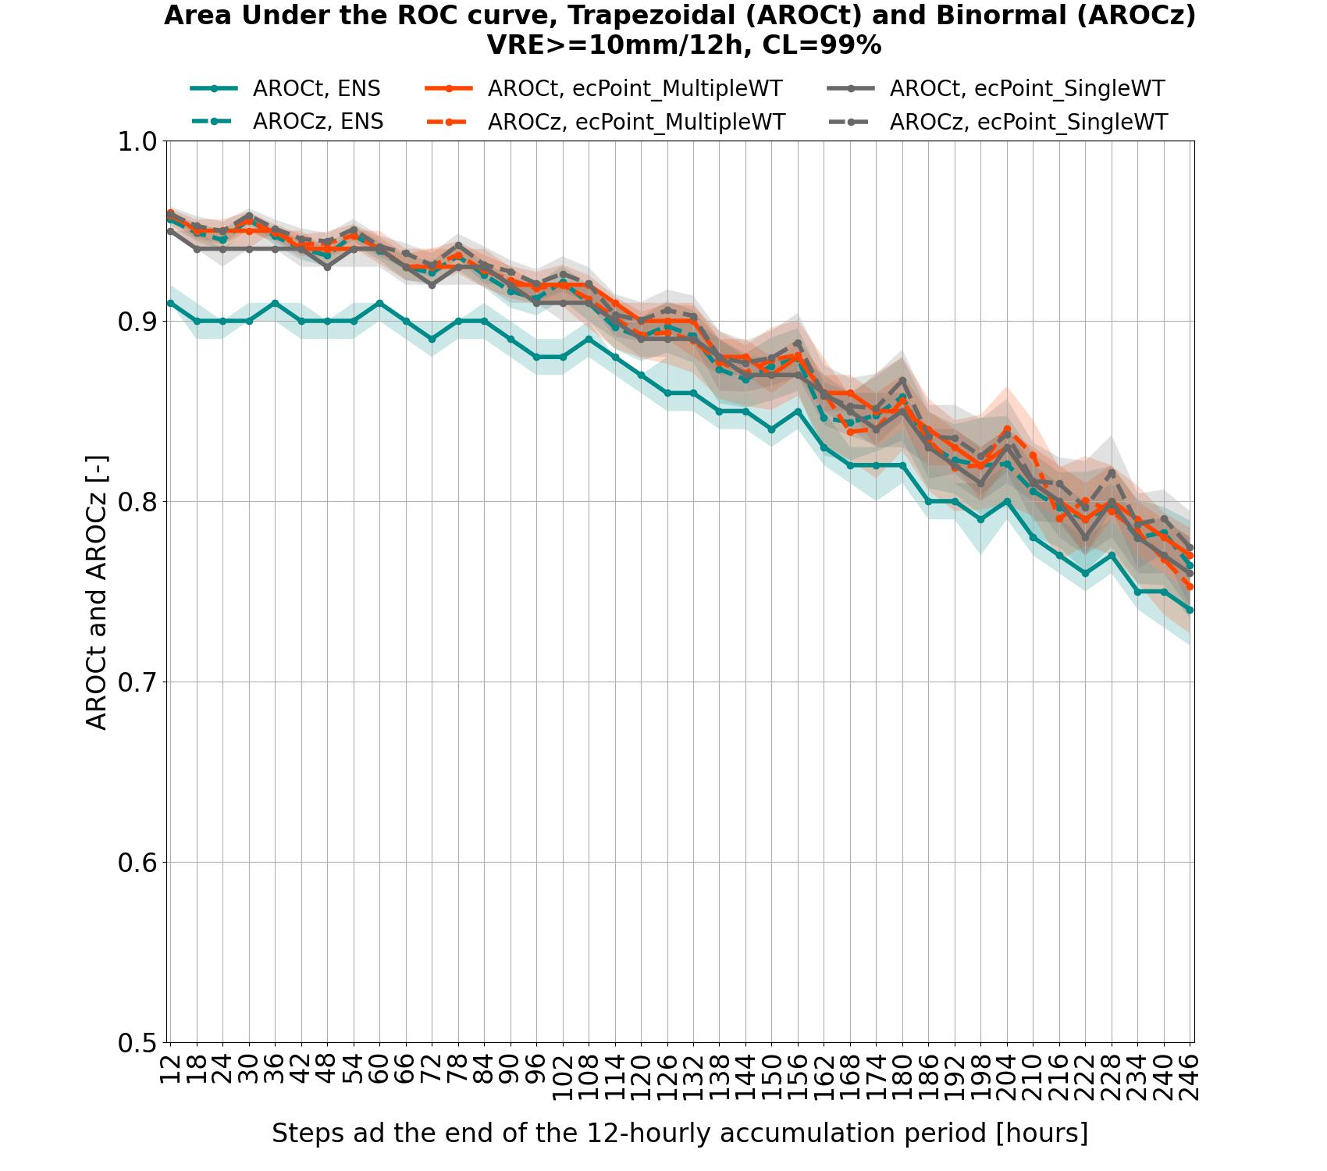
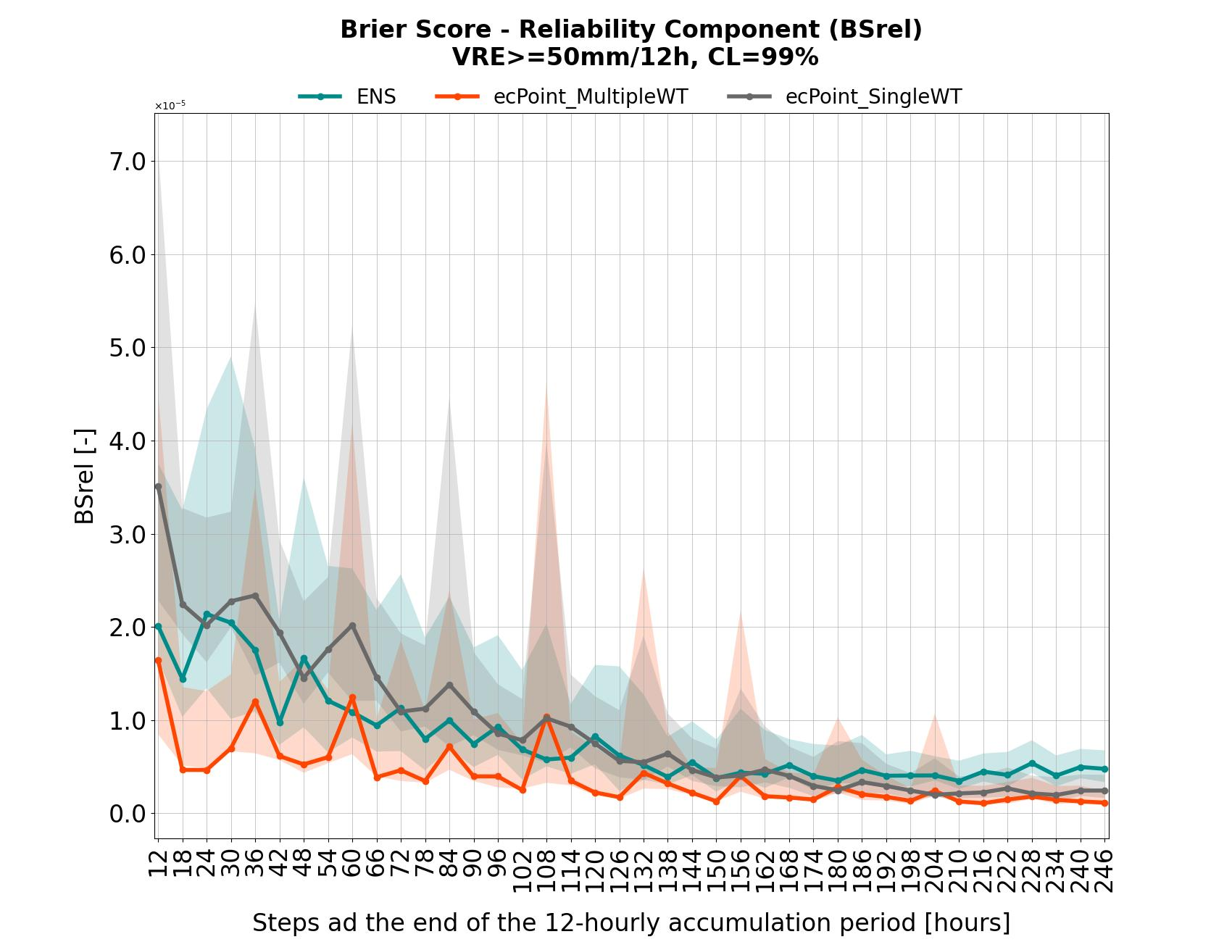
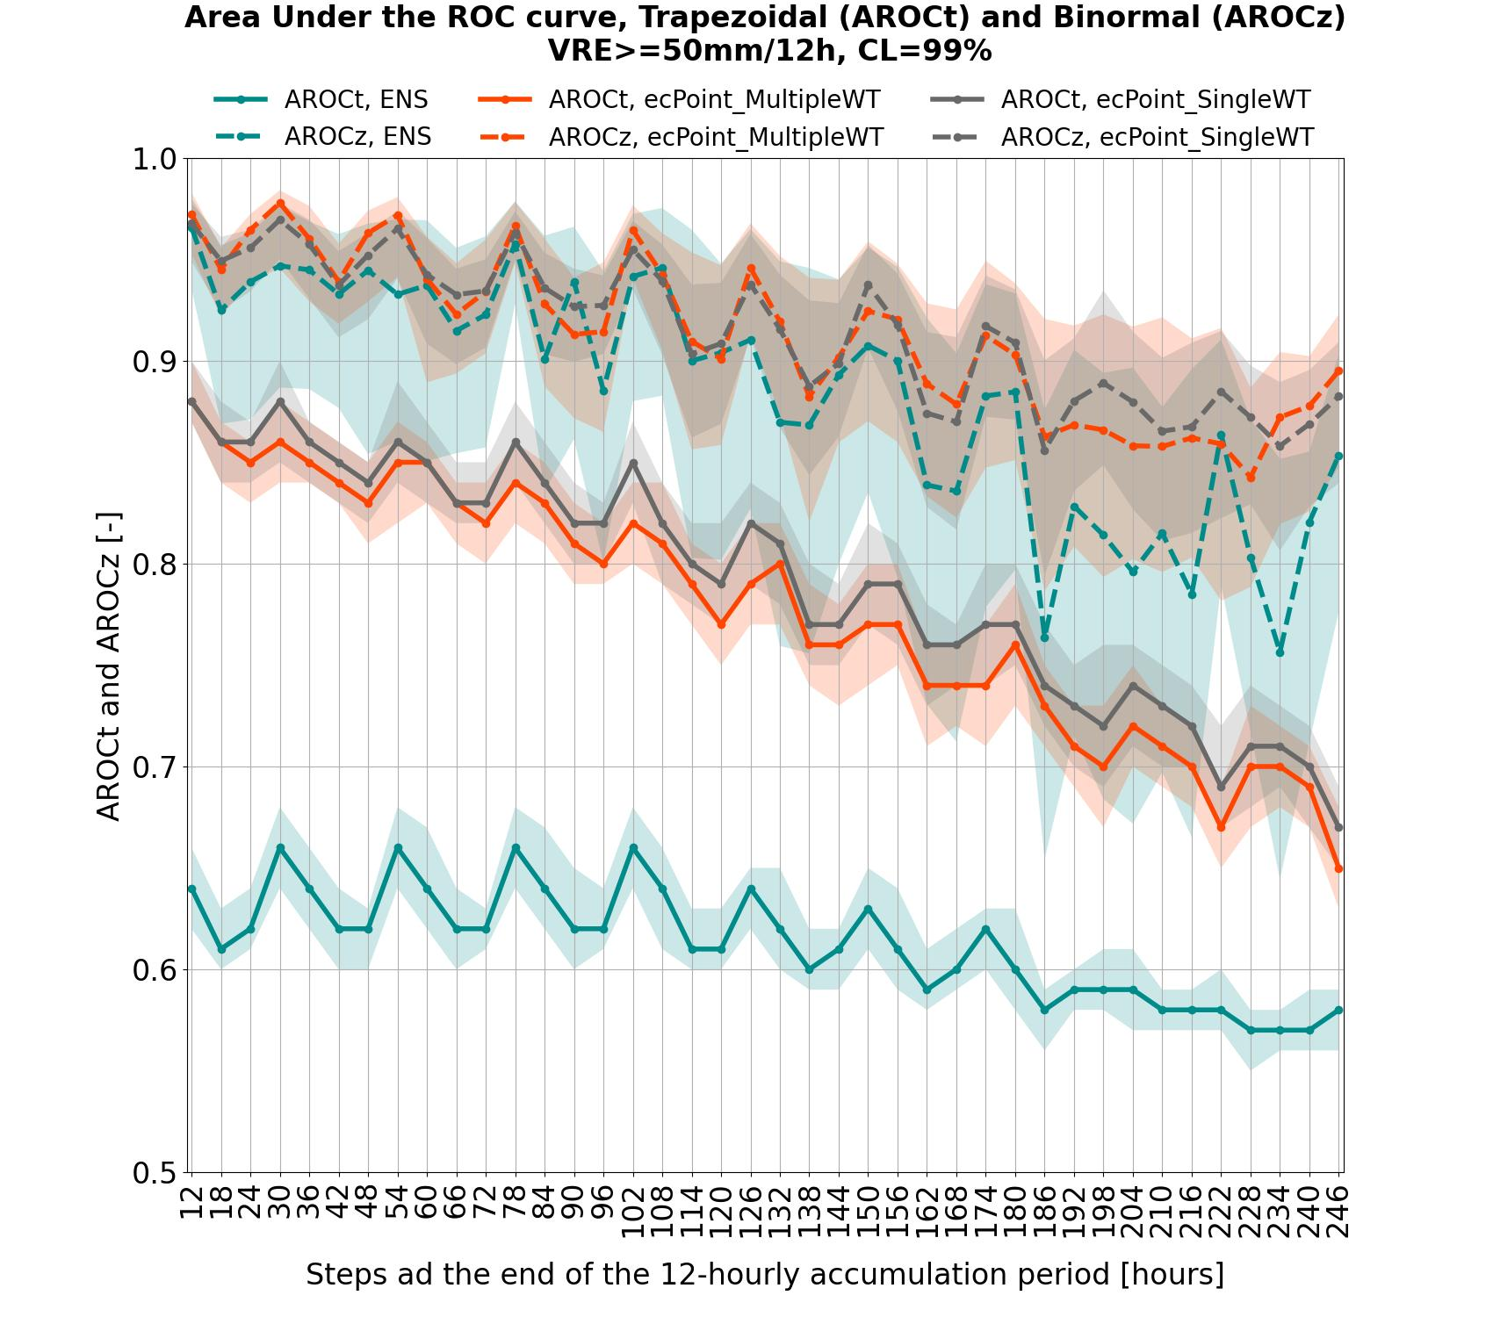
Brier Score – Reliability Component
(BSrel)
Area Under the ROC curve - Trapezoidal (AROC_{t}) and Binormal (AROC_{z})
ENS
Multiple-WT
ecPoint
Single-WT
ecPoint
ENS
Multiple-WT
ecPoint
Single-WT
ecPoint
BSrel
AROC_{t}
99% CI
AROC_{z}
10^2
99% CI
VRT >= 0.2 mm/12h
a
d
VRT >= 10 mm/12h
10^3
b
e
VRT >= 50 mm/12h
10^5
c
f

