Slide 1
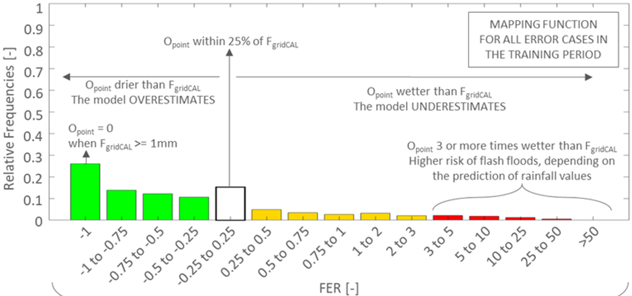
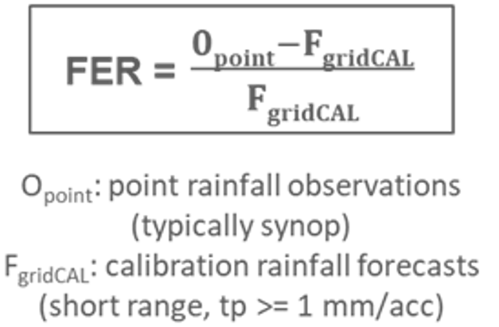
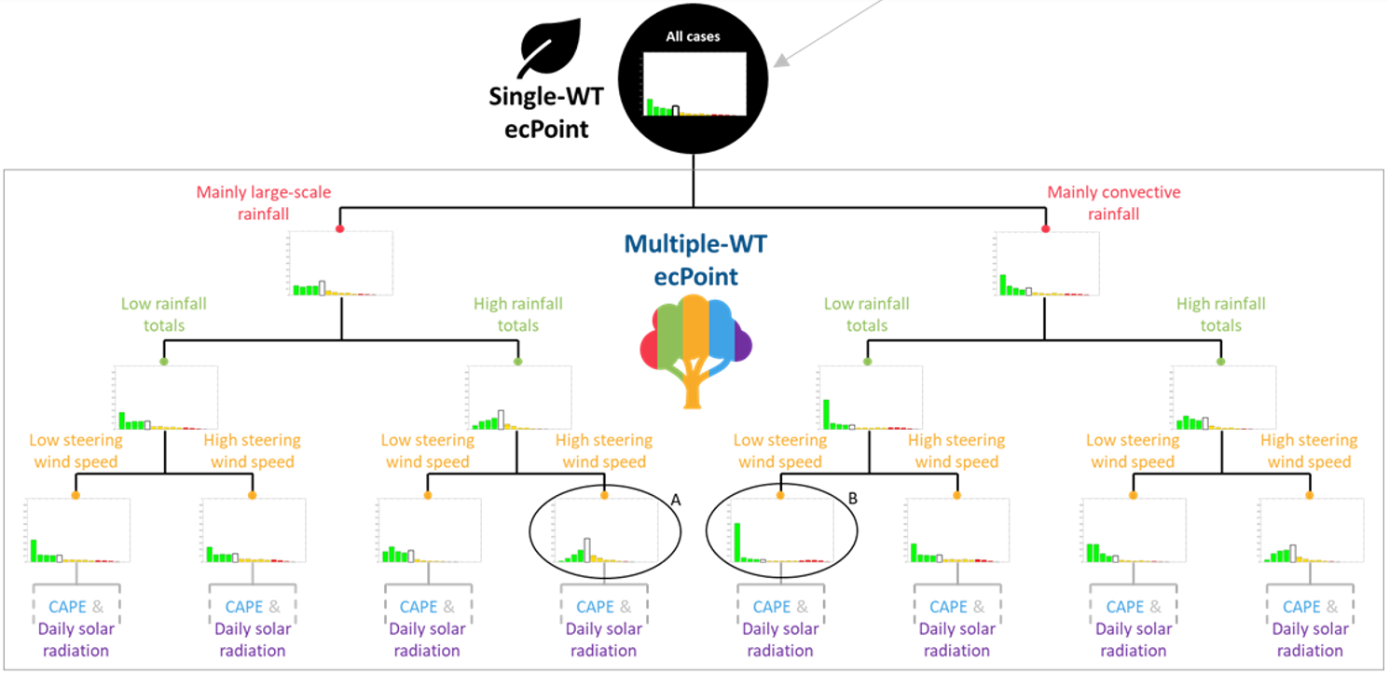
(b)
Errors distribution:
MAPPING FUNCTION (MF)
(a)
Error formulation for accumulated variables (e.g., rainfall)
FORECAST ERROR RATIO (FER)
(c)

