Slide 1
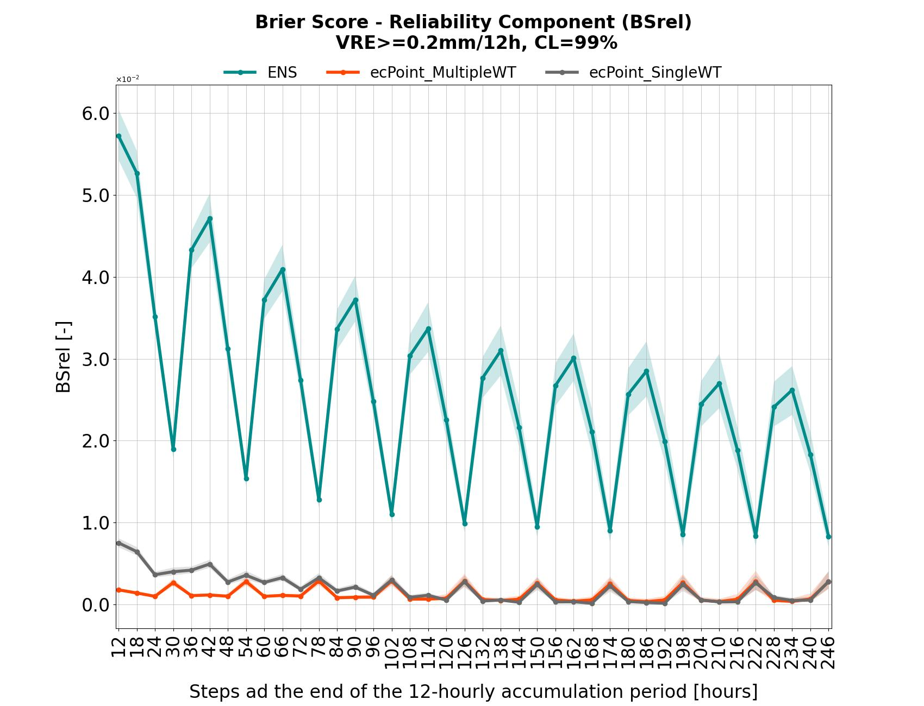
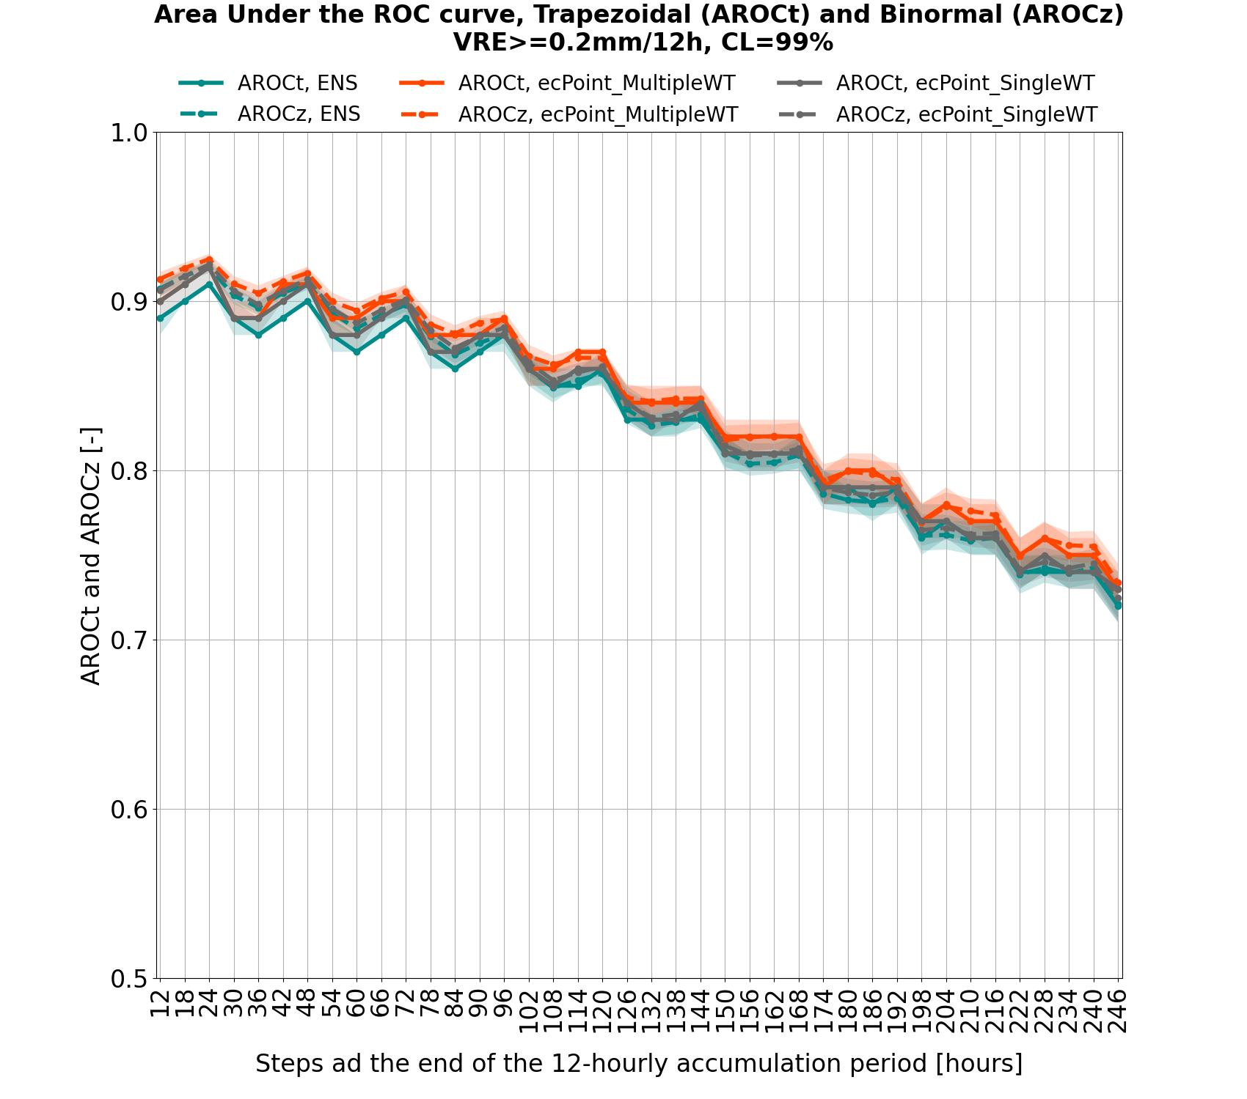
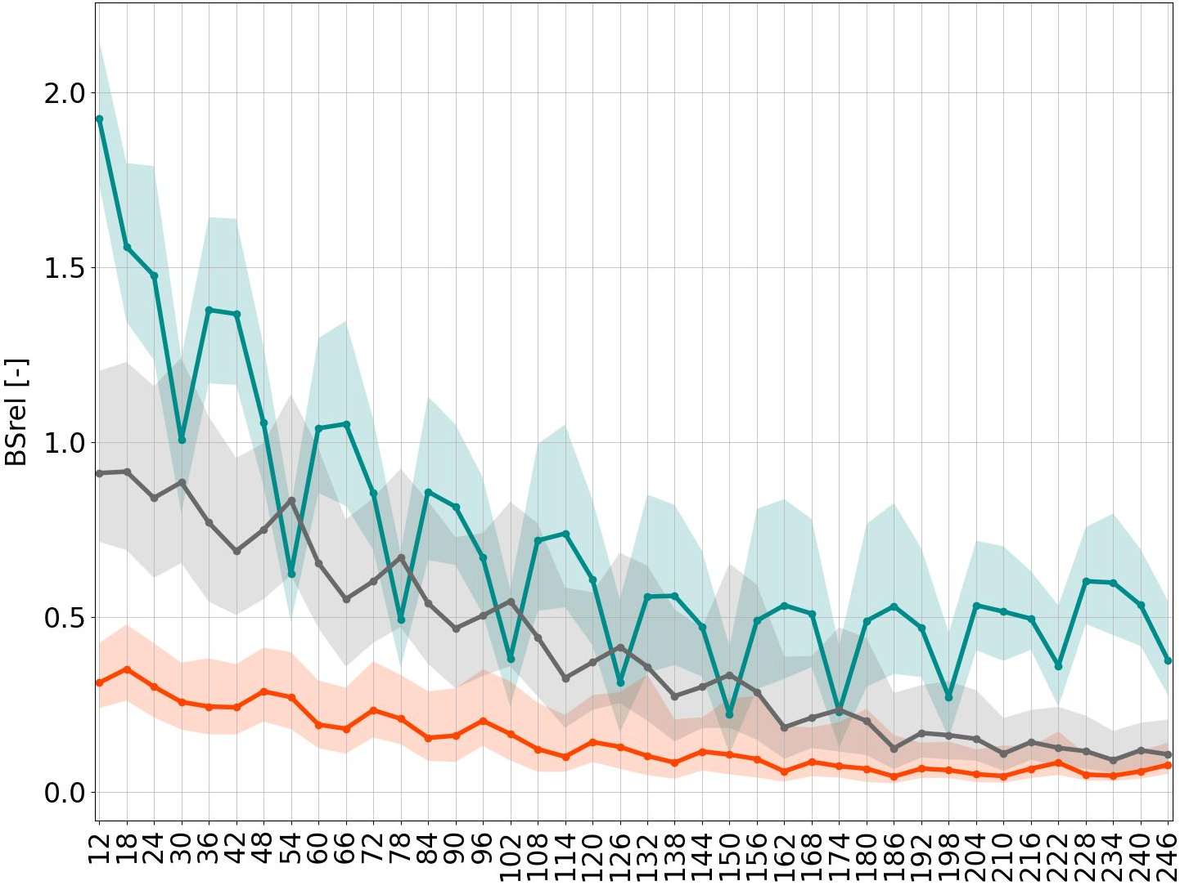
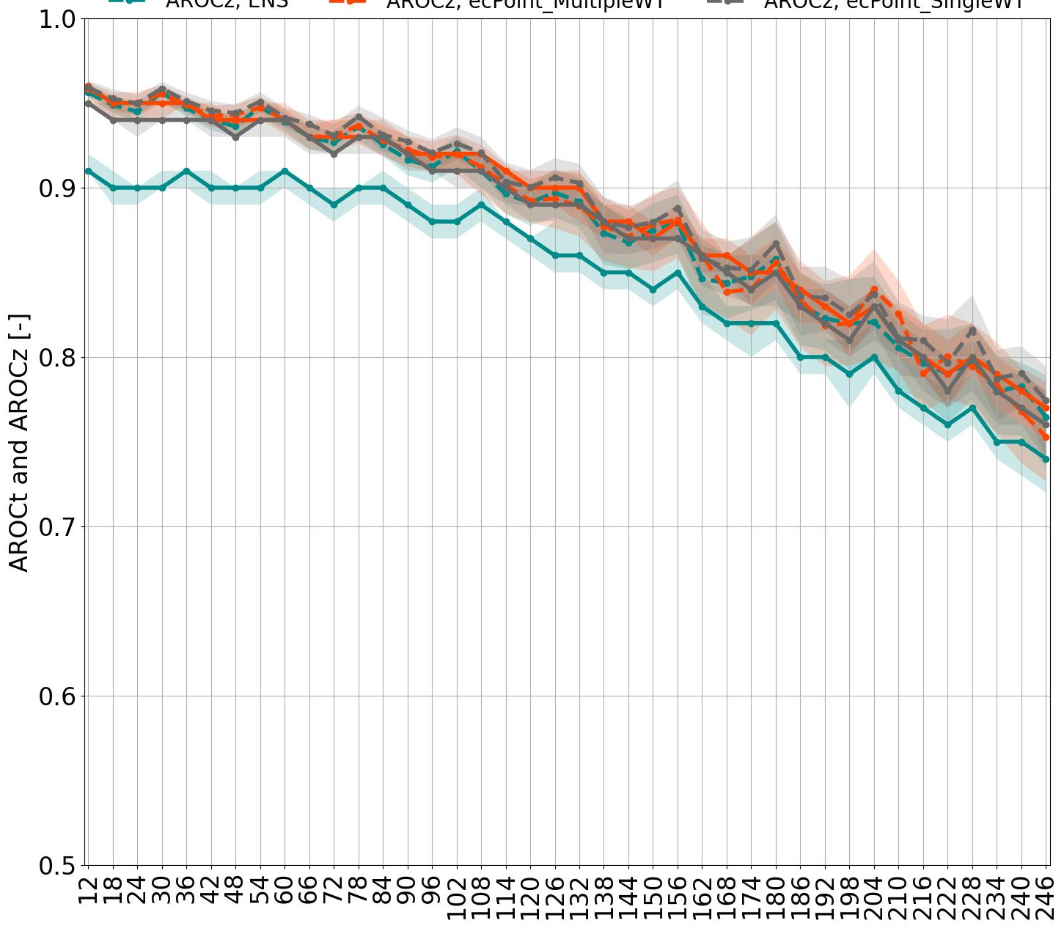
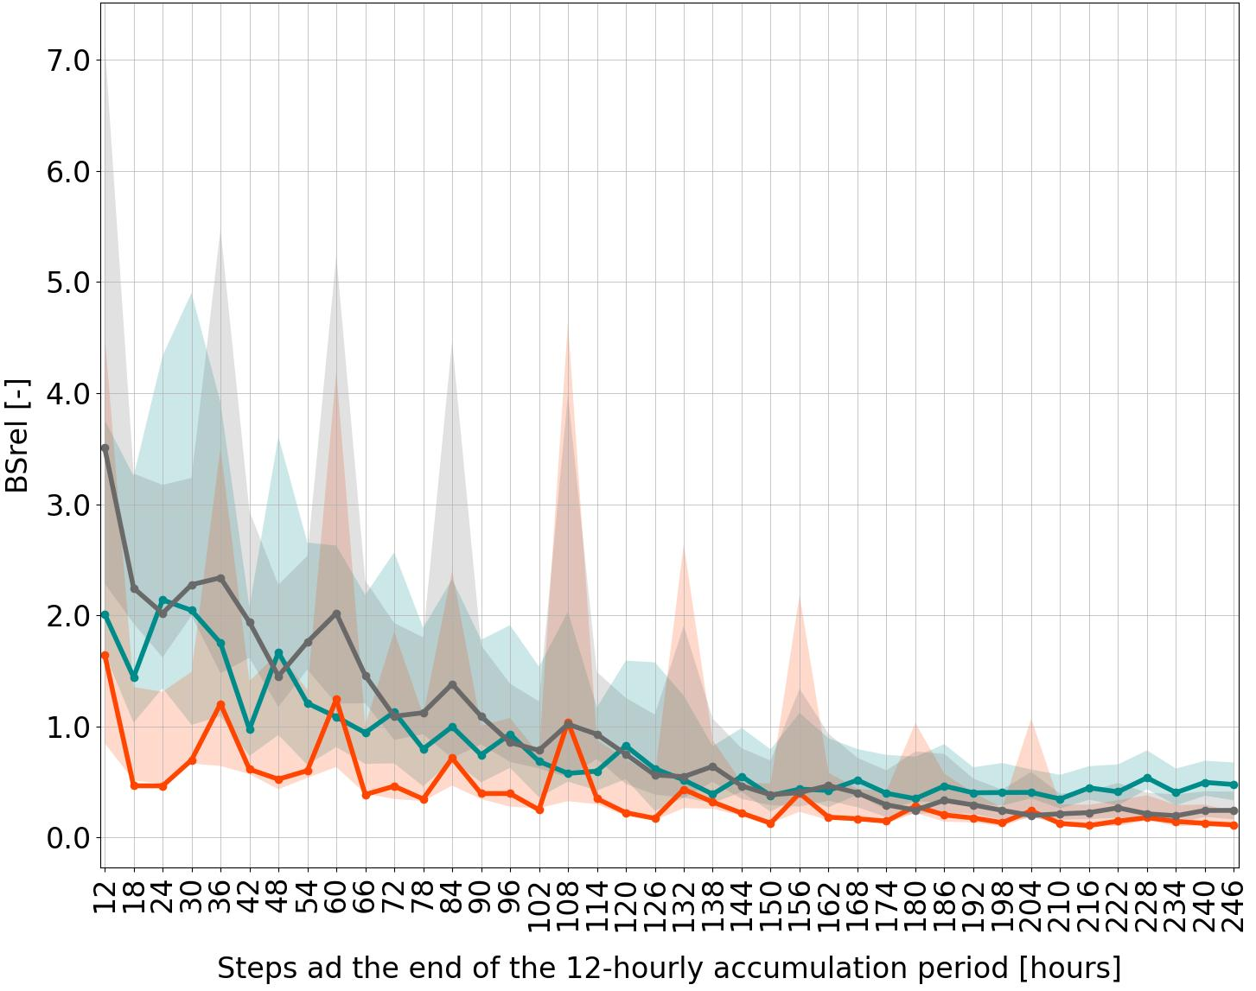
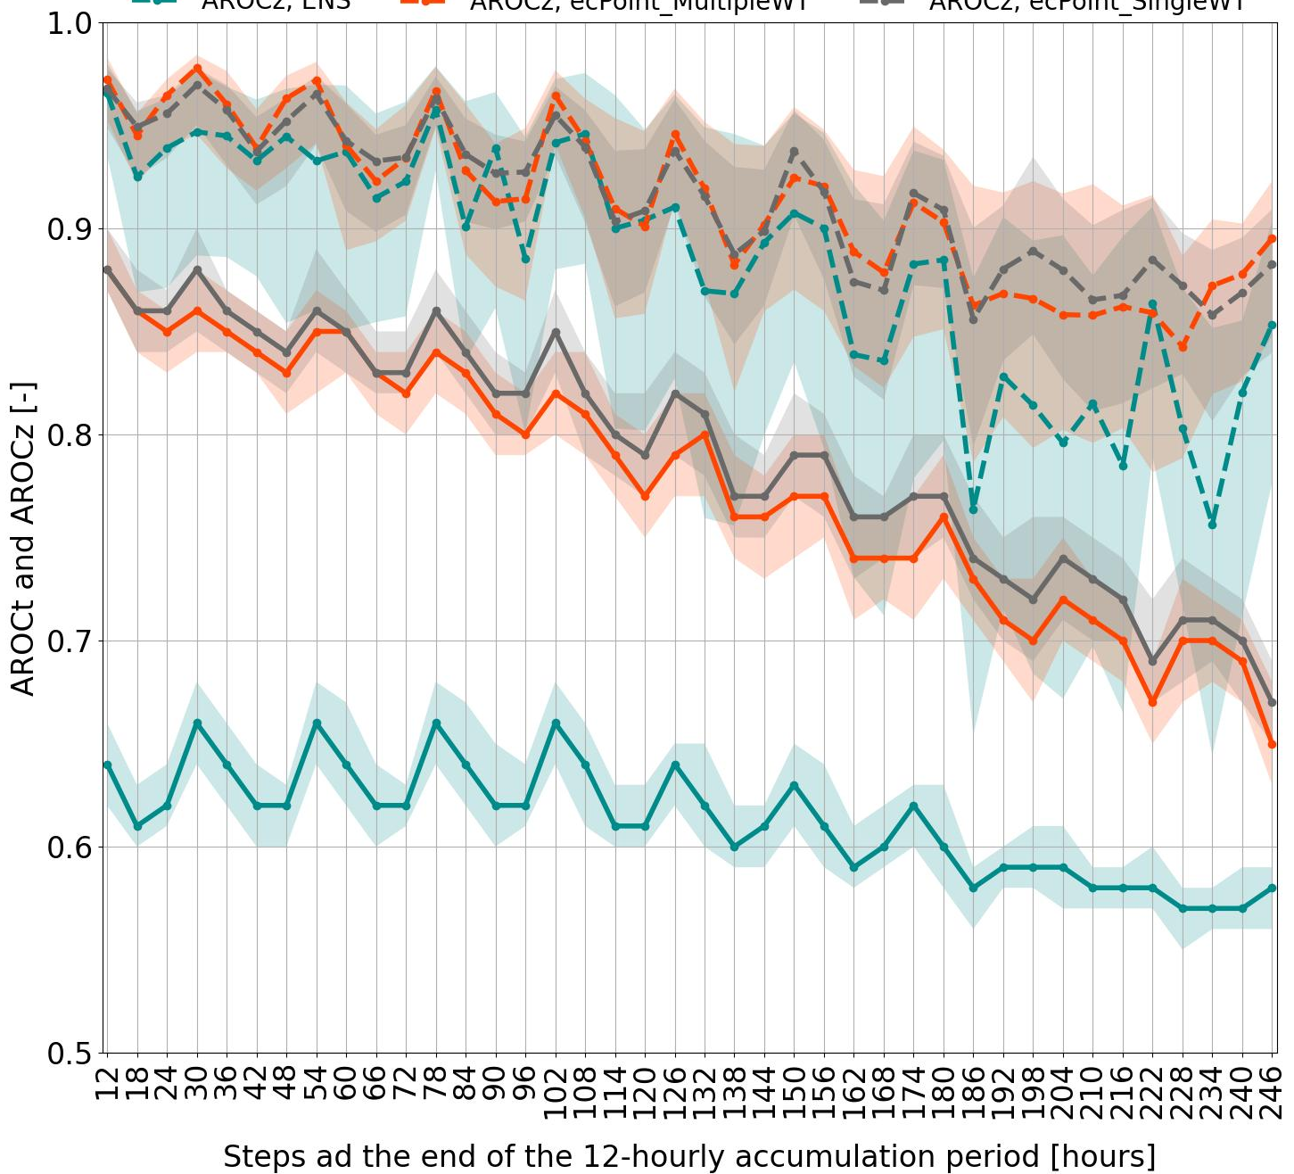
Area Under the ROC curve - Trapezoidal (AROC_{t}) and Binormal (AROC_{z}), CL = 99%
Brier Score – Reliability Component, CL = 99%
VRT >= 0.2 mm/12h
10^2
d
a
VRT >= 10 mm/12h
10^3
e
b
10^5
f
VRT >= 50 mm/12h
c

